Slide 1
The Role of Business in society
Understanding Business
Higher Business Management
Notes:
BICS lesson 1

Slide 2
What is a Business?
A business organises people and resources to produce a good or provide a service to satisfy demand – consumers’ needs and wants

Slide 3
What is a Business?
Goods and Services are produced using Resources. Resources are Limited which means that consumers and businesses must make a choice.

Slide 4
Factors of Production
LAND
LABOUR
CAPITAL
ENTERPRISE
The natural resources which the business uses
The workforce of the business
The man made resources – the assets of the business
This is where the entrepreneur will use land, labour and capital to achieve a business idea, producing goods or services
Example
Plot of land, coal, diamonds, wood, oil and water
Example
human resources, the employees
Example
Finances (money), tools, machinery and equipment...

Slide 5
Case Study
LAND Leather, rubber, wood
LABOUR
Shop and factory staff
CAPITAL
Furniture and Fittings (chairs, shelves, foot measures) and finances (money)
ENTERPRISE
Senior Management (to make high quality shoes)

Slide 6
Case Study
LAND
Complete the Factors of Production with a business of your choice.
Share with your partner.
LABOUR
CAPITAL
ENTERPRISE

Slide 7
Questions - 1
What is Business?
List our basic needs.
Can we always have everything we want? Explain your answer.
This means we must make what?
What is the difference between a Good and a Service?
Give an example of each in Question 5.
What are the 4 Factors of Production?

Slide 8
Sectors of Industry
There are four Sectors of Industry
Sectors of industry
Primary
Secondary
Tertiary
Quaternary
Notes:
Teacher Note
Explain what each sector involves, try to use q and a to establish the basics:
Private – to make money (profits)
Public – to provide a service which the whole country benefits from (refer back to “services”
Voluntary – to raise FUNDS for worthy causes, at this stage it is good to ensure pupils do not just think about money. If your school does the Xmas shoe box appeal (another “thing” for BM pupils to be involved in from Oct to Xmas through Red Cross) where we put “goods” together to send to children and adults less fortunate than us, you can use this to put the voluntary across of not just being “money”.

Slide 9
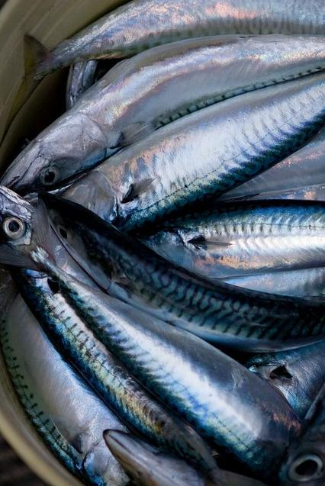
Sectors of Industry
The Primary sector of industry involves businesses which extract natural goods from the earth. Britain originally relied on the Primary Sector.
Such as,
Fishermen, fish, shellfish
Farmers, wheat, meat, fruit
Oil drilling, oil, gas
Coal miners, coal
Foresters, wood
Now around 12% of the workforce is involved.
Primary
Notes:
Teacher Note
Discuss what happens in this industry, might recap on “profit-making”.

Slide 10
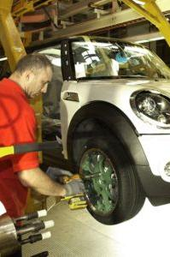
Sectors of Industry
These types of businesses are involved with making things (manufacture). After the 1900’s, over 50% of workers were employed in this sector.
Such as,
Shipbuilding, ships
Construction, houses
Factories, clothes
Secondary
Now around 10% of the workforce is involved.
Notes:
Teacher Note
Discuss what happens in this industry, might recap on “profit-making”.

Slide 11
Sectors of Industry
These types of businesses do not produce goods but provide services. Currently, this sector employs over 50% of the workforce.
Such as,
Shops
Hotels
Window Cleaners
Hairdressers
Banks
Post Office
Tertiary
Notes:
Teacher Note
Discuss what happens in this industry, might recap on “profit-making”.

Slide 12
Sectors of Industry
This can also be described as the support sector. It is knowledge based. Combined with the Tertiary Sector, it employs over 75% of the UK workforce.
Such as,
IT consultants
Accountants
Media bodies
Education
Quaternary
Notes:
Teacher Note
Discuss what happens in this industry, might recap on “profit-making”.

Slide 13
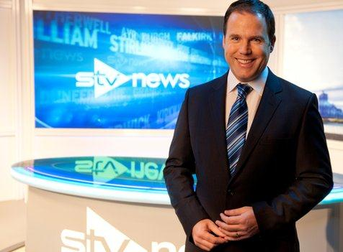
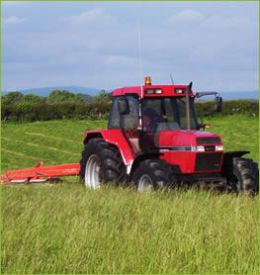
Quaternary
Primary

Slide 14
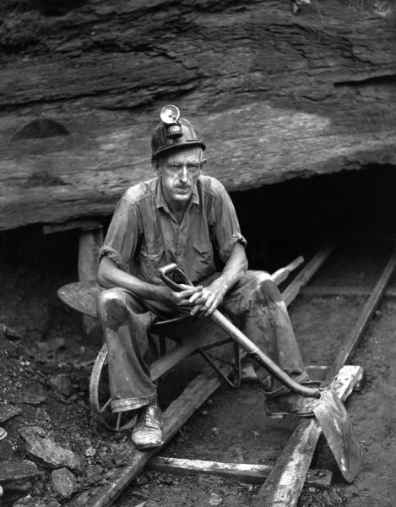
Tertiary
Primary

Slide 15
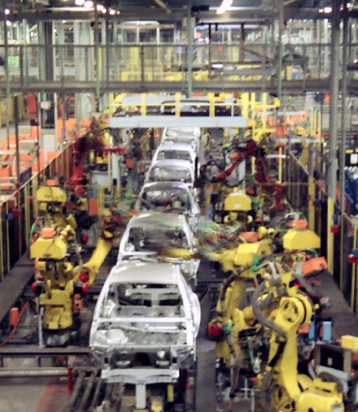
Secondary
Tertiary

Slide 16
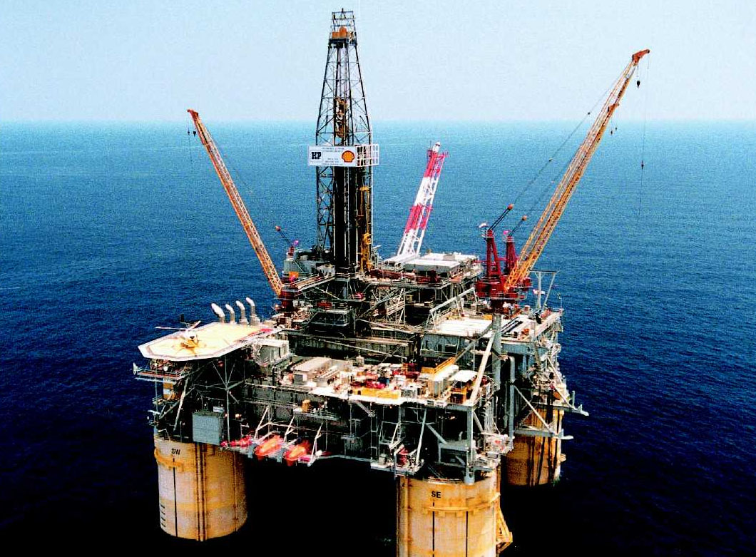
Primary

Slide 17
Quaternary
Tertiary

Slide 18
Your Tasks
Create 4 PowerPoint slides which includes quality images that represents each of the 4 sectors of industry.
From the School Website, complete the Sectors of Industry Exercises.
Primary
Secondary
Tertiary
Quaternary

Slide 19
Questions - 2
What are the 4 Sectors of Industry?
Give 2 examples of what is produced or serviced in each one.
Why do you think that in the UK there is now more Tertiary and Quaternary Sector jobs?

Slide 20
Sectors of Industry
What changes do you think UK Industry has seen in the past 10 years and why is this?
Notes:
Lesson 3 Class Mind Map

Slide 21
Sectors of Industry
Decline in manufacturing, steel factories and shipbuilding
Global threats , increased competition from abroad
Tertiary Sector has grown considerably
More disposable income for services, such as beauty

Slide 22
Sectors of the Economy
Private
Public
Third
ECONOMY
There are three Sectors of Economy
Notes:
Teacher Note
Explain what each sector involves, try to use q and a to establish the basics:
Private – to make money (profits)
Public – to provide a service which the whole country benefits from (refer back to “services”
Voluntary – to raise FUNDS for worthy causes, at this stage it is good to ensure pupils do not just think about money. If your school does the Xmas shoe box appeal (another “thing” for BM pupils to be involved in from Oct to Xmas through Red Cross) where we put “goods” together to send to children and adults less fortunate than us, you can use this to put the voluntary across of not just being “money”.

Slide 23
Sectors of Business
There are three Business (Economy) Sectors
Private
Public
Third
There are four Industry Sectors
Primary
Secondary
Tertiary
Quaternary
Notes:
Teacher Note
Explain what each sector involves, try to use q and a to establish the basics:
Private – to make money (profits)
Public – to provide a service which the whole country benefits from (refer back to “services”
Voluntary – to raise FUNDS for worthy causes, at this stage it is good to ensure pupils do not just think about money. If your school does the Xmas shoe box appeal (another “thing” for BM pupils to be involved in from Oct to Xmas through Red Cross) where we put “goods” together to send to children and adults less fortunate than us, you can use this to put the voluntary across of not just being “money”.

Slide 24
Private Sector
The Private Sector aims to
Maximise Profits
To turn innovative ideas into successful businesses
(fill gaps in the market)
To expand the business
Notes:
Teacher Note
Go through the aims, at this point pupils should be able to provide answers.

Slide 25
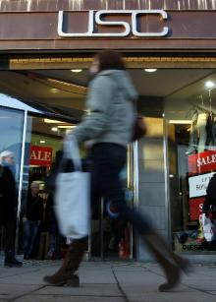
Private Sector Organisations
Sole Traders
Partnerships
Private Limited Companies (Ltd)
Public Limited Companies (Plc)
Franchise
MNC
Notes:
Teacher Note
Explain the way in which the Private Sector operates.
Also at this stage you may need to explain the different types of business organisations in brief, as you will cover this in more detail on slides 19 – 23.

Slide 26
Public Sector
The Public Sector aims to
To provide a high quality service to everyone in a country
To make good use of taxpayers’ money and provide the services needed
Notes:
Teacher Note
Go through the aims, at this point pupils should be able to provide answers.

Slide 27
Public Sector Organisations
Police
Schools
Hospitals
Fire Brigade
Army
BBC
Notes:
Teacher Note
Explain the way in which the Private Sector operates.
Also at this stage you may need to explain the different types of business organisations in brief, as you will cover this in more detail on slides 19 – 23.

Slide 28
Third Sector
The Voluntary Sector aims too
To provide support for worthy causes Shelter, food, clothing, funding
To promote awareness of “good causes”
To provide the best service possible
Notes:
Teacher Note
Go through the aims, at this point pupils should be able to provide answers.

Slide 29
Third Sector Organisations
Charities
Voluntary Organisations
Notes:
Teacher Note
Explain the way in which the Private Sector operates.
Also at this stage you may need to explain the different types of business organisations in brief, as you will cover this in more detail on slides 19 – 23.

Slide 30
Public
Private
Third
Private
Notes:
Coke icon plays infographic

Slide 31
Third
Public
Private

Slide 32
Private
Private
Third

Slide 33
Sectors of the Economy
 | Public Sector | Private Sector | Third Sector
Refuse Collection
Oxfam
Tesco
Marks and Spencer
Police
Cancer Research
✓
✓
✓
✓
✓
✓

Slide 34
Activity
In groups of 3, draw up a list of businesses in the 4 sectors of Industry (Primary, Secondary, Tertiary and Quaternary).
Think about jobs you would like to do, as well as jobs that your parents and grandparents have held.
Primary | Secondary | Tertiary | Quaternary
Extension – for each business above, identify the sector of the economy that business belongs to by writing Private (Pr), Public (Pu) or Third (Th).

Slide 35
Questions - 3
What are the 3 Sectors of the Economy?
Explain the difference between the public sector and private sector in terms of ownership and finance.
Oxfam is a charity. Can you think of 3 aims of voluntary organisations?

