Slide 1
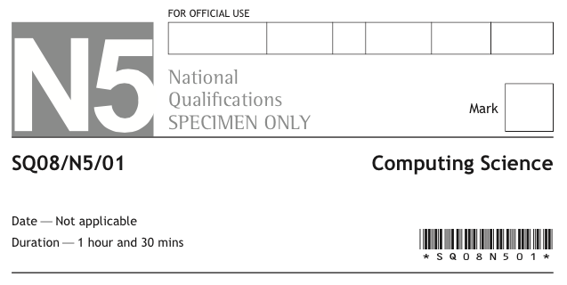
90

Slide 3
P85 How to pass CS

Slide 4
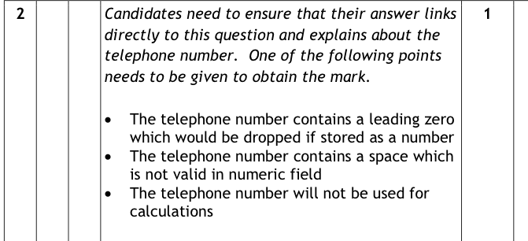
P97 How to pass CS

Slide 5
P84 How to pass CS

Slide 6
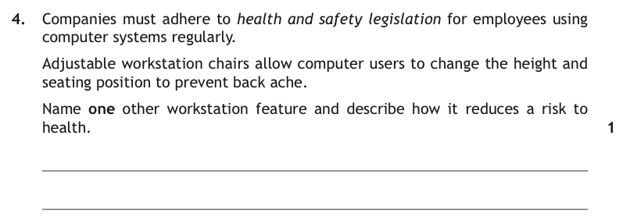
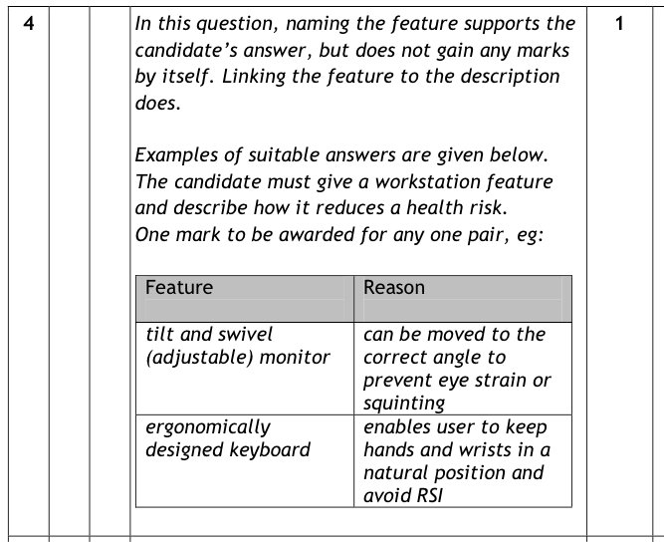
P85 How to pass CS

Slide 7
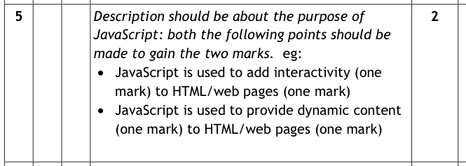
P107 How to pass CS

Slide 8
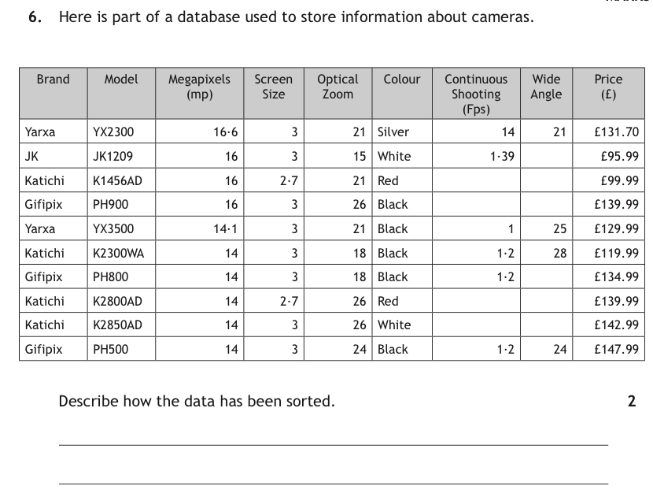
P99 How to pass CS

Slide 9
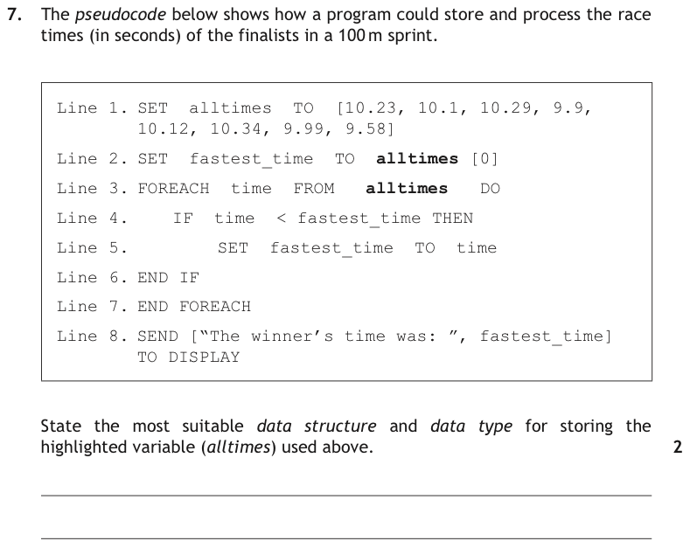
P60,142 How to pass CS

Slide 10
P106 How to pass CS

Slide 11
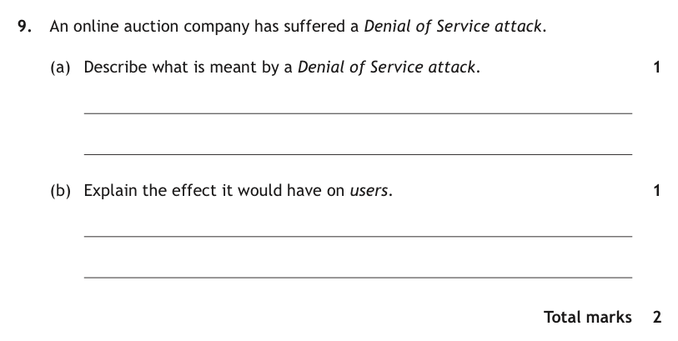
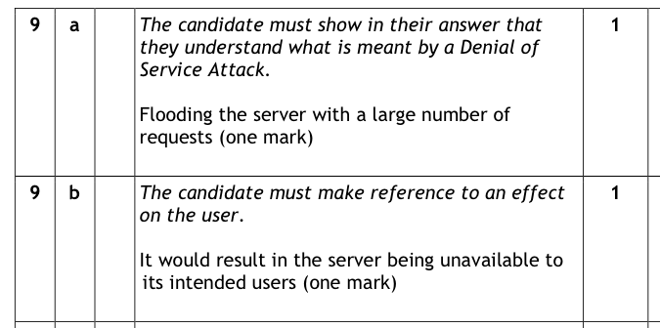
P130 How to pass CS

Slide 12
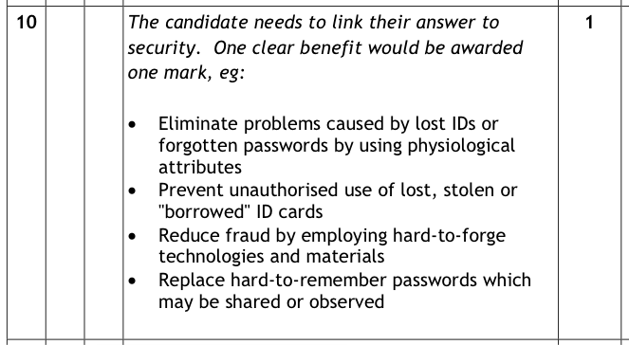
P131 How to pass CS

Slide 13
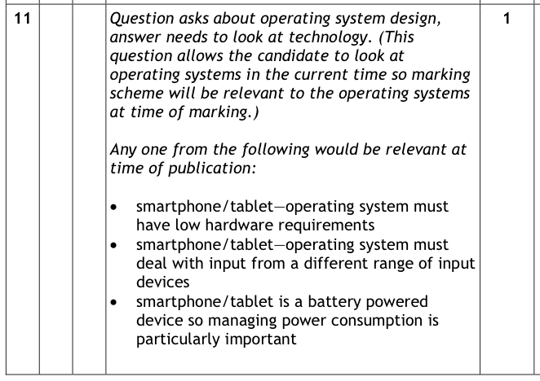
P123/4 How to pass CS

Slide 14
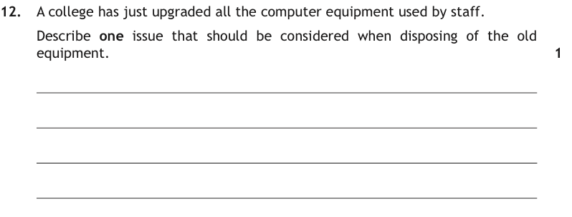
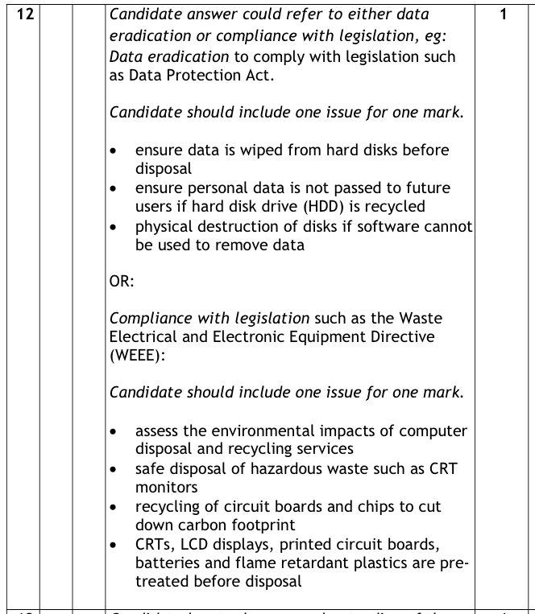
P133-5 How to pass CS

Slide 15
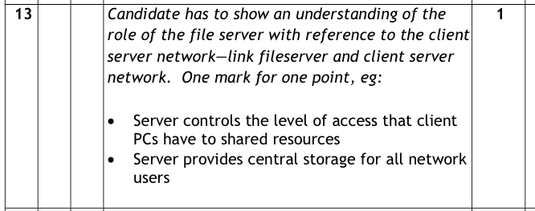
P127/8 How to pass CS

Slide 16
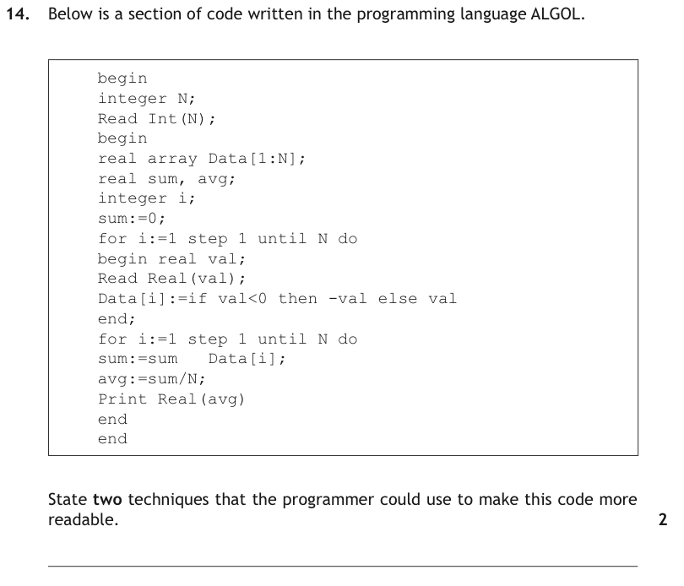
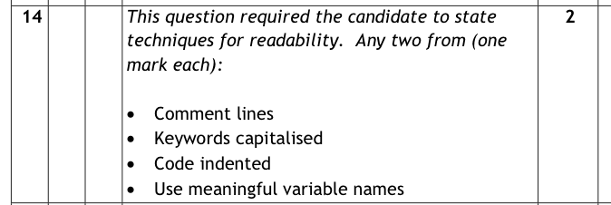
P66/7 How to pass CS

Slide 17
P115 How to pass CS

Slide 18
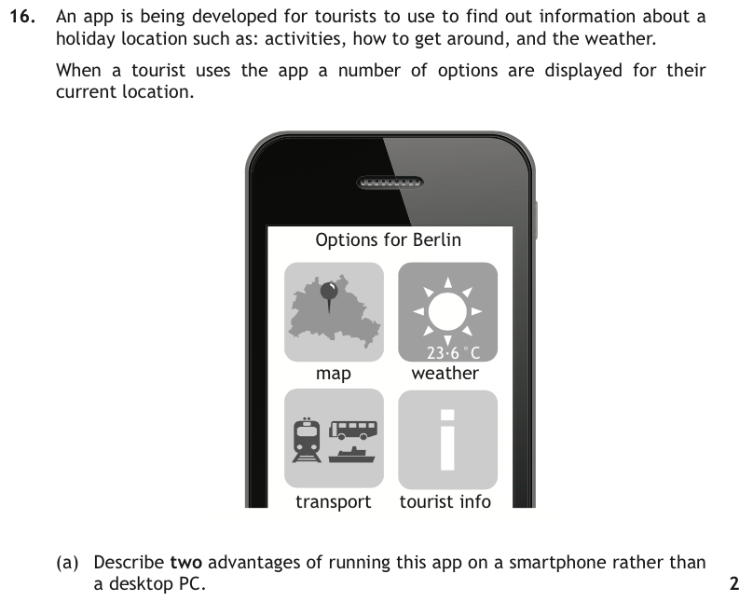
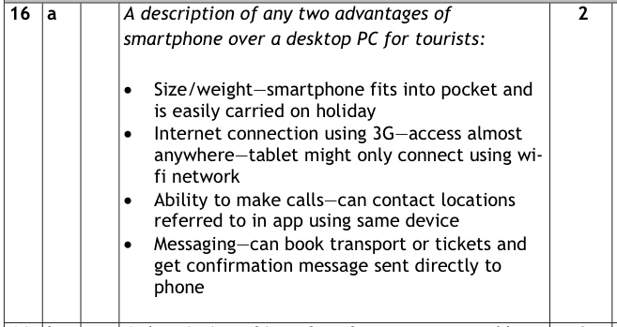
P122 How to pass CS

Slide 19
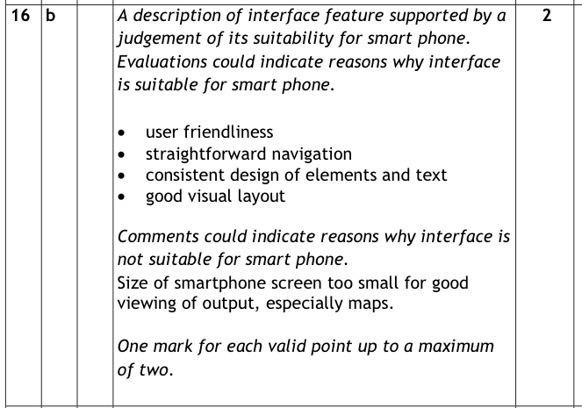
P104/5 How to pass CS

Slide 20
P88 How to pass CS

Slide 21
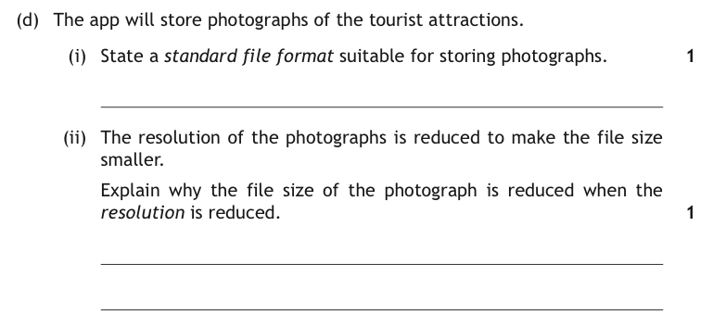
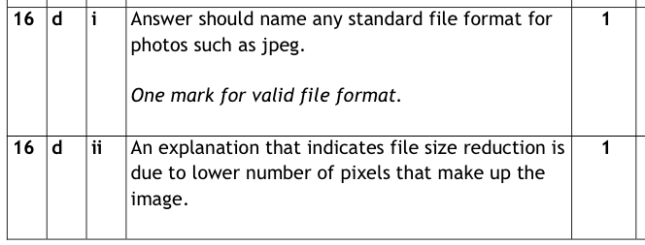
P110 How to pass CS

Slide 23
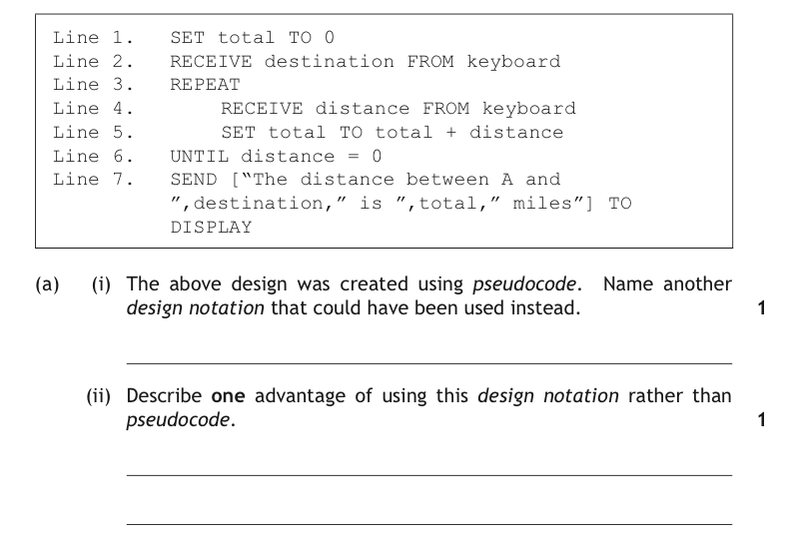
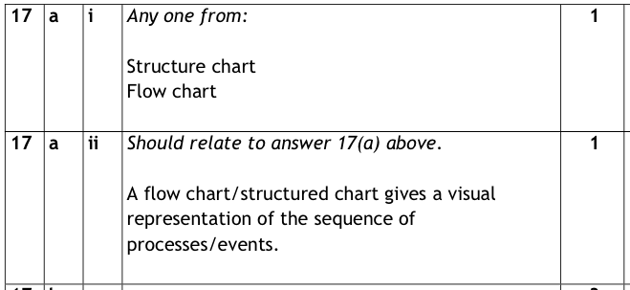
P28,64 How to pass CS

Slide 24
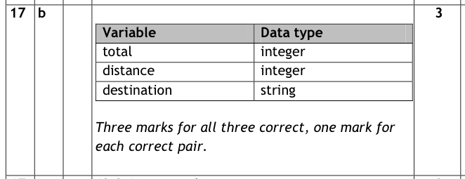
P142 How to pass CS

Slide 25
P75 How to pass CS

Slide 26
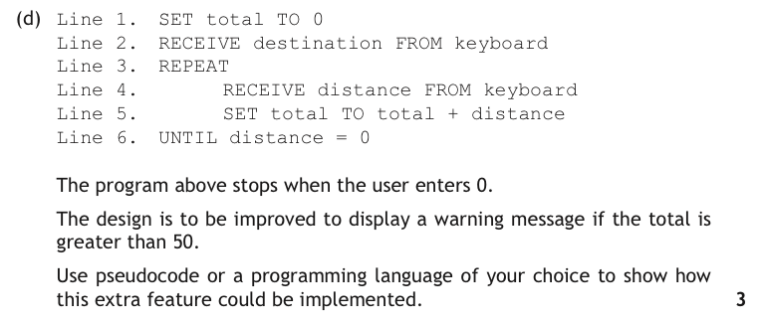
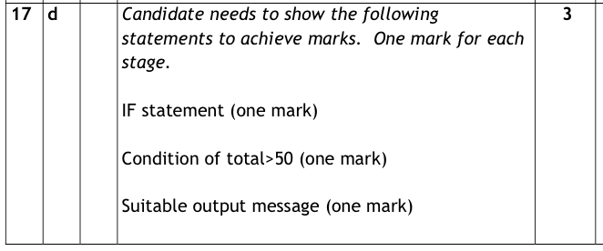
P52/53 How to pass CS

Slide 27
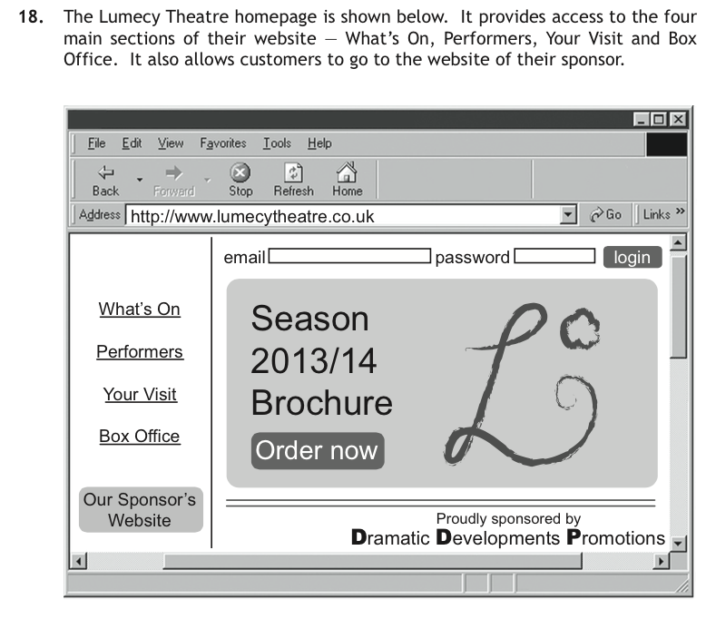

Slide 28
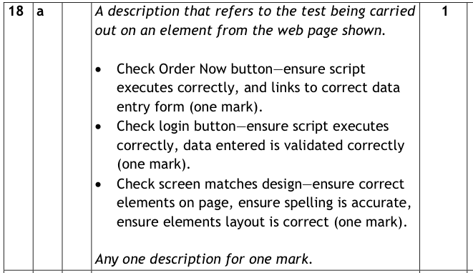
P105 How to pass CS

Slide 29
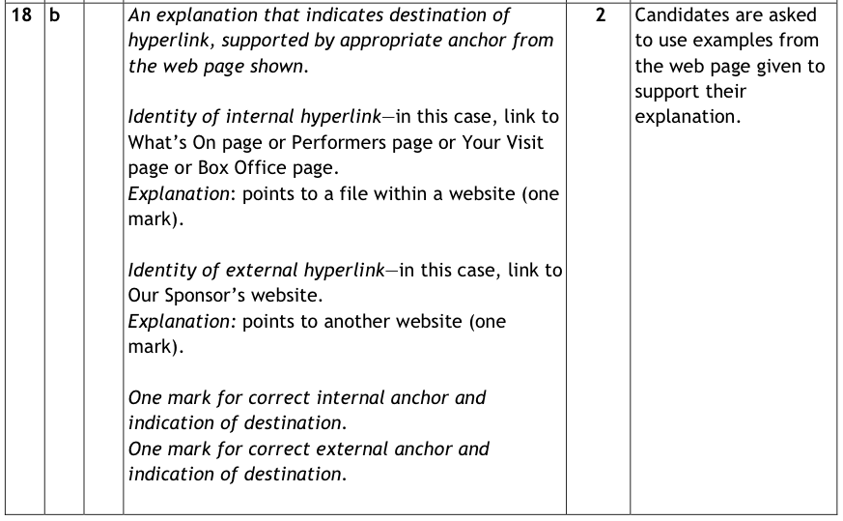
P100/1 How to pass CS

Slide 30
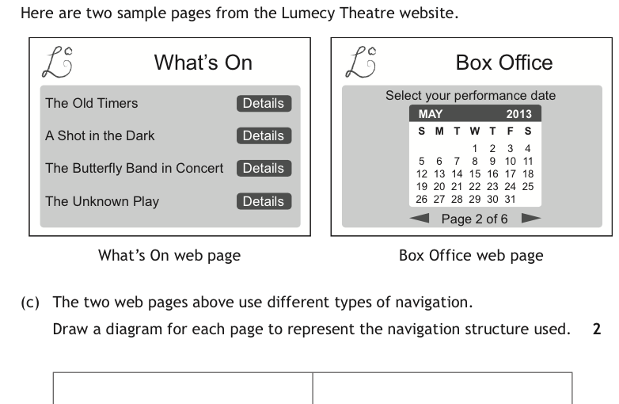
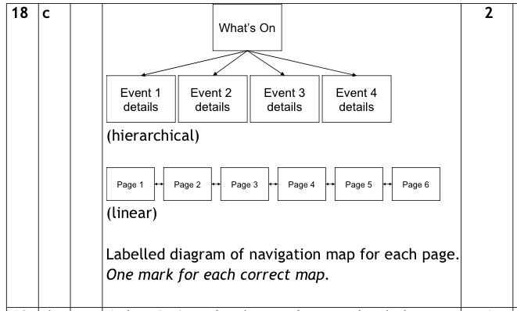

Slide 31
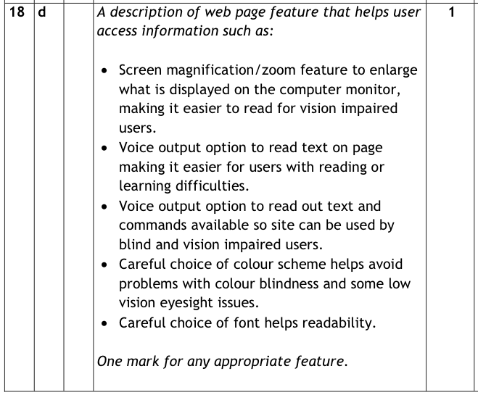
P101,102 How to pass CS

Slide 32
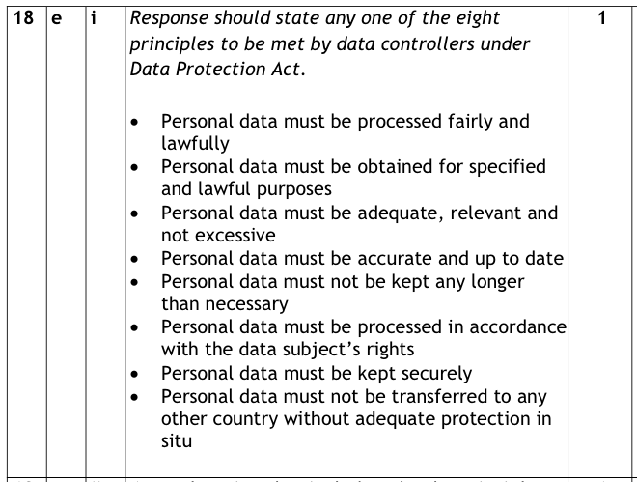
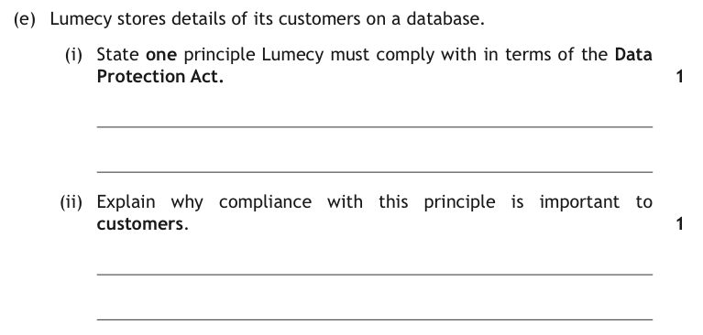
P133-5 How to pass CS

Slide 33
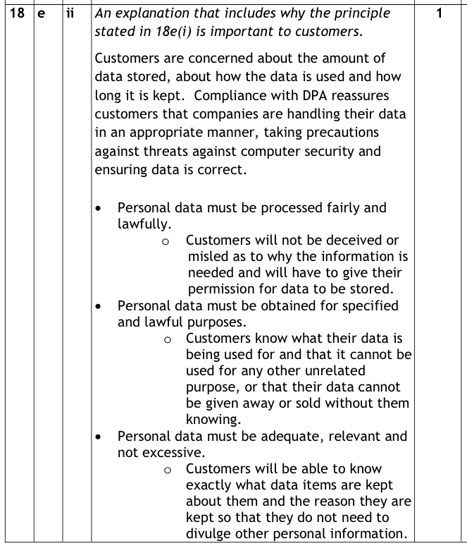
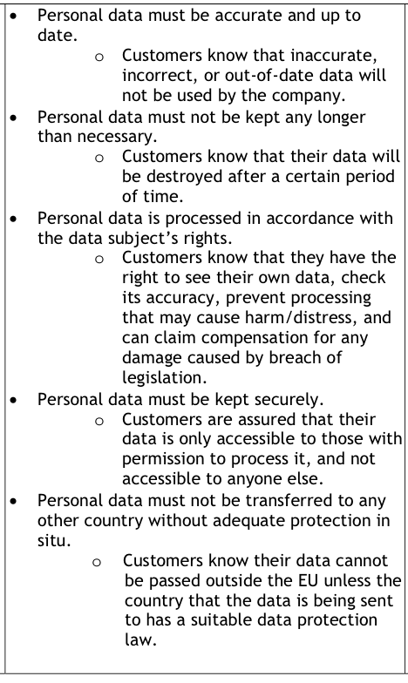

Slide 34
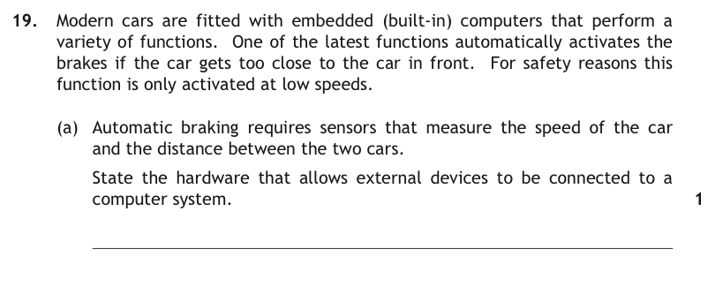
P84,85 &122,123 How to pass CS

Slide 35
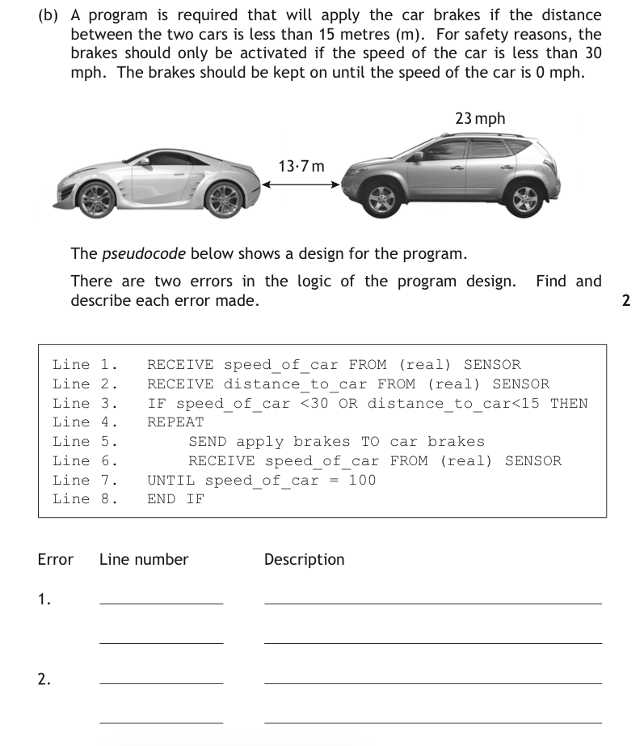
P52-54 & 68-69 How to pass CS

Slide 36
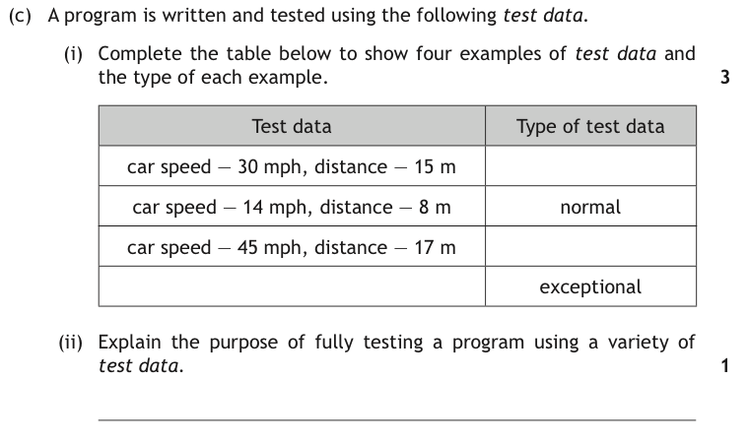
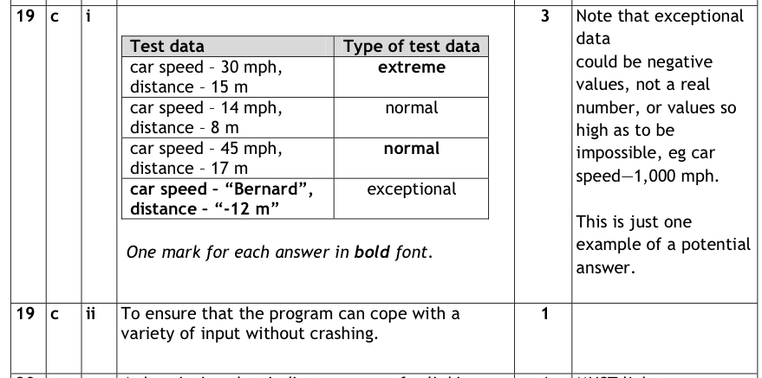
P50 How to pass CS

Slide 37
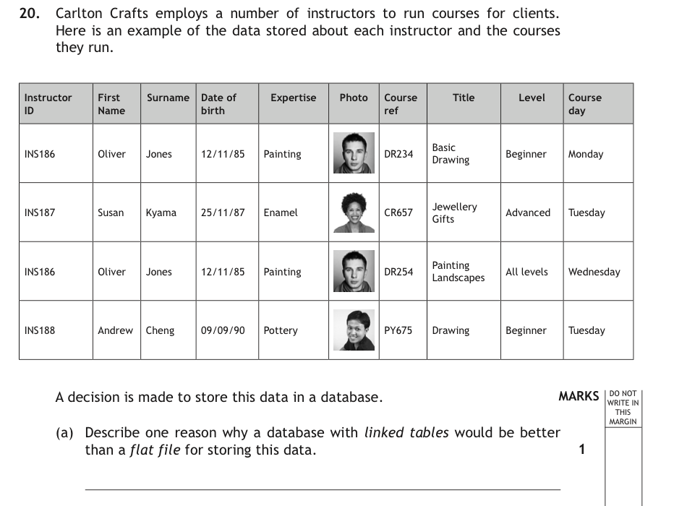
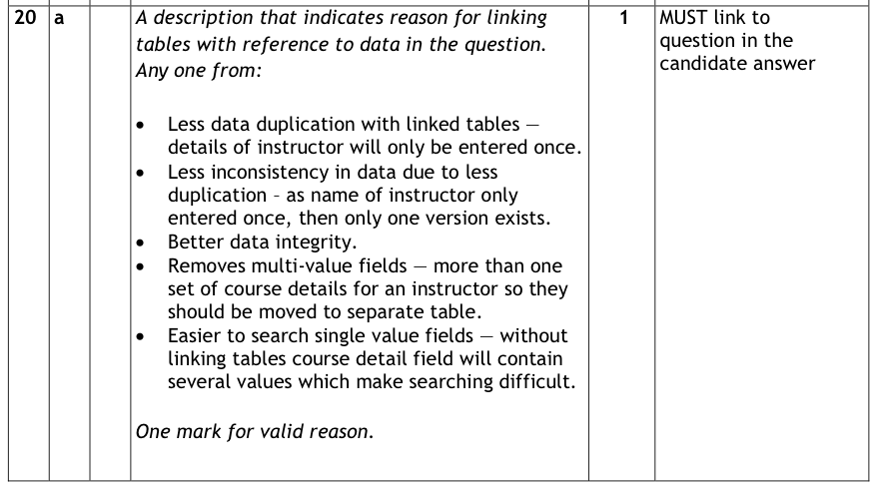
P98 How to pass CS

Slide 38
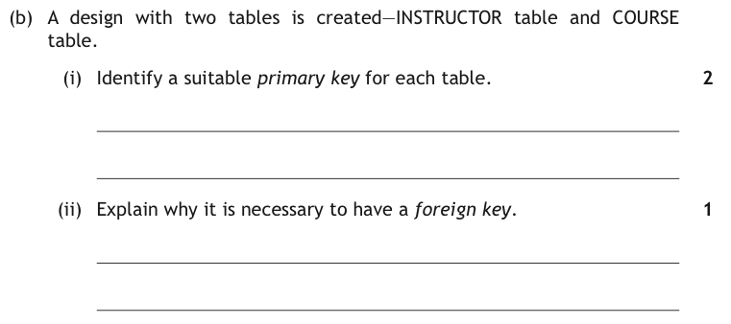
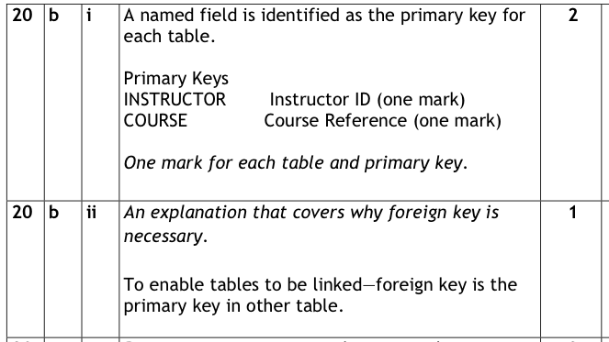
P98 How to pass CS

Slide 39
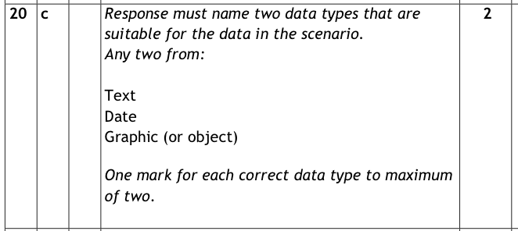
P97,98 How to pass CS

Slide 40
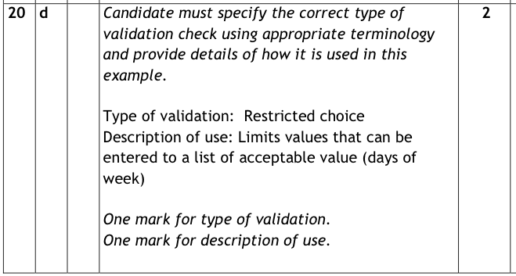
P98 How to pass CS

Slide 41
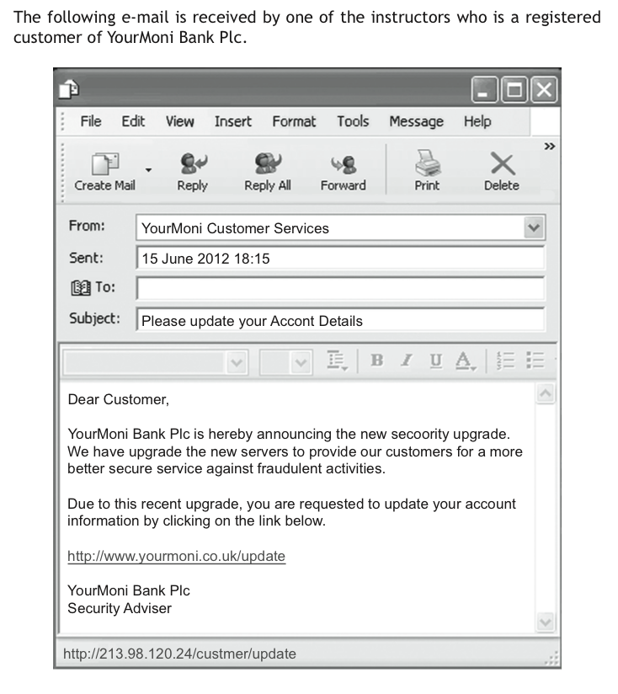
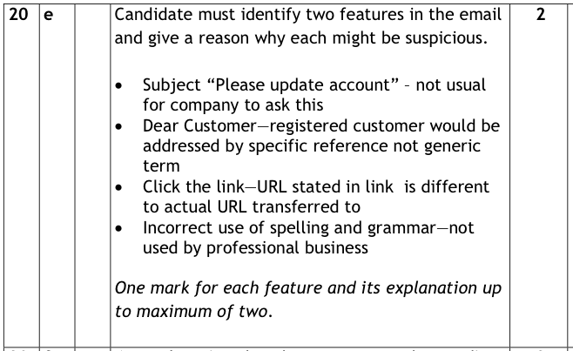
P130 How to pass CS

Slide 42
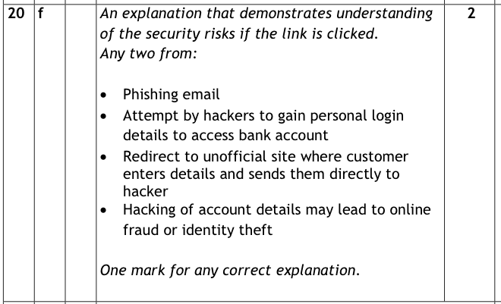
P129 How to pass CS

Slide 43
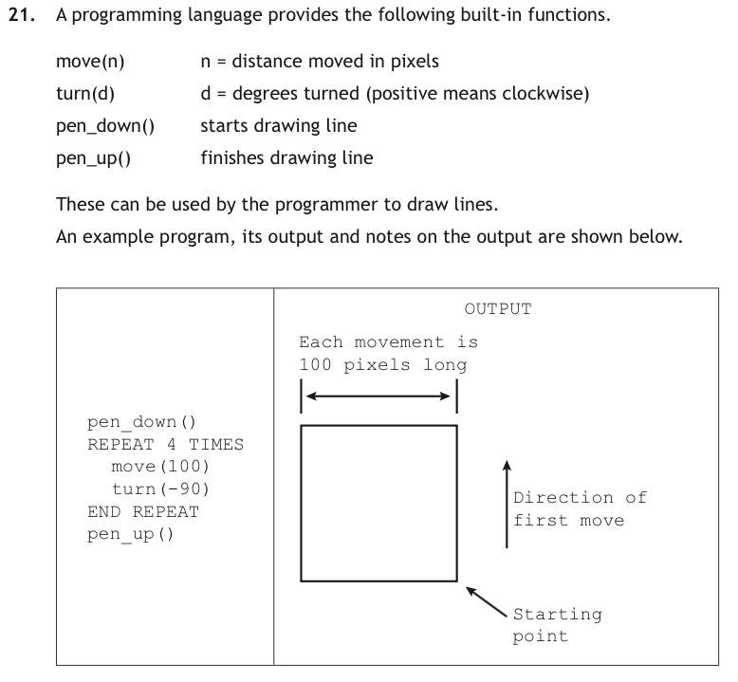
P8 How to pass CS

Slide 44
P8 How to pass CS

Slide 45
P8 How to pass CS

Slide 46
P110 How to pass CS

Slide 47
P46,47 & 66 How to pass CS

Slide 48
P1,5 & 67-8 How to pass CS

Slide 49
P126-7 How to pass CS

Slide 50
Days another word
for counter variable
P68 How to pass CS

Slide 51
P44,46,47-51,69 How to pass CS

Slide 52
P87 How to pass CS

