Slide 1
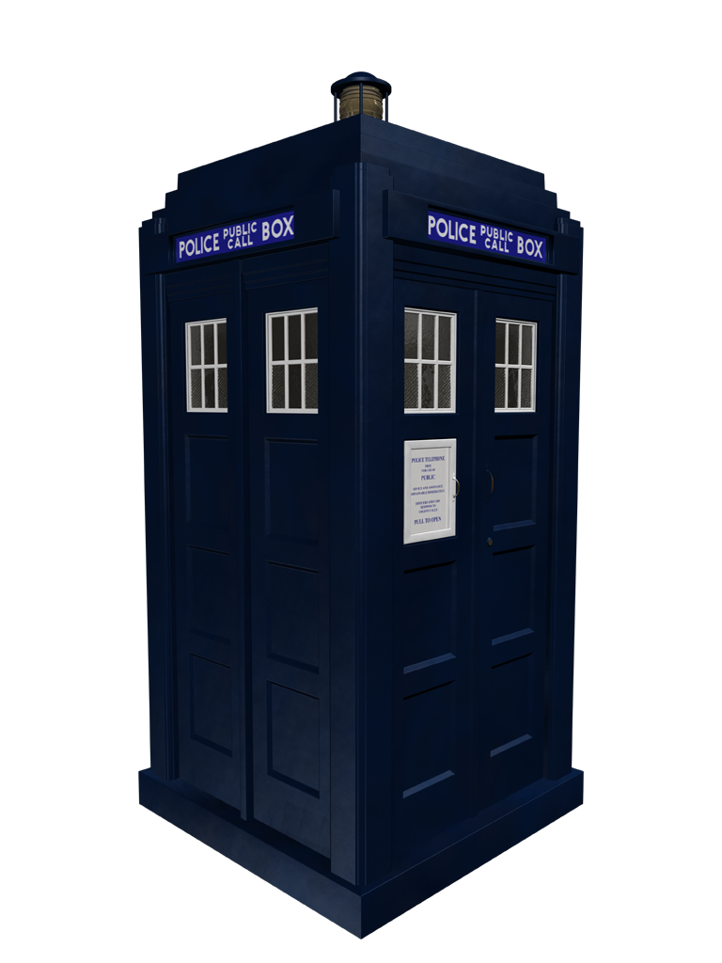
Doctor Who - TARDIS
T.A.R.D.I.S.
Time
And
Relative
Dimension
In
Space

