Slide 1
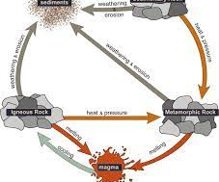

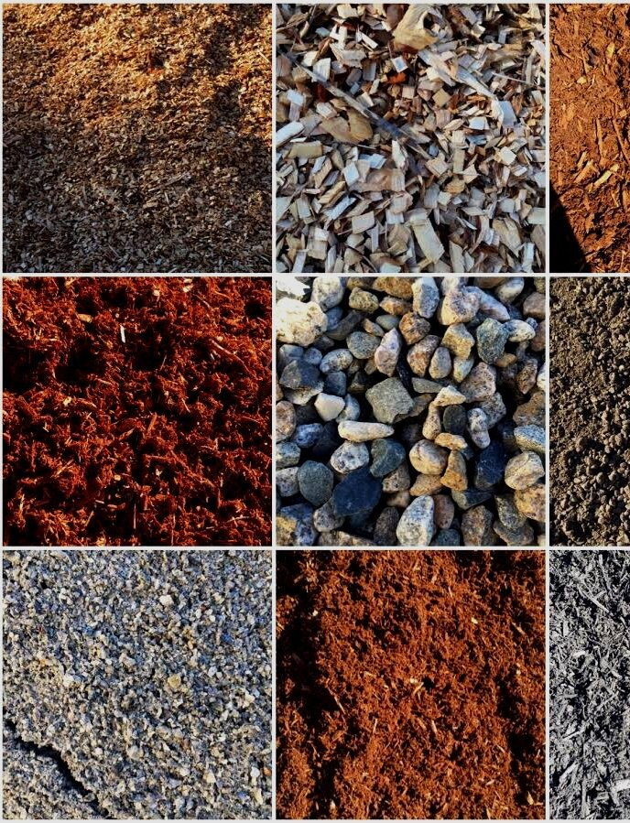
Earth’s Materials

Slide 2
Teacher Summary
Lesson Week | 1 | 2 | 3
1 | The Rock Cycle | Different Types of Rock KIT 1 | Uses of Rocks
2 | Soil | Minerals Research IT ROOM | Minerals Presentation HOMEWORK 1
3 | Ores | Extracting Metals KIT 2 | Fossil Fuels HOMEWORK 2
4 | Burning Fuels | The Greenhouse Effect | Acid Rain HOMEWORK 3
5 | Acid Rain investigation | Acid Rain Investigation KIT 3 | Acid Rain Investigation
6 | Summary and revision | End of Topic test | Results and Feedback

Slide 3
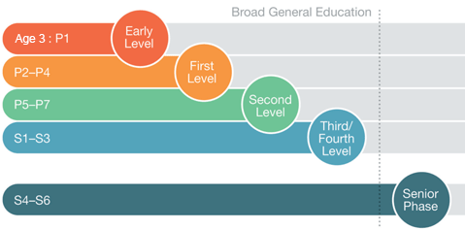

There are 3 benchmarks that you will achieve in the Earth’s Materials unit that are based on the following areas of the 3rd level of the Broad General Education (BGE)
The Rock Cycle
Extracting Natural Resources
Pollution

Slide 4
PowerPoint Icons
All the PowerPoints used in the course have the same icons so you know what to expect. The icons used are:
A note to copy
Numeracy
Question/Think point
Health and Wellbeing
Literacy
Citizenship

Slide 5
Topic Overview
Lesson Week | 1 | 2 | 3
1 | The Rock Cycle | Different Types of Rock | Uses of Rocks
2 | Soil | Minerals Research | Minerals Presentation
3 | Ores | Extracting Metals | Fossil Fuels
4 | Burning Fuels | The Greenhouse Effect | Acid Rain
5 | Acid Rain investigation | Acid Rain Investigation | Acid Rain Investigation
6 | Summary and revision | End of Topic test | Results and Feedback

Slide 6
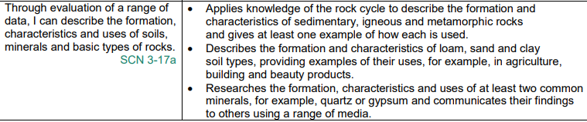

Slide 7
Introduction
All animals make use of things in their surroundings, called resources, to survive.
The use of resources extends beyond food and shelter. Monkeys use rocks to break open nuts and rhinos use mud as sunblock to protect their skin from sunburn.
Humans not only make use of the Earth’s natural resources to survive, but also to enhance our living standards.
This topic takes a look at some of the Earth’s resources that are extracted for our use.

Slide 8
The Rock Cycle
The rock cycle is a never-ending process in which rocks continually change over millions of years.
This long slow process involves Heat and Pressure deep within the Earth which makes rock change into a different types.
There are three main types of rock:
  Sedimentary Rocks
  Metamorphic Rocks
  Igneous Rocks

Slide 9
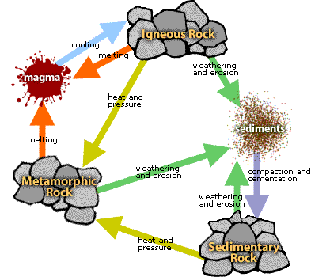
The Rock Cycle
Stick the blank diagram in your jotter and complete the labels.
If you have time, you can also colour it in.

Slide 10
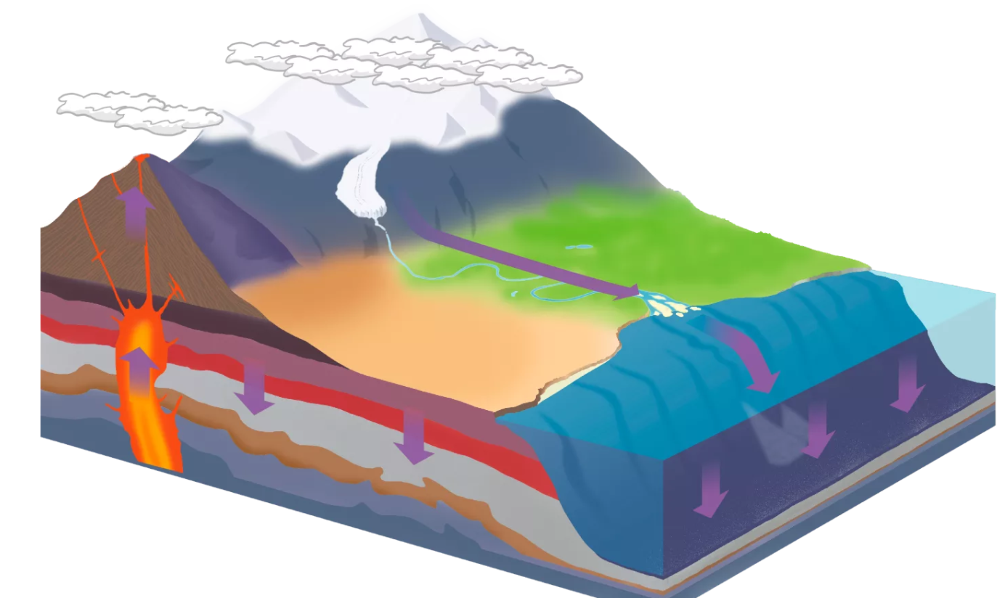
If the heating is very intense, both sedimentary and metamorphic rock can get so hot they turn into magma (hot liquid rock)
1. Weathering
During volcanic eruptions magma bursts through the earths surface. It cools on the surface and forms IGNEOUS rock.
Rivers and steams carry rock pieces while breaking them down further. Glaciers remove rocks from mountainsides and carry them long distances
Rock particles get squashed and packed together under pressure. They gradually harden and form solid SEDIMENTARY rock
Rock pieces are carried away by rivers, glaciers or the wind
Rain, wind, frost, chemicals, heat and all living things break down rocks
Rock pieces settle as sand, mud or pebbles at the coast. They then get carried into the seas and settle on the seabed
Heat and pressure deep within the earth can change sedimentary rock to METAMORPHIC rock
2. Erosion
3. Carrying
4. Settling
8. Volcanic
7. Intense Heating
6. Heating
5. Compacting

Slide 11
Stages of the Rock Cycle
Stage | Stage Name | Description
1 | Weathering | Rain, wind, frost, chemicals, heat and all living things break down rocks
2 | Erosion | Rivers, glaciers or the wind break rocks down.
3 | Carrying | Rivers and streams carry rock pieces while breaking them down further. Glaciers remove rocks from mountainsides and carry them long distances
4 | Settling | Rock pieces settle as sand, mud or pebbles at the coast. They then get carried into the seas and settle on the seabed
5 | Compacting | Rock particles get squashed and packed together under pressure. They gradually harden and form solid SEDIMENTARY rock
6 | Heating | Heat and pressure deep within the earth change sedimentary rock to METAMORPHIC rock
7 | Intense Heating | If the heating is very intense, both sedimentary and metamorphic rock can get so hot they turn into magma (hot liquid rock)
8 | Volcanic | During volcanic eruptions magma bursts through the Earth's surface. It cools on the surface and forms IGNEOUS rock

Slide 12
Literacy
Use the table on the previous slide to summarise the stages of the Rock Cycle.
You are aiming to have a maximum of 5 sentences.

Slide 13
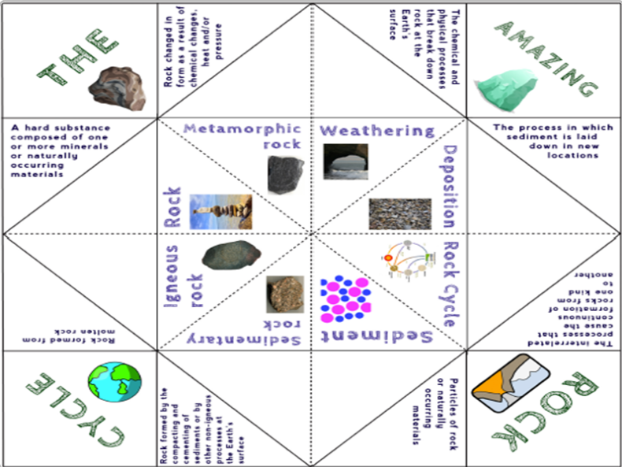
Extension
You can cut out and make the rock cycle “Fortune Teller”.

Slide 14
Starter:
What were the three different type of rock mentioned in the previous lesson?
How is each type of rock formed?

Slide 15
You are going to watch a video on the different types of rocks that exist. Copy the sentences on the next 2 slides into your jotter and use the information in the video to fill in the blanks.

Slide 16
Igneous Rocks
Igneous is a word that means f____. Igneous rocks are formed when l___ or m____ cools. Example of igneous rocks include g______, t___, o_______ and p______. Igneous rocks make up roughly __% of the Earth’s surface.
Sedimentary Rocks
Sediment is made up of s___, m__ and o______ material. These rocks are formed when layers of sediment are s_______ and c_________ over time. F______ are usually found in sedimentary rocks. Examples of sedimentary rocks include l________, s____ and s________.

Slide 17
Metamorphic Rocks
The word metamorph means c_____ f___. Metamorphic rocks are formed when different rocks are changed by extreme h___ and p_______. Different rocks become different metamorphic rocks:
Shale becomes s____
Sandstone becomes q________
Limestone becomes m_____.

Slide 18
Igneous Rocks
Igneous is a word that means f____. Igneous rocks are formed when l___ or m____ cools. Example of igneous rocks include g______, t___, o_______ and p______. Igneous rocks make up roughly __% of the Earth’s surface.
Sedimentary Rocks
Sediment is made up of s___, m__ and o______ material. These rocks are formed when layers of sediment are s_______ and c_________ over time. F______ are usually found in sedimentary rocks. Examples of sedimentary rocks include l________, s____ and s________.
f

Slide 19
Metamorphic Rocks
The word metamorph means c_____ f___. Metamorphic rocks are formed when different rocks are changed by extreme h___ and p_______. Different rocks become different metamorphic rocks:
Shale becomes s____
Sandstone becomes q________
Limestone becomes m_____.

Slide 20
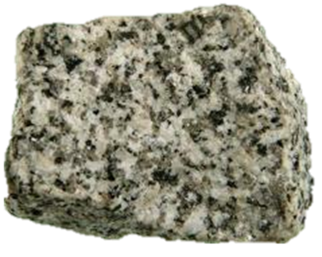
Igneous Rocks
Igneous rocks are formed when molten rock called magma cools on the earths surface.
They are mostly crystalline (made up of interlocking crystals) and usually very hard to break.
Granite is made of coarse-grained interlocking crystals. It has more light coloured crystals than dark, usually of white or pink.

Slide 21
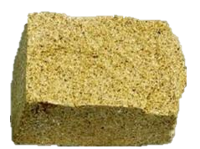
Sedimentary Rocks
Sedimentary rocks are formed from sediment grains deposited by water, wind or ice.
They are always formed in layers, called “beds” or “strata”, and quite often contain fossils.
Sandstone is made of sand grains packed together.
It is formed from sediment deposited by rivers, the sea, or by the wind.

Slide 22
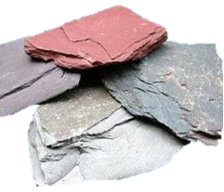
Metamorphic Rocks
Metamorphic rocks were once igneous or sedimentary rocks, but have been changed (metamorphosed) as a result of intense heat and/or pressure within the Earth’s crust.
They are crystalline and often have a “squashed” texture.
Slate is made of fine-grained interlocking crystals which lie flat in the same direction, these rocks can be easily split.

Slide 23
Rock characteristics
Each of the different rock types will look differently since they are all formed in different ways.
You are going to try and classify different rock types using the information on the next page. You should write your findings on the “Rocks Observation Sheet”.

Slide 24
Properties of different Rocks
Igneous
These can have either:
Crystal grains
Holes where hot gases escapes (porous)
Glassy appearance with no grains
Sedimentary
These can have either:
Sand-sized grains cemented together
Flat layers
Fossils
Can be scratched with a fingernail
Metamorphic
These can have either:
Alternating dark and white bands
Swirly pattern
One colour throughout

Slide 25
Uses of Rocks
As you have seen there are many different types of rock which a variety of different characteristics/properties.
These properties determine the uses of each of the different rocks.

Slide 26

Scenario
You have been asked by the headteacher of the local primary school to create a 1 page information leaflet on the uses of different rocks. They have supplied a booklet of information but they feel it is too much for the pupils.

Slide 27
What to do:
Take a sheet of A4 paper and split it into three columns (one for Sedimentary, one for Igneous and one for Metamorphic).
Summarise all the information in the booklet onto this page.
Remember you should make your page eye-catching for the primary pupils so should be colourful with pictures.
Sedimentary Igneous Metamorphic

Slide 28
Soil Formation
When rocks are work away but weather, chemical factors and biological factors, tiny grains of rock are broken off.
These grains make up much of soil. But soil contains other things too:
Water
Air
Humus

Slide 29
Water
When freshly dug soil is left in a dry place, it slowly loses mass. The water in the soil is evaporating.
Why do you think water is important in soil?
In this soil sample
What mass of water is present?
What percentage of the soil is made of water?

Slide 30
Air
The soil has air trapped in between the particles.
Why do you think air is important in the soil?
In this soil sample
What volume of air is present?
What percentage of the soil is made of air?

Slide 31
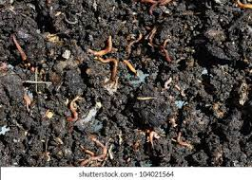
Humus
Humus is mostly made of dead plant material which is slowly rotting.
Humus helps to keep the soil rich in nutrients that the plants need to grow.

Slide 32
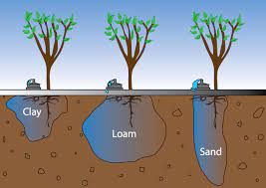
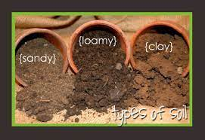
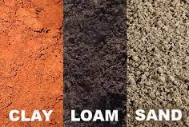
Different Soil Types
ACTIVITY:
The next slide will show you information on different soil types.
For each of the three soil types write notes under each of the headings:
Description
Disadvantages
Uses

Slide 33
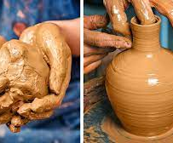

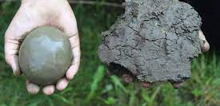
Clay
Some soils are made up of lots of tiny grains stuck close together. These are clay soils. Clay soils have few air spaces and have water trapped between the grains. As a result, the soils are heavy and drain badly.
Clay soils have a variety of different uses including making ceramics and pottery, but more surprisingly they can be used to make inexpensive medicines due to their antimicrobial properties.

Slide 34
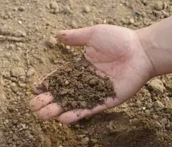
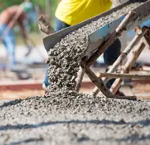
Sand
Sandy soils are made up of bigger grains, which bigger spaces between them. Water can easily pass through the spaces, and so sandy soils are light and easily drained. Only plants which do not require a lot of water can grow in sandy soils.
Sandy soil doesn’t get sticky. It is cohesionless. It has a light and loose structure. That’s why it can be easily used for construction purpose. Sandy soil can be a great aggregate for concrete. Also, it can be used as a construction material of mortar aside cement.

Slide 35
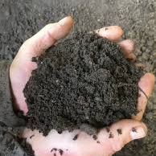
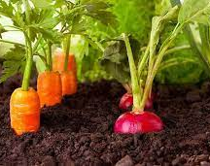
Loam
The best soils contain some clay, some sand and lots of humus. A soil like this is called loam. Loam is particular good at storing nutrients so is often used as the growing medium for agriculture. Loam, however, must be carefully monitored to ensure it has the right pH and composition.

Slide 36
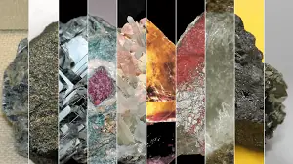
What's in a Mineral?
Minerals are inorganic substances found in the Earth’s crust which are formed through the cooling of lava or liquid solutions or the evaporation of mineral-rich solutions.
They can also exist at high temperatures and pressures in the Earth's core.

Slide 37
Five Characteristics of a Mineral
Minerals Are Natural
  Minerals are not made in laboratories.
Minerals Are Inorganic
  Minerals don't belong to any class of organic compounds made by living things.
Minerals Are Solids
  Minerals cannot be liquids or gases; they exist only as solids.
Definite Chemical Composition
  Each mineral has its own specific combination of atoms that cannot be found in any other mineral
Crystalline Structure
  Minerals form crystals that contain repeated arrangements of atoms or ions.

Slide 38
Mineral Research Task
There are many minerals that mankind have been using for hundreds and thousands of years.
They have been used because of their many important properties.
These properties might include how hard they are, how pretty they are etc.
Your task is to carry out research into two different minerals in a group of no more than 3 students.
Produce a poster, power point or information leaflet which communicates to the class your findings. Use the following questions to help:

Slide 39
Mineral Research Task
In a pairs, you need to research the following task and present your findings to the class..
Research the:-
  formation
  characteristics
  and uses
of at least two common minerals e.g. quartz or gypsum.
Use the Mineral Research booklet to record your findings.
You will have to present your information to the class in the next lesson.

Slide 40
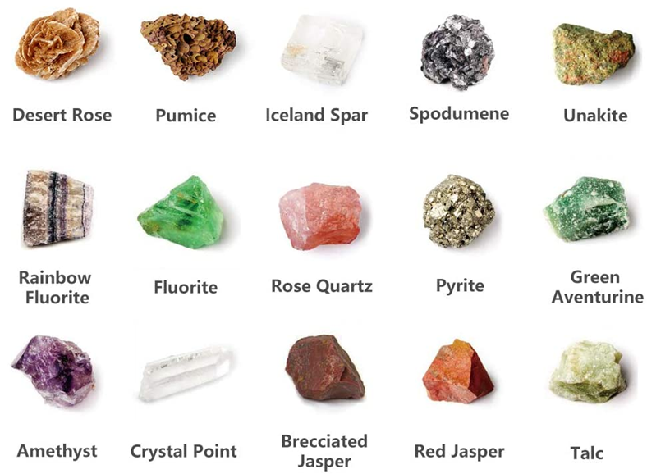
Some that you can choose from

Slide 41
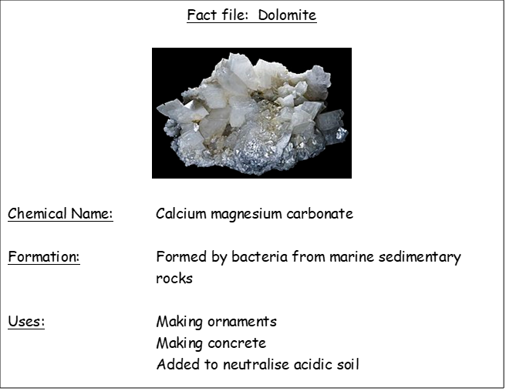
Example

Slide 42
Rocks as Ores
Ores are naturally occurring rocks that contain metals or metal compounds in sufficient amounts to make it worthwhile extracting them.
The method used to extract a given metal from its ore depends upon the reactivity of the metal and so how stable the ore is.

Slide 43
ACTIVITY – Examples of Ores
On the next slide you will see different ores, naming the metal that is contains.
You should present this information in a table with suitable headings.

Slide 44
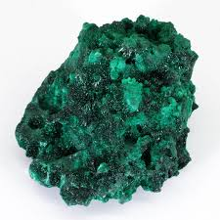
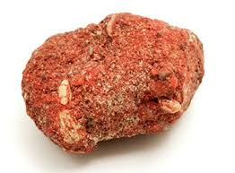
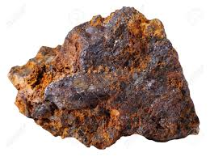
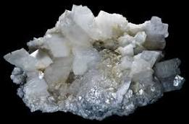
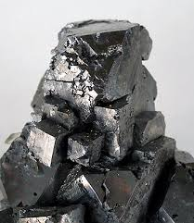
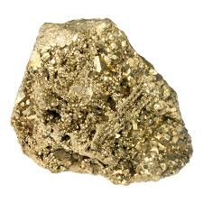
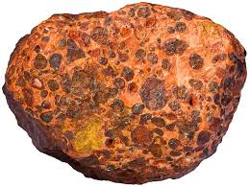
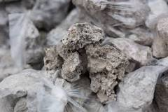
Malachite is a compound of copper
Mercury comes from the ore Cinnabar
Haematite is the main ore of Iron
Dolomite is a mineral ore for the extraction of magnesium.
Sodium comes from the reactive ore saltpetre.
Aluminium is extracted from the ore bauxite
We get lead from the ore galena
Pyrite (sometimes called fools gold) is another compound of iron.

Slide 45
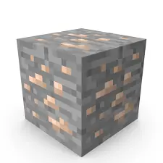

Extracting Metals
Believe it or not Minecraft almost gets the Science of ores correct.
You firstly have to dig the ore out of the ground from a “vein”. This is an area where there is a lot of the metal ore.
After you get the ore, it must then be extracted in order to get the usable metal.
The method of extraction changes depending on how reactive the metal is.

Slide 46
Extraction of Metals
Increasing reactivity
METALS
Potassium
Sodium
Magnesium
Aluminium
Zinc
Iron
Lead
Copper
Silver
Gold
The first four metals are so reactive that electricity is needed to extract the metal.
The next four metals still form ores, but they just needed to be heated with carbon. They have to be heated to really high temperatures
The last two metals are so unreactive that you can find them lying on the ground (you have to look hard though).
Really hard
Fairly easy
Easy peasy

Slide 47
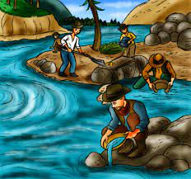

Native metals
Silver and gold are naturally occurring, or native, metals. This means that they can be found in the ground as the metals. They don’t normally form ores.
Think about the Gold Rush in America when people went to California to try and pan for gold.

Slide 48
Heating with Carbon
Most of the metals that we use today are extracted from their ores with carbon.
Iron, the most common metal used in construction, is extracted in a Blast Furnace.

Slide 49
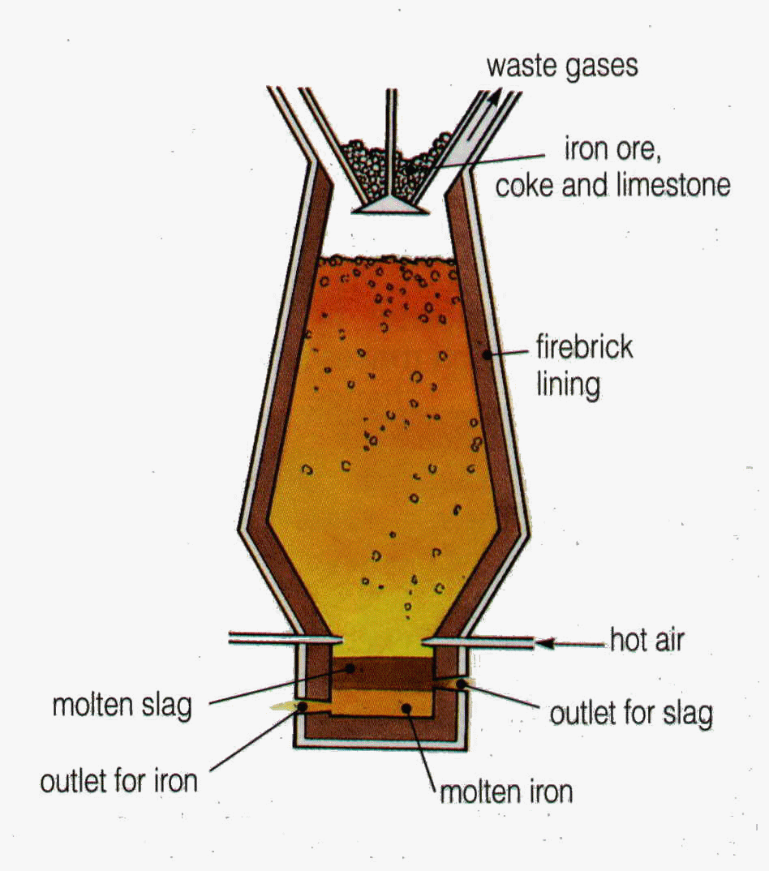
ACTIVITY
Collect a copy of the Blast Furnace diagram, colour and label it before sticking it in your jotter.
Slag is the chemical term for impurities

Slide 50
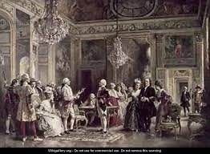

Using electricity
Some metals are so reactive that you need to use electricity to extract them from their ore.
Did you know?
In the court of Louis XVI of France they destroyed all the gold plates and cutlery to replace it with aluminium.

Slide 51

ACTIVITY
You are going to carry out an experiment to try and extract copper from copper oxide (a simplified version of the ore).
Instructions
Add one spatula of both the carbon and copper oxide powder.
Heat the mixture over a blue flame for at least 10 mins
  Make sure the mouth of the test tube is facing the wall.
Carefully drop the test tube with the heated mixture into a beaker of cold water
  Remember this is going to be hot and the test tube will shatter.

Slide 52
Fuels
A major resource that we extract from the Earth are fuels.
This section will look at some of the fuels that we use in out everyday lives, both the advantages and disadvantages of each.

Slide 53
What is a fuel?
Watch the video and answer the following questions in your jotter.
What is a fuel?
What are some examples of fuels in everyday lives?
What does combustion mean?
What conditions are needed for a fuel to burn?

Slide 54
Fossil Fuels
We have learned about fuels and the element carbon. Many of the fuels that we use are FOSSIL FUELS. This means that they took millions of years to make.

Slide 55
Fossil Fuels
____, _____ ___and ________ ___ are all fossil fuels. They took millions of years to make. Fossil fuels can be classed as ______ resources, they are going to run out one day.

Slide 56
Formation of Coal
Watch the video and answer the questions below in your jotter.
Plants lived near what?
When they died what were they covered with?
How do we remove coal from the ground?
They decompose and first turn into p_____.
The w_______ of the ground and the h_______ of the earth then turn this into c________.

Slide 57
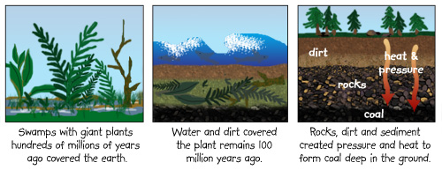
Cut and stick the formation of coal diagram into your jotter. You will need to add the notes.

Slide 58
Formation of Oil
Watch the video and answer the following questions in your jotter.
What lived in the water that covered the earth?
What happened to them?
What were they covered with?
What did they turn into first?
H________ from the earth and the w_________ of the rocks turned them into o_____.
Oil can travel through the p_______ in the rocks.
Where do we extract oil?

Slide 59
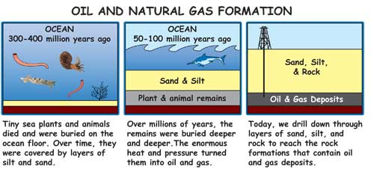
Cut and stick the formation of oil diagram into your jotter. You will need to add the notes.

Slide 60
Combustion
The best fuels all contain the element CARBON. This is because carbon can form very large molecules in chains. Carbon compounds also release a lot of energy when you burn them. This makes them good for fuels.
The products of combustion can vary depending on the concentration of oxygen present when the fuel burns.
You are going to carry out a some experiments to look at the products of combustion. When completing the experiments you may wish to take notes in your jotter.

Slide 61
Experiment 1
You are going to compare the two flames on a Bunsen burner (air hole open and closed).
Draw a diagram of each flame, noting the colour, heat, shape, sound etc of each flame.
THINK
What are you changing by opening and closing the air hole in a Bunsen burner?

Slide 62
Experiment 2
You are now going to heat up a beaker half filled with water firstly with the blue flame and then orange.
THINK
What difference do you notice between the beaker from both experiments?

Slide 63
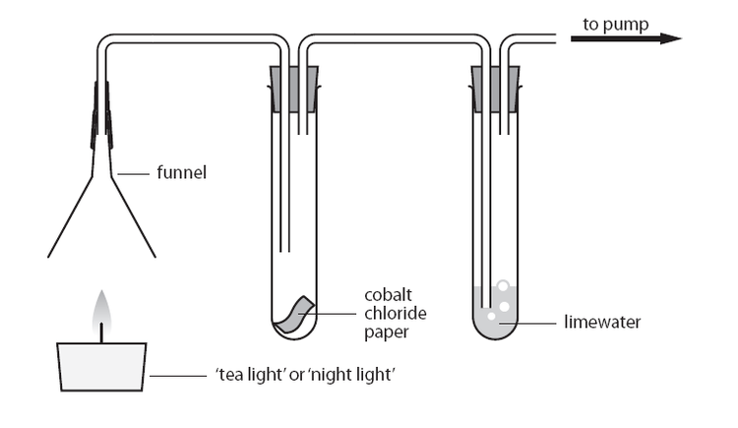
Demonstration
Your teacher will now show you the set up to determine the products of complete combustion.

Slide 64
Complete and Incomplete Combustion
COMPLETE COMBUSTION is when a substance burns in a _ _ _ _ _ _ _ _ _ supply of oxygen.
The products on complete combustion of a fuel are _ _ _ _ _ _ _ _ _ _ _ _ _ and _ _ _ _ _
INCOMPLETE COMBUSTION occurs when there is a _ _ _ _ _ _ _ supply of oxygen.
During incomplete combustion unburnt carbon (_ _ _ _) and the poisonous gas _ _ _ _ _ _ _ _ _ _ _ _ _ are also formed.

Slide 65
IMPORTANT NOTES
These experiments showed us:
1. _ _ _ _ _ _ is required to allow fuels to burn. The test for this gas is that it _ _ _ _ _ _ _ _ a glowing splint.
2. _ _ _ _ _ _ _ _ _ _ _ _ gas is produced when fuels burn. The test for this gas is that it turns limewater from _ _ _ _ _ to _ _ _ _ _ _.

Slide 66
The Problems of Fossil Fuels
Fossil fuels have been used for thousands of years. Records show that the Chinese were using coal in 3490 BCE. But it is only since the Industrial Revolution in the eighteenth century that humans have used fossil fuels on a larger scale. Today most of the energy used in the world is obtained by burning fossil fuels.
Can you think of any problems with this reliance on burning fossil fuels?

Slide 67
In the 1890s, a Swedish chemistry, Svante Arrhenius, concluded that burning fossil fuels would increase carbon dioxide levels in the atmosphere and lead to global warming.
The burning of fossil fuels expels huge quantities of carbon dioxide, carbon and other gases (such as sulfur dioxide and nirotgen oxide) into the atmosphere.

Slide 68
Problems with Fossil Fuels
Burning fossil fuels has a number of disadvantages including:
Global Warming and Climate Change
Smog Formation
Acid Rain

Slide 69
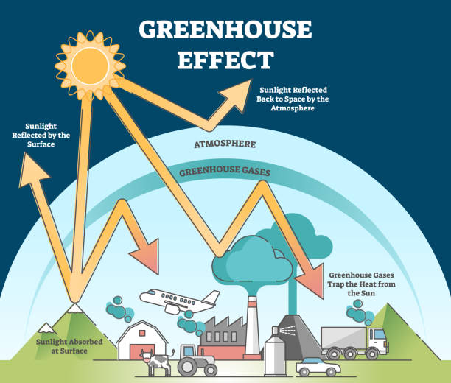
The Greenhouse Effect
WHAT TO DO
Collect a copy of the diagram of the greenhouse effect and stick it in your jotter.

Slide 70
Smog – Read the article and answer the questions (in sentences)
In December 1952 London was almost brought to a standstill by a smog, a mixture of smoke and fog. A period of unusually cold weather, combined with windless conditions, collected airborne pollutants —mostly arising from the use of coal — to form a thick layer of smog over the city. It lasted from Friday 5 December to Tuesday 9 December 1952, then dispersed quickly when the weather changed.
Government medical reports in the weeks following the event estimated that 100,000 more were made ill by the smog's effects on the human lungs and 4,000 of people affected died as a result.
As a result of this new laws were brought in to reduce the amount of coal which was burned in houses and to move the industrial centre of the city.
What is smog?
What cause the Great Smog in London?
How long did the Great Smog last?
What percentage of people who were affected by the smog died as a result?
TRY TO FIND OUT the name of the law that was introduced to make the air quality in London better.

Slide 71
Acid Rain
Acid rain is caused when harmful gases are released into the atmosphere.
Sulphur dioxide and carbon dioxide are produced by the burning of fossil fuels and nitrogen oxides are formed by the sparking of air in car engines.
These gases all dissolve in atmospheric water to form weak acids. This is known as acid rain.
Acid rain has many damaging effects:
Corrosion of buildings made of iron and steel.
Erosion of buildings made from carbonate rock
Increases the acidity of soil which is harmful to plant and animal life.

Slide 72
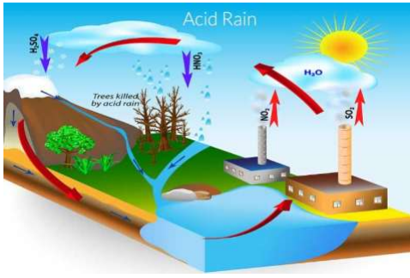

Slide 73
Acid Rain
When non-metal elements such as carbon and sulfur are burned they combine with ___________ from the air and the non-metal oxide is formed:
e.g. carbon + oxygen → __________ ___________
sulfur + oxygen → ___________ ___________
Both carbon dioxide and sulfur dioxide are soluble gases and can dissolve in rainwater to produce________ _______.

Slide 74
Use the word list to complete the note on acid rain.
Acid rain can cause several problems.
It causes buildings made of __________ rocks e.g. limestone to __________. It can also cause iron and steel to __________e.g. in bridges. If it gets into rivers and lakes it can ___________the aquatic life. It can also kill plants and trees if it gets into the ____________.
It can be treated by adding __________ to the soil or water to help neutralise the acid.
Word List
errode
kill
rust
soil
sedimentary
alkali

Slide 75
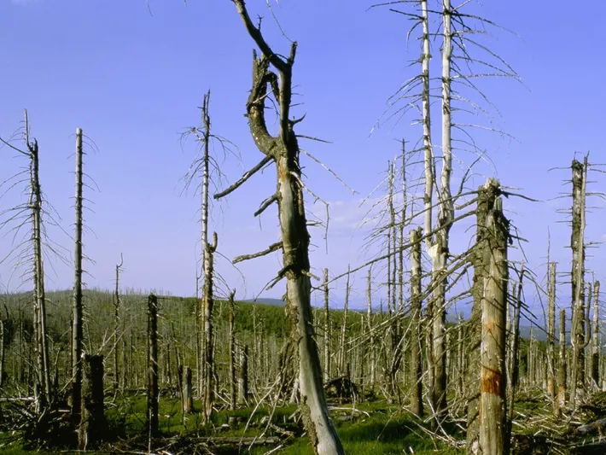
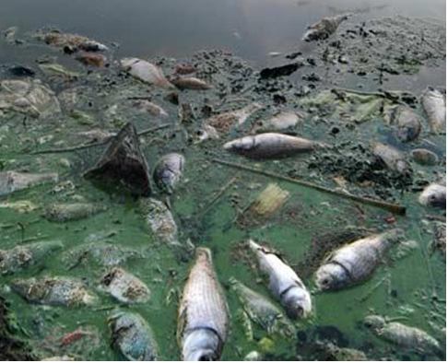
Damaging effects of acid rain

Slide 76
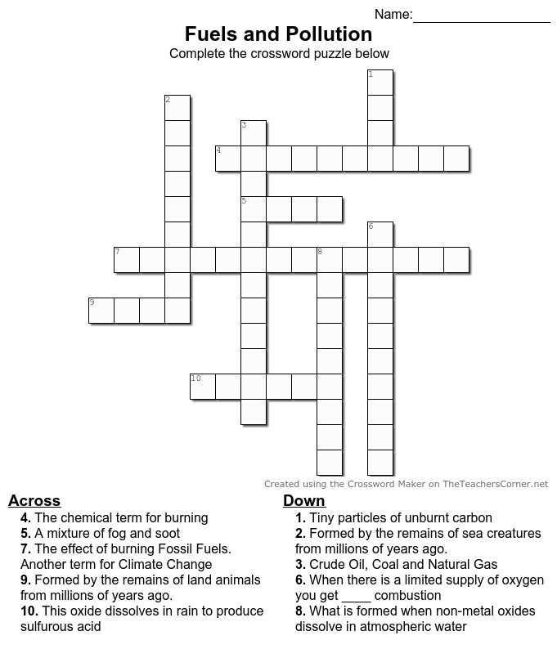
ACITIVITY
Collect a copy of the Fuels and Pollution Crossword.
Stick the completed crossword into your jotter.

Slide 77
INVESTIGATION
Over the next three periods you are going to plan an investigation into the damaging effects of acid rain.
You will have to choose what you investigating, then plan, carry out and write up.
You can choose from Effect of acid rain on Metals, Rocks or Sea Shells.

