Slide 1
S1 Space Unit Benchmarks Overview
Science Benchmarks
Light and Waves –By exploring the refraction of light when passed through different materials, lenses and prisms, I can explain how light can be used in a variety of applications SCN 3-11a
By exploring radiations beyond the visible, I can describe a selected application, discussing the advantages and limitations. SCN 3-11b
Literacy Benchmarks
I am developing confidence when engaging with others within and beyond my place of learning. I can communicate in a clear, expressive way and I am learning to select and organise resources independently. LIT 3-10a
I can make notes and organise them to develop my thinking, help retain and recall information, explore issues and create new texts, using my own words as appropriate. LIT 3-15a / LIT 4-15a
To show my understanding, I can comment, with evidence, on the content and form of short and extended texts, and respond to literal, inferential and evaluative questions and other types of close reading tasks. ENG 3-17a
To help me develop an informed view, I am exploring the techniques used to influence my opinion. I can recognise persuasion and assess the reliability of information and credibility and value of my sources. LIT 3-18a
I can persuade, argue, evaluate, explore issues or express an opinion using a clear line of thought, relevant supporting detail and/or evidence. LIT 3-29a
Numeracy Benchmarks
I can continue to recall number facts quickly and use them accurately when making calculations. MNU 3-03b
I can display data in a clear way using a suitable scale, by choosing appropriately from an extended range of tables, charts, diagrams and graphs, making effective use of technology. MTH 2-21a / MTH 3-21a

Slide 2
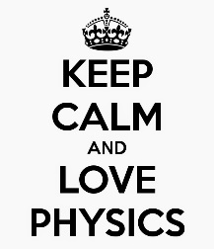
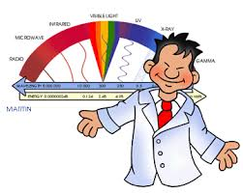
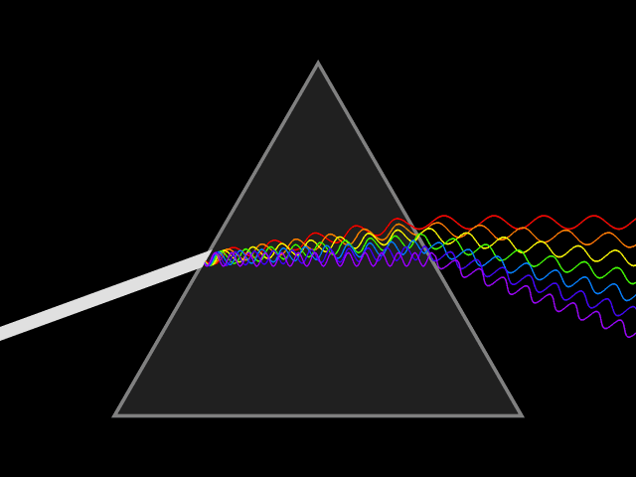
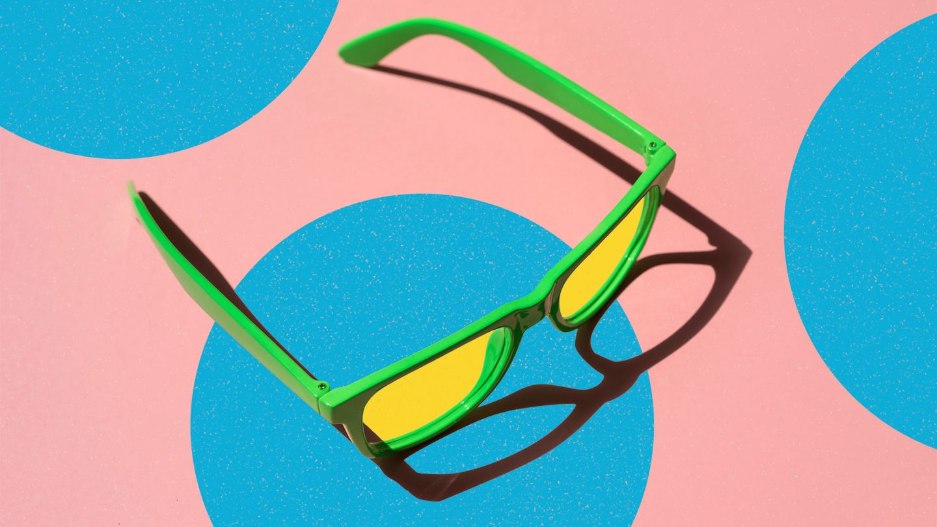
Light & Waves

Slide 3

Power point Icons
All the Power points used in the course have the same icons so you know what to expect. The icons used are:
A note to copy
Numeracy
Question/Think point
Health and Wellbeing
Literacy
Citizenship
Videoclip

Slide 4
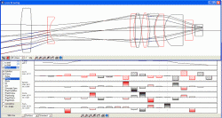
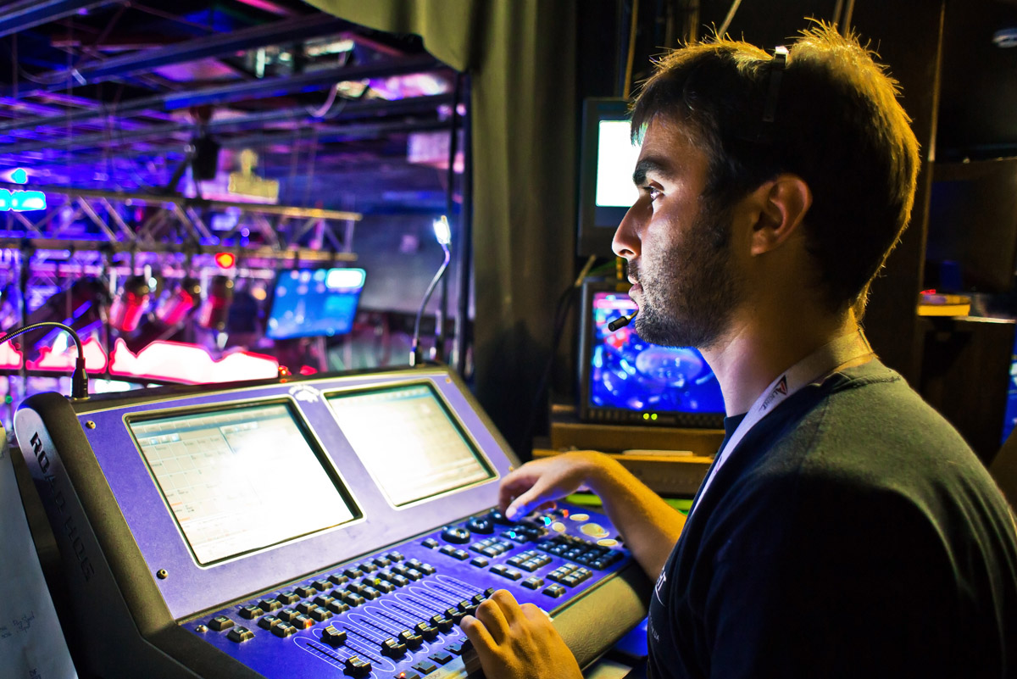
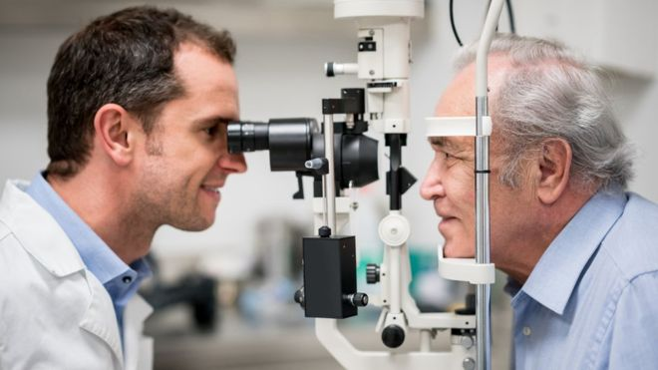
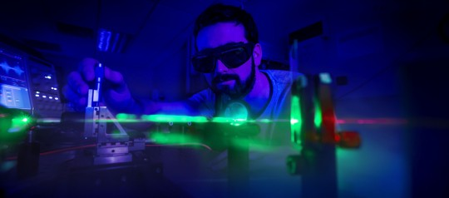
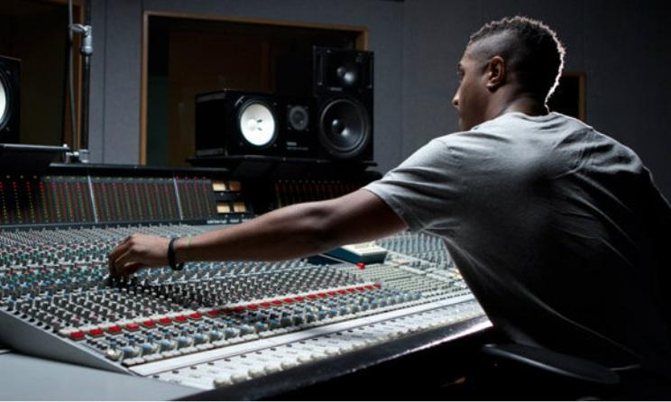
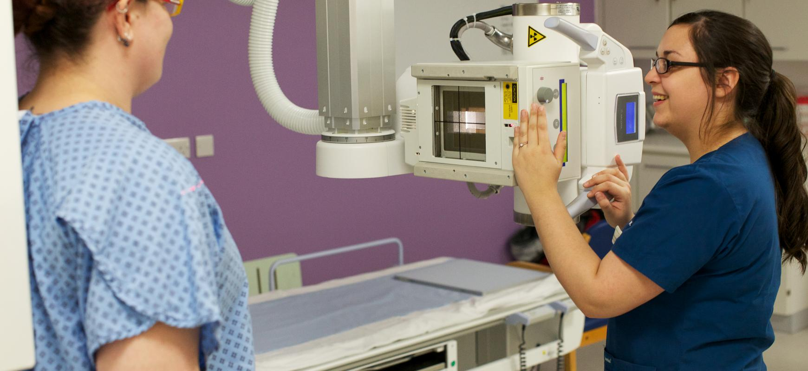
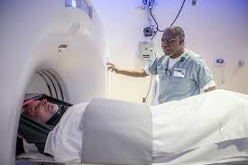
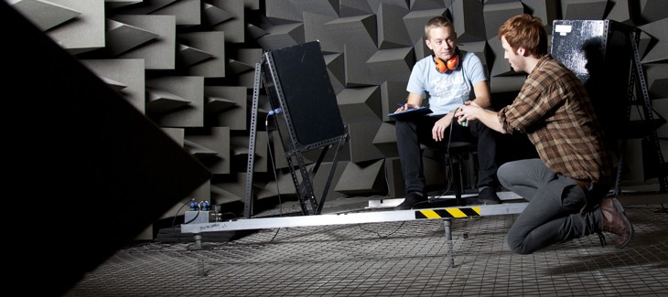
Careers Link!
Waves is a Physics Topic
optician
Light technician
Sound engineer
Health physics,
radiographer

Slide 5
Lesson 1
We are learning to...
State what refraction is
List some everyday situations that use refraction

Slide 6


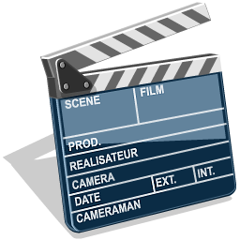
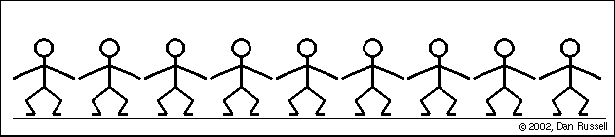
Waves
What is a wave?
A wave is a vibration that carries energy e.g. sunlight.
Not these kinds of wave!
Waves (3min 48sec)
More like a Mexican wave!

Slide 7
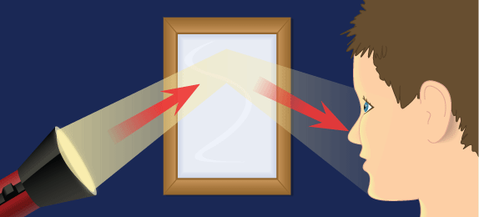
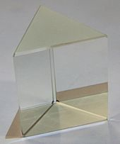
Light
What happens when a wave such as light shines on a mirror?
The light reflects, which is known as reflection.
What happens when light shines on a see through (transparent) object like a prism or piece of glass?

Slide 8
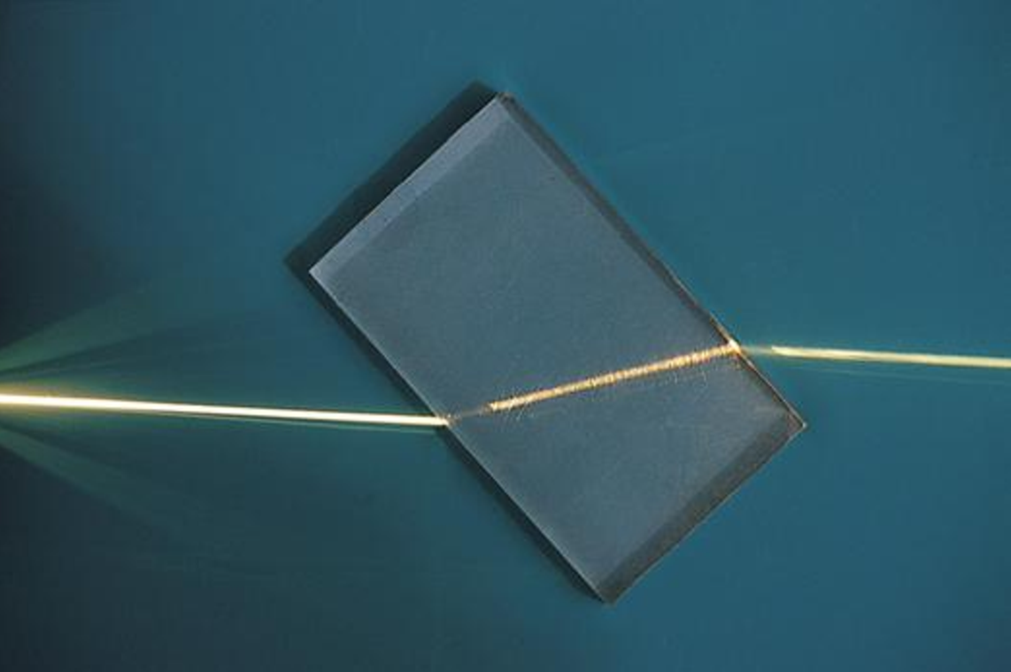
Refraction
The light actually changes speed by slowing down and changes direction inside the prism.
The light refracts, which is known as refraction.
We do not say “the light bends”, as light always moves in a straight line.

Slide 9
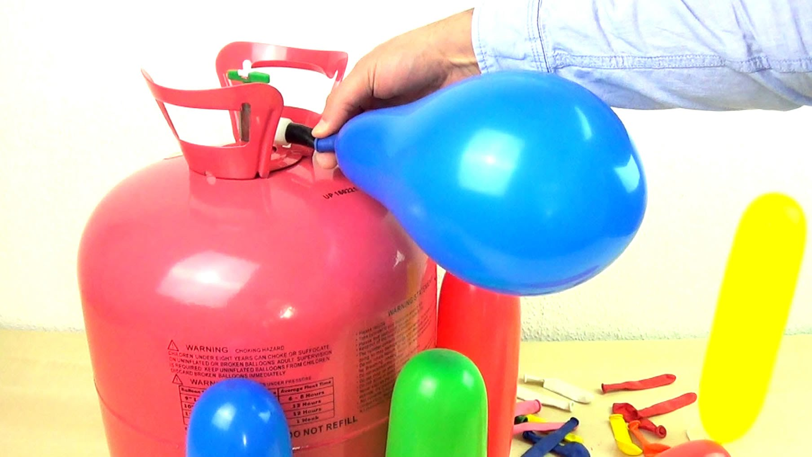
Refraction
Refraction is when light changes speed and direction as it moves into a different material.
The light refracts as the different material has a different density which alters the speed and direction of the wave.
The same thing happens with other waves such as sound waves, which is why your voice sounds higher in helium!

Slide 10
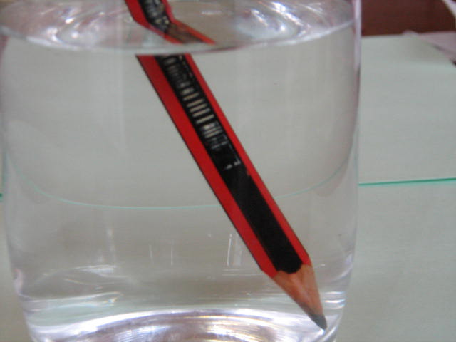
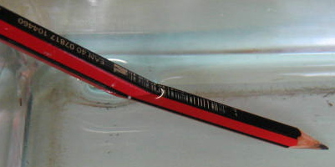
Why does a pencil look like this in water?
REFRACTION
Light speeds up going into air (and slows down going into water), making the pencil appear to change direction.

Slide 11
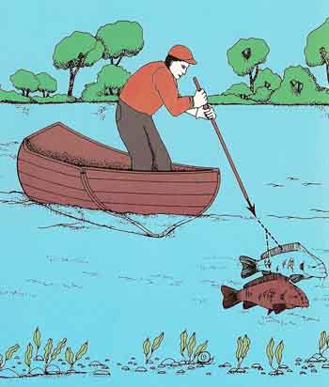
REFRACTION
If the fisherman stabs where he sees the fish, he’ll miss as the light has been refracted by the water.
When do we use refraction in everyday life?

Slide 12
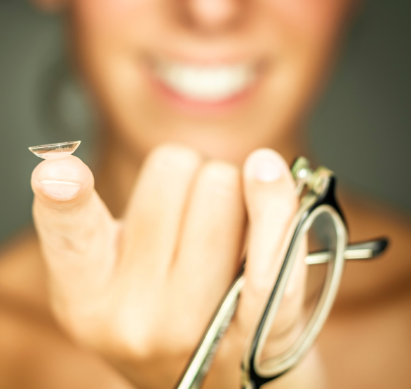
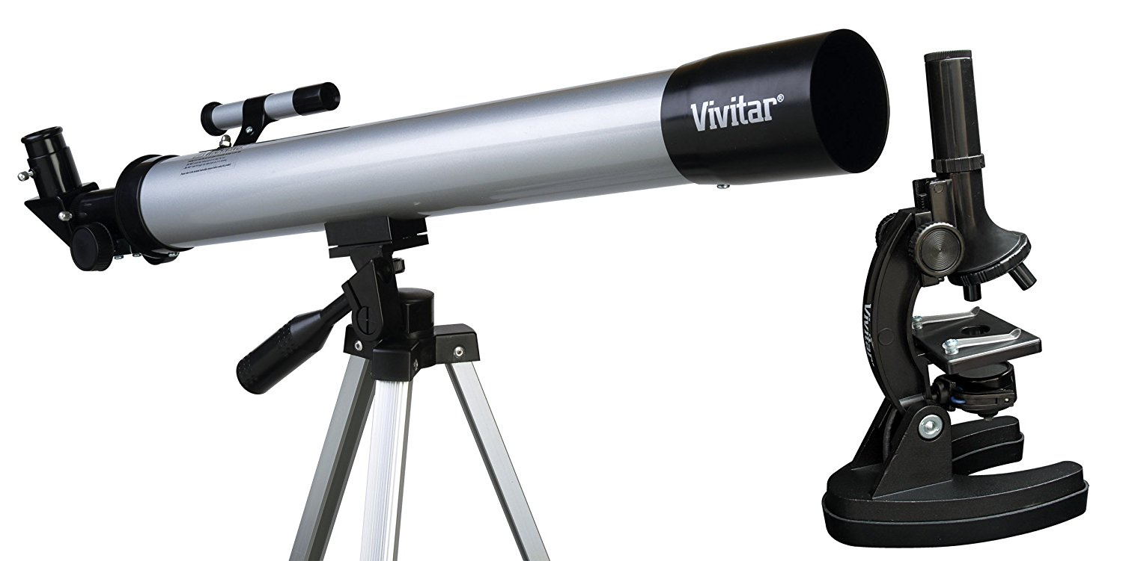
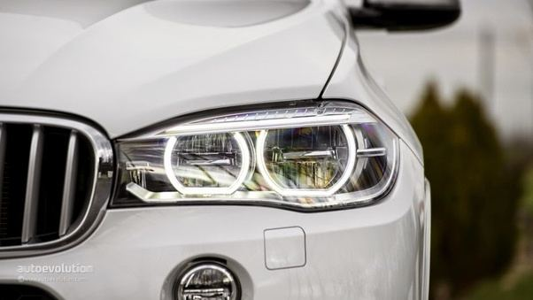
Refraction
Refraction is used in many everyday
situations such as in:
Spectacles/contact lenses
Microscopes/telescopes
Car headlights
Refraction (4min 36sec)

Slide 13
Lesson 1
You should be able to…
State what refraction is
List some everyday situations that use refraction

Slide 14
Lesson 2
We are learning to...
Draw a convex lens and a concave lens
Explain what a convex lens and a concave lens do to light rays

Slide 15
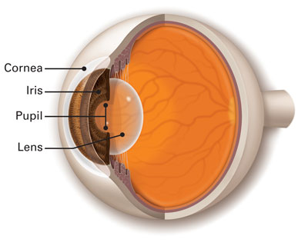
Lenses
What is a lens?
A lens is a transparent device that is used to refract light. This can be useful in focusing light such as in the eye.
Lenses can be used to focus light and see objects clearly such as in microscopes, telescopes, contact lenses and glasses.

Slide 16
Lenses
There are two types of lens:
(1) Convex
(2) Concave
Both types of lens refract light but in different ways.
Light travels in a straight line until it is refracted by the lens.

Slide 17
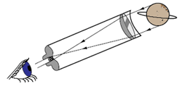
Lenses
The simplest of telescopes consists of 2 convex lenses positioned in a long cylindrical tube.
Convex lens
(eyepiece)
Convex lens
(objective)

Slide 18
Lenses
A lens is a device that is used to refract light. This can be used to focus light to see things clearer.
There are two types of lens – convex and concave.
Task:
Collect a raybox, lenses, paper and a pencil.
In a dark room, investigate what happens when light is refracted through a convex and a concave lens.

Slide 19
Lenses
Result:
The convex lens brings all the beams of light to a focus. This is known as converging.
Focus

Slide 20
Lenses
Result:
The concave lens makes all the beams of light spread out. This is known as diverging.

Slide 21
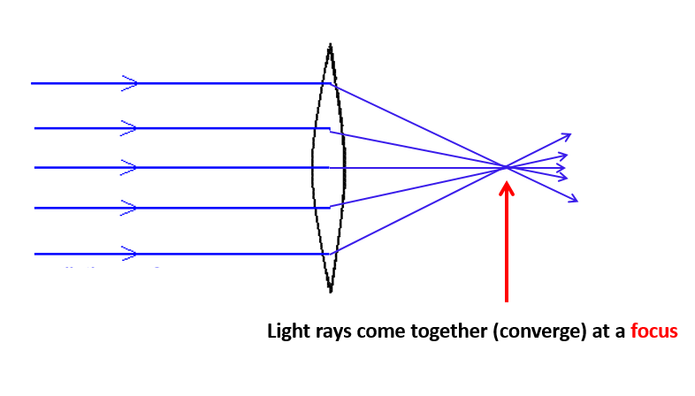
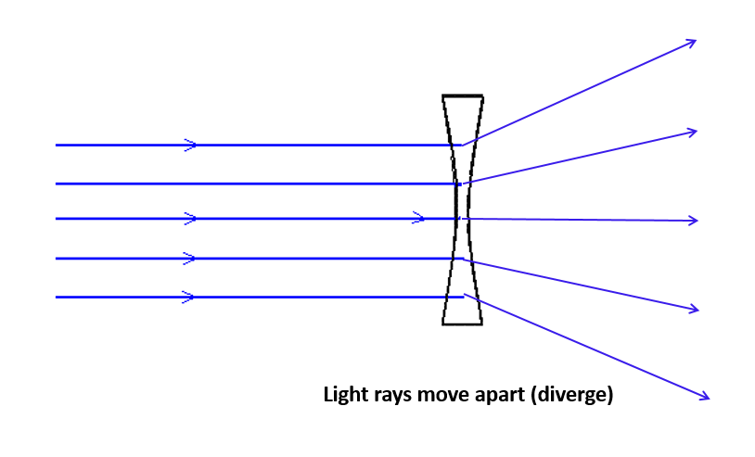
Lenses
Task:
Collect the lenses diagram and glue into your jotter. Label the diagram to show which is the convex lens and which is the concave lens.
Convex
Concave

Slide 22
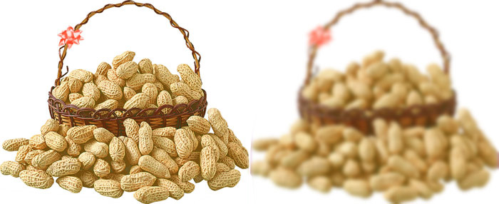
Lenses
Imagine looking at a basket of peanuts. Some people see picture A and others picture B…why do glasses not make the image clearer for everyone?
A B

Slide 23
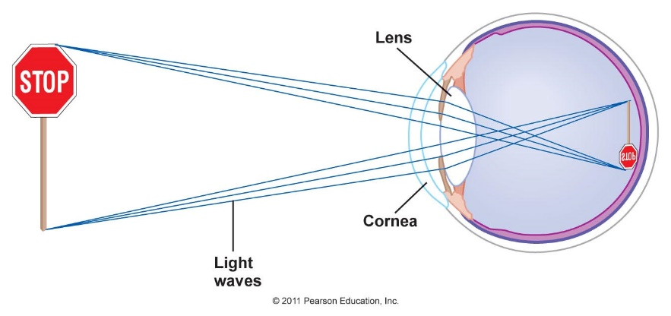
Lenses
The lens of our eyes have a unique shape.
If the object doesn’t focus on the back of the eye (the retina) then the object will be blurry.
A lens in front of the eye helps to focus light.

Slide 24
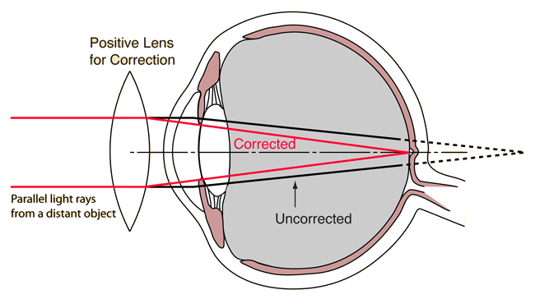
Lenses

Slide 25
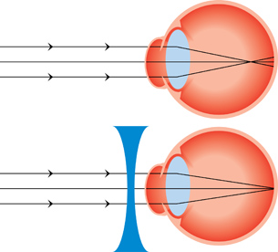
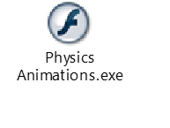
Go to :
Pupil Share> Physics> Flash Learning> Physics Animations> > Optics and relativity> Sight-Normal, long, short for animation about how these lenses work

Slide 26
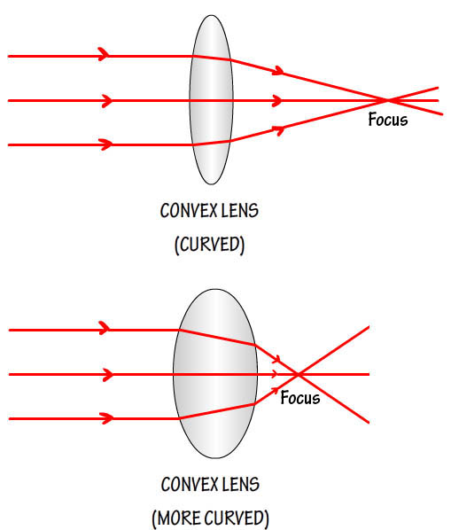
Lenses
Thicker lenses refract the light more and the focus is then closer to the lens.

Slide 27
Lesson 2
We are learning to...
Draw a convex lens and a concave lens
Explain what a convex lens and a concave lens do to light rays

Slide 28
Lesson 3
We are learning to...
Explain how a visible spectrum is produced as light passes through a prism
List the order of the main colours that make up the visible spectrum

Slide 29
Visible spectrum
What is the visible spectrum?
The visible spectrum is basically light that we can see. Although light looks ‘white’ to us, it is in fact made of a variety (spectrum) of 7 colours.
These 7 colours become obvious when light is refracted through a triangular prism.
Raindrops act as natural prisms and refract light into a well known pattern…

Slide 30
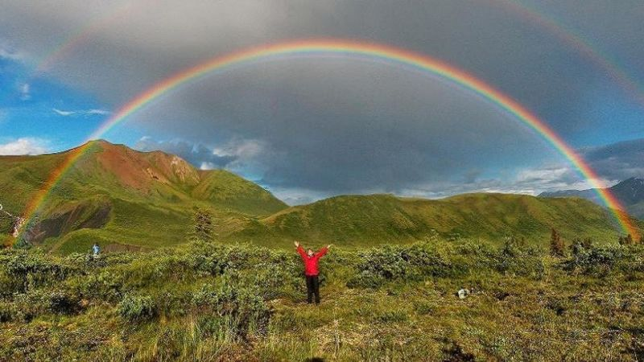
Visible spectrum
A rainbow shows the 7 colours of light that are known as the visible spectrum.

Slide 31
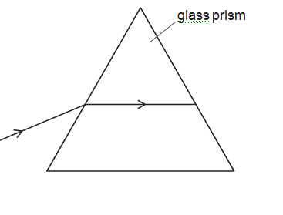
Task 1 : - Collect a ray box
- Connect to power supply
- Shine fine beam of light through triangular prism as shown
below ( should be equilateral triangle)
- Observe results on white paper screen

Slide 32
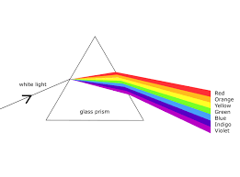
-Collect your colour spectrum diagram and stick in jotter
-Complete your diagram with colour pencils

Slide 33
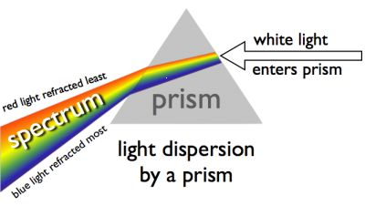
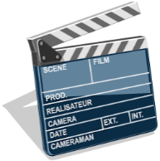
Visible spectrum
All the colours are refracted differently e.g. red light is refracted the least.
This explains why the blue region (which is most refracted) is the main colour of the sky at midday, but often red at sunrise or sunset as the red light is refracted over the horizon.
Visible spectrum (4min 7sec)

Slide 34
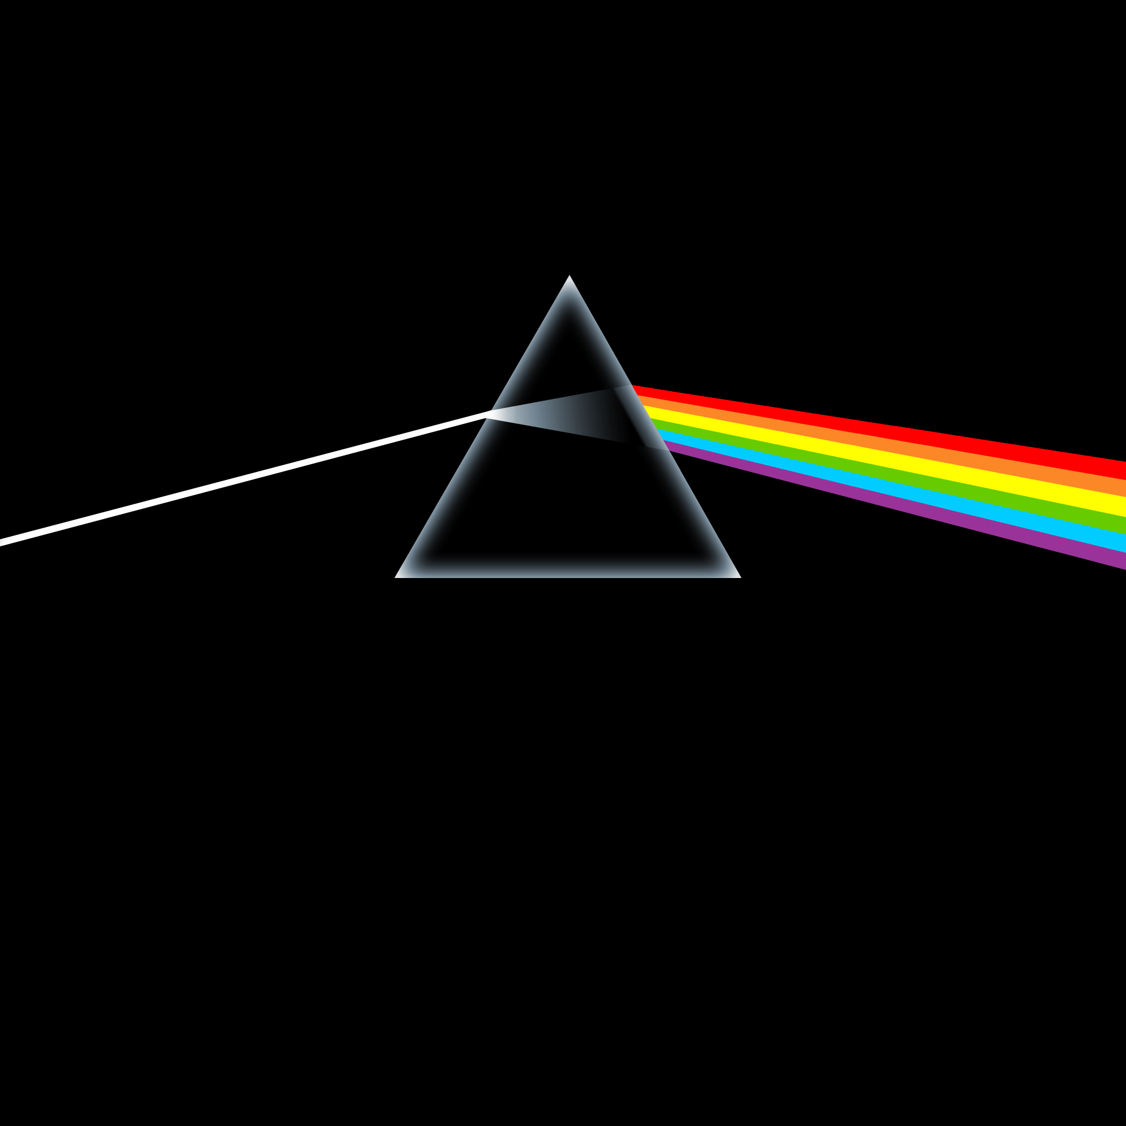
White light is made up of all of the colours of the RAINBOW

Slide 35
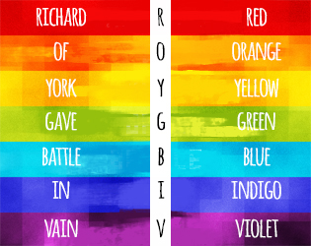
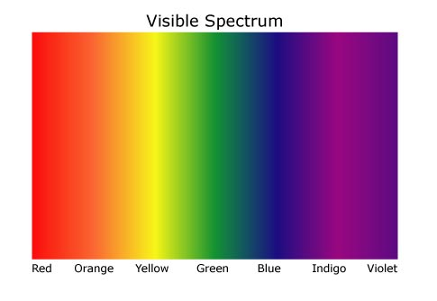
Visible spectrum
The visible spectrum is the light we can see.
The visible spectrum is produced when light passes through a prism as some colours refract more than others.
The colours that make up the visible spectrum are:

Slide 36
Task 2 : Using the first letters of the colours of the visible spectrum, make a mnemonic ( your teacher will explain) of the letters to remember the order of the colours easily

Slide 37
Lesson 3
We are learning to...
Explain how a visible spectrum is produced as light passes through a prism
List the order of the main colours that make up the visible spectrum

Slide 38
Lesson 4
We are learning to...
Describe what the electro-magnetic spectrum (EMS) is
Give examples of types of waves (and their uses) in the EMS
Use the internet to search for information
Work as a team to produce a research poster

Slide 39
Electro-Magnetic Spectrum (EMS)
Visible light is one member of a family of waves known as the electro-magnetic spectrum (or EMS for short).
All the waves move at the same speed (the speed of light = 300,000,000 metres per second!).
The other waves are not visible, but all behave the same way as light e.g. they can be reflected and refracted.

Slide 40
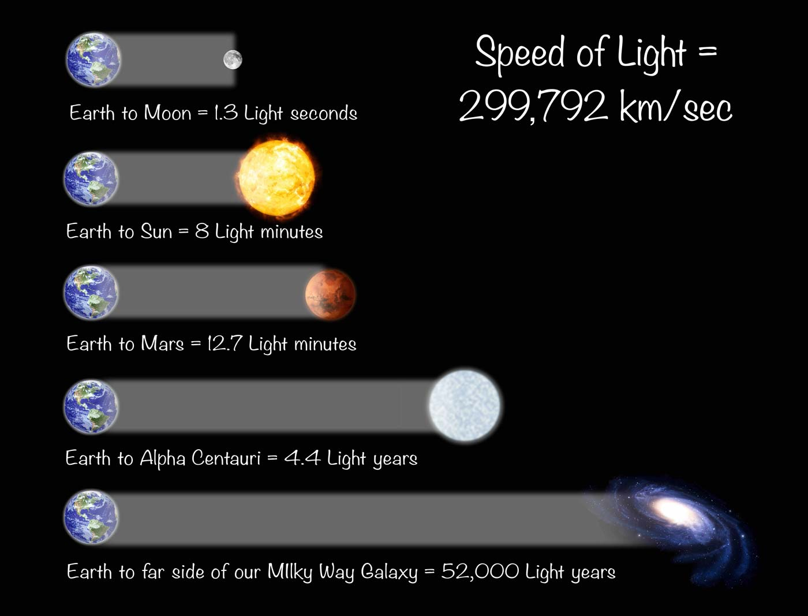

Slide 41
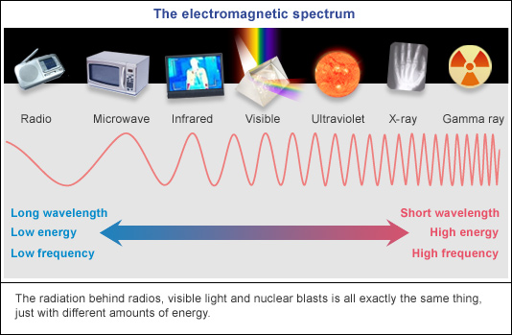

Slide 42
Electro-Magnetic Spectrum (EMS)
Radio & TV waves
X-rays
Infrared waves
Ultraviolet waves
Microwaves
Gamma
rays

Slide 43
Gamma X-Rays Ultraviolet Visible Light Infrared Microwaves TV/Radio
short
waves
Violet
Red
long
waves

Slide 44
Electro-Magnetic Spectrum (EMS)
The electro-magnetic spectrum (EMS) is a family of waves that can all move at the speed of light.
As well as visible light, there are 6 other types of waves in the EMS:
Task:
Collect the EMS waves diagram and complete.

Slide 45
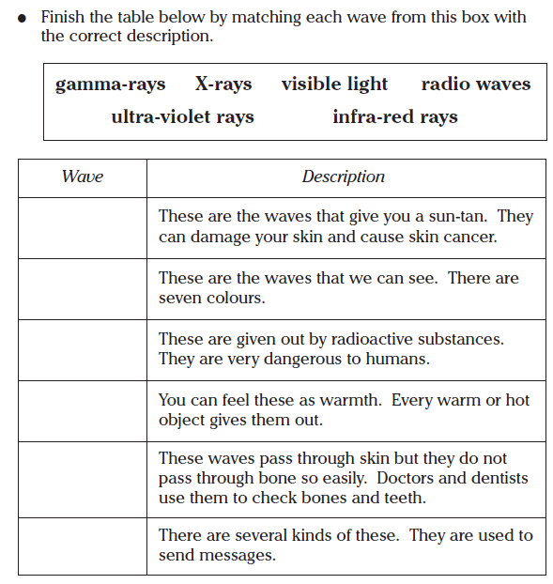
Electro-Magnetic Spectrum (EMS)
Task:
Add “microwaves” to your table with a suitable description e.g. “Used for cooking and in mobile phone communication”
Ultra violet rays
Visible light
Gamma rays
Infra-red rays
X-rays
Radio waves

Slide 46
Electro-Magnetic Spectrum (EMS)
Task:
Working as part of a group, you will now do an internet research task on one wave from the EMS.
Once you have researched the wave, its wavelength, its uses and some interesting facts, make a colourful, informative poster to teach the rest of the class about your part of the EMS.
We will then peer assess each others posters.

Slide 47
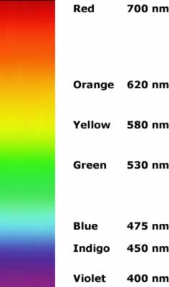
Radio & TV waves
Microwaves
Infrared waves
Ultraviolet waves
X-rays
Visible Light
Gamma
rays

Slide 48
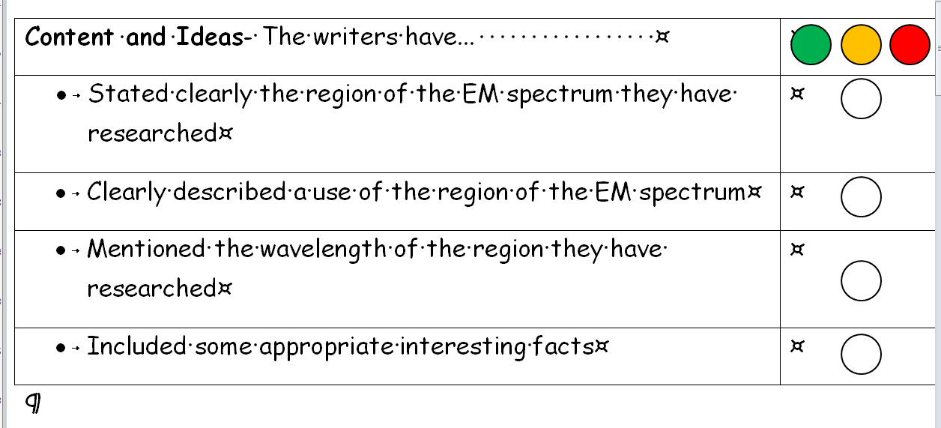
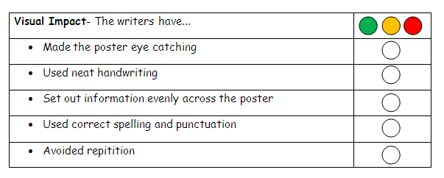
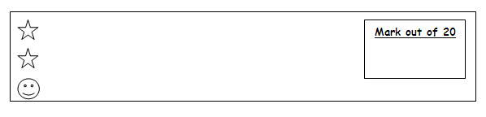
Peer Assessment
There are 3 sections to the peer assessment form:

Slide 49
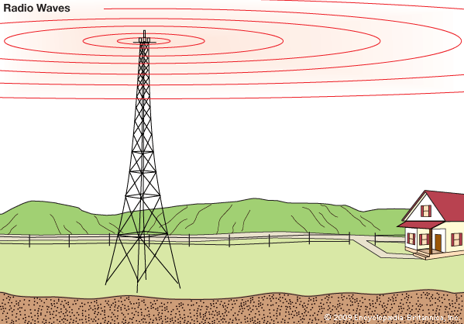
Summary of EM spectrum
Radio
Carries;
  Information (Internet)
  News
  Music

Slide 50

Microwave
Used for
  Cooking
  Mobile Phones
  Radar
  Satellite communication

Slide 51

Infrared
Used for
  Thermal scan
  Search & Rescue
  Night vision
  Physiotherapy

Slide 52

Visible light
Used to
  See
  Take photographs
  Power solar cells

Slide 53

Ultraviolet
Used for
  Getting a suntan (or SUNBURN)
  Security marking
  Coatings in fluorescent lights

Slide 54

X-rays
Used for
  Seeing inside the body
  Airport security
  Killing cancer cells

Slide 55

Gamma rays
Used to
  See inside the body
  Kill cancer cells
  Sterilise medical equipment
  Look into deep space

Slide 56
The EM spectrum song ( 2minutes)

Slide 57
Lesson 4
We are learning to...
Describe what the electro-magnetic spectrum (EMS) is
Give examples of types of waves (and their uses) in the EMS
Use the internet to search for information
Work as a team to produce a research poster

Slide 58
Lesson 5
We are learning to...
Describe what coloured filters do
Give examples of common uses of filters
Explain the effects of using of different filters

Slide 59


Coloured filters
Filters are used to stop certain things passing through, like sand or insoluble parts of coffee. They can also be used to change the appearance of things.
From this
to this
But they also have practical uses
Filters can be used to make coloured light from white light bulbs, for example in traffic lights, car brake lights, and in theatres.

Slide 60
Task:
Collect a ray box, power pack and paper.
Connect your ray box to power pack
Shine light through different coloured filter onto paper
Attach 2 filters, what do we see?
Now collect some coloured card
- Shine different coloured light onto different coloured card, what do we see?

Slide 61
A red filter only lets red light through, and absorbs (stops) other colours.
A blue filter only lets blue light through, and absorbs (stops) other colours.
So, 2 filters should stop all light
Different colours of light can make different colours of card appear to change colour
( don’t worry if you don’t understand why the
colours change, the next lesson should help this)

Slide 62
Looking at things using coloured light
We normally see things in sunlight, which is white.
If we look at things in coloured light, they look different. A blue object reflects blue light, and absorbs the other colours.
When we see it in white light, it looks blue.
But if you shine red light on it, the red is absorbed.
No light is reflected to your eyes, and so the blue object appears to be black.

Slide 63




Some images with filters:

Slide 64


Pupil Task : Observe the following images through different filters
Teacher demo :
How we see - Single colour with filters ANIMATION
Choose Single Bulb (then pick a colour or white) to see the effects of filters

Slide 65
A filter is a coloured object that lets only certain colours of light pass through it.
For example, a red filter only lets red light through, and absorbs (stops) other colours.
Filters can be used to make coloured light from white light bulbs, for example in traffic lights, car brake lights, car indictors and in theatres.
Filters can also be used in special effects to give different colour surfaces different appearances under different lights.

Slide 66
Lesson 5
We are learning to...
Describe what coloured filters do
Give examples of common uses of filters
Explain the effects of using of different filters

Slide 67
Lesson 6
We are learning to...
State the 3 primary colours of light
Explain how different colours can be produced from 3 primary colours

Slide 68



Close up image of modern LCD computer monitor
Close up image of old TV screen
Colours on Mr.McGhee’s “Whiteboard”

Slide 69
Primary colours and colour mixing
The three primary colours of light are red, green and blue. (RGB)
These colours can be mixed to produce all other colours. (The primary colours of light are different from the primary colours of paints.)
All TV screens, projectors and mobile phones use this principle

Slide 70
Task: In groups of 4
Collect 2 ray boxes, a power pack and paper.
Connect your ray boxes to power pack as before
Now add 2 filters (any combination of red, green and blue) to each ray box and shine coloured light onto paper
Observe colour produced when light mixes
Repeat for other combinations
Record results

Slide 71
Conclusion:
The three RGB colours of light mix as follows
Red + Green = Yellow
Red + Blue = Magenta
Blue + Green = Cyan
Red + Blue + Green = White
Other colours are produced by changing the brightness of each RGB.
Colour mixing ANIMATION choose RGB bulbs
also Pupil Share> Physics> Flash Learning> Physics Animations> > Photons> Colour monitor/TV screen

Slide 72




Slide 73
First colour photograph - James Clarke Maxwell ( 1minute)
Recreating first colour photograph (1 minute)

Slide 74
Lesson 6
We are learning to...
State the 3 primary colours of light
Explain how different colours can be produced from 3 primary colours

