Slide 1
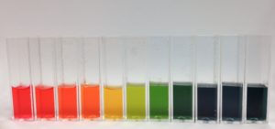
S2 Science: Chemical Changes
The pH Scale

Slide 2

The pH Scale: Benchmarks
Science Benchmark
Having taken part in practical activities to compare the properties of acids and bases, I have demonstrated ways of measuring and adjusting pH and can describe the significance of pH in everyday life. SCN 3-18a
Literacy Benchmarks
I can make notes and organise them to develop my thinking, help retain and recall information, explore issues and create new texts, using my own words as appropriate. LIT 3-15a / LIT 4-15a
I can convey information, describe events, explain processes or concepts, and combine ideas in different ways. LIT 3-28a
Numeracy Benchmark
I can display data in a clear way using a suitable scale, by choosing appropriately from an extended range of tables, charts, diagrams and graphs, making effective use of technology. MTH 2-21a / MTH 3-21a

Slide 3

Powerpoint Icons
All the Powerpoints used in the course have the same icons so you know what to expect. The icons used are:
A note to copy
Numeracy
Question/Think point
Health and Wellbeing
Literacy
Citizenship
Videoclip

Slide 4
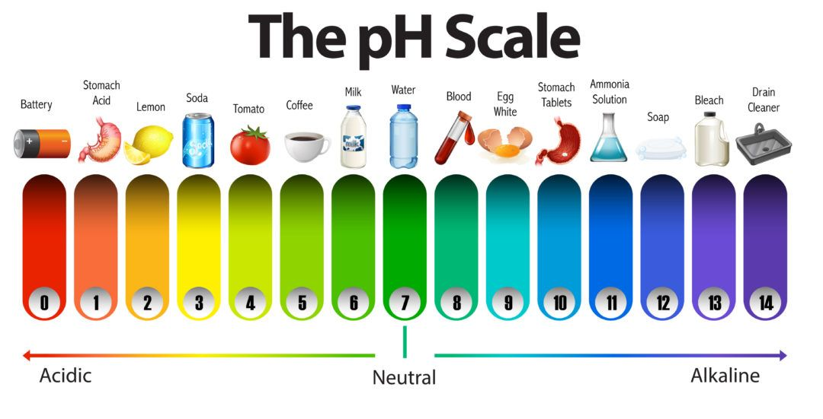
Lesson 1: Indicators and the pH Scale Success Criteria
describe the colour changes of universal indicator when added to acids and bases
identify substances as acidic (pH of less than 7), alkaline/basic (pH of greater than 7) or neutral (pH equal to 7)

Slide 5
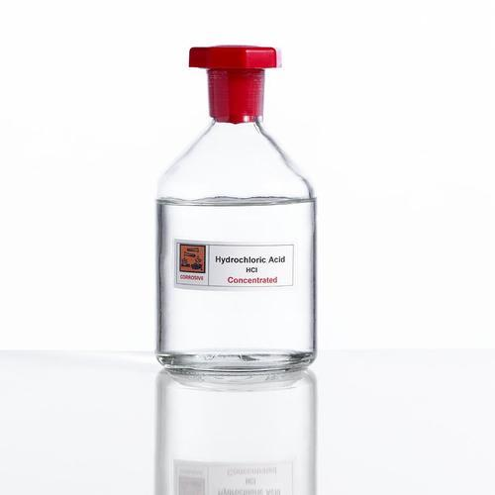
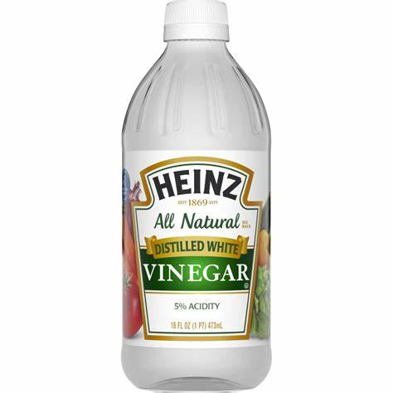
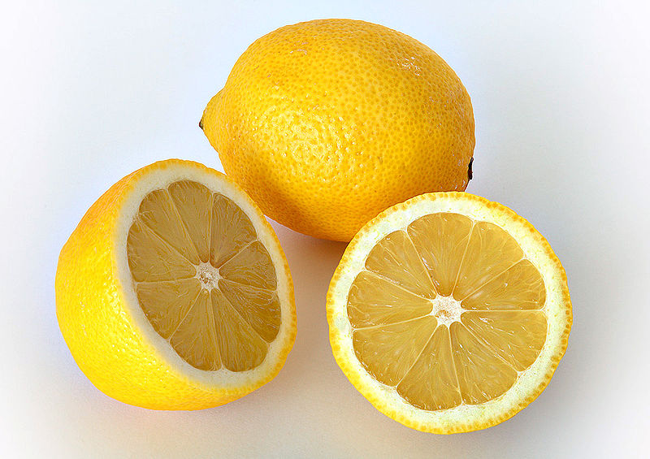
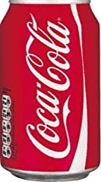
Indicators and the pH Scale
Acids and bases (alkalis) can be found all around us, in our school lab and in our homes. Can you name any acids or alkalis?
Laboratory Acids Household Acids
hydrochloric acid vinegar
sulfuric acid lemon juice
nitric acid cola

Slide 6
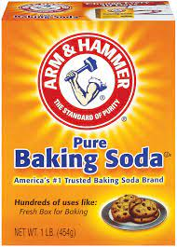
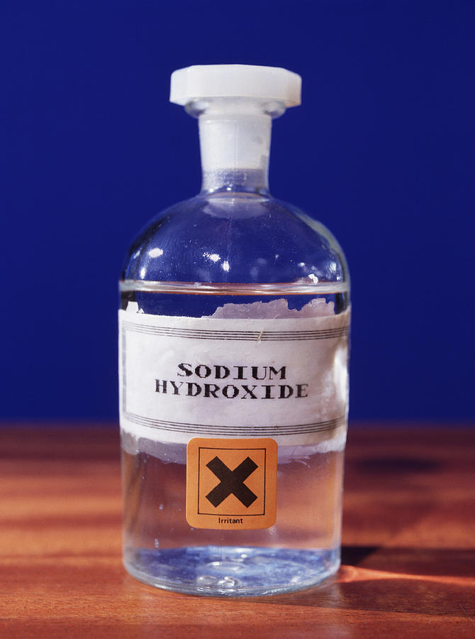
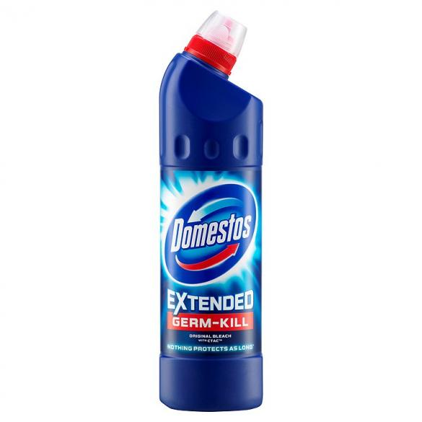
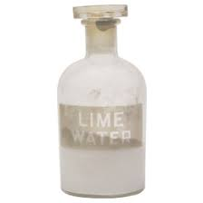
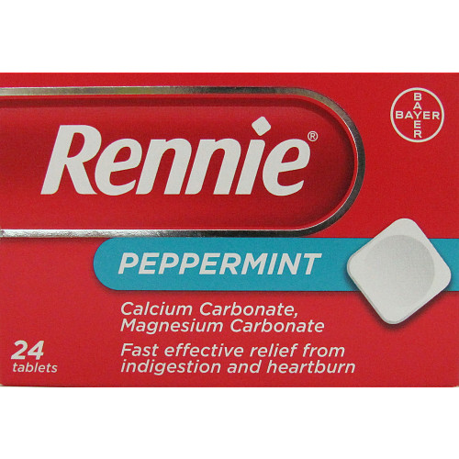
Laboratory alkalis Household alkalis
sodium hydroxide baking soda
potassium hydroxide bleach
limewater indigestion remedies

Slide 7
Universal Indicator
Indicators, such as universal indicator, are chemicals which produce
different colours when placed in acids and alkalis/bases.
Universal indicator is a mixture of different indicator chemicals.
Universal indicator colours can be matched to a number on the pH scale.
As it can change through a range of different colours, it can also be used to show the strength of an acid or alkali.

Slide 8
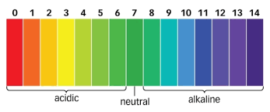
The pH Scale
The pH scale is used to determine how acidic or alkaline a substance is.
The range of the pH scale is from below 0 to above 14 but between 0-14 is where the pH of most substances occur.
acids getting stronger
alkalis getting stronger

Slide 9
Collect a copy of a pH scale diagram and stick it into your jotter.
Copy and complete the note below under the diagram.
Acids have a pH of ______ than 7. Alkalis/bases have a pH of _____
than 7 and neutral substances have a pH ________ to 7.

Slide 10
Everyday Substances – Predicting pH
ACTIVITY 1
In pairs, collect a copy of a pH scale and cut-outs of everyday substances.
Place each substance at the correct number on the pH scale.
This might take several attempts as, at this stage, you are likely to be guessing (creating a hypothesis). You will confirm this by experiment in the next lesson.
Check with your teacher how many you have correct.

Slide 11
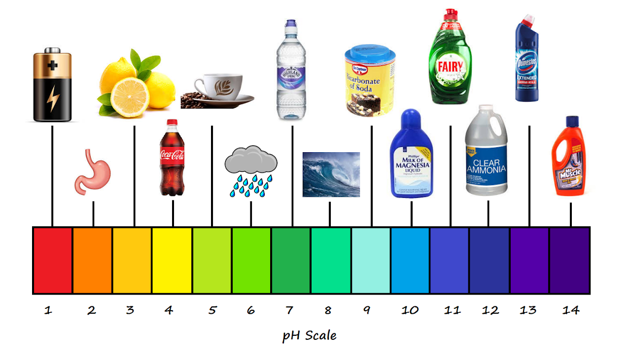
ACTIVITY 1 - ANSWERS

Slide 12
Lesson 2: Testing Everyday Substances Success Criteria
investigate and describe the pH of everyday substances.
write a report on the experiment.

Slide 13
Experiment 1: Testing Everyday Substances
Aim: To find the pH values of everyday substances and to classify them
as acidic, alkaline or neutral.
Procedure: Follow the instructions as detailed on the experiment card.

Slide 14
Raw Data (Results):
Processed Data:
Complete the last column in the table to classify each substance as acidic, alkaline or neutral.
Substance | Colour of Indicator | pH | Acidic/Alkaline/Neutral

Slide 15
Experiment Report
Write a brief report on the experiment using the following headings
Title: Testing Everyday Substances
Aim: To use universal indicator to test the pH of everyday substances.
Summary of Procedure: A brief sentence or diagram to describe how you carried out the experiment.
Raw Data: Your results table.
Processed data: Final Column of your Table
Conclusion: Identify substances as acids or bases

Slide 16
Lesson 3: Natural Indicators Success Criteria
prepare red cabbage indicator and use it to describe the pH of
everyday substances
write a report on the experiment.

Slide 17

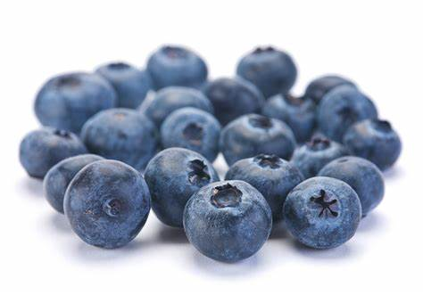
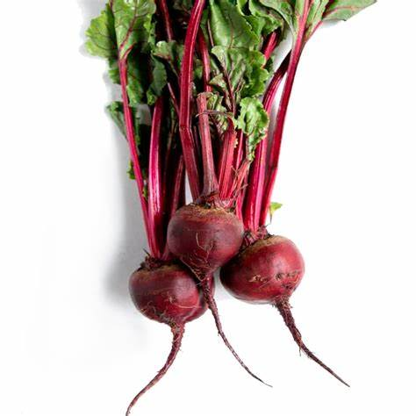

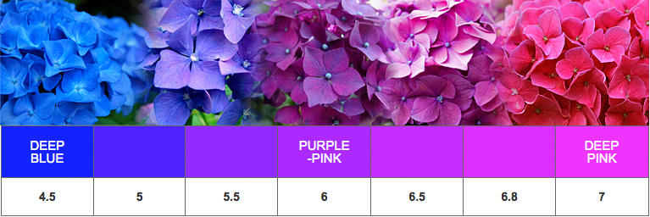
Natural Indicators
Nature has given us many plants that can be used to test the pH of
solutions. These include beetroot, blackberries, blueberries, geranium petals, onion, turmeric, rose petals, tea and red cabbage among a variety of others.
Hydrangea Flower Colours in Different Soil pH

Slide 18
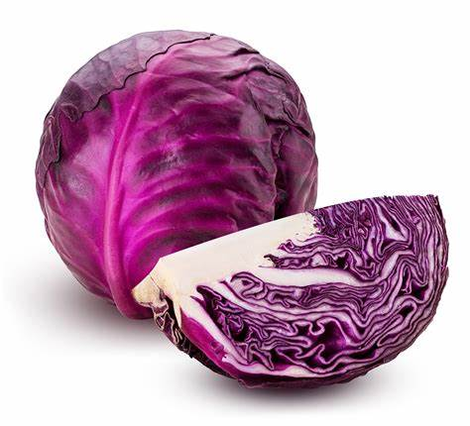
Red cabbage juice contains a natural pH indicator that changes colour depending on the acidity of the substance it is added to.
Red Cabbage Indicator
Colour | pH
red | 2
purple | 4
violet | 6
blue | 8
blue-green | 10
green-yellow | 12

Slide 19
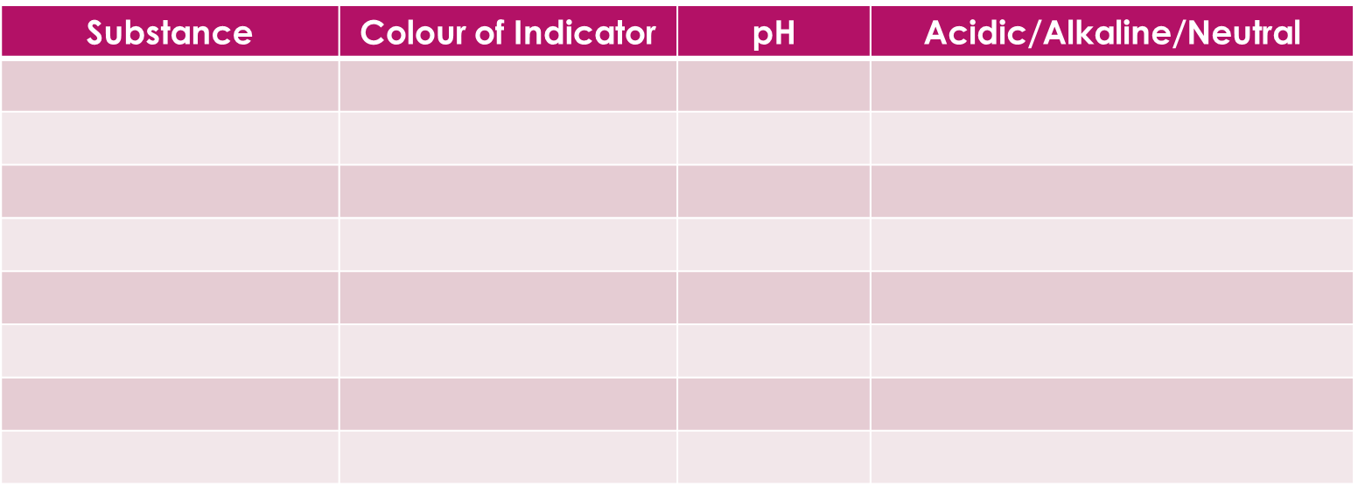
Experiment 2: Red Cabbage Indicator
Aim: To make an indicator from red cabbage and use it to determine
the pH of everyday substances.
Procedure: Follow the instructions as detailed on the experiment card.
Raw and Processed Data:

Slide 20
Experiment Report
Write a brief report on the experiment using the following headings
Title:
Aim:
Summary of Procedure:
Raw Data:
Processed data:
Conclusion:

Slide 21

DYW Spotlight on a Career
Textile Dyeing Technician
Mixing chemicals from plants to create dyes for fabrics and textiles. Researching to create the right colour, temperature and dyeing method.
Salary from £22,000 to £68,500 per year.
Working 37 – 40 hours per week (possibly on a shift system).
Entry Requirements: Degree/HNC/HND in subjects like chemistry,
  chemical engineering, colour science, physics
  OR a Modern Apprenticeship in Textile Manufacture
Skills required taking initiative, planning and development, analysing
      observation, working with numbers, problem solving…

Slide 22
Lesson 4: Investigating Indicators Success Criteria
investigate and describe the colour changes of different indicators when added to acids and bases

Slide 23
Investigating Indicators
pH Indicators are substances that change colour when they are added
to acidic or alkaline solutions. Universal indicator is commonly used but there are a number of other pH indicators including methyl orange, phenolphthalein and bromothymol blue.
Experiment 3: Investigating Indicators
Aim: To compare the colour changes of different indicators with acids and
alkalis.
Procedure: Follow the instructions as detailed on the experiment card.
Raw Data: Collect a copy of the results card and use coloured pencils to fill in the colours.
Glue this into your jotter.

Slide 24
Lessons 5 & 6: Neutralisation Success Criteria
investigate and describe what happens to the pH when an acid is added
to an alkali/base.
complete word equations to name the salts formed in an acid/alkali neutralisation reaction.

Slide 25
Acid-Base Reactions
A neutralisation reaction occurs when an acid reacts with a base (alkali).
During the neutralisation reaction, the pH of solution will move towards pH 7 (neutral).
Experiment 4: Acid/Alkali Neutralisation
Aim: To investigate what happen to the pH when an alkali is added to an
acid.
Procedure: Follow the instructions as detailed on the experiment card.
Raw Data: Record your results in an appropriate format.

Slide 26
Conclusion (Copy and complete)
When an alkali is added to an acid, the pH of the acid ___________ towards pH 7.
The pH of the alkali ___________ towards pH 7.
When an acid and alkali react together in a neutralisation reaction, they form a SALT and WATER.
General Word Equation
acid + alkali salt + water
REACTANTS PRODUCTS
Word Equation
hydrochloric acid + sodium hydroxide sodium chloride + water
The type of salt formed depends on the acid and alkali used in the reaction

Slide 27
Naming Salts
The salt formed depends on which acid and alkali have been used in the neutralisation reaction.
The first part of the salt name comes from the first (metal) part of the alkali
The second part of the salt name comes from the acid as shown below:
Name of Acid | 2nd part of the Salt Name
hydrochloric acid | chloride
nitric acid | nitrate
sulfuric acid | sulfate
ethanoic | ethanoate

Slide 28
Activity
Complete the following word equations as shown in the example below;
hydrochloric acid + sodium hydroxide sodium chloride + water
1.nitric acid + potassium hydroxide
2.sulfuric acid + calcium hydroxide
3.hydrochloric acid + lithium hydroxide

Slide 29
Activity Answers
Complete the following word equations as shown in the example below;
hydrochloric acid + sodium hydroxide sodium chloride + water
1.nitric acid + potassium hydroxide potassium nitrate + water
2.sulfuric acid + calcium hydroxide calcium sulfate + water
3.hydrochloric acid + lithium hydroxide lithium chloride + water

Slide 30
Lessons 7: pH in Everyday Life
research information on the significance of pH in everyday life.
produce a presentation to display the information.

Slide 31
Lessons 7: pH in Everyday Life
RESEARCH
Choose ONE of the following topics to research
  the effect of acids on human health
OR
  the effect of acids on the environment
  PRESENTATION
  Present the information in one of the following ways
  PowerPoint Presentation
  Poster
  Leaflet
  Video Clip
  Podcast

