Slide 1
Parent Video Meeting

Slide 2
Parent Video Meeting Parents Evening Booking System
Format of Parent Video Meeting – what to expect, timings/duration of each appointment/maximum number of appointments per young person
Login details/Booking Appointments
Support

Slide 3
Parent Video Meeting Information What to expect
Our aim is to hold our year group Parent Meetings as Parent/Teacher Video Meeting
Meetings will be booked online, and then held by video meeting rather than in-person at the school
Parents will be able to meet each of their child's teacher via scheduled video call meetings using the Parents Evening Booking System website
Parents can book 7 appointments per child
Two Parents can log in with different login details

Slide 4
Parent Video Meeting Information What to expect
Each appointment will last 4 minutes, throughout this time, you will be able to discuss your child's progress with each of their class teachers
There will be a 1 minute gap between each appointment stopping and the next starting
Visible timer on the screen that counts down
Teachers will be aware of time and will leave time for you to ask questions/respond to the report they have given before the appointment ends
Unlike a Teams meeting where we choose to press the leave meeting button when a meeting has ended, the meeting will stop automatically after 4 minutes

Slide 5
Login/Booking
We will send a letter/email to parents with a link to the Parents Evening Booking website address. This address is linked to our school
To log in to book, and access the parents evening on the night, parents will need to enter:
Their title (Mr/Mrs/Miss) and surname
Their child’s first name, surname and date of birth
The login details you enter must match those we have on record for you. If you have not alerted the school to any name changes, we will be expecting you to login with the details you gave us originally on your data check forms.
Once you have logged in, we suggest you use the 'Booking Wizard' to make your appointments, although a manual booking option (one booking at a time) also exists.

Slide 6
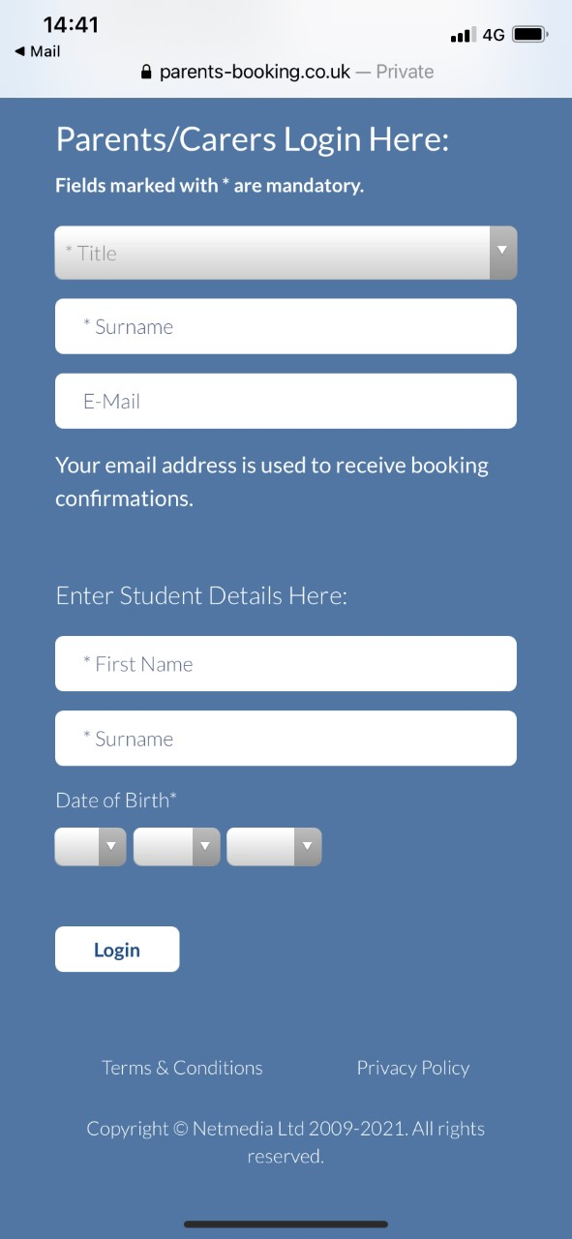
Parent Login

Slide 7
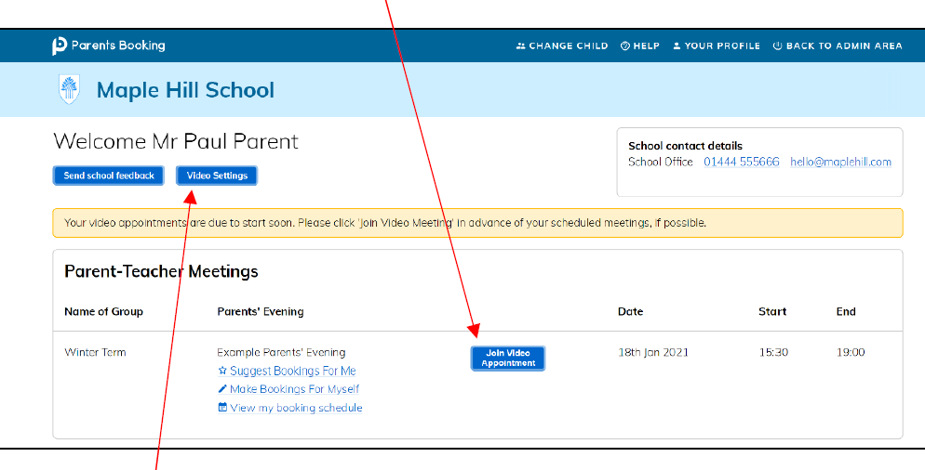

Slide 8
Login/Booking
After you have made your appointments you can choose to print or receive an e-mail confirmation of the bookings. The email also provides links to the website to edit the bookings and a link to the video meetings instruction guide.

Slide 9
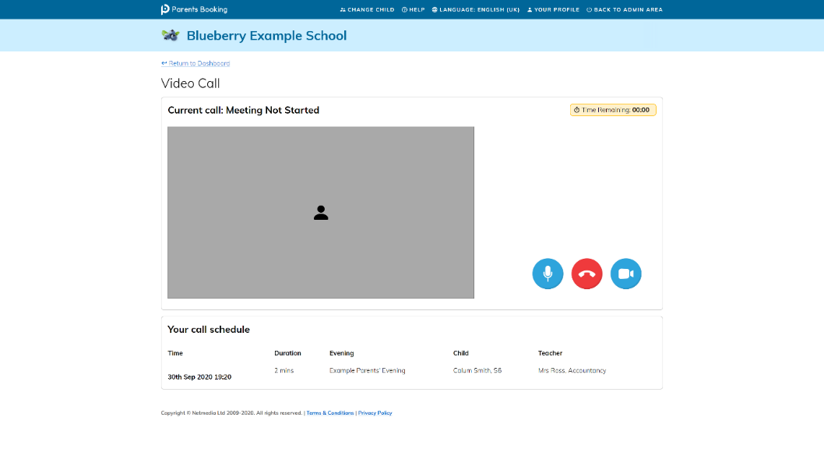
​
On the day of your appointments, you need to re-login at the website address Parents Evening Booking website address.
If you are early and click the “Join Video Appointment” button, you will be shown a “Meeting Not Started Yet” message, until the instant your appointment is due to begin.

Slide 10
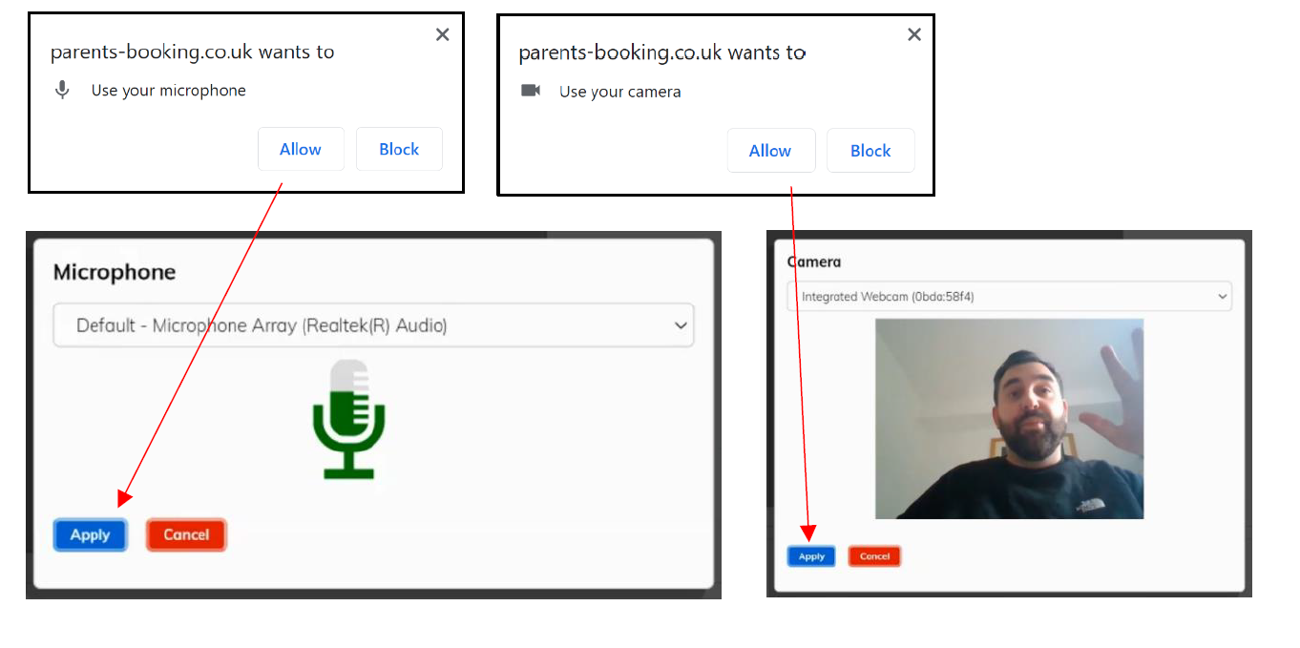
When the time of your first appointment starts, and provided the teacher is also ready for the meeting, your meeting will start. Before you can talk, you will need to provide permission to your internet browser to use its microphone and webcam. You will be asked for permission by your internet browser, and then shown a ‘pop-up’ that asks which microphone, and then which webcam, you want to use. Press ‘Allow’ and ‘Apply’ for all of these.

Slide 11
Once you have provided permission to the microphone and webcam, your video meeting will start. Appointments follow on automatically. Your schedule is shown at the bottom of the page. Once one appointment has finished the next will start instantly, and you do not need to change web page.

Slide 12
Internet Browser Compatibility
Internet Browser Compatibility:
You must use one of the below devices and internet browser combinations for the video meeting technology to work, this information will be included in the letter/email for booking:
Apple iPhone/iPad (iOS 11+): Safari
Android phone/tablet: Chrome or Firefox
Linux computer: Chrome or Firefox
Microsoft Surface: Chrome or Firefox
Mac computer: Safari, Chrome or Firefox
Windows computer: Chrome, Firefox or Edge (Chromium)

Slide 13
IT Support
To prevent errors connecting to the video meetings, we also recommend:
• Updating your internet browser to the latest version.
• Updating your Android / iOS software to the latest version.
o N.B. Apple iOS 14.3 had a bug that caused some audio distortion in video meetings.
• Make sure to close Teams, Zoom or any other software/apps which might have some measure of 'control' over your webcam/microphone before joining video meetings in Parents Booking.
• If you see a grey screen, where there should be a video of the other participant, during the time when your meeting should be taking place, this means your device/computer cannot 'connect' to the video meeting server. We recommend trying on a different internet connection (e.g. 3G/4G instead of Wi-Fi) to see if this makes a difference, and also trying a different internet browser or even a different device if required.

Slide 14
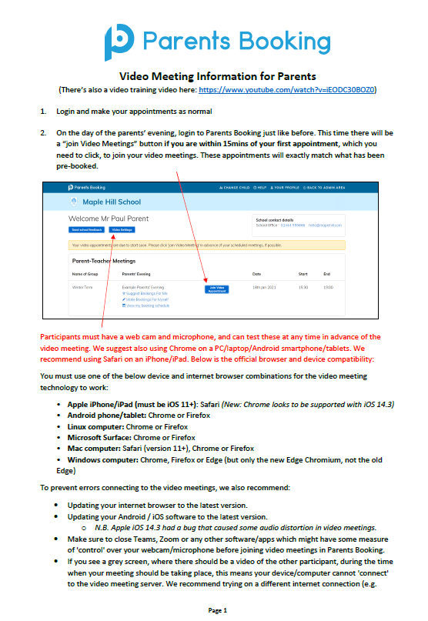
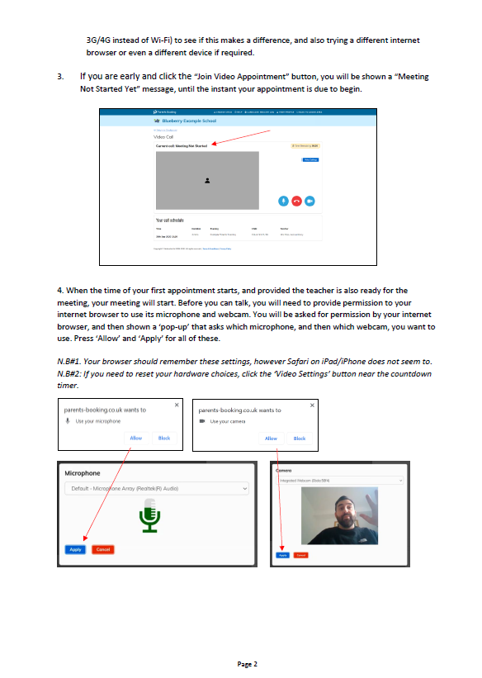
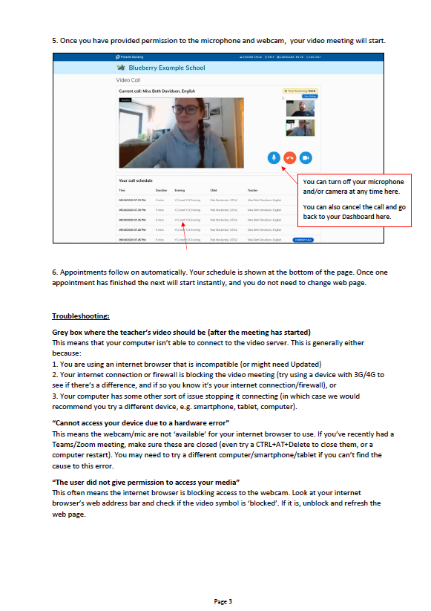

Slide 15
Support
On the night we will have ICT support from Mr McKay

Slide 16
Questions

