Slide 1
Preparing for my prelims
What resources will help me get ready?

Slide 2
Prelims
Prelims will take place from 28th November to 13th December
You have 23 days and only 16 school days (6th November)
Elements of Practical subjects may fall out with these times.

Slide 3
Why
Prelims give you a good idea of what to expect for your final exam.
It gives you an idea of what you are doing well and what your next steps are.
You will get helpful feedback from your teacher after your paper is marked.
If you are at risk of failing your teacher can recommend a level change so you don’t end up with nothing.

Slide 4
PRELIM TIMETABLE 28TH NOV-13TH DECEMBER 2024

Slide 5
PRELIM TIMETABLE 28TH NOV-13TH DECEMBER 2024

Slide 6
PRELIM TIMETABLE 28TH NOV-13TH DECEMBER 2024

Slide 7
PRELIMS AFTER CHRISTMAS

Slide 8
Supported Study
Many faculties in the school offer supported study session after school.
Your subject teachers should let you know about this, but the timetable is also available on the school website.
Sessions won’t always be with your usual class teacher, but you will still be welcome to attend.
This presentation will highlight other support you can access if your subject isn’t on the list.
Sign up for Supported Study will be sent out to parents/carers. You will need to indicate which sessions you intend to go to, and a register will be taken to monitor attendance
Scan QR Code for Timetable

Slide 9
How can I prepare – Supported Study Senior Phase – Cumbernauld Academy
FACULTY | Subject Offered | Level | Day | Start Time/Finish Time | Staff Member
Design | Graphic Communication | N5 | Tues | 3.45 - 4.45pm | Ms Oyler
Design | Design & Manufacture | N5 | Thurs | 3.45 - 4.45pm | Mr Henderson
Design | Design & Manufacture | Higher | Thurs | 3.45 - 4.45pm | Mr Henderson
Design | Graphic Communication | Higher | Thurs | 3.45 - 4.45pm | Mr Lucas
Design | Art & Design | N5 | Wed | 3.45 - 4.45pm | Miss Cree
Design | Art & Design | Higher | Wed | 3.45 - 4.45pm | Miss Cree
Design | Art & Design | N5 | Thurs | 3.45 - 4.45pm | Ms Farrow
Design | Art & Design | Higher | Thurs | 3.45 - 4.45pm | Ms Farrow
English | English | N4/N5/H | Mon | 3.45 -4.45pm | Mrs Passmore
Humanities | History | N5 | Tues | 4pm - 5pm | Mr Waddell & Mr Hodgman
Humanities | History | N5 | Tues | 3.45pm-4.45pm | Mr Reilly
Humanities | History | N5 | Thurs | 4pm - 5pm | Mr Waddell & Mr Hodgman
Humanities | History | Higher | Tues | 4pm - 5pm | Mr Waddell & Mr Hodgman
Humanities | History | Higher | Thurs | 4pm - 5pm | Mr Waddell & Mr Hodgman
Humanities | History | Higher | Wed | 3.45-4.45pm | Mr Reilly
Humanities | Modern Studies | N5 | Tues | 4pm - 5pm | Mrs Marshall & Mrs McGowan
Humanities | Modern Studies | N5 | Wed | 4pm - 5pm | Mrs Marshall & Mrs McGowan
Humanities | Modern Studies | N5 | Wed | 4pm - 5pm | Mrs Marshall & Mrs McGowan
Humanities | Modern Studies | Higher | Tues | 4pm - 5pm | Mrs Marshall & Mrs McGowan
Humanities | Modern Studies | Higher | Wed | 4pm - 5pm | Mrs Marshall & Mrs McGowan
Humanities | Geography | N5 /Higher | Mon & Thurs | 4pm - 5pm | Mrs Murray
Humanities | Psychology | Higher | Thurs | 3.45-4.45pm | Mrs Marshall
Maths | N5 Maths & N5 AppsMaths | N5 | Mon | 3.45-4.45pm | Miss Waterson

Slide 10
How can I prepare – Supported Study
Maths | All Senior Maths Levels | N5/Higher | Wed | 3.45-4.45pm | Mr Gibson and Mrs McArthur
Maths | All Senior Maths Levels | N5/Higher | Tues | 3.45-4.45pm | Mr Krausen
Mod Lang,Bus&Admin IT | Admin and IT | N5 | Mon | 3.45 - 4.45pm | Miss McGarry
Mod Lang,Bus&Admin IT | Admin and IT | Higher | Mon | 3.45- 4.55pm | Miss McGarry
Mod Lang,Bus&Admin IT | Spanish | N5 | Mon | 12.45 - 1.15pm | Mrs O'Neill
Mod Lang,Bus&Admin IT | French | N5 | Wed | 3.45 - 4.45pm | Ms Hamilton
Mod Lang,Bus&Admin IT | Spanish | Higher | Mon | 3:45-4:45pm | Mr O'Neill
Mod Lang,Bus&Admin IT | French | N5 | Mon | 3.45 - 4.45pm | Miss Small
Mod Lang,Bus&Admin IT | French | Higher | Tues | 3.45-4.45pm | Mrs O'Neill
Performance | PE | N5 | Mon | 4-5pm | Miss Quinn
Performance | PE | Higher | Mon | 4-5pm | Mr Parker
Performance | Music technology | N5 | Wed | 12.40-1.15pm | Mr Phillips
Performance | Music technology | Higher | Wed | 12.40-1.15pm | Mr Phillips
Science & Computing | Physics | N5/Higher | Tues | 3.45 - 4.45pm | Miss Bear
Science & Computing | Physics | N5/Higher | Mon | 3.45 - 4.45pm | Miss Bear
Science & Computing | Chemistry | N5 | Mon | 3.45 - 4.45pm | Miss McPhail
Science & Computing | Chemistry | Higher | Mon | 3.45 - 4.45pm | Mrs MacPhail
Science & Computing | Biology | N5 | Wed | 3.45 - 4.45pm | Mrs Beaton
Science & Computing | Biology | Higher | Wed | 3.45 - 4.45pm | Mrs Beaton
Science & Computing | Biology | N5 | Thurs | 3.45 - 4.45pm | Mrs Martin
Science & Computing | Biology | Higher | Thurs | 3.45 - 4.45pm | Mrs Martin
Science & Computing | Chemistry | N5 | Thurs | 3.45 - 4.45pm | Mr Cupples
Science & Computing | Chemistry | Higher | Thurs | 3.45 - 4.45pm | Mr Cupples
Science & Computing | Biology | N5 | Wed | 3.45 - 4.45pm | Miss Gartshore
Science & Computing | Biology | Higher | Wed | 3.45 - 4.45pm | Miss Gartshore

Slide 11
Online resources
There is a lot available online to help you prepare and revise.
These resources can also help you catch up with work you may have missed through absence.
At the end of this presentation there is a link to a document with lots of subject specific help which will be updated as we go along.

Slide 12
BBC Bitesize
BBC Bitesize online has lots of resources for pupils of all levels.
If you create an account, you can add all the subjects that are relevant for you.
Each subject has clearly labelled sections with units broken down. This means if you miss any lessons, it is a good resource for catch up.

Slide 13
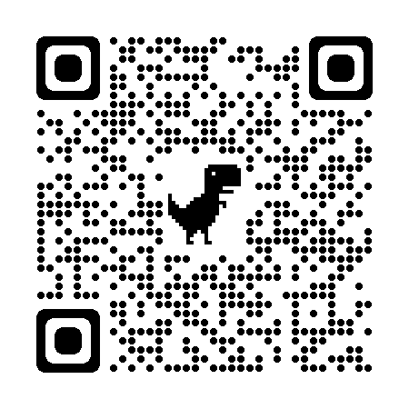
How can I prepare - BBC Bitesize https://www.bbc.co.uk/bitesize/secondary

Slide 14
Achieve
Mr Cairns has purchased a licence for you all to access the ‘achieve’ website.
You can use it to learn, revise and do quizzes.
Some teachers may choose to set you task on it
You can use it even if your teacher hasn’t set tasks

Slide 15
How can I prepare – Achieve https://achieve.hashtag-learning.co.uk/user-start/?next=/
Sign up using the school code:
Zeis9rdX

Slide 17
Scholar
Scholar is an e-learning tool provided by Heriott Watt University. They offer online courses for 42 subjects.
Scholar is highly regarded and worth a look.

Slide 18
How can I prepare – SCHOLAR https://scholar.hw.ac.uk/
You should be able to sign in to scholar using your glow username and password.

Slide 20
SQA Website
On the SQA website you can access recent past papers for every subject at every level
You can also access the marking scheme for each paper
For many subjects you will see a pattern in what is asked that may help you prioritise your studying
You can then create model answers to revise for those commonly asked things.

Slide 21
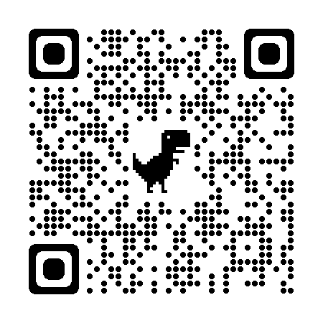
How can I prepare – SQA Website www.sqa.org.uk/pastpapers/findpastpaper.htm

Slide 22
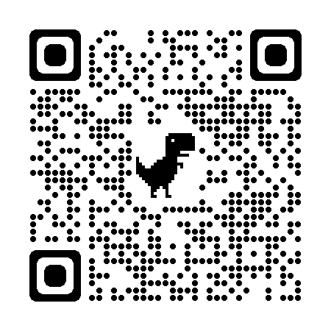
E-Sgoil
E-sgoil is an online supported study offer available to everyone.
If you register, you can sign up for webinars and access resources to help you study.
There are fifty-one weekly evening Study Support webinars during term time, covering a wide range of subjects and levels. Study Support is for Senior Phase learners who are working towards National Qualifications.

Slide 23
E-sgoil https://www.e-sgoil.com/senior-phase/study-support/

Slide 25
Subject Specific Websites

