Slide 3
S1 – S3 BGE Progression Pathways in HUMANITIES 2024 – 2025
S1
S2
S3
National 3
Modern Studies
History
Geography
People & Society
Level 2
Modern Studies
History
Geography
Level 2 or below
BGE Humanities
Level 2
Modern Studies
History
Geography
Level 3 (Not on Track)
Modern Studies
History
Geography
National 3
Modern Studies
History
Geography
People & Society
Level 3
Modern Studies
History
Geography
Level 3 (Inconsistent)
Modern Studies
History
Geography
Level 2
BGE Humanities
National 4
Modern Studies
History
Geography
People & Society
Level 3 (Requires Challenge/On Track)
Modern Studies
History
Geography
Level 3
Modern Studies
History
Geography
Level 2/3
BGE Humanities
National 5
Modern Studies
History
Geography
Level 4 (Requires Challenge/On Track)
Modern Studies
History
Geography

Slide 4
S4 – S6 Progression Pathways in HUMANITIES 2024 – 2025
S4
S5
S6
Beyond S6
NPA in Criminology at SCQF Level 5
National 5
Modern Studies
History
Geography
NC in Social Sciences at SCQF Level 6
College
NPA in Criminology SCQF Level 6
College
National 3
Modern Studies
History
Geography
People & Society
National 4
Modern Studies
History
Geography
People & Society
NPA in Criminology at SCQF Level 5
National 5
Modern Studies
History
Geography
NPA in Criminology at SCQF Level 6
National 4
Modern Studies
History
Geography
People & Society
University or College or
Employment
Higher
History
Modern Studies
Geography
Politics
RMPS
Psychology
National 5
Modern Studies
History
Geography
Higher
Modern Studies
History
Geography
Higher & AH
Modern Studies AH
History AH
Geography
Politics
RMPS
Psychology
University or College or
Employment

Slide 6
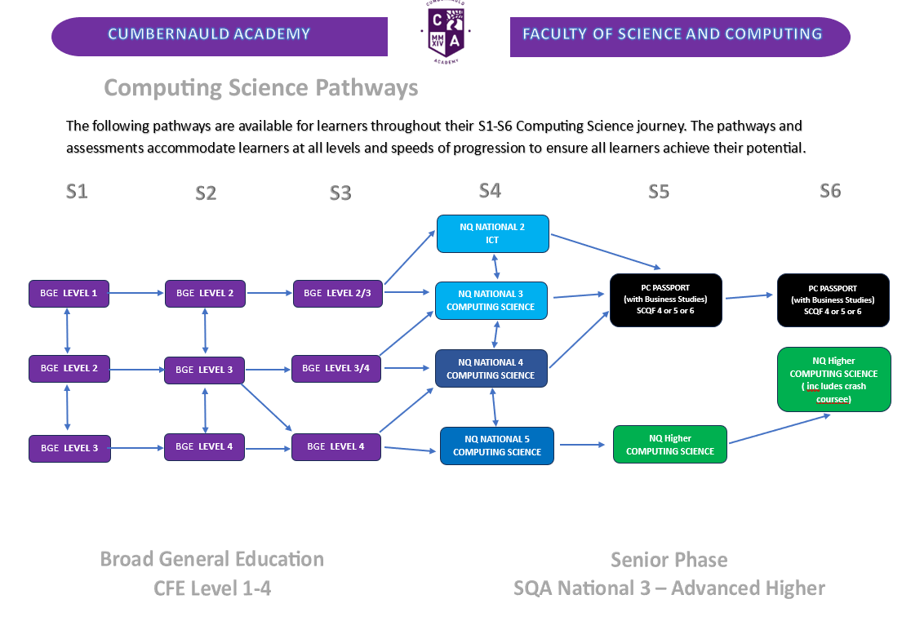

Slide 7
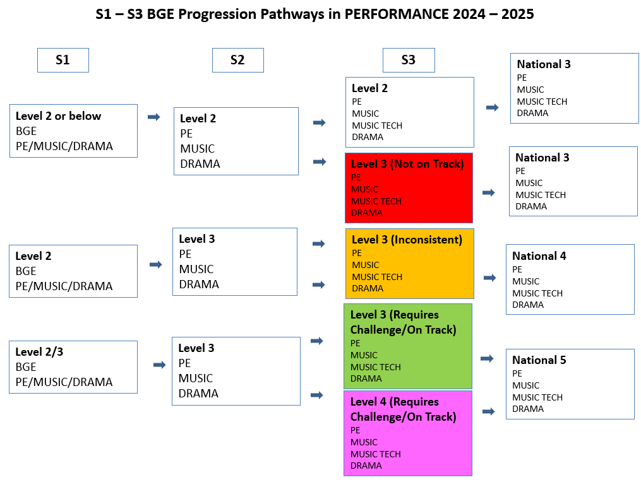

Slide 8
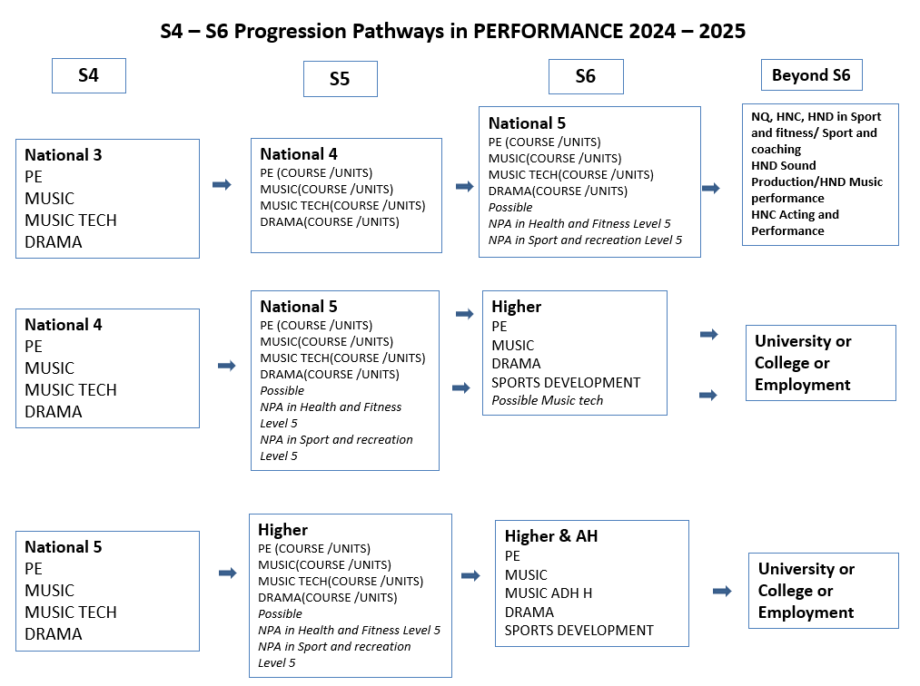

Slide 9
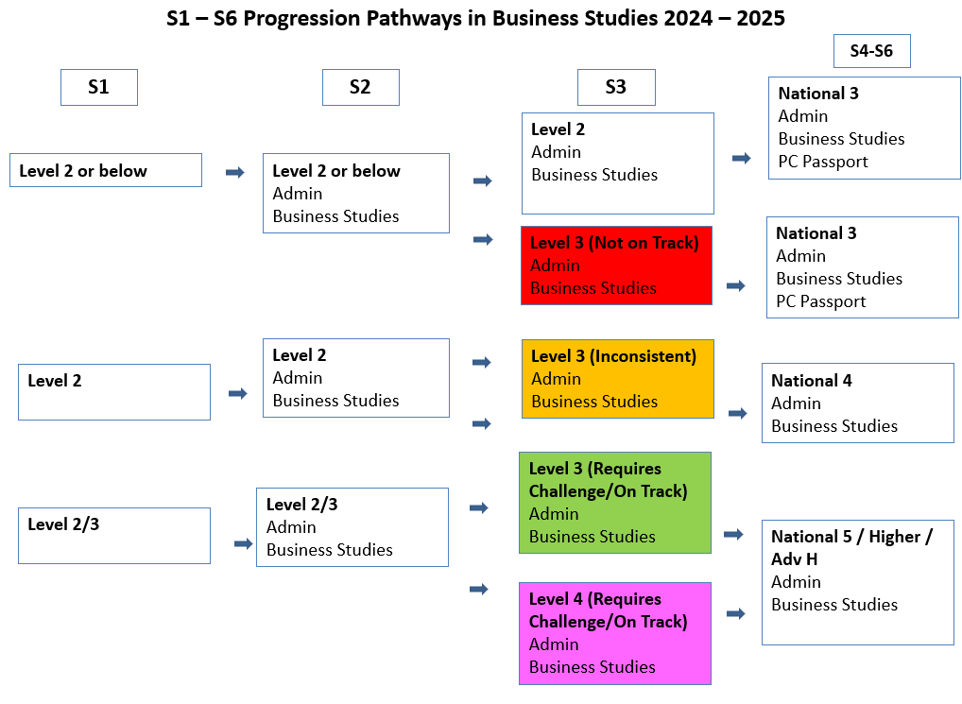

Slide 10
