Slide 1

CUMBERNAULD ACADEMY ASSEMBLY
JUNE 2022
Notes:
Design tech languages

Slide 2
Young People at Cumbernauld Academy are…
Respectful
Ready to Learn
Hard working
Wears appropriate uniform
Attend
Proud of their environment
On time
Notes:
Design tech languages

Slide 3
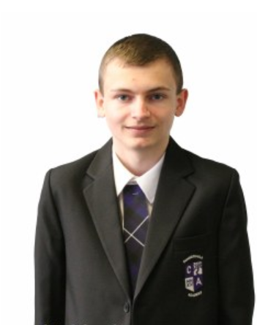
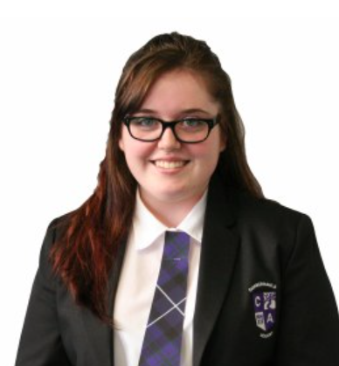
Uniform
School Blazer
White shirt with collar
School tie
Black school trouser or skirt
Plain black footwear
PE Uniform
Plain black T shirt and shorts ¾ length leggings or short
Appropriate change of footwear

Slide 4
Unacceptable Uniform
Jeans or jean like materials of any kind Denim jackets
Leggings, jeggings or footless tights Baseball caps
Combat trousers or other wide baggy trousers Hooded tops
Tracksuit bottoms or tops

Slide 5
Attendance
90% attendance = half a day missed every week.
90% attendance in one school year = 4 whole weeks of lessons missed in that year.
90% attendance over 5 years of secondary school = half a year of school missed.
Notes:
Design tech languages

Slide 6
Latecoming
School starts at 8:55
You are expected to be at school for the start of the school day
No hanging about the gates (morning, interval or lunchtime)

Slide 7
Ready to learn
Every young person in Cumbernauld Academy has the right to a quality education
You can not get a good education if you are not in class
All pupils must be in class all of the time
Unless you have an arranged appointment with
    Pupil Support/SMT/SfL
    Jacqueline
    Counsellor
    PC Mackie
    Careers Advisor
    Music Instructor
    Teaching Staff

Slide 8
Toilets
Toilets should only be accessed at Break and Lunchtime
  Unless you have permission by a member of staff or have been issued a Toilet Pass by Pupil Support
It is your responsibility to go to the Toilet during these times
You should not wait until the bell goes at the end of Interval and Lunchtime

Slide 9
Behaviour
We are a school which values respect for EVERYONE
Poor behaviour towards each other and staff within the school is unacceptable.
No one should be out of class and wandering the corridors – staff will be monitoring pupils out of class
Time out card – you must report to Pupil Support or SMT

Slide 10
Moving around the school
Library – Not in use during Class Time (unless with a teacher) or Break and Lunchtime
Accessing Lockers – 5 minutes at the start of Interval and Lunch
No access to Lockers at any other time
Dining Hall – Tidy up your rubbish
Yard and Pitches – Behaviour towards your peers and staff
Gates – No congregating at the Gates during Interval and Lunch

Slide 11
How does all this link in with reward system?
Relaunch of Rewards System
Merit Score – A Merit will be worth +1 point, and a Demerit worth -1 point.
Attendance – Instead of a certain percentage putting you ‘Off Track’, various percentages will be awarded different points.
Timekeeping – Being late in the morning, after lunch or being late to class between periods will be worth -1 points.

Slide 12






Merits
IMPROVEMENT
EXCELLENCE
CITIZENSHIP
RESILIENCE
TARGET
WEEKLY COOPERATION

Slide 13





deMerits
NO HOMEWORK
LACK OF EFFORT
POOR-COOPERATION
DISRUPTIVE
LATE TO CLASS

Slide 14

Notes:
Design tech languages

