Slide 1


Slide 2


Hello Parents/Carers
Our LGBTQ+ Pupil Parliament Committee have been working hard over the past year and wanted to share our success with you.
We are so very close to gaining out Gold Charter Award from LGBTYS.
This will make us the 2nd school in North Lanarkshire Council to get this award.

Slide 3
Here is a tiny snippet of the work we have been up to…

Slide 4
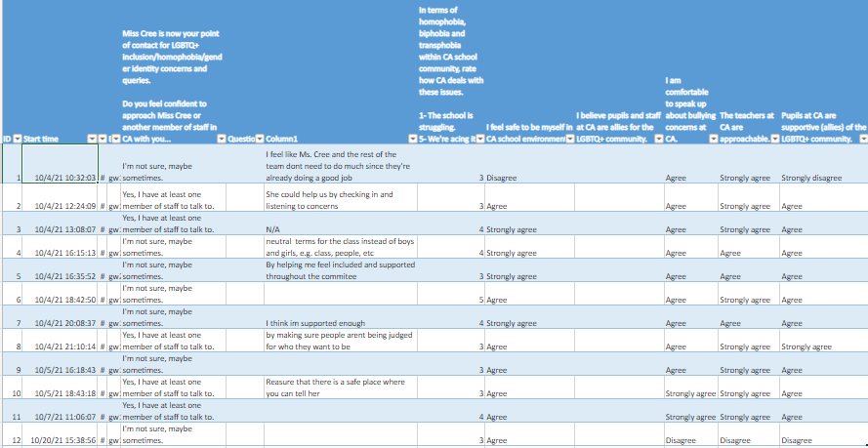
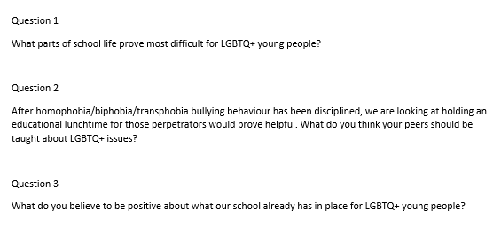
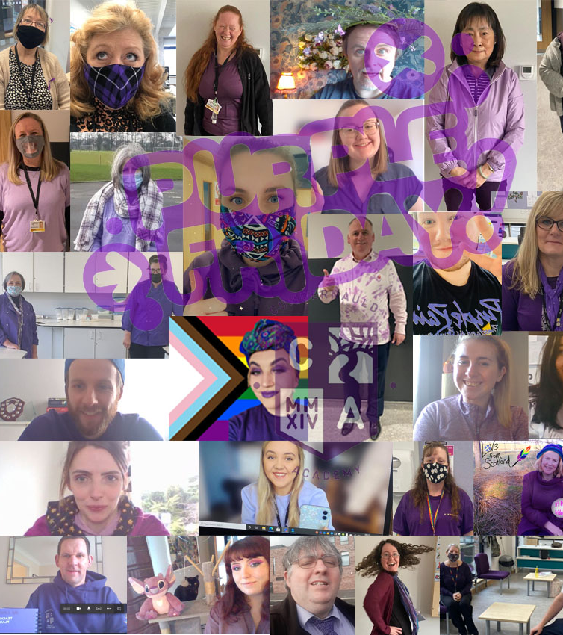

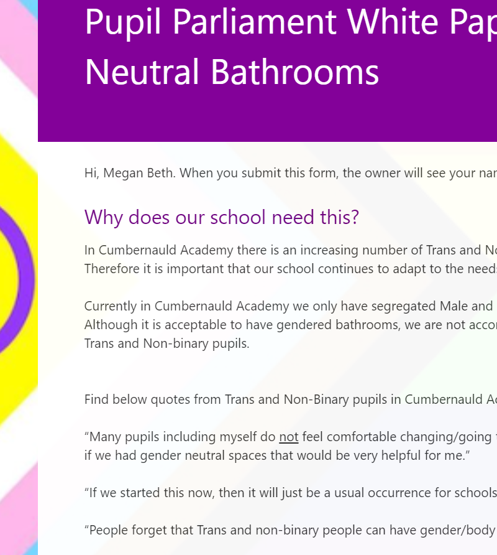
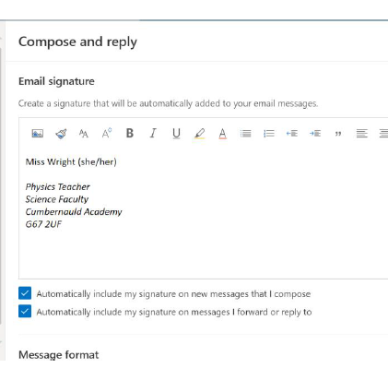
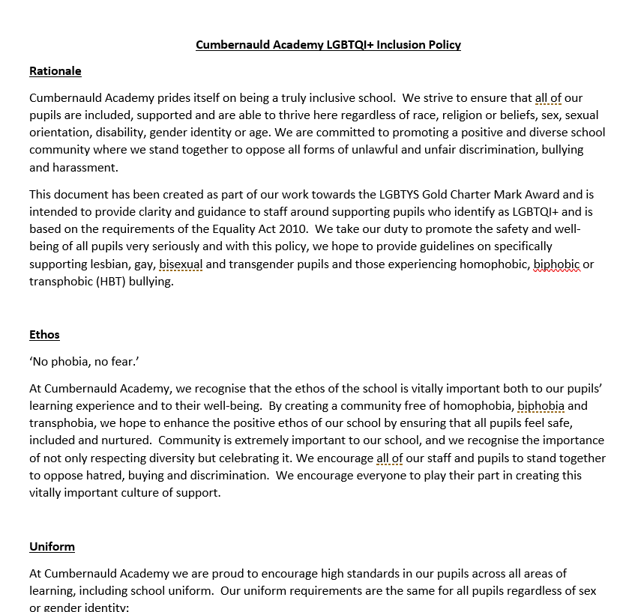

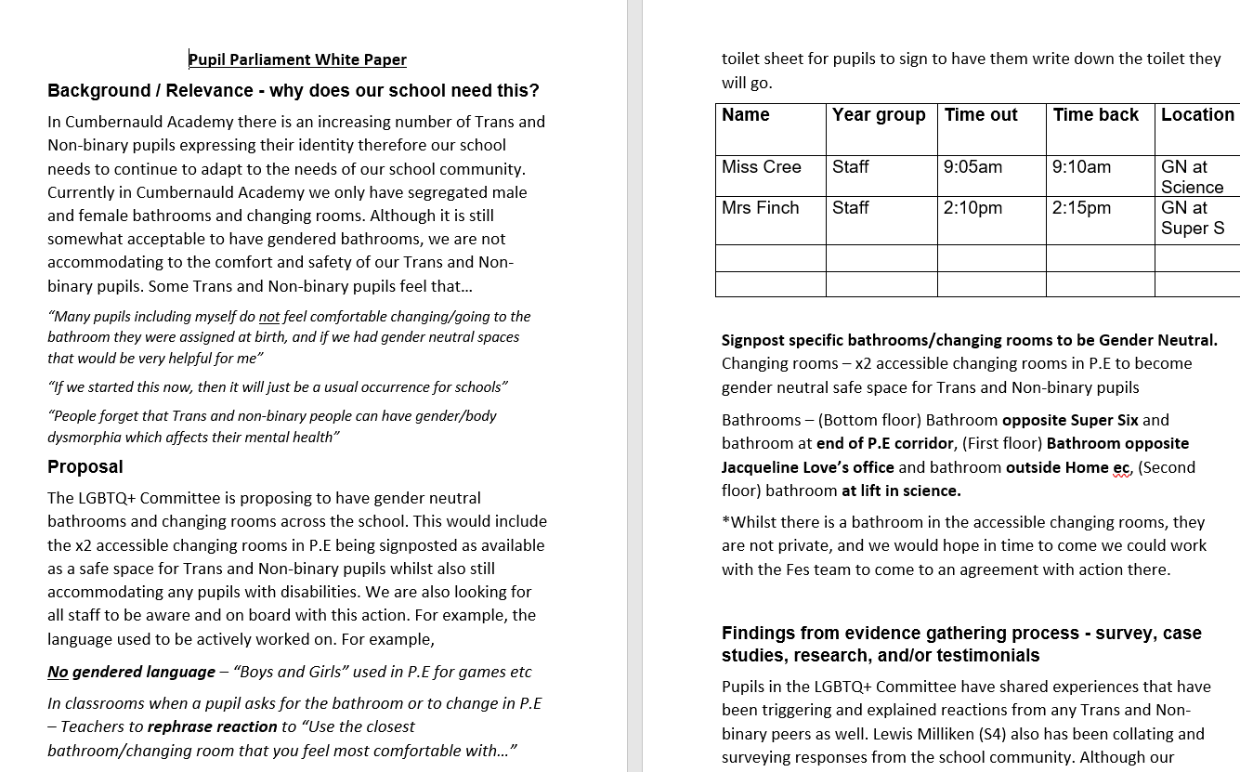

Survey of what support LGBTQ+ Pupils have already
LGBTQ+ Committee pupil survey on what they need from their school
Purple Friday 2021
Our school pledge
Our guide to change email signature to include pronoun for staff
Our LGBTQ+ Policy complete
Pride picnic 2021
Pupil parliament survey on gender neutral bathrooms/changing rooms
Our first door sign made for gender neutral bathroom/changing rooms
Our white paper for Parliament

Slide 5
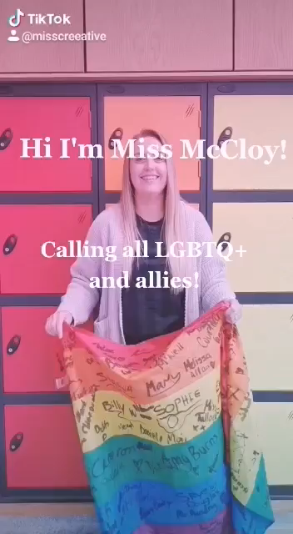
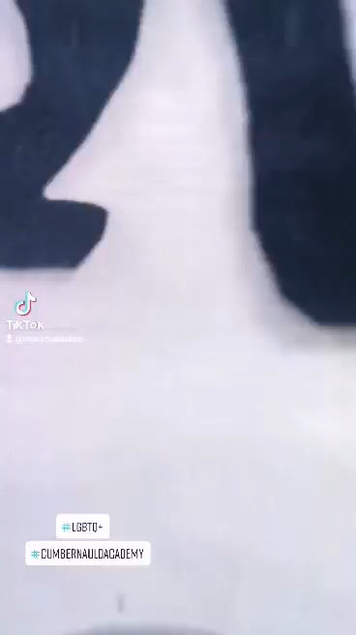
CA Staff LGBT+ Working group… ->
Encouraging engagement for our LGBT Pupil Parliament committee <-
Head to @misscreeative for more fun TikToks

