Slide 1

Cumbernauld Academy
S2 INTO S3 OPTION Information march 2022

Slide 2
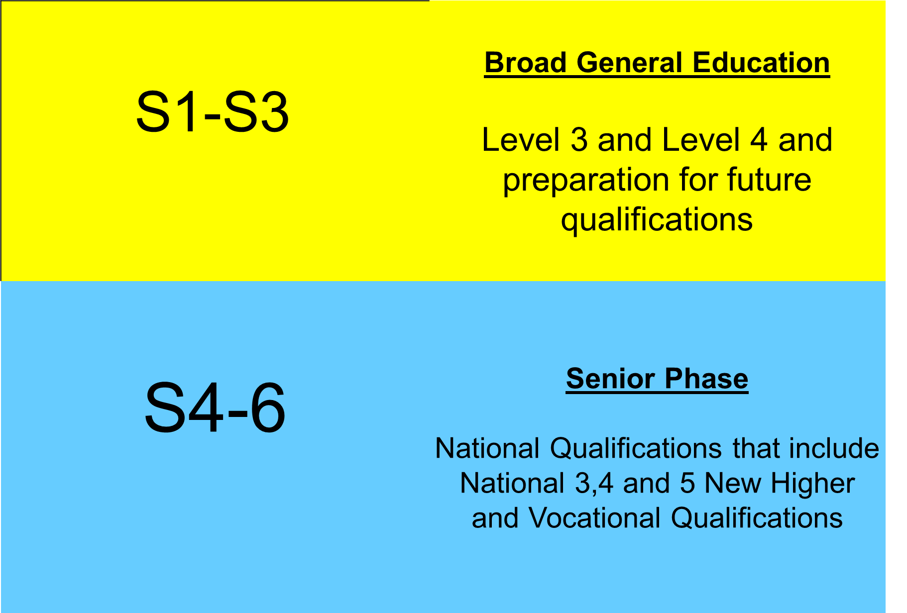
Curriculum for Excellence

Slide 3
BGE Curriculum Areas
Expressive Arts
Languages and Literacy
Mathematics and Numeracy
Religious and Moral Education
Sciences
Social Studies
Technologies
All of the above areas are underpinned by Literacy, Numeracy and Health and Wellbeing

Slide 4
S3 Curriculum Structure – March 2022
Languages And Literacy | Mathematics And Numeracy | Languages And Literacy | Sciences | Social Subjects | Technologies | Expressive Arts | Health and Wellbeing | Religious & Moral Education | Personal Choice 1 | Personal Choice 2
4 Periods | 4 Periods | 3 Periods | 3 Periods | 3 Periods | 3 Periods | 3 Periods | 2 Periods | 1 Periods | 3 Periods | 3 Periods
This model allows all students the opportunity to choose from subjects across all areas of the curriculum thus retaining a good breadth of curriculum and allows for a degree of personalisation through the options in the last two columns.
In addition it provides the opportunity to deepen learning in all of these areas before a further choice is made in S4.
Notes:
Calculation based on Average tariff point. Take total number of tariff points and divide by number of students. At that level. How well did the students do that were presented? We don’t have the largest number taking AH but 5th best in NLC is very good

Slide 5
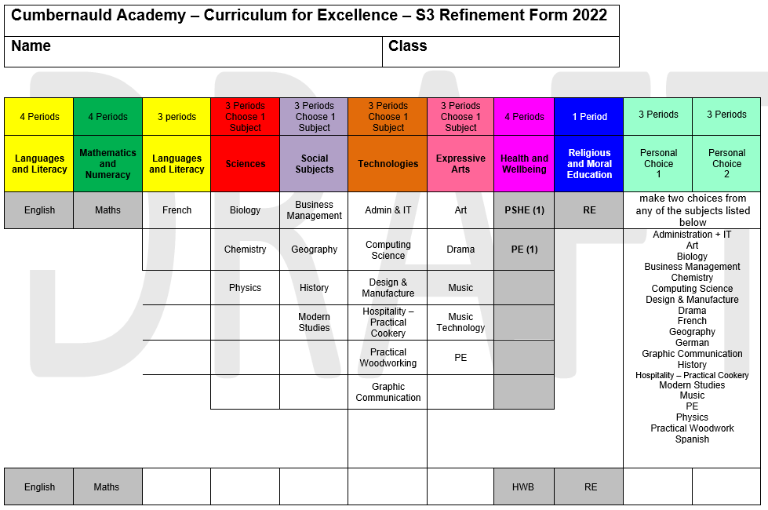

Slide 6
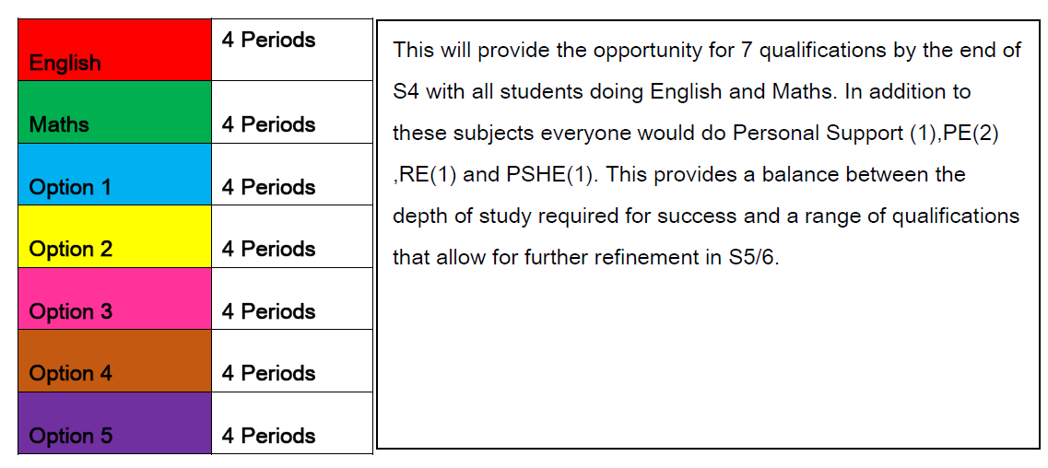
Senior Phase – S4 The following Session
Notes:
Very creditable performance. 6 students got 5As or better
Amy Keys got 6As, got 5As and a B, Cira Bowen , Emma Brown

Slide 7
National Qualifications
Curriculum for Excellence
National 3
National 4
National 5
New Higher
New Advanced Higher

Slide 8

School Partnerships
Student
Encouragement
and Support
Learning & Teaching
and supported study
Parental Support
Effective communication
School Support

Slide 9
Option Interviews S2 into S3
Options interview week beginning 7th March

Slide 10



Communication@ CA
aPP
tWITTER
WEBSITE
https://blogs.glowscotland.org.uk/nl/CAcad/
@cumbernauldacad

