Slide 1

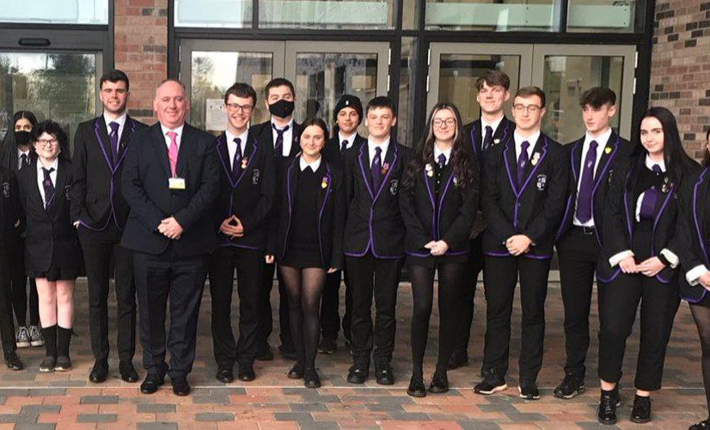
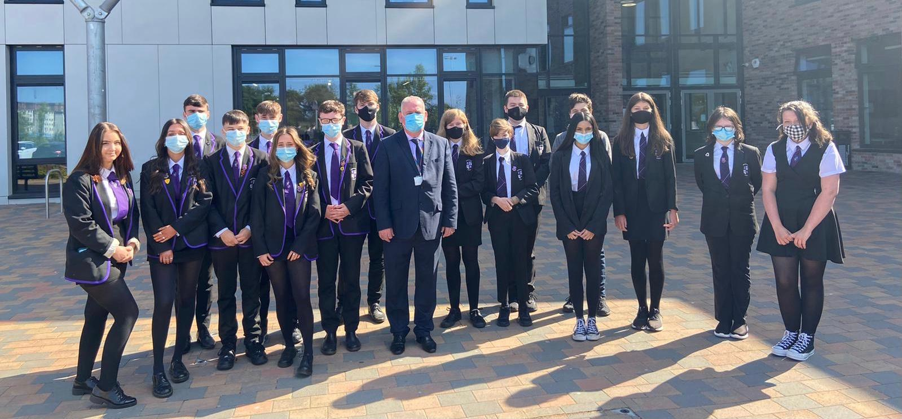
CA PUPIL PARLIAMENT
YOUR SCHOOL NEEDS YOU!

Slide 2
Why join our Pupil Parliament?
Here is what we got up to in year 1!
https://www.youtube.com/watch?v=CYLpSWSxwCM&feature=youtu.be
Have your say about issues that you care about.
Being involved in something that feels really important to our school community.
Develop your confidence and communication skills.
Having your voice, (and the voice of others) heard by Mr Cairns.
Grab yourself a leadership position, which will also help develop your CV/UCAS etc.
Have a look at what we got up to last year, from the pupils who were involved:

Slide 3


Join our Pupil Parliament!
Choose ONE committee on Microsoft Teams:
  Health and Wellbeing (CODE – jimcnx3)
  Sustainability (CODE – xusp7ys)
  Equalities (CODE – bd13k3f)
  Community (CODE – h90exca)
  LGBTQ+ (CODE – dis61c2)
For more info:
  follow us on Twitter @CAStudentVoice
  OR
  see Mrs Marshall Room F065.

Slide 4




A word from the Health and Wellbeing Committee:
Our aim is to support young people in Cumbernauld Academy with their physical and mental wellbeing.
We aim to do this by….
Supporting the extra curricular clubs on offer at CA, find out what students want to happen and try to include these clubs
Supporting the work of the school’s Mental Health Ambassadors
Organising whole school events, charity fundraisers and interhouse competitions for all pupils & staff

Slide 5

Passionate about the Environment?
The Sustainability Committee needs you!
We aim to improve things such as recycling/reducing waste, enhancing the school environment and doing our bit for climate change to making our stay here more eco-friendly (sustainable)
Join us on Teams using Code xusp7ys
Or see Mrs Murray / Miss Small / Mr McNamara or Miss Motaghian

