Slide 1
Cumbernauld Academy
S3 INTO S4 OPTION Information Assembly
Wednesday 17th February 2021

Slide 2
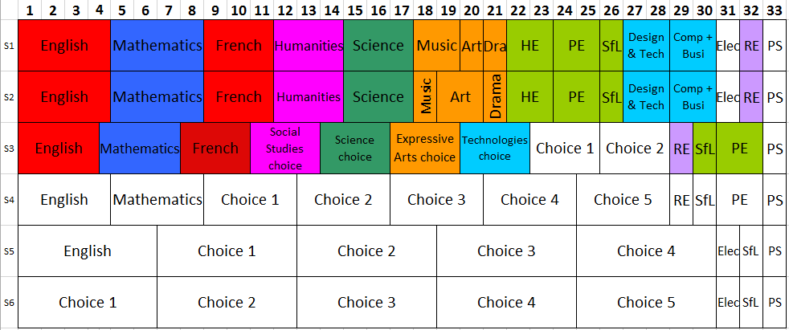
Curriculum Structure – August 2021

Slide 3
How will we allocate the time?
English | Maths | Option 1 | Option 2 | Option 3 | Option 4 | Option 5
4 Periods N3/4/5 | 4 Periods N3/4/5 | 4 Periods N3/4/5 | 4 Periods N3/4/5 | 4 Periods N3/4/5 | 4 Periods N3/4/5 | 4 Periods N3/4/5
This will provide the opportunity for a total of 7 qualifications by the end of S4 with all students undertaking English, Maths and 5 other subjects. In addition to this all pupils will undertake 1 period of RE, 1 period of Skills for Life, 1 period of Personal Support and 2 periods of Core PE. This provides a balance between depth of study required for success and a range of qualifications.
Pupil Option Interviews: w/b 8/03/21

Slide 4
S3 into S4 Options - Planning
You were asked to complete a Google Form explaining your ideal choices for S4.
The responses from this form generated 132 replies, and this information has been entered in our system to generate the ‘Best-Fit’ Option form for your year group.
Some pupils responded twice, so the last data entered was put in for them.
We are currently working on finalising this form and hope to have it ready for the end of the week. If you have not completed the Form yet it can still be completed for data to be collected. The deadline would be for the end of Thursday 18th February.

Slide 5
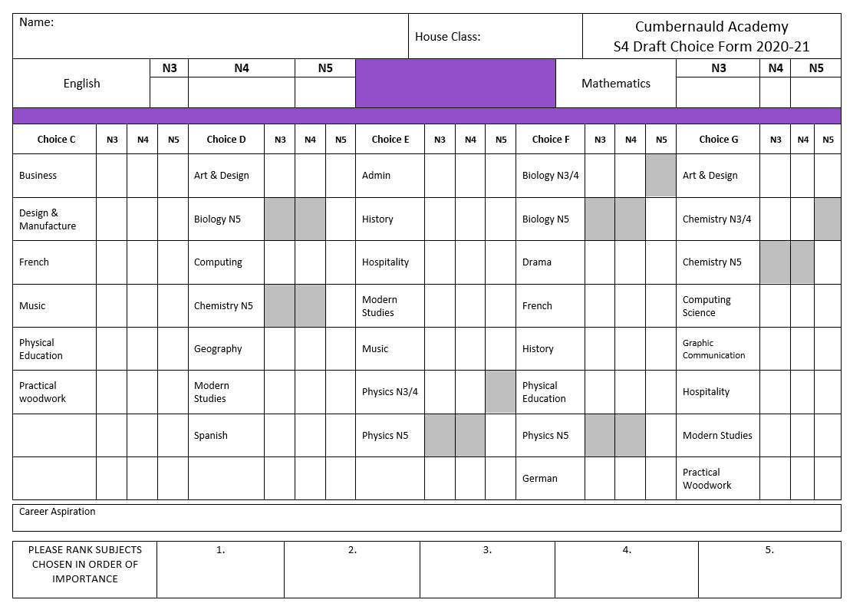
The Option Form for last year was….

Slide 6
National Qualifications
Curriculum for Excellence
National 3
National 4
National 5
New Higher
New Advanced Higher

Slide 7
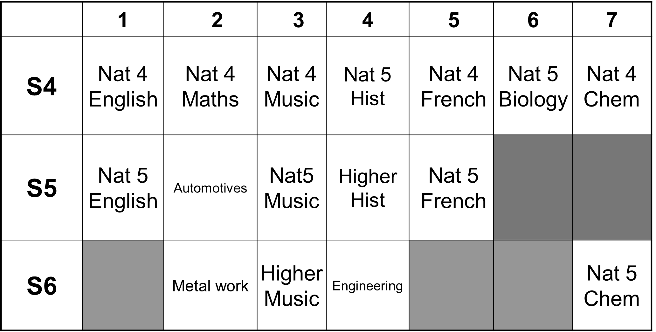
Possible Achievement Pathway – Apprenticeship

Slide 8
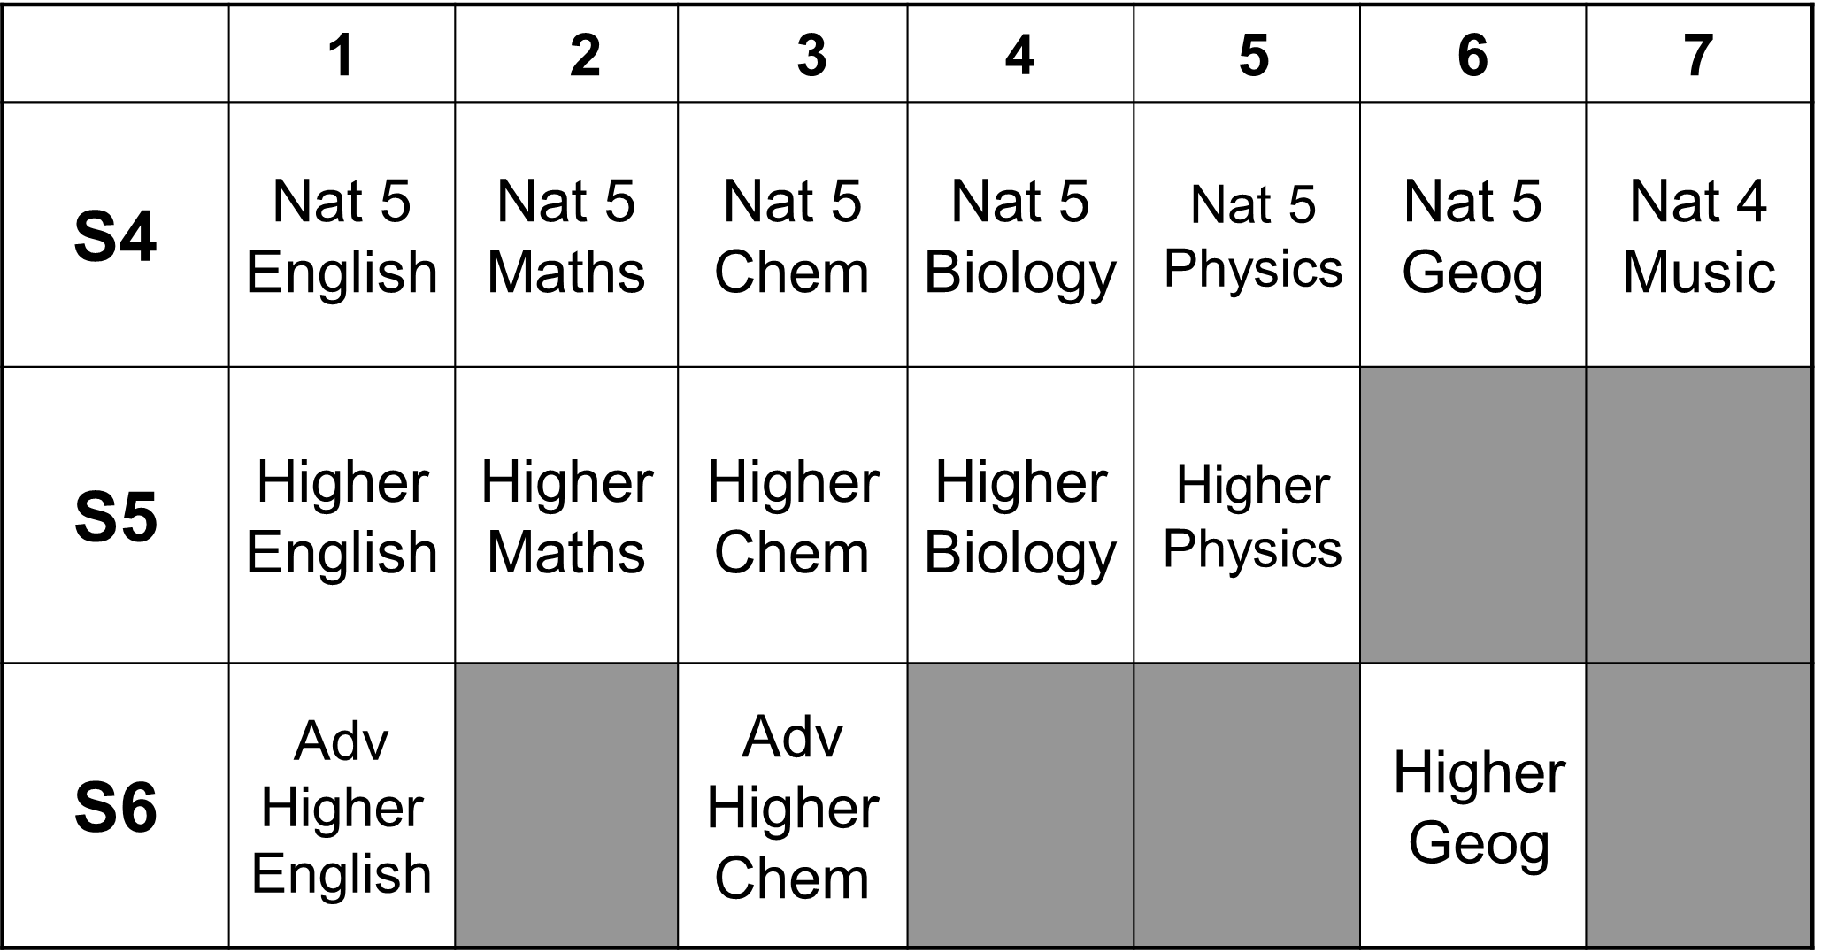
Possible Achievement Pathway – Hopes of Medicine?

Slide 9
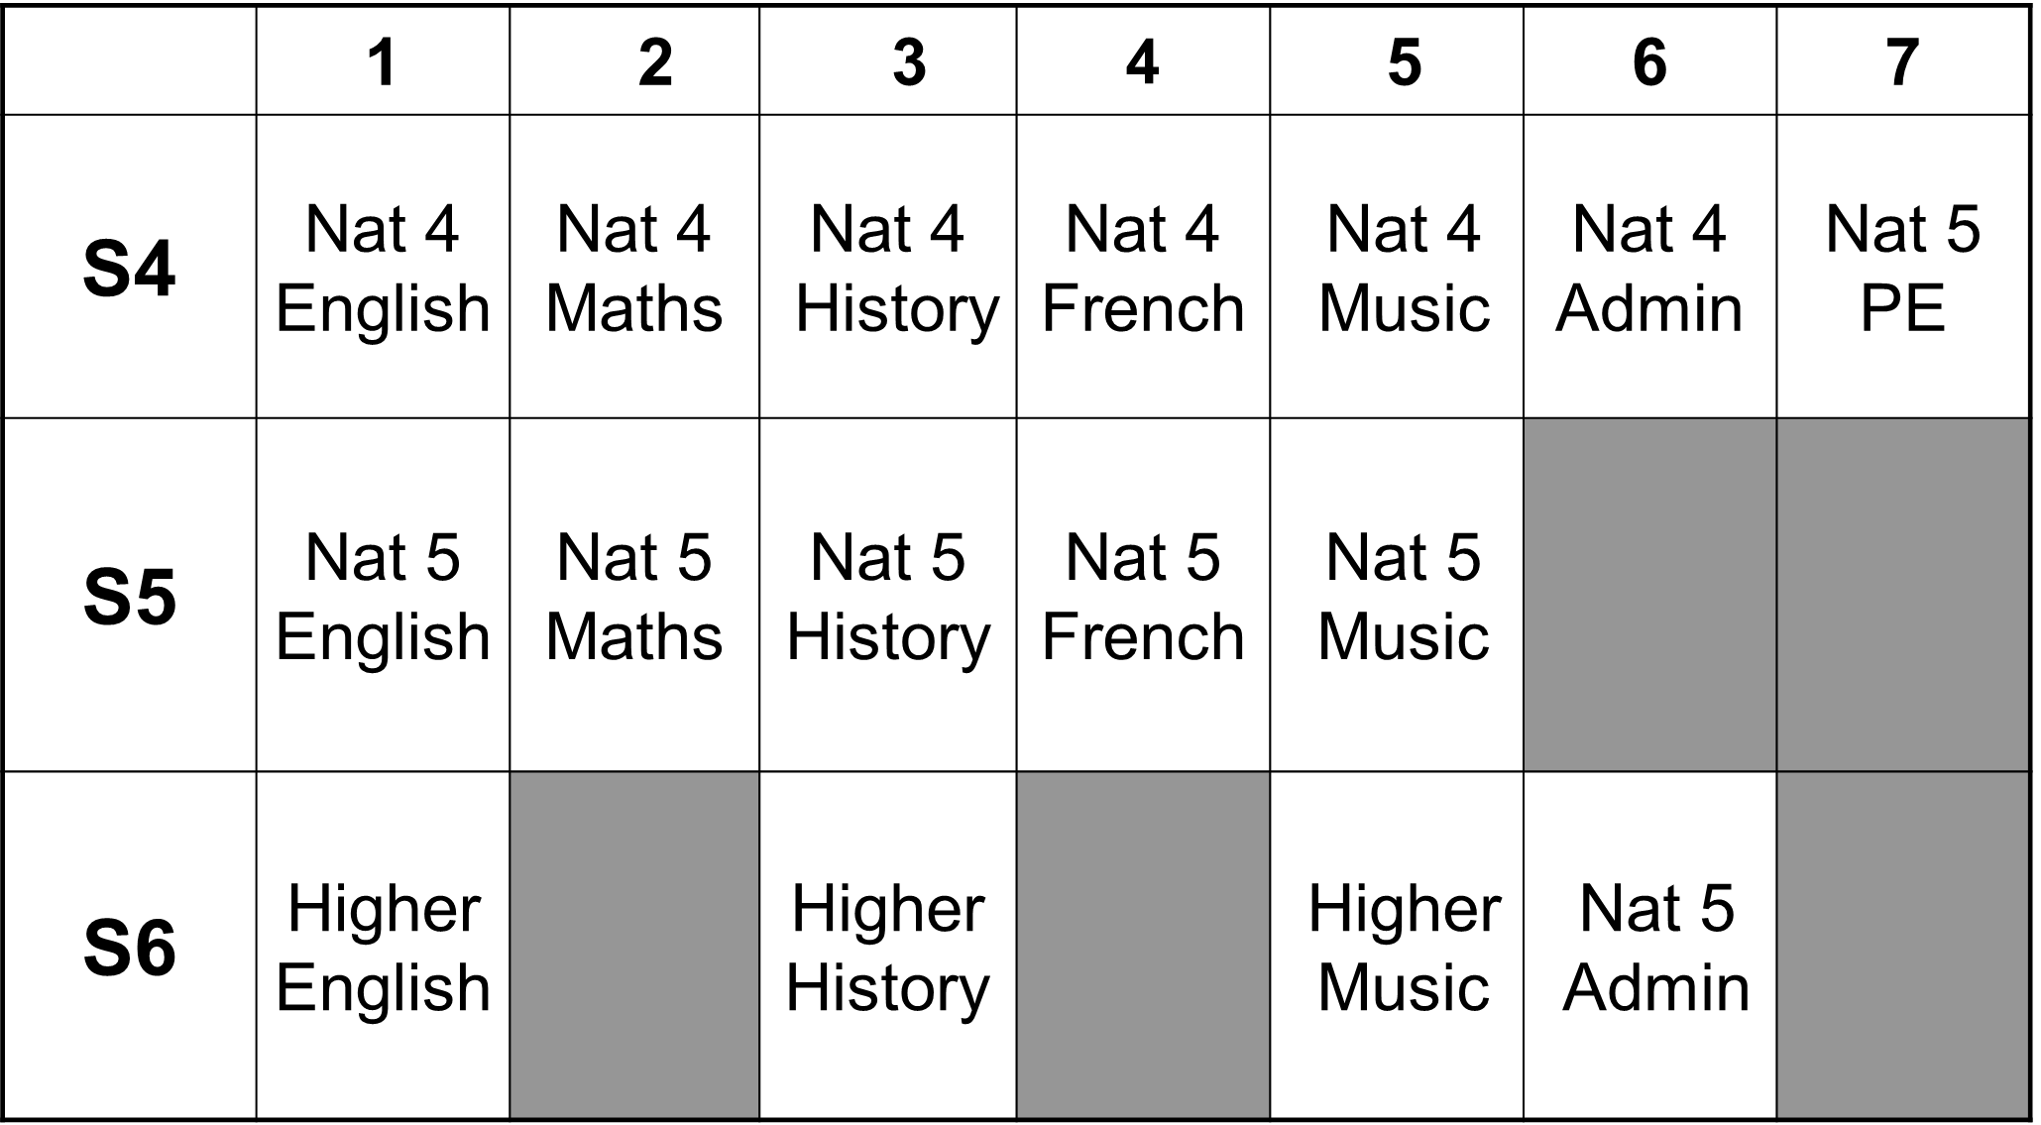
Possible Achievement Pathway – Taking time to get there?

Slide 10
S4 National Assessments
In National 3 & 4 courses pupils must pass two or three internal units (depending on subject). There is no final exam
In National 5 courses pupils will not have internal units to pass however there will be an external exam
Some subjects also have assignments/practical or Folio work which contributes to their overall grade.
Assessment Calendar – will be on the website and will show the time frame of internal assessments.

