Slide 1
Inspired by HOMECOMING 2014
Bagpipe Ted’s Caledonian Crumble
A taste of home

Slide 2
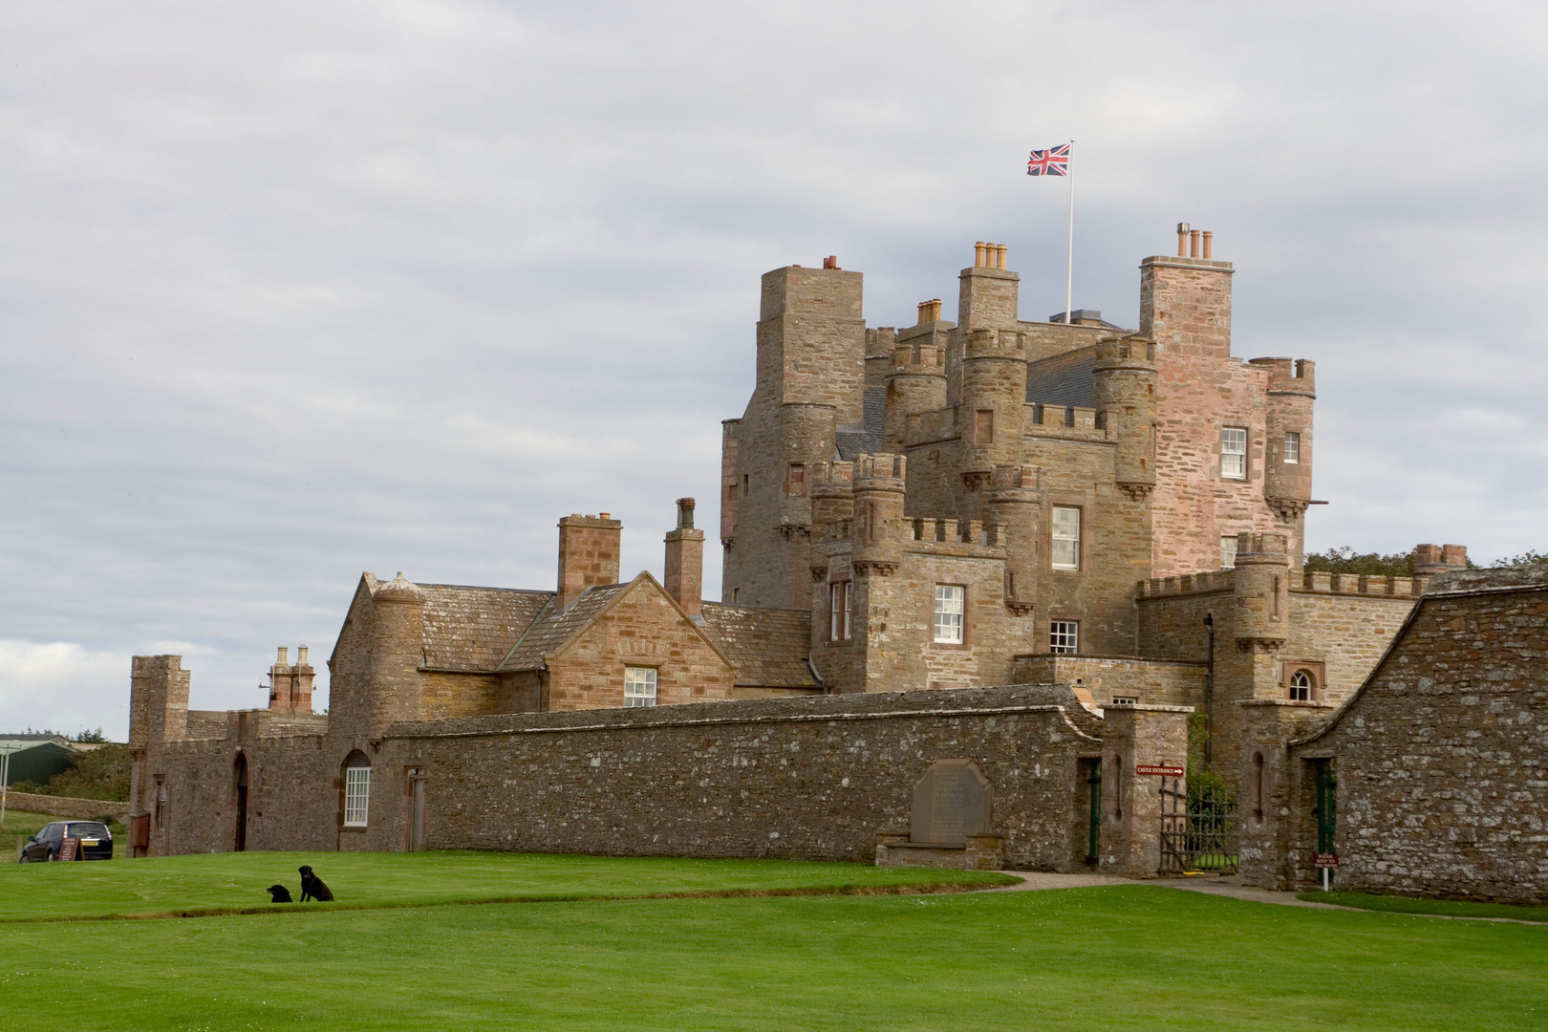
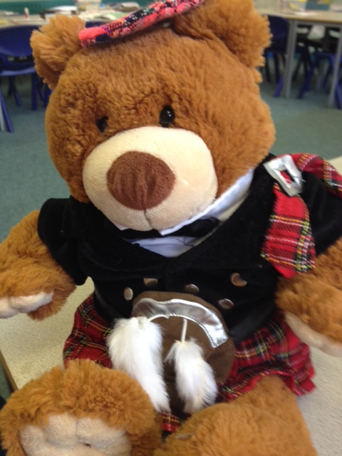
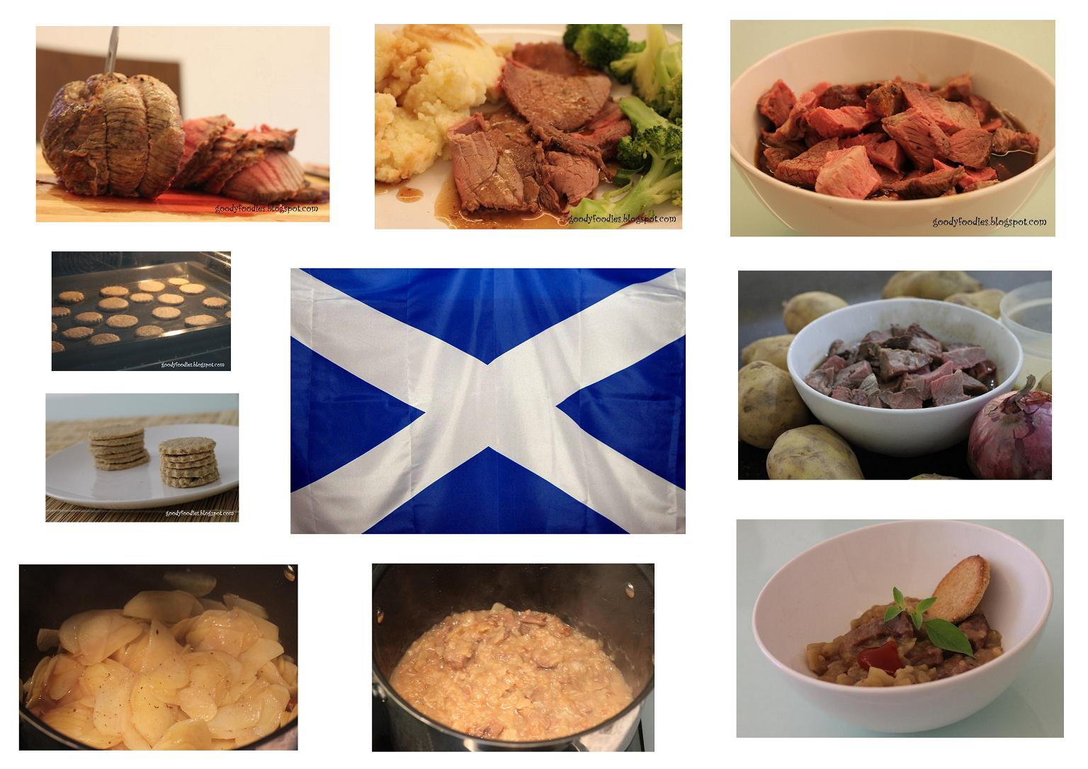
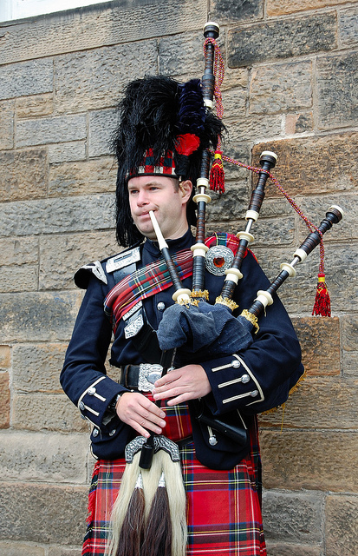
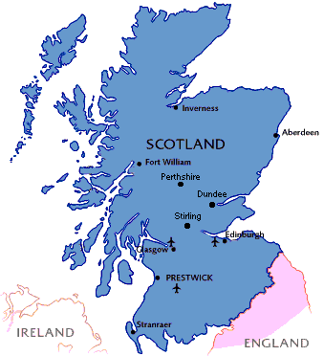
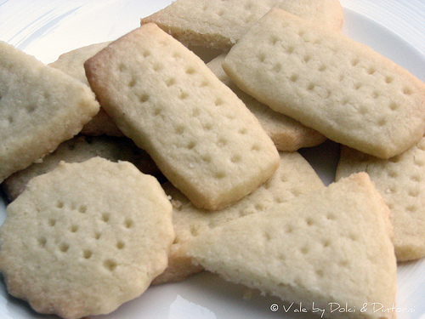
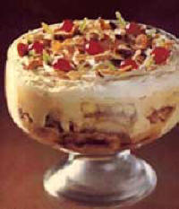
Scotland

Slide 3
Why crumble?
We wanted to change the negative reputation that Scottish food has and produce a delicious dessert that has some proven healthy ingredients in it.

Slide 4
Original Recipe
Updated
Recipe
Plain Flour
Caster Sugar
Butter
Brown Sugar
Apples
Nutmeg
Cinnamon
Wholemeal Flour
Honey
Butter
Margarine
Spoonful Sugar
Apples
Nutmeg
Cinnamon

Slide 5
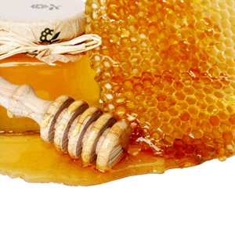
A Healthier Option
Honey
Natural sugars, glucose and fructose
Minerals; magnesium, potassium, calcium and sodium.
Vitamins B1, B2, C, B5, B6 and B3

Slide 6
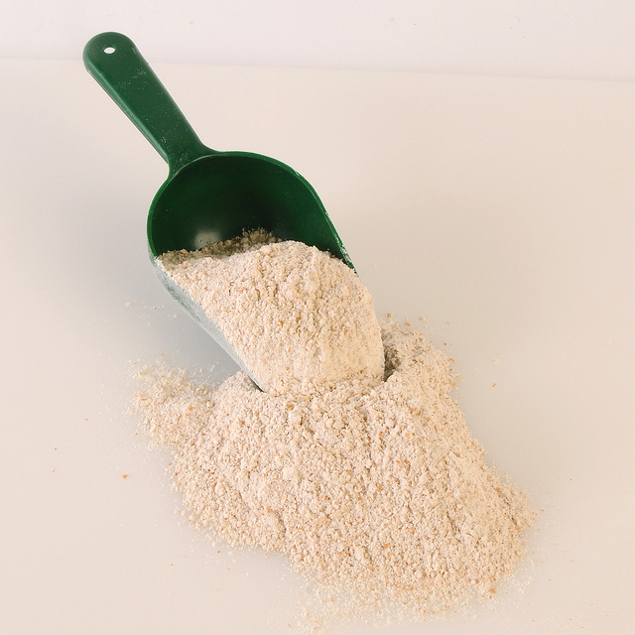
A Healthier Option
Wholemeal flour
Full flavour
Fibre
Minerals
It is more natural than white flour

Slide 7
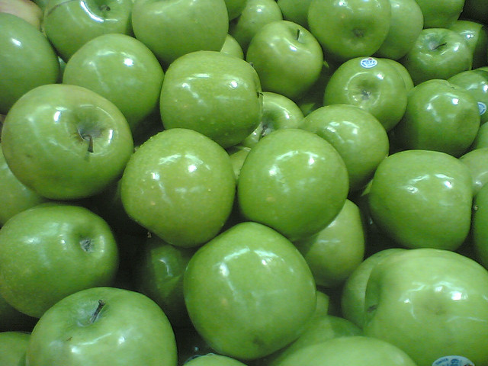
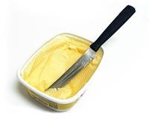
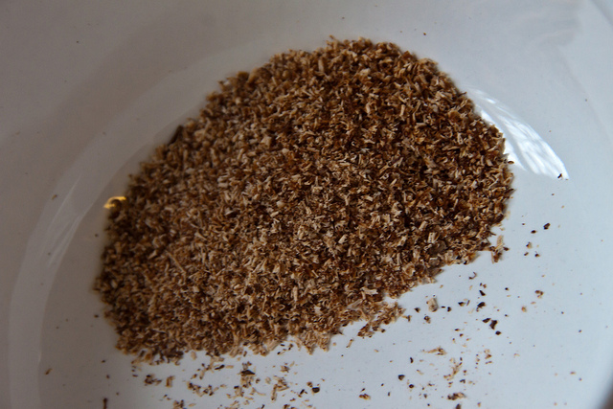
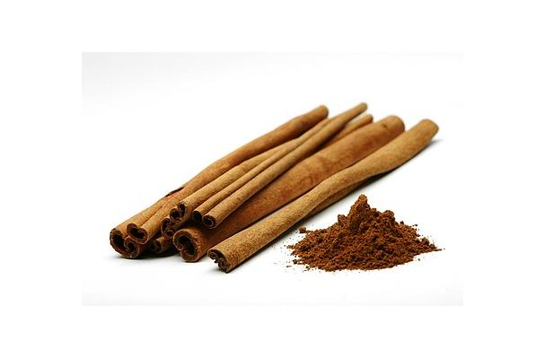
A Healthier Option
Green Apples
Natural sugar
Vitamins in skin
Margarine
Less saturated fat
Nutmeg
Helps indigestion
Cinnamon
Helps balance blood sugar levels

Slide 8
Social Benefits
Fairtrade ingredients would mean that Caledonian Crumble could qualify for Fairtrade status.
Light brown sugar

Slide 9
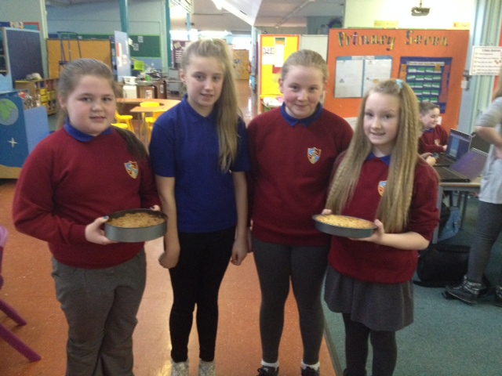
Battle of the Crumbles
Healthy vs Regular

Slide 10
Customer Research
Made both versions of the crumble and this is what people had to say:
“Delicious, really sweet and tasty.” Miss Neary, Primary 6a
“Delightful dish.” Bethany, Primary 7
“Really strong honey taste.” Mrs Ewing
“Great.” Mr Smith
“The Healthier version is better.” Cameron, Primary 7
Based on the feedback we would say that everyone enjoyed the less healthy version and most people enjoyed the texture and spicy taste of the healthy dish.

Slide 11
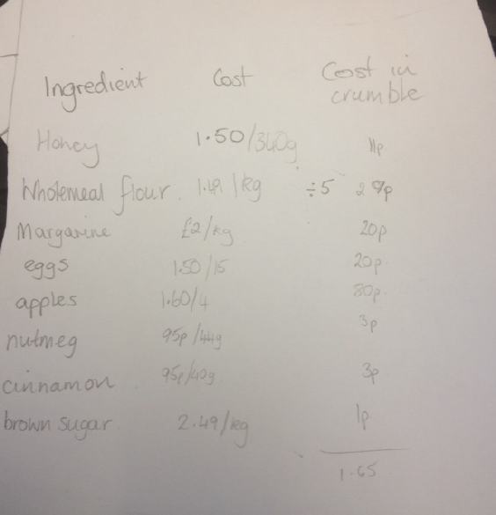
Cost
We investigated the pricing of each ingredient on the Tesco website and worked out the costs
Cost to make crumble – around about
£2.00
Charge - £5.00, this would allow a good advertising campaign with posters in airports, train stations and around main areas where tourists would be.

Slide 12
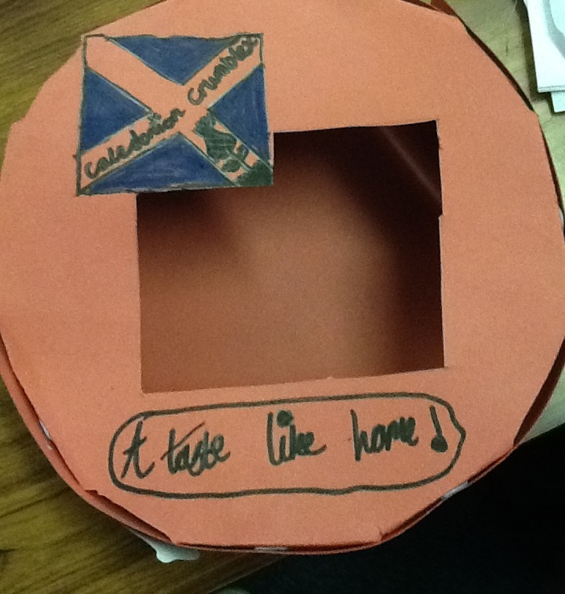
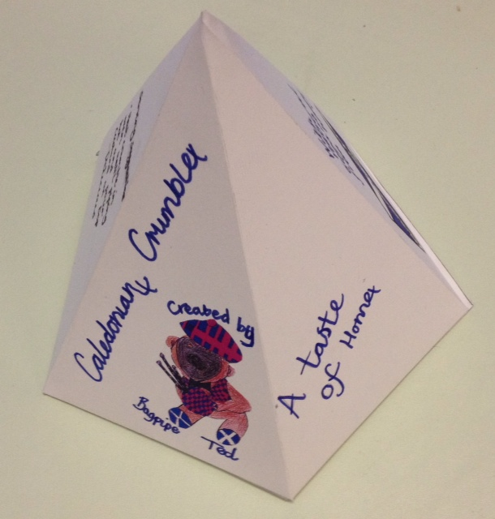
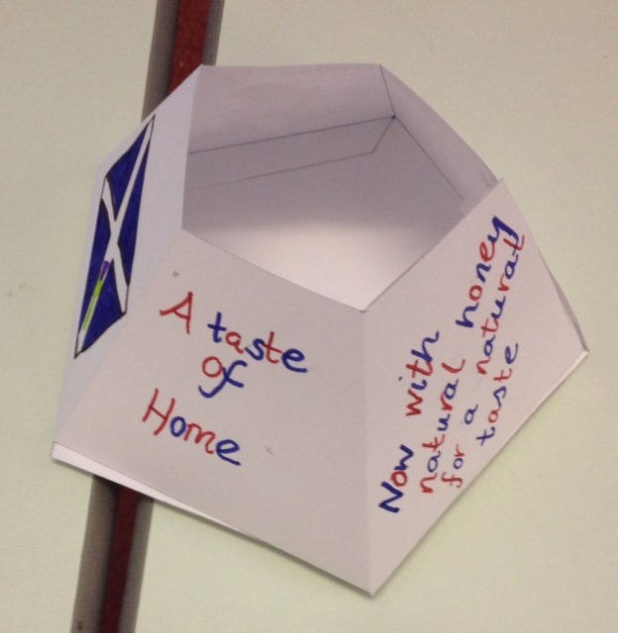
Packaging
Cylinder box showing Caledonian Crumble Logo. See through window on front to allow people to see crumble through packaging.
This size serves 8 people, if we design a smaller
crumble then we could change the packaging to pentagonal pyramid shape, this would be special as a gift.

Slide 13
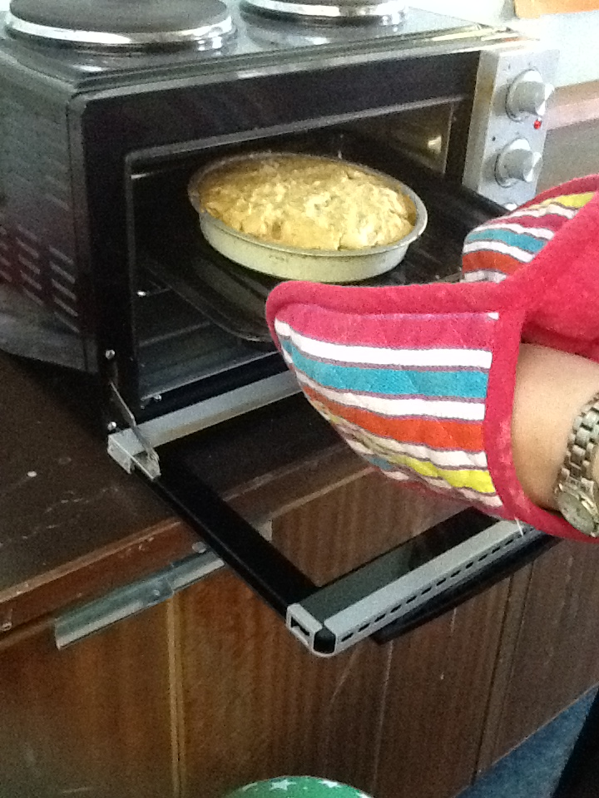
A taste of home
A slogan that shows what Homecoming 2014 is all about and will hopefully make people curious about the ingredients.
We developed another slogan that we would use for the healthy option :
A taste like home

Slide 14
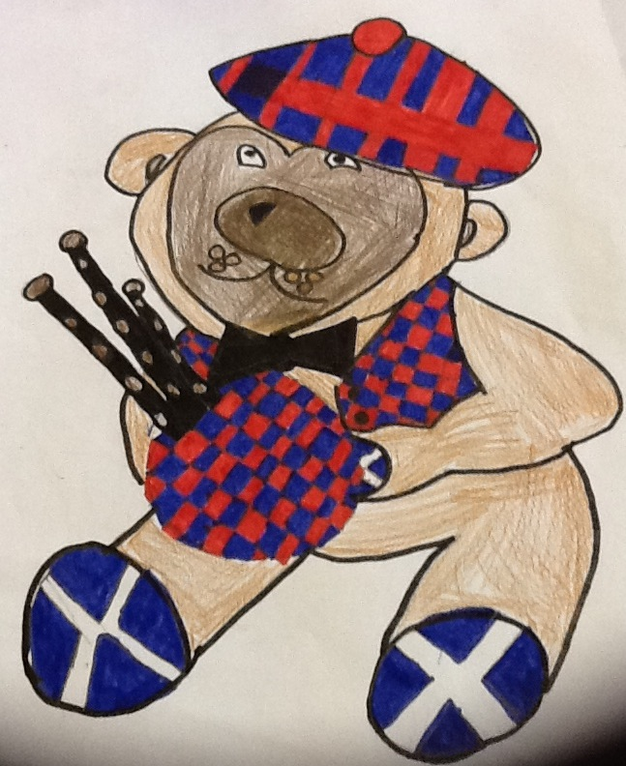
Bagpipe Ted
Our Mascot and Advertising Ploy
Appeals to children and memories for adults
Scottish twist - tartan bonnet, waistcoat and bagpipes.
Saltire flags on feet

Slide 15
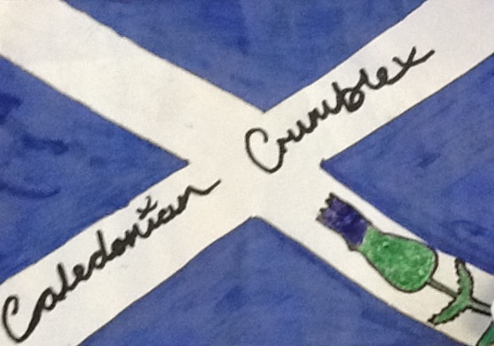
Thistle and Saltire Logo will show everyone where the crumble originates and will appeal to tourists and people returning home.
The crosses on the end of each word can be seen as kisses or as the cross from the Scottish flag.

Slide 16
Going Forward
Develop individual crumbles for gifts
Approach supermarkets that stock Scottish products
Garden centres – good market for tourists
Advertising in airports, train stations and bus stations
Around seaside towns and cities where people will be visiting

Slide 17
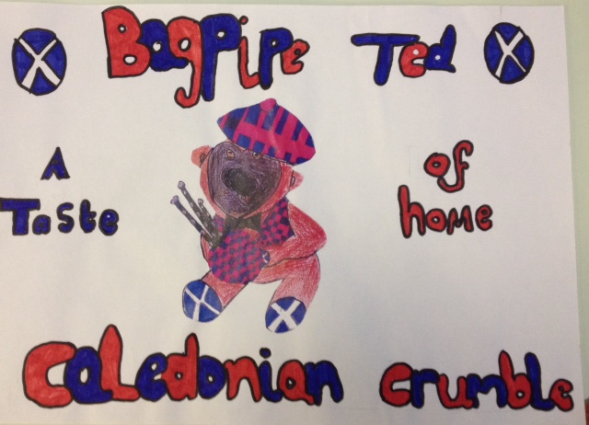

Slide 18
Thank you!

