Slide 1
Whiting Bay Primary
Weekly Bulletin
24/09/2026

Slide 2

Dates for your Diary
25th September – Arran Sports Hall Athletics P6/7
2nd October – last day of term
November – Parents Evening – W.C 16th November
November – Parent Council Meeting – date/ time TBC
W.C 2nd November – Swimming Lessons start for P3-7 (details to follow)
10th November – Sports Hall Athletics P6/7 - Irvine

Slide 3


Parents Portal & Edu Spot
If you haven’t already done so then please can you sign up as soon as possible for Parents Portal and Edu Spot.
Parents Evening Sign Up in November will be run through Parents Portal.
If you need help in signing up for either app, then please get in touch.

Slide 4

Easy Fundraising
Whiting Bay Primary is registered it Easy Fundraising.
Almost £1400 has already be raised via Easy Fundraising which goes into our school fund and help support school trips, swimming lesson, fun days, transport, additional sport equipment and many other items for the pupils.
How it works
We turn your daily shopping into free donations!
easyfundraising partners with over 8,000 retailers who will donate part of what you spend to a cause of your choice. It won't cost you any extra. The cost is covered by the retailer.
Retailers pay us a commission because when you start your shop from the easyfundraising website or app, they can see we sent you to them. If you make a purchase, a commission is generated, and we turn that into a donation! No extra cost, no extra effort.
To find out more and register please use the link:
Easy Fundraising Registration Link

Slide 5

Spare Clothes
With the weather being wetter at the moment the grass has become quite muddy around the school. Recently we’ve had a couple incidents with pupils ending up quite muddy at the end of breaks.
We have lots jumpers but no spare trousers, leggings, shorts, skirts – for all ages and genders. If you have anything suitable that you would be able to donate then please can you drop them off at school.
A spare change of clothes in school bags would also be welcomed, if you are able to provide one.

Slide 6
School Contact Details
School e-mail: whitingbay@ea.n-ayrshire.sch.uk
Phone Number: 01770700260
Website: Whiting Bay Primary
Our website has information on school policies, the school handbook & copies of the Parent Council minutes.
The website is being updated and we hope to add in more features and useful information in the near future.

Slide 7
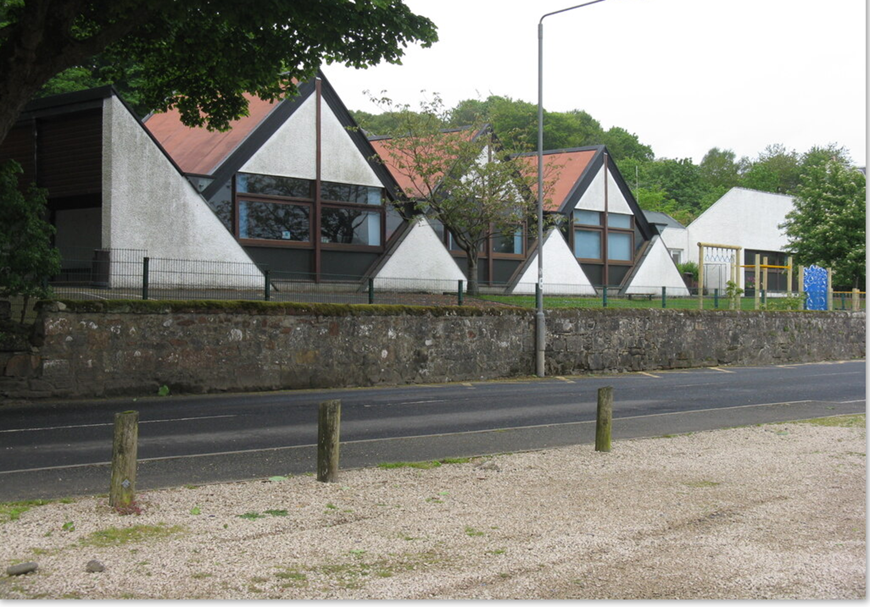


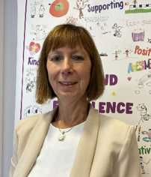
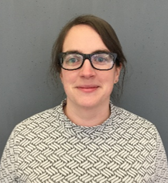
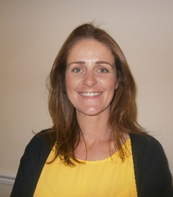
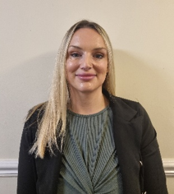

Child Protection Protocol
Education Services has a fundamental duty to contribute to the care and safety of all children and young people in North Ayrshire.
All staff, parents and visitors of Brodick Primary School have a responsibility to protect the welfare of our young people. If you have a concern for a young person or a disclosure is made by a young person, you should report this to a school staff member immediately. This will be passed on to the Child Protection Officer.
The Arran Social Work Team is based at the Council Offices, Lamlash. They can be contacted on 01770 600742.
If you are worried about someone during the night or at the weekend an ‘out of hours’ team is available to deal with emergencies . Please contact North Ayrshire Council ‘Out of Hours’ Tel: 0800 328 7758
Child Protection Co-ordinator Allison Conner Head Teacher | (in HT absence) Claire McNally Depute Head Teacher | (in HT absence) Jenny Duncan Depute Head Teacher | (in HT absence) Claire Kelso Depute Head Teacher

