Slide 1
Whiting Bay Primary
Weekly Bulletin
16/09/2026

Slide 2

Dates for your Diary
18th Whiting Bay Fun Club
21st September – Inservice Day
25th September – Arran Sports Hall Athletics P6/7
November – Parents Evening – date/ time TBC
November – Parent Council Meeting – date/ time TBC
W.C 2nd November – Swimming Lessons start for P3-7 (details to follow)
10th November – Sports Hall Athletics P6/7 - Irvine

Slide 3

Parent Helpers
We are looking for a number of parents to help us with school trips/ activities around the school. Without your support we find it difficult to offer the number of trips/ activities that we would.
If you would be interested in becoming a Parent Helper then please either call or e-mail the school.
Helpers do require a PVG check, but we are able to support this.
We are also looking for some volunteers to help re-felt our shed roof.
Please either call or e-mail the school if you would be able to support this.

Slide 4

Easy Fundraising
Whiting Bay Primary is registered it Easy Fundraising.
Almost £1400 has already be raised via Easy Fundraising which goes into our school fund and help support school trips, swimming lesson, fun days, transport, additional sport equipment and many other items for the pupils.
How it works
We turn your daily shopping into free donations!
easyfundraising partners with over 8,000 retailers who will donate part of what you spend to a cause of your choice. It won't cost you any extra. The cost is covered by the retailer.
Retailers pay us a commission because when you start your shop from the easyfundraising website or app, they can see we sent you to them. If you make a purchase, a commission is generated, and we turn that into a donation! No extra cost, no extra effort.
To find out more and register please use the link:
Easy Fundraising Registration Link

Slide 5



Champions for Change
Champions for Change is a project which uses sport and physical activity to promote active lifestyles and positive mental health to support and educate on the risks of drug and alcohol consumption.
Over the next two weeks our P5-P7 children will be working with a mainland team on Champions for Change. It consists of 2 x 2 hour sessions. Times and days vary depending on each individual school.
Please contact the school if you have any questions or would like to advise us of any reason why your child may need a little extra support with this learning. Thank you.

Slide 6

Meet the Teacher
Thank you to everyone that came along to the event last night.
If you didn’t get a chance to fill in our survey while you were here please use the links below:
P1/2 Feeback
P3-7 Feedback

Slide 7

Whiting Bay Primary Parent Council
Next Meeting: TBC
Thank you to everyone that came along to our BBQ last night, especially when it was a bit dreich weather wise
Still awaiting final figures, but we raised a really good amount of money that will go toward our fundraising goals.
There has been discussion over how we go forward with fundraising as a Parent Council. Could everyone please take 2 seconds to complete the question you’ll find through this link:
Fundraiser Question
Your Parent Council:
Chairperson: Vik Steel
Treasurer: Sheila Barr
Secretary: Joanna McCallum

Slide 8

Spare Clothes
With the weather being wetter at the moment the grass has become quite muddy around the school. Recently we’ve had a couple incidents with pupils ending up quite muddy at the end of breaks.
We have lots jumpers but no spare trousers, leggings, shorts, skirts – for all ages and genders. If you have anything suitable that you would be able to donate then please can you drop them off at school.
A spare change of clothes in school bags would also be welcomed, if you are able to provide one.

Slide 9
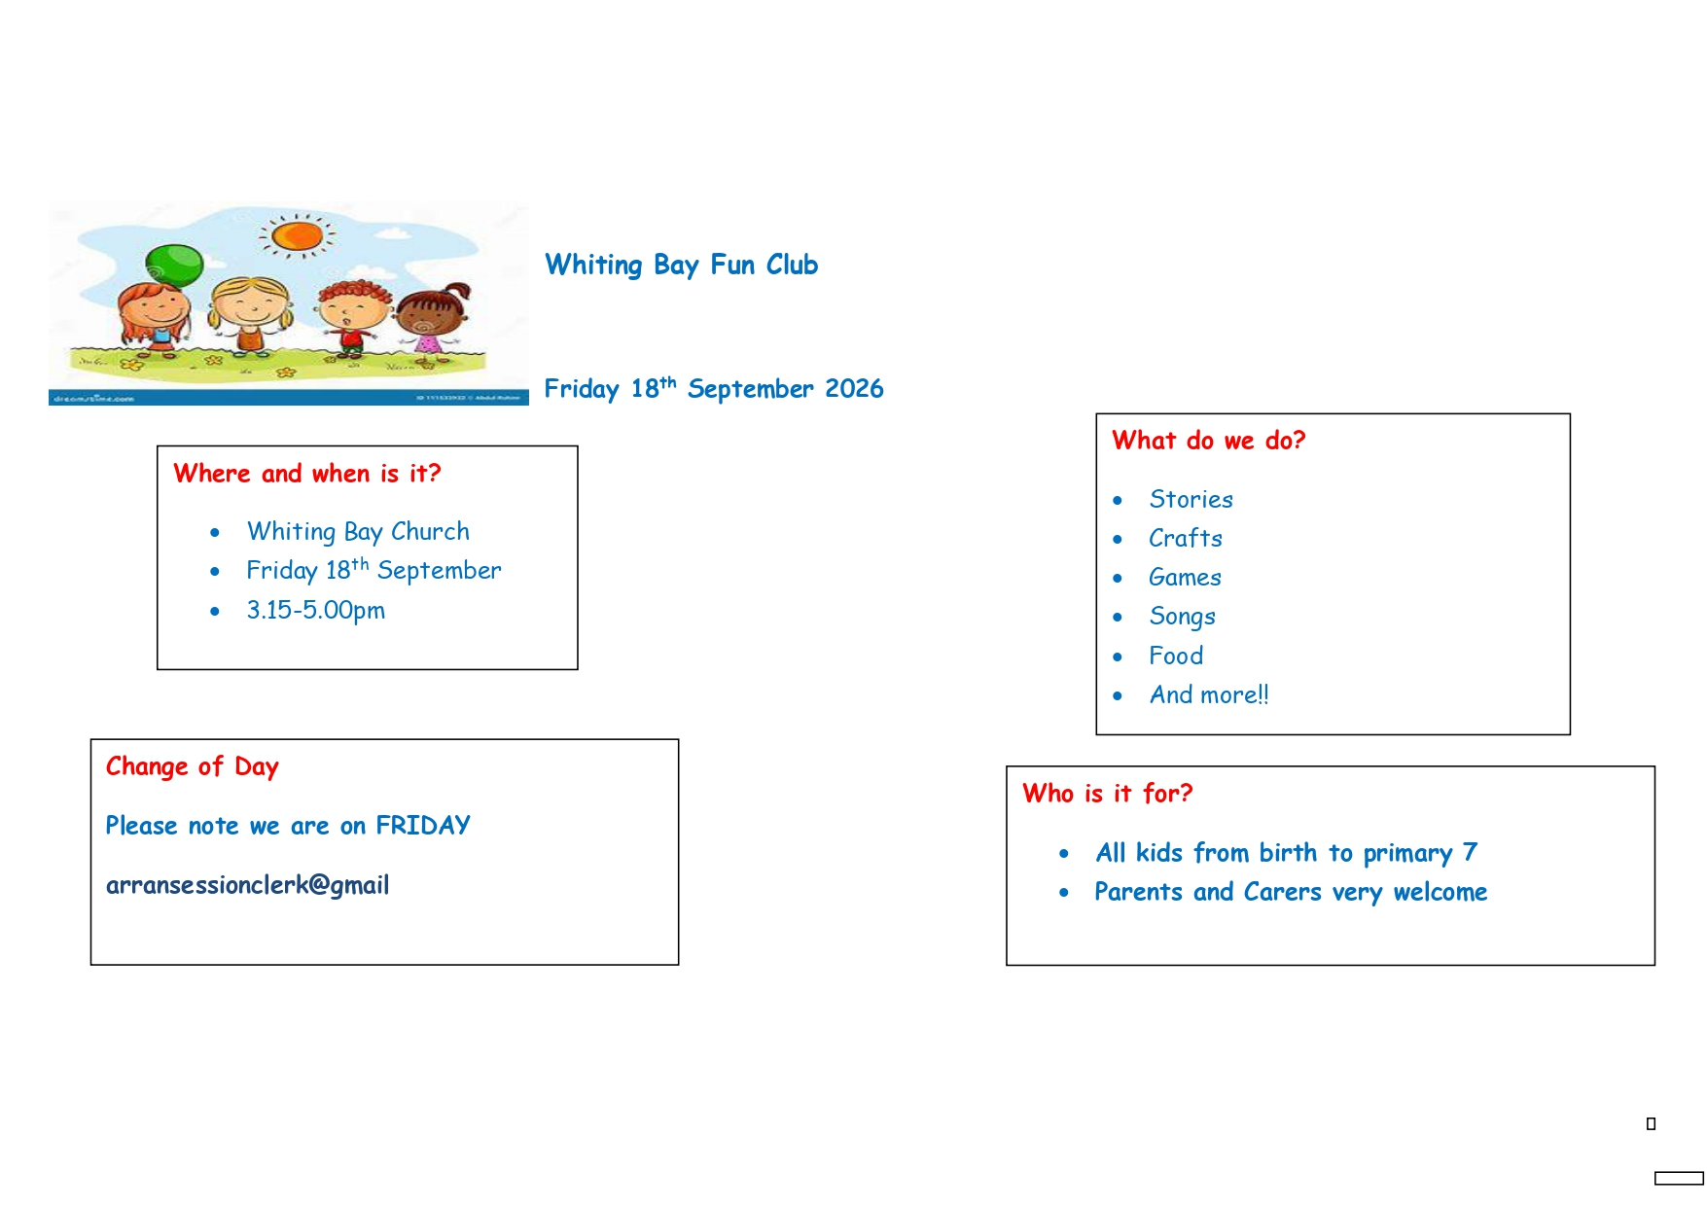
Whiting Bay Fun Club

Slide 10
School Contact Details
School e-mail: whitingbay@ea.n-ayrshire.sch.uk
Phone Number: 01770700260
Website: Whiting Bay Primary
Our website has information on school policies, the school handbook & copies of the Parent Council minutes.
The website is being updated and we hope to add in more features and useful information in the near future.

Slide 11
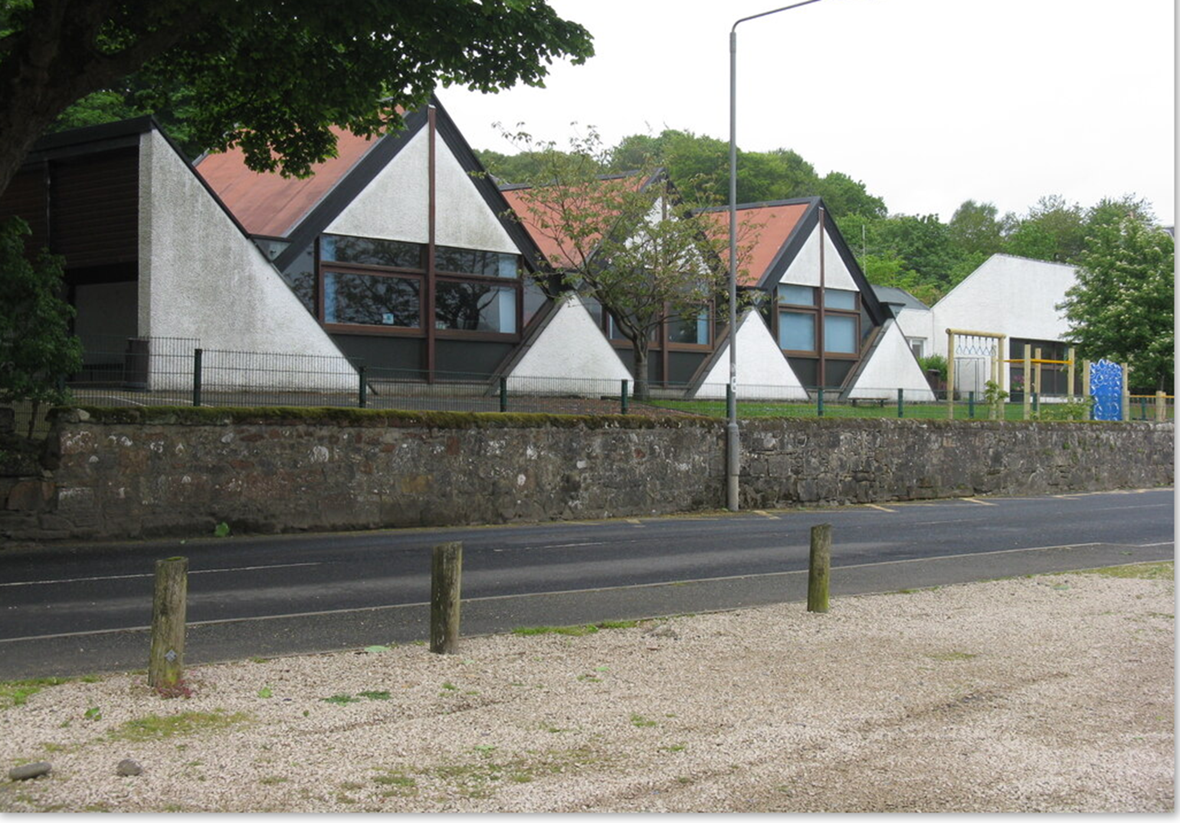


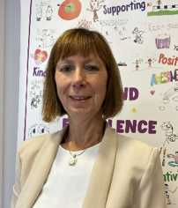
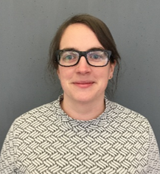
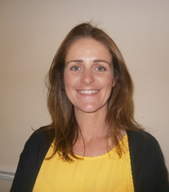
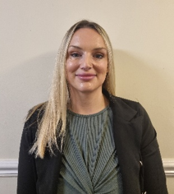

Child Protection Protocol
Education Services has a fundamental duty to contribute to the care and safety of all children and young people in North Ayrshire.
All staff, parents and visitors of Brodick Primary School have a responsibility to protect the welfare of our young people. If you have a concern for a young person or a disclosure is made by a young person, you should report this to a school staff member immediately. This will be passed on to the Child Protection Officer.
The Arran Social Work Team is based at the Council Offices, Lamlash. They can be contacted on 01770 600742.
If you are worried about someone during the night or at the weekend an ‘out of hours’ team is available to deal with emergencies . Please contact North Ayrshire Council ‘Out of Hours’ Tel: 0800 328 7758
Child Protection Co-ordinator Allison Conner Head Teacher | (in HT absence) Claire McNally Depute Head Teacher | (in HT absence) Jenny Duncan Depute Head Teacher | (in HT absence) Claire Kelso Depute Head Teacher

