Slide 1
Whiting Bay Primary
Weekly Bulletin 27th August 2026

Slide 2


Slide 3

Annual Forms
All forms have now been sent out via Parents Portal, please can you complete by the 4th of September.
Annual Data Check
Annual EV5
Photography Consent
ICT Consent
If you haven’t yet registered for Parents Portal, paper copies have been given to pupils today.
Please return by the 4th of September.
If you haven’t already registered for Parents Portal then please do as soon as possible.

Slide 4

School Bag Check
Please can ensure that school bags include:
Water Bottles
Jackets/ Coats
Spare clothes (in case of accidents)
We’ve also had a number of toys brought in recently and would ask that these stay at home as we would hate for these to be damaged or lost at school.

Slide 5
House/ Vice Captain Application
Our P7’s are in the process of applying for House/ Vice Captain position.
Forms have been sent home this week in school bags.
Deadline for forms to be returned is Monday 14th of September

Slide 6
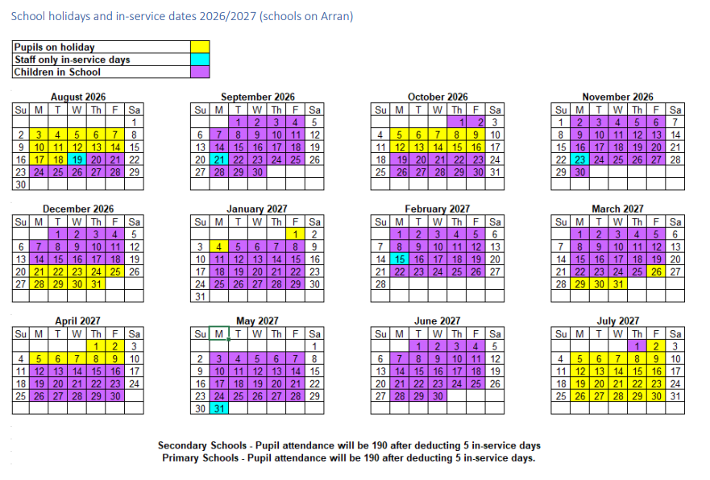
Dates for your diary
Early Closure Dates:
Friday 18th December - 2.30pm
Thursday 26th March - 2.30pm
Thursday 1st July - 1pm

Slide 7

Golf Competition
Please contact the club directly for more information.

Slide 8


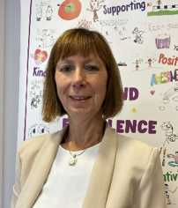
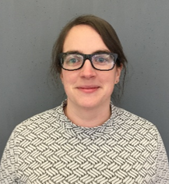
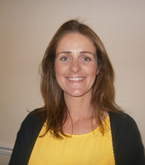
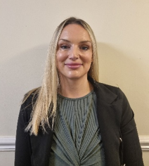

Child Protection Protocol
Education Services has a fundamental duty to contribute to the care and safety of all children and young people in North Ayrshire.
All staff, parents and visitors of Brodick Primary School have a responsibility to protect the welfare of our young people. If you have a concern for a young person or a disclosure is made by a young person, you should report this to a school staff member immediately. This will be passed on to the Child Protection Officer.
The Arran Social Work Team is based at the Council Offices, Lamlash. They can be contacted on 01770 600742.
If you are worried about someone during the night or at the weekend an ‘out of hours’ team is available to deal with emergencies . Please contact North Ayrshire Council ‘Out of Hours’ Tel: 0800 328 7758
Child Protection Co-ordinator Allison Conner Head Teacher | (in HT absence) Claire McNally Depute Head Teacher | (in HT absence) Jenny Duncan Depute Head Teacher | (in HT absence) Claire Kelso Depute Head Teacher

