Slide 1
World Book day Book Bonanza 2020

Slide 2
Which book are these the opening sentences from?
One afternoon, when Bruno came home from school, he was surprised to see Maria, the family’s maid – who always kept her head bowed and never looked up from the carpet- standing in his bedroom, pulling all his belongings out of the wardrobe and packing them into four large wooden crates, even things he’d hidden at the back that belonged to him and were nobody else’s business.

Slide 3
Which book are these the opening sentences from?
I know I’m not an ordinary ten year kid. I mean, sure, I do ordinary things. I eat ice cream. I ride my bike. I play ball. I have a Xbox. Stuff like that makes me feel ordinary. I guess. And I feel ordinary. Inside. But I know ordinary kids don’t make other ordinary kids run away screaming in playgrounds. I know ordinary kids don’t get stared at wherever they go.

Slide 4
Which book are these the opening sentences from?
Gail was eating cornflakes when her shadow disappeared. She didn’t even really like cornflakes. It happened, she thought, between the third and fourth mouthful. She watched the shadow slip under the kitchen door, rippling like an eel into the garden, leaving Gail with an itch in her right foot and a dribble of milk on he chin. She wasn’t surprised. Everything was falling apart, including her. And it was all Kay’s fault.

Slide 5
Which book are these the opening sentences from?
Mr Hoppy lived in a small flat high up in a tall concrete building. He lived alone. He had always been a lonely man and now he was retired from work he was more lonely than ever.
There were two loves in Mr Hoppy’s life. One was the flowers he grew on his balcony. They grew in pots and tubs and baskets, and in the summer the little balcony became a riot of colour.
Mr Hoppy’s second love was a secret he kept entirely to himself.

Slide 6
Which book are these the opening sentences from?
If you are interested in stories with happy endings, you would be better off reading some other book. In this book, not only is there no happy ending, there is no happy beginning and very few happy things in the middle. This is because not very many happy things happened in the lives of the three Baudelaire youngsters. Violet, Klaus, and Sunny Baudelaire were intelligent children, and they were charming, and resourceful, and had pleasant facial features, but they were extremely unlucky, and most everything that happened to them was rife with misfortune, misery and despair. I’m sorry to tell you this, but that is how the story goes.

Slide 7
Which book are these the opening sentences from?
If someone had asked Jared Grace what jobs his brother and sister would have when they grew up, he would have had no trouble replying. He would have said that his brother, Simon, would either be a veterinarian or a lion tamer. He would have said that his sister, Mallory, would either be an Olympic fencer or in jail for stabbing someone with a sword. Nut he couldn’t say what job he would grow up to have. Not that anyone asked him. Not that anyone asked his opinion on anything at all.

Slide 8
Guess who has been for dinner?

Slide 9
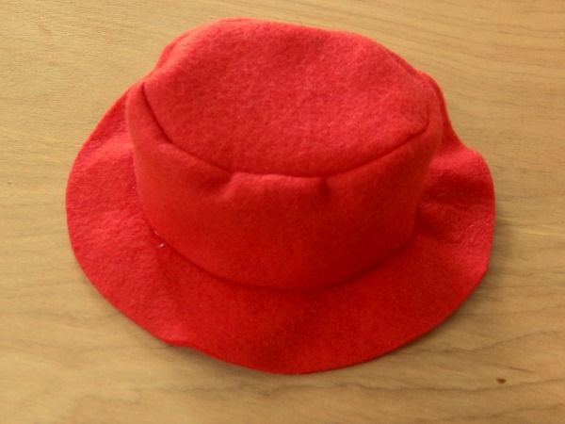
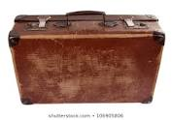
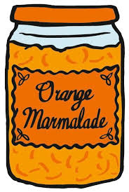

Slide 10
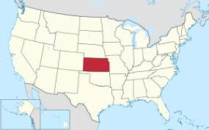
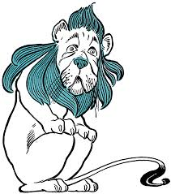
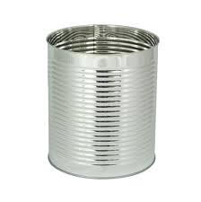
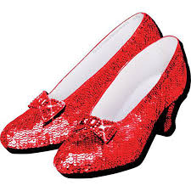
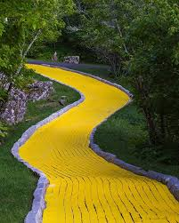

Slide 11
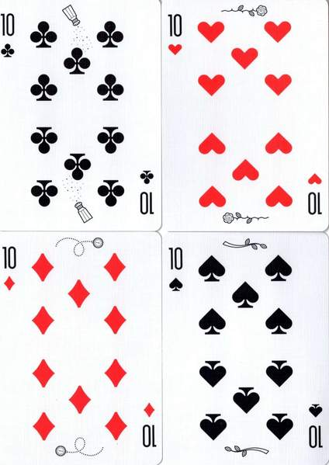
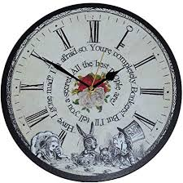
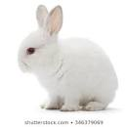
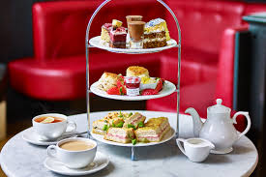

Slide 12
