Slide 1





Meet the Teacher
All about the curriculum

Slide 2


What do we want you to take from today?
*An understanding of what learning and teaching will look like in P1.
*Confidence in us! Your children are in safe hands.

Slide 3

Play
Play-based learning is a key part of early education in Scotland, supported by the Curriculum for Excellence. It enables children to learn through games, role-play, and exploration, helping build confidence, develop social and communication skills, and introduce reading, writing, and maths in a natural, engaging way. It also fosters creativity and supports a smoother, less stressful transition into Primary 1.

Slide 4
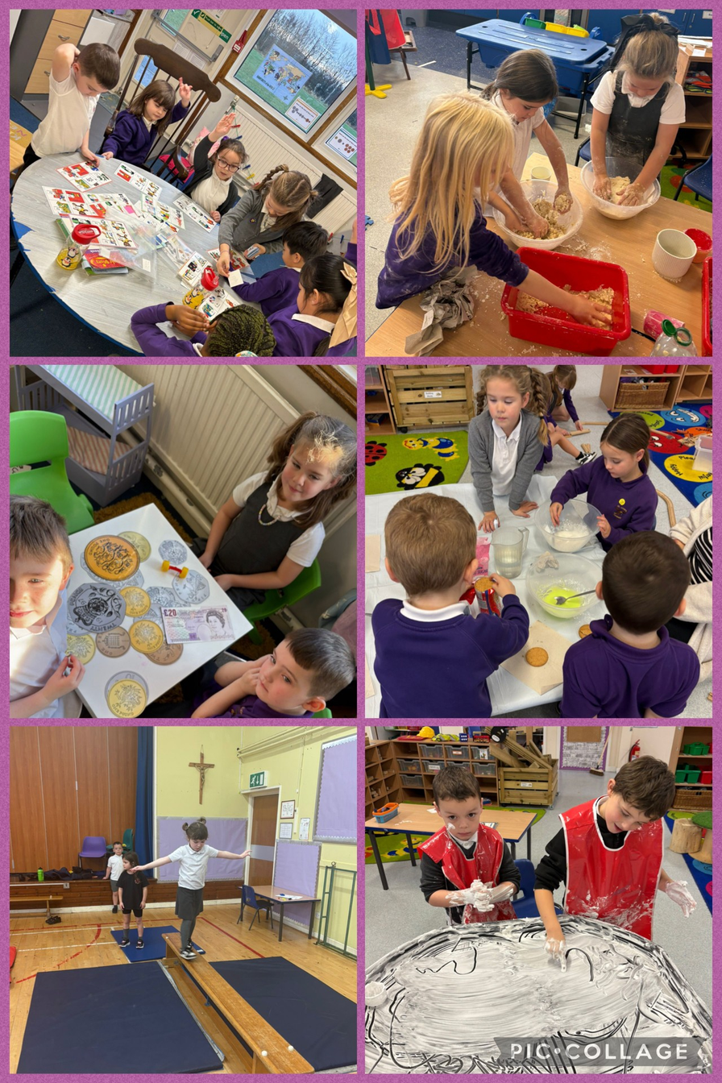
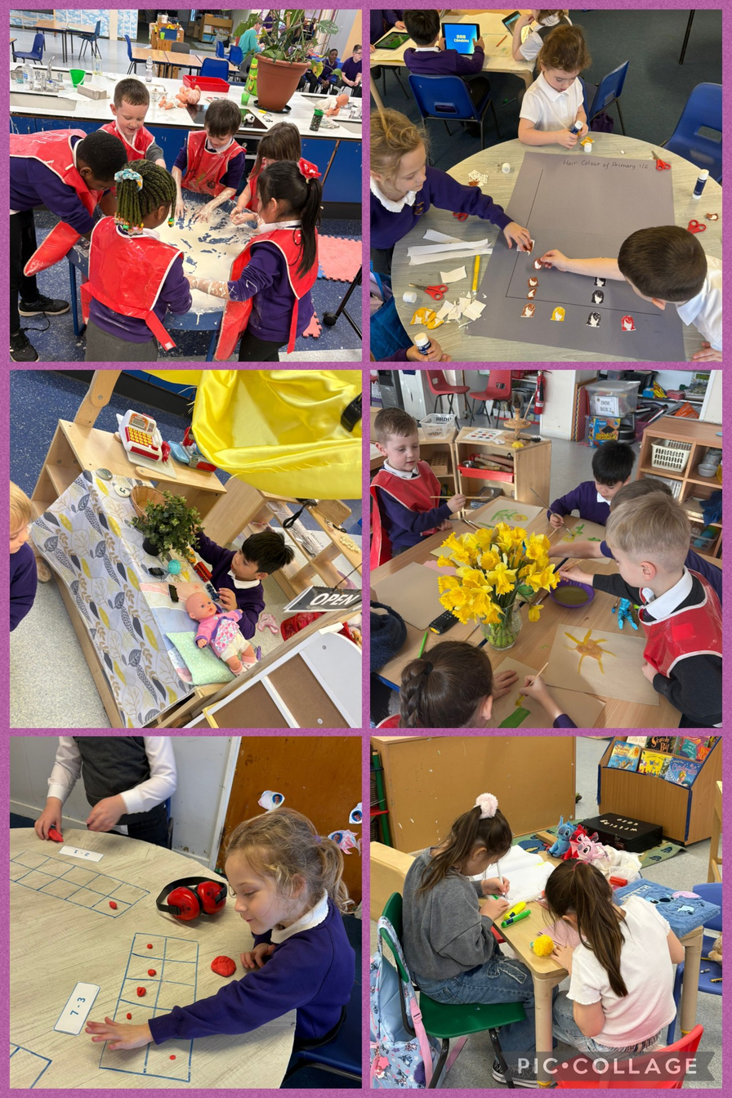

Slide 5
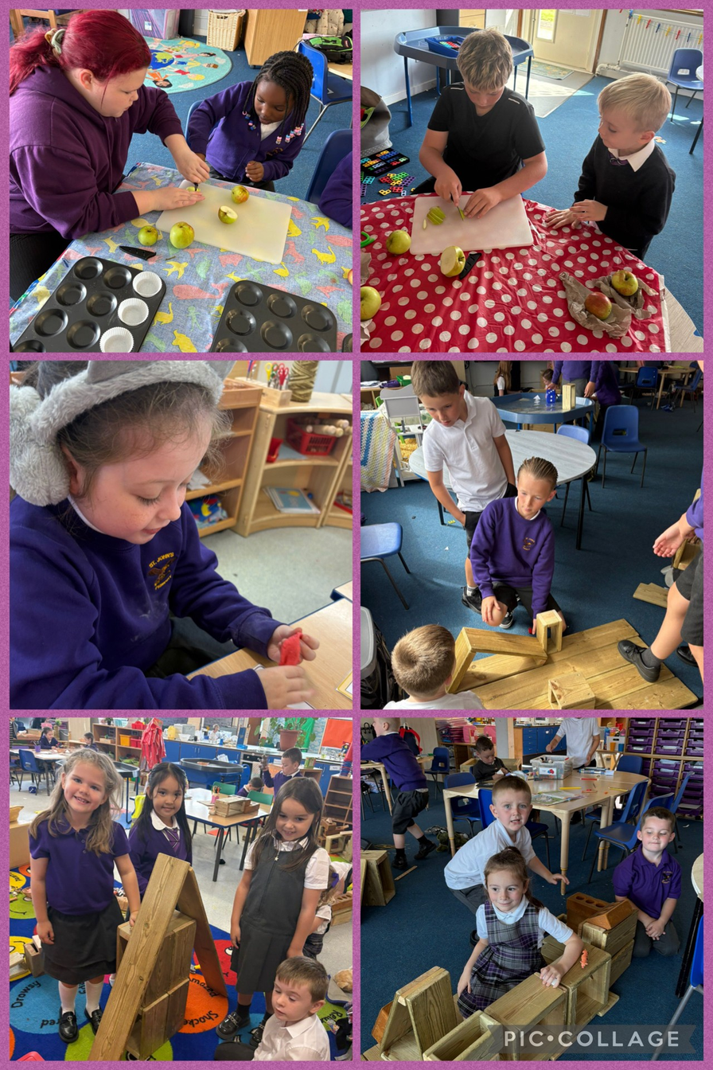
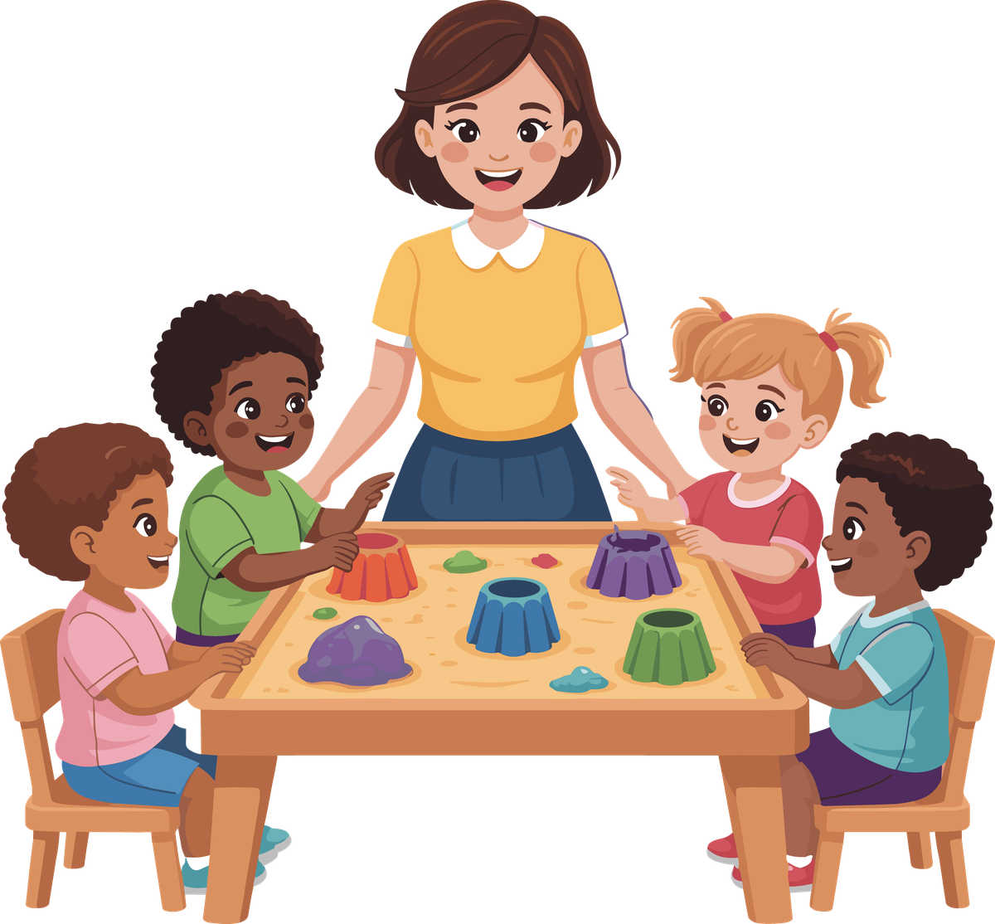

Slide 6

Numeracy & Mathematics
How do we teach numeracy and mathematics?
*Practical approaches
*Dripping tap effect
*Follow up written work
*Holistic assessment
“Maths is not just about getting the right answer. It is all about thinking through and finding ways of solving problems. It does not matter if your child gets the wrong answer, as long as they are able to explain their method of reasoning.”

Slide 7
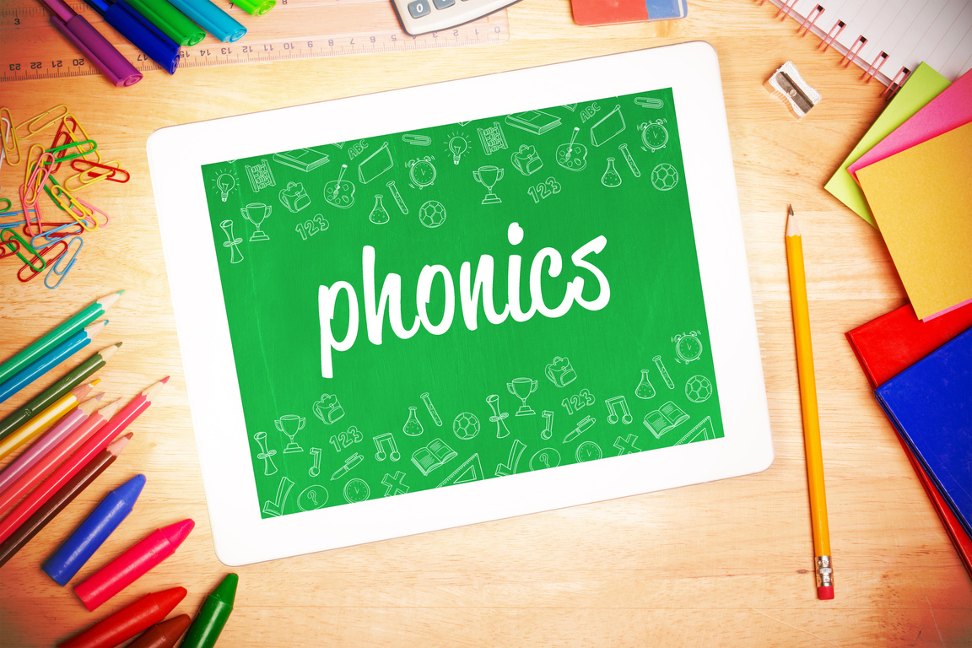
Phonics
*All words are made up of sounds.
*26 letters in the alphabet, but there are 44 sounds in the English language.
*East Ayrshire Literacy is the current scheme that we use.
*Daily lesson involves learning the sound and letter name, letter formation, a song and words that begin with the particular letter being taught.

Slide 8


Literacy-
Letter Formation
*At this stage in their development it is important that children learn to form their letters correctly.
*A variety of activities will be used to ensure this, for example
*Mark making
*Sand/glitter/shaving foam trays
*Daily written practice
*Observation

Slide 9

Literacy- Reading
*As a whole school we will be taking part in the North Ayrshire Reads programme
*In Primary 1 we will use a range of reading resources and books.
*The books begin with picture books with an extended story to go with the book, this reinforces that illustrations also tell a story.
*Most key words can be sounded out which links to our phonics. Some words just need to be learned for example: was, her and put.

Slide 10
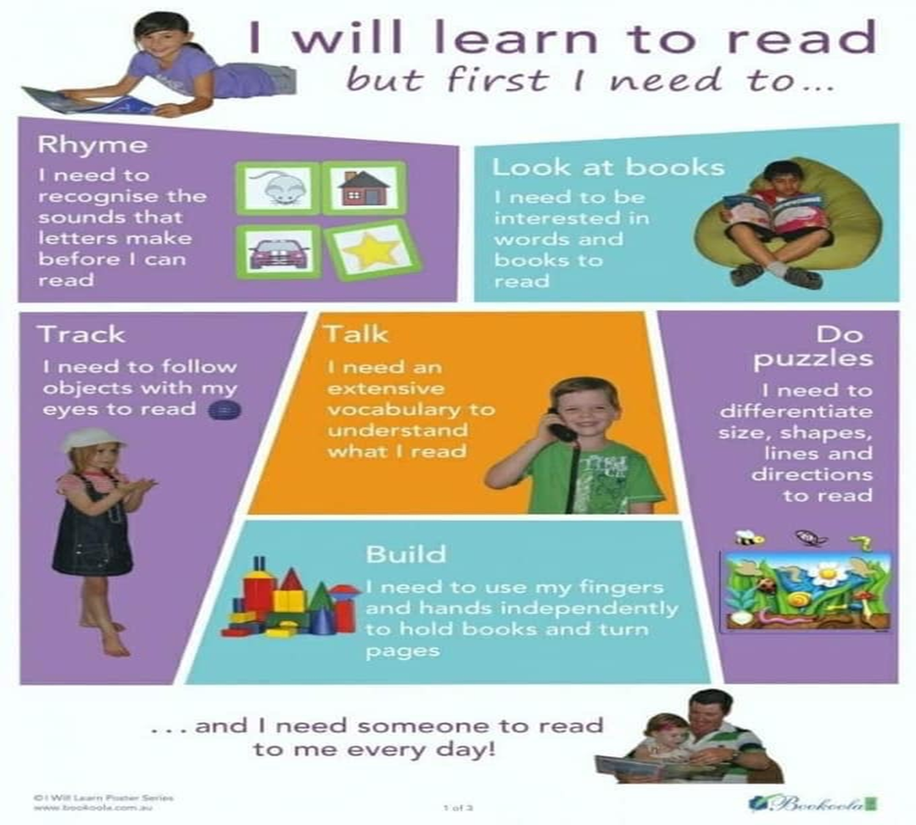

Slide 11

Health and Wellbeing
Health and Wellbeing topics will be covered throughout the year.
*Food
*Feelings
*All about me
*Healthy mind & body
*People who help us
*Keeping safe
These topics are taught through a variety of resources and experiences

Slide 12
What else?
*RE
*Expressive Arts
*Social Studies
*Technology
*Science
*Spanish

Slide 13

Homework
*Numeracy
*Using the home environment to look at real life numeracy and mathematics
*Forming numbers
*Counting real life objects
*Real life shapes
*Literacy
Learning keywords
*Discussing the pictures and ask questions about the book.
*Daily reading
*Encourage your child to read in any situation will be beneficial

Slide 14
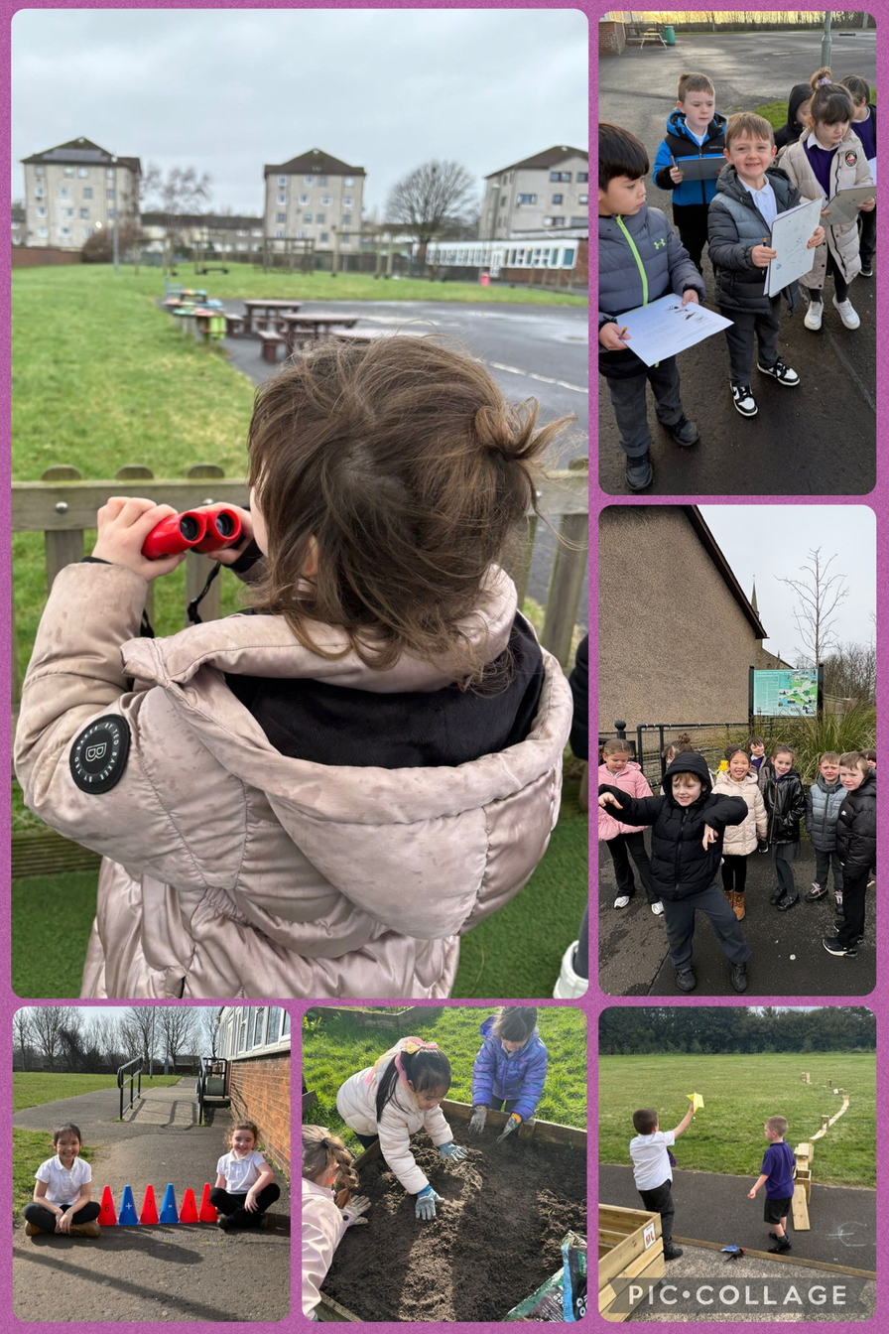
Outdoor Learning
We take part in outdoor learning across the curriculum and try to access our outdoor areas as often as possible.
We have access to some waterproofs and welly boots.

Slide 15
Getting A Head Start
*All P1-5 children are entitled to a free school meal. Pin up the weekly menu and read this over at home.
*Can your child get changed independently so they feel comfortable changing for PE?
*Do they recognise their name?
*Only first letter of name to be written in upper case
*Label everything!
*Encourage them to open their own snacks and packets at home
*Velcro shoes are best
*Can your child put on their own jacket and zip it up?

Slide 16
We are all in this together!
*We understand that this is a huge moment for your children and you.
*Trust that we will love your children as if they were our own.
*We have an open door policy!
*Let’s work together for your children.

