Slide 1

Primary 1 Induction- The curriculum
Mrs Cavani
Notes:
Welcome to our Primary 1 Induction Slide Show. This power point is hosted by Mrs Cavani. I am the Primary 1 teacher for the session beginning August 2024. In the following power point I will share with you different aspects of the curriculum I will teach and how I will implement this for your child. I am looking forward to welcoming all children soon.

Slide 2
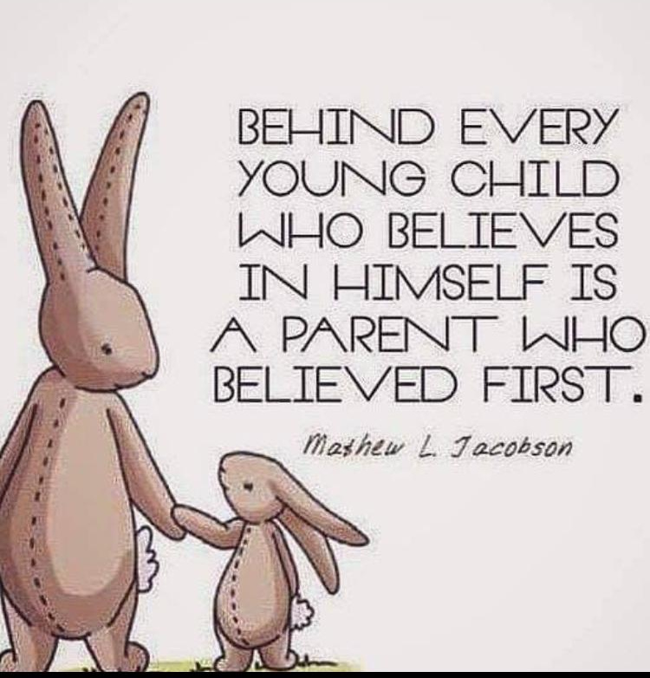


What do we want you to take from today?
An understanding of what learning and teaching will look like in P1.
Confidence in us! Your children are in safe hands.

Slide 3
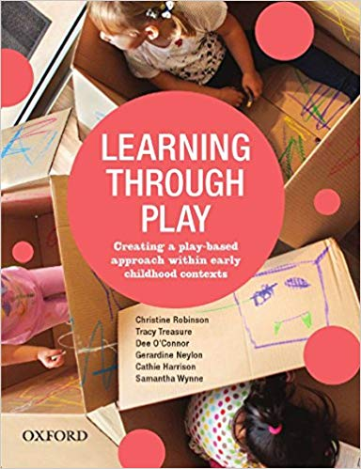
Play
“Play is the natural way in which children learn. Young children are learning new concepts all of the time during a range of play activities”
Types: Role play
Small world
Tuff trays
Water/sand
Cooking
ICT
Notes:
Play is a huge part of your child’s learning. We have a play zone within the open area. We plan the areas with the children and we have access to this all week. This provides a balance of play based learning and focused learning and teaching strategies. Examples of the areas available are the home corner, art table and writing table. The development of this area this year has been really successful with the classes who use it and is always really enjoyed by all.

Slide 4
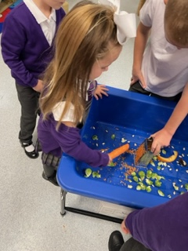
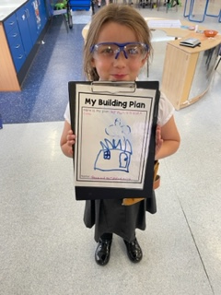
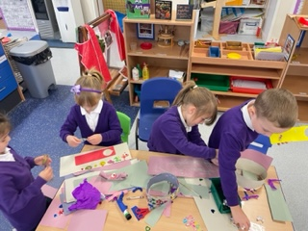
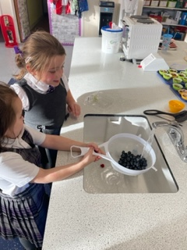
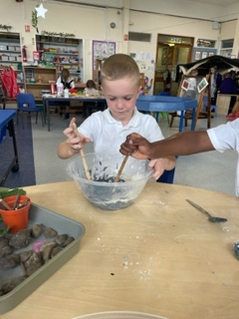

Slide 5

Numeracy and Mathematics
How do we teach numeracy and mathematics?
  Practical approaches
  Dripping tap effect
  Follow up written work
  Holistic assessment
  “Maths is not just about getting the right answer. It is all about thinking through and finding ways of solving problems. It does not matter if your child gets the wrong answer, as long as they are able to explain their method of reasoning.”
Notes:
In Primary 1 the teaching of Numeracy and Mathematics is developed through play, active approaches, song and rhymes. Number work is the main focus and the teaching of this is weaved through all daily activities for example through discussing dates, birthdays, ages and daily mental maths activities. Ensuring all children are secure with numbers 1-20 and have the ability to add and subtract within this bracket is our main priority. We use a variety of resources to support this learning for example number lines and rekenreks. We will explore shape, pattern, money and measurement alongside all number work. We will always make learning relevant to real life and experiences for the children.

Slide 6
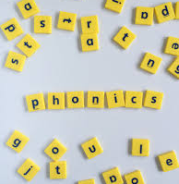
Literacy- Phonics
All words are made up of sounds.
26 letters in the alphabet, but there are 44 sounds in the English language.
North Lanarkshire Literacy, supported by Jolly Phonics, is the current scheme that we use.
Daily lesson involves learning the sound, letter formation, a song and words that begin with the particular letter being taught.
Notes:
Having a secure phonological awareness is the foundation to learning how to read and write. In Primary 1 we will teach a variety of sounds as well as the individual letters of the alphabet. Through practical activities, songs and play based tasks your child will expand their knowledge and understanding of various sounds. It is important for your child to identify the initial sound of a word and the sounds within a word before they move forward. Using this learning your child will begin blending various sounds to create words. In addition to learning their sounds, all children will be exposed to common words such as the, what and her. These words cannot be sounded out using the blending method so therefore the children will be encouraged to learn the shape and letters of these words. Children will learn roughly two sounds a week and will come home with these within a sounds jotter to practice. We ask for your support in helping your child learn these sounds at home and there are so many way to do this without it seeming like another piece of homework. Looking for the sound in the house, when in the car, in there books.

Slide 7
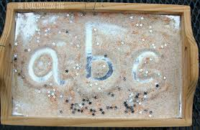
Literacy- Letter Formation
At this stage in their development it is important that children learn to form their letters correctly.
A variety of activities will be used to ensure this, for example
  Mark making
  Sand/glitter/shaving foam trays
  Daily written practice
  Observation
Notes:
For children to be able to form letters properly it is important that they have developed their fine motor skills needed for a pencil grip. You can develop this through the use of tweezers, threading beads, holding pens/paintbrushes/pencils/crayons etc. We will encourage letter formation through active play. On the resource table you will see a mixture of material we use to encourage the children to form letters in a fun way.

Slide 8
Literacy- Reading
In Primary 1 we will use a range of reading resources and books.
The books begin with picture books with an extended story to go with the book, this reinforces that illustrations also tell a story.
Most key words can be sounded out which links to our phonics. Some words just need to be learned for example: was, her and put.
Notes:
It is important to expose children to as many genres of texts as possible. Additionally, reading can be developed through everyday activities. For example, reading road signs, supermarket labels, TV screens etc. It is common for children to memorise books they read often and they may present themselves as a confident reader. Strategies to avoid this could be pointing at each word as they read, opening the book at random pages, covering the pictures and ask them to read the sentence backwards. Again this is something we ask for your support with at home.

Slide 9
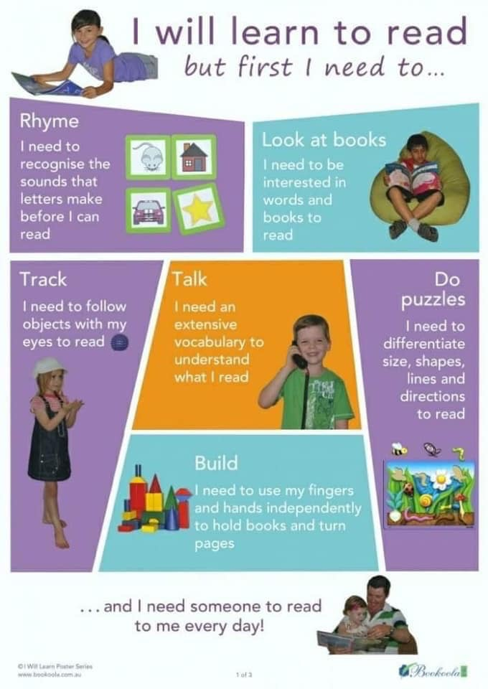

Slide 10
Health and Wellbeing
Health and Wellbeing topics will be covered throughout the year.
  Food
  Feelings
  All about me
  Healthy mind & body
  People who help us
  Keeping safe
  These topics are taught through a variety of resources and experiences

Slide 11

What else?
RE
Expressive Arts
Social Studies
Technology
Science
Spanish

Slide 12
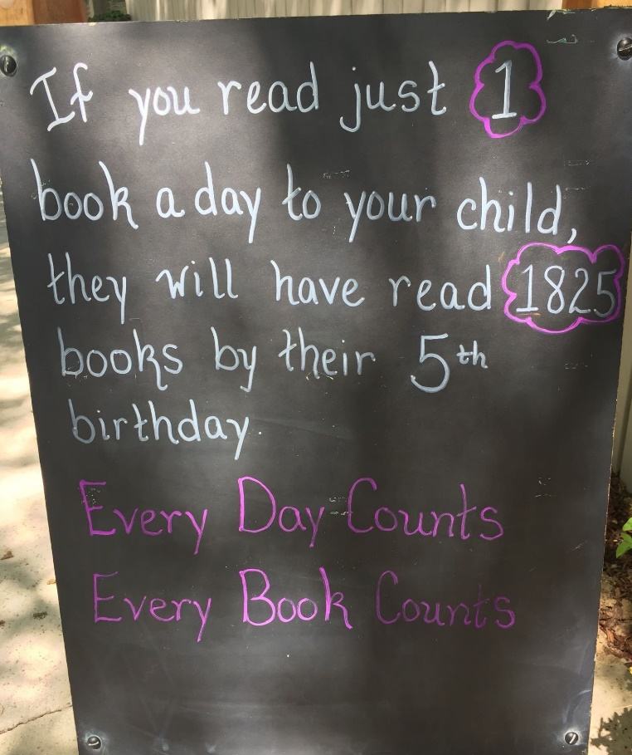
Homework
Literacy
Numeracy
Learning keywords
Discussing the pictures and ask questions about the book.
Daily reading
Encourage your child to read in any situation will be beneficial
Using the home environment to look at real life numeracy and mathematics
Forming numbers
Counting real life objects
Real life shapes
Communication is key for the development of your child.
Notes:
Homework will take many forms. At first your child will receive written homework for further consolidation. Active games will also be distributed to reinforce learning at home. Your child will receive a homework record which is a key form of communication. The children will come home with their purple bag with their homework for the week. They do not have to complete all the homework until the Thursday however we do ask that they bring their purple bags back to school everyday so we can do their reading with them in class. Reading and phonics/keyword revision should be done daily with other homework to be done within the week. It is really important for the children to read every day at home whether this be their school reading book or online resources.

Slide 13
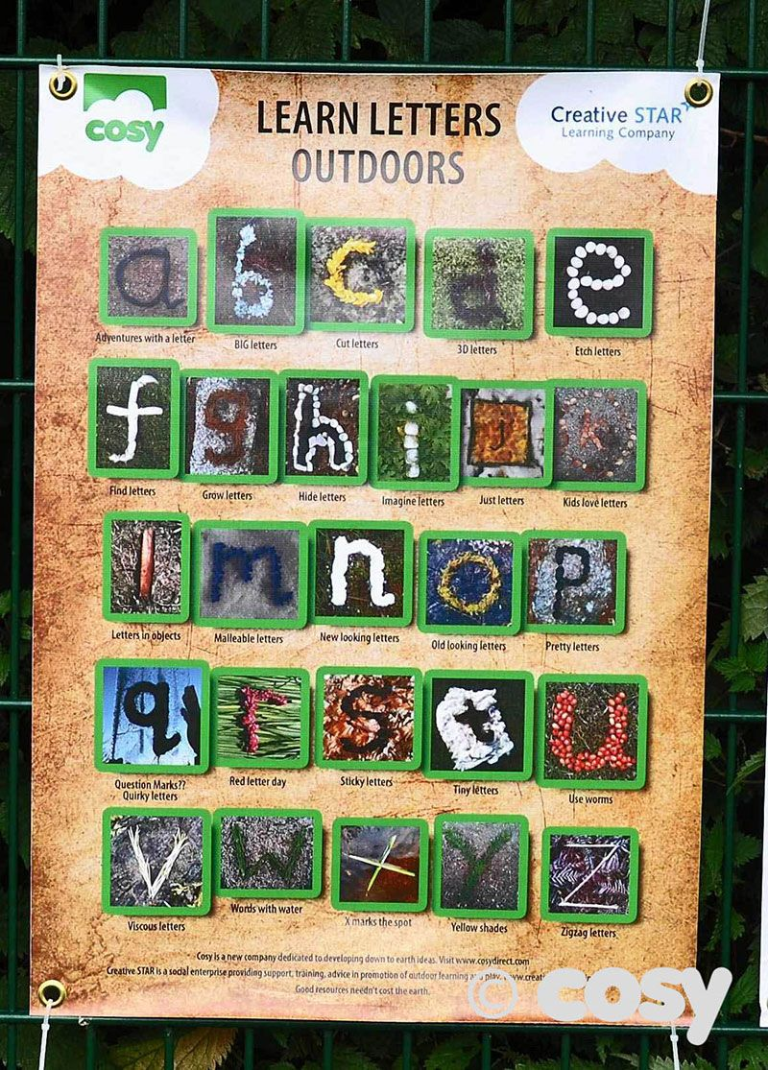
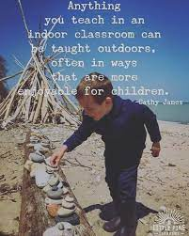

Outdoor Learning

Slide 14
Getting A Head Start
Things to consider…
Do they recognise their name?
Only first letter of name to be written in upper case
Label everything!
Encourage them to open their own snacks and packets at home
Velcro shoes are best
Can your child put on their own jacket and zip it up?
All P1-5 children are entitled to a free school meal. Pin up the weekly menu and read this over at home.
Can your child get changed independently so they feel comfortable changing for PE?

Slide 15

Team work makes the dream work.
We understand that this is a huge moment for your children and you.
Trust that we will love your children as if they were our own.
We have an open door policy!
Let’s work together for your children.

