Slide 1
Primary 1 Induction- The curriculum
Miss Hopkins and Miss Bonn
Notes:
Welcome to our Primary 1 Induction Slide Show. This power point is hosted by Miss Hopkins and Miss Bonn. We are the Primary 1 teachers for the session beginning August 2020. In the following power point we will share with you different aspects of the curriculum we will teach and how we will implement this for your children. We are looking forward to welcoming all children soon.

Slide 2
Overview
Play
Numeracy and Mathematics
Literacy – Phonics
Literacy- Reading
Supporting your child at home

Slide 3
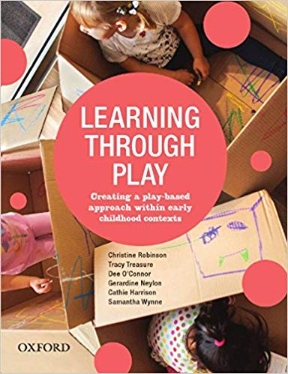
Play
“Play is the natural way in which children learn. Young children are learning new concepts all of the time during a range of play activities”
Types: Role play
Small world
Tuff trays
Water/sand
Cooking
ICT
Notes:
Play is a huge part of your child’s learning. We understand that due to current circumstances that play may look different come August. However, we truly believe play has an enormous impact on a child’s learning and therefore we will be finding creative ways to ensure we continue our play based approach to teaching and learning.

Slide 4
Numeracy and Mathematics
How do we teach numeracy and mathematics?
Practical approaches
Dripping tap effect
Follow up written work
Holistic assessment
“Maths is not just about getting the right answer. It is all about thinking through and finding ways of solving problems. It does not matter if your child gets the wrong answer, as long as they are able to explain their method of reasoning.”
Notes:
In Primary 1 the teaching of Numeracy and Mathematics is developed through play and active approaches. Number work is the main focus and the teaching of this is weaved through all daily activities. Ensuring all children are secure with numbers 1-20 and have the ability to add and subtract within this bracket is our main priority. We will explore shape, pattern, money and measurement alongside all number work.

Slide 5
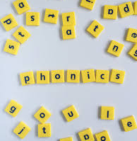
Literacy- Phonics
All words are made up of sounds.
26 letters in the alphabet, but there are 44 sounds in the English language.
North Lanarkshire Literacy, supported by jolly phonics, is the current scheme that we use.
Daily lesson involves learning the sound, letter formation, a song and words that begin with the particular letter being taught.
Notes:
Having a secure phonological awareness is the foundation to learning how to read and write. In Primary 1 we will teach a variety of sounds as well as the individual letters of the alphabet. Through practical activities, songs and play based tasks your child will expand their knowledge and understanding of various sounds. It is important for your child to identify the initial sound of a word and the sounds within a word before they move forward. Using this learning your child will begin blending various sounds to create words. In addition to learning their sounds, all children will be exposed to common words such as the, what and her. These words cannot be sounding out using the blending method so therefore the children will be encouraged to learn the shape and letters of these words.

Slide 6
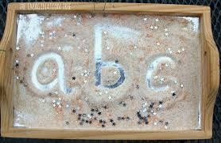
Literacy- Letter Formation
At this stage in their development it is important that children learn to form their letters correctly.
A variety of activities will be used to ensure this, for example
Mark making
Sand/glitter/shaving foam trays
Daily written practice
Observation
Notes:
For children to be able to form letters properly it is important that they have developed their fine motor skills needed for a pencil grip. You can develop this through the use of tweezers, threading beads, holding pens/paintbrushes/pencils/crayons etc.

Slide 7
Notes:
Here is an example of active literacy in action.

Slide 8
Literacy- Reading
In Primary 1 we will use a range of reading resources and books.
The books begin with picture books with an extended story to go with the book, this reinforces that illustrations also tell a story.
Most key words can be sounded out which links to our phonics. Some words just need to be learned for example: was, her and put.
Notes:
It is important to expose children to as many genres of texts as possible. Additionally, reading can be developed through everyday activities. For example, reading road signs, supermarket labels, TV screens etc. It is common for children to memorise books they read often and this may present itself as a confident reader. Strategies to avoid this could be pointing at each word as they read, opening the book at random pages, covering the pictures and ask them to read the sentence backwards.

Slide 9
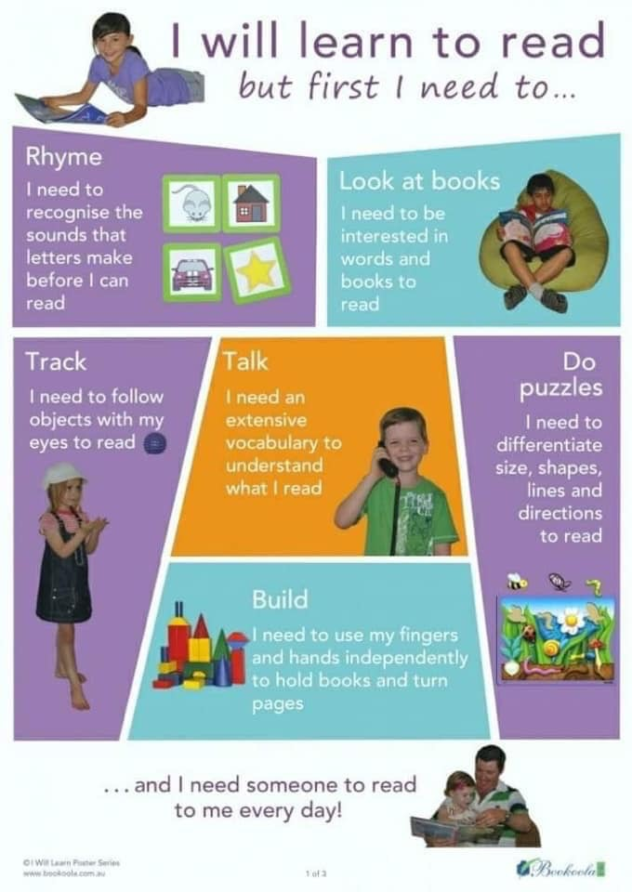

Slide 10
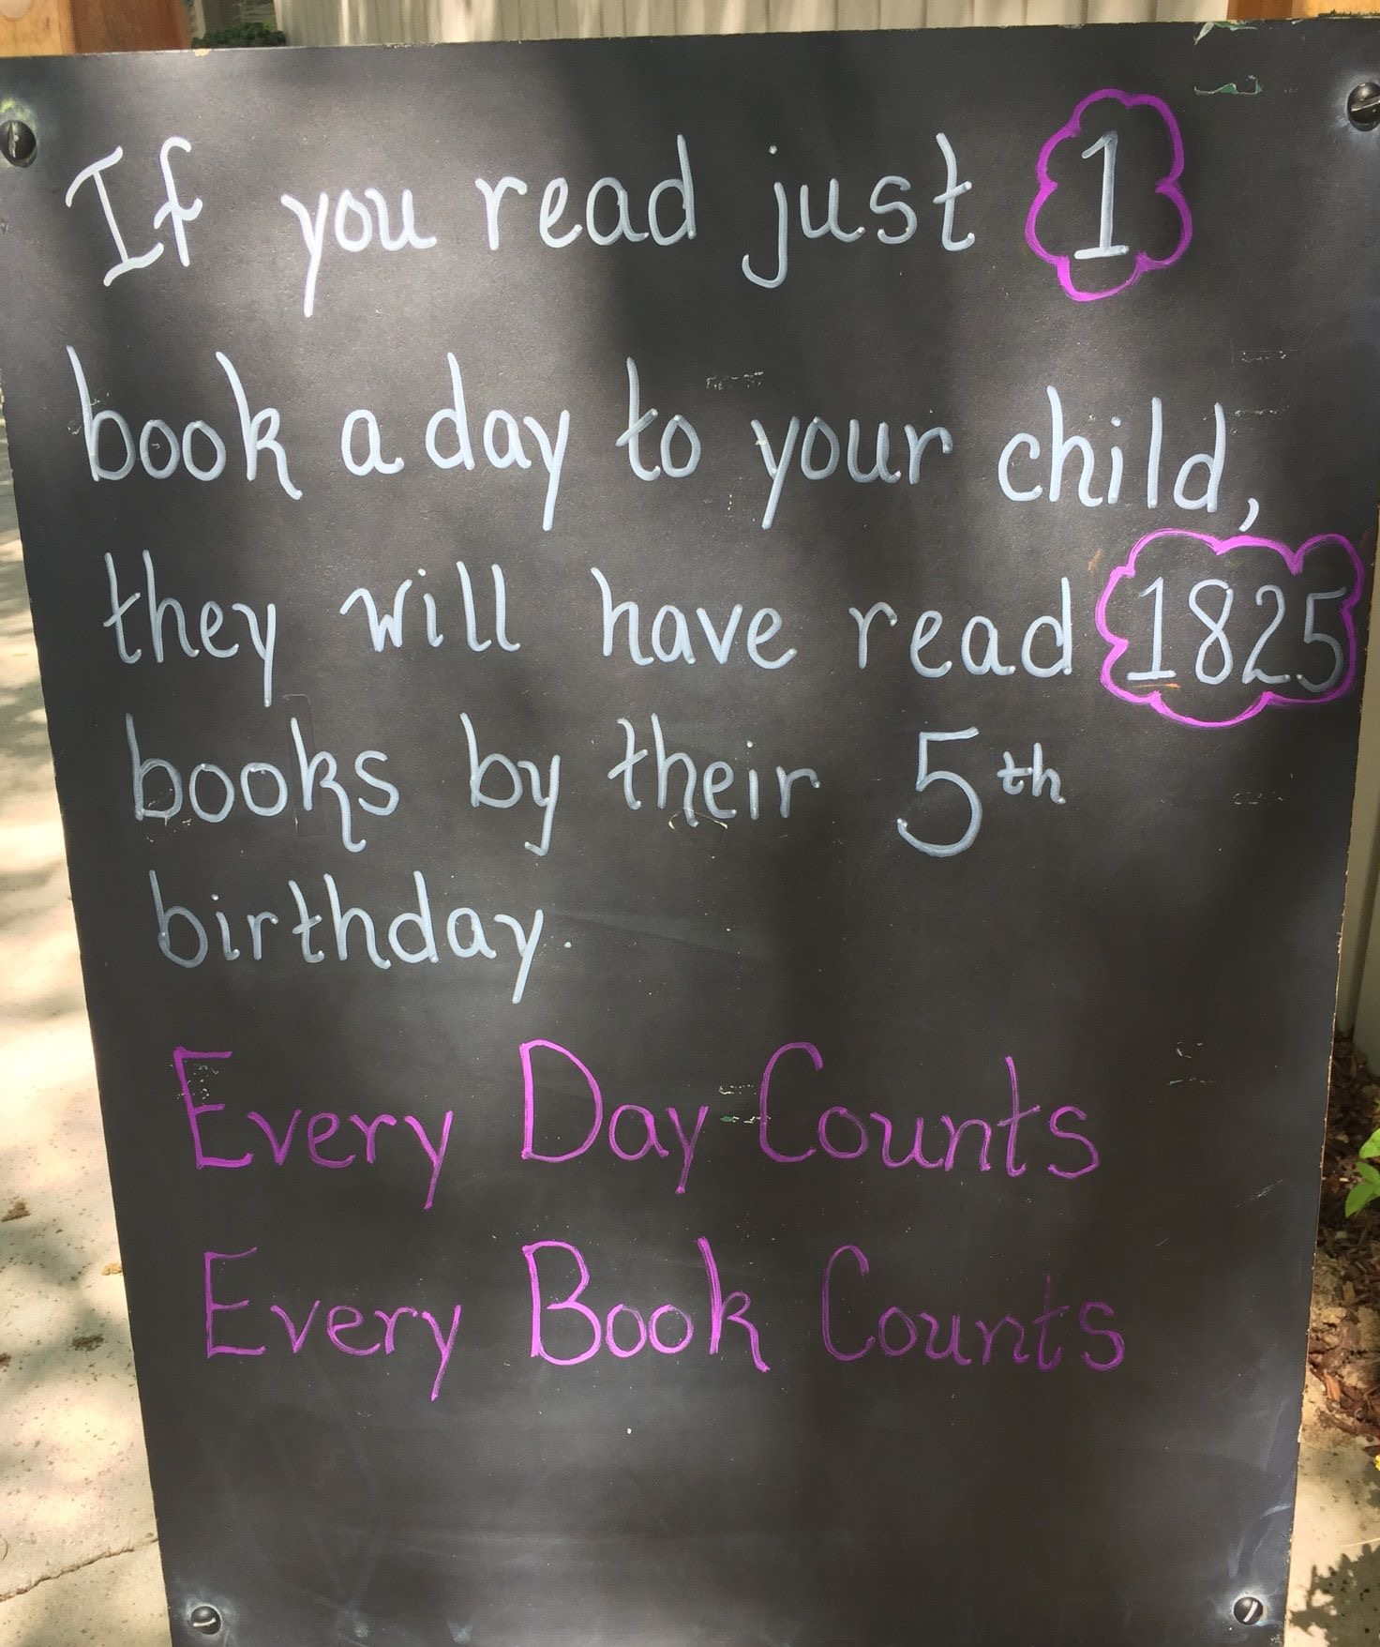
Homework
Literacy
Numeracy
Learning keywords
Discussing the pictures and questions your child
Daily reading
Encourage your child to read in any situation will be beneficial
Using the home environment to look at real life numeracy and mathematics
Forming numbers
Counting real life objects
Real life shapes
Communication is key for the development of your child.
Notes:
Homework will take many forms. At first your child will receive written homework for further consolidation. Active games will also be distributed to reinforce learning at home. Your child will receive a homework diary which is a key form of communication. Within this diary the children will set targets and evaluate their learning. Parental engagement with this diary is important for communication. It is really important for the children to read every day at home whether this be their school reading book or online resources.

Slide 11
Getting A Headstart
Things to consider…
Do they recognise their name?
Only first letter of name to be written in upper case
Label everything!
Encourage them to open their own stacks and packets at home
Velcro shoes are best
Can your child put on their own jacket and zip it up?
All P1-3 children are entitled to a free school meal. Pin up the weekly menu and read this over at home.
This year is unique but remember every child is in the same situation
Can your child get changed independently so they feel comfortable changing for PE?

Slide 12
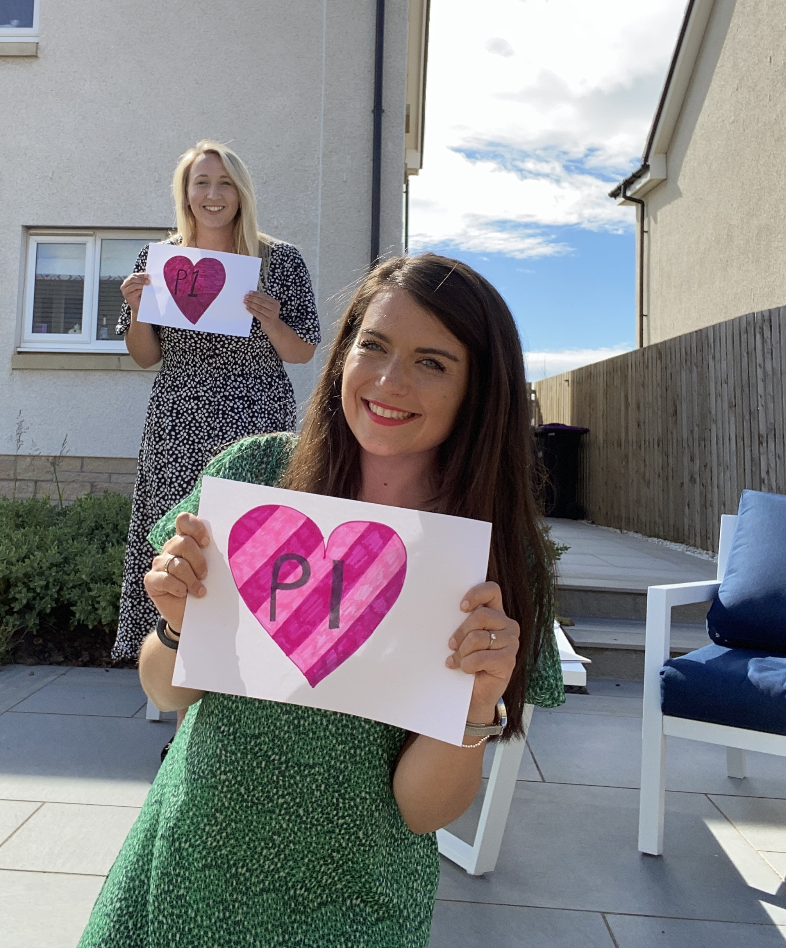
We really can’t wait to meet you!
Miss Bonn
Miss Hopkins

