Slide 1
Springside Primary & Early Years
Rights Respecting School update
Collegiate – Tuesday 7th February

Slide 2
Springside Primary & Early Years is working to create a safe and inspiring place to learn, where our children are respected, their talents are nurtured and they are able to thrive. Our Rights Respecting Schools Award embeds these values in daily school life and gives children the best chance to lead happy, healthy lives and to be responsible, active citizens.

Slide 3
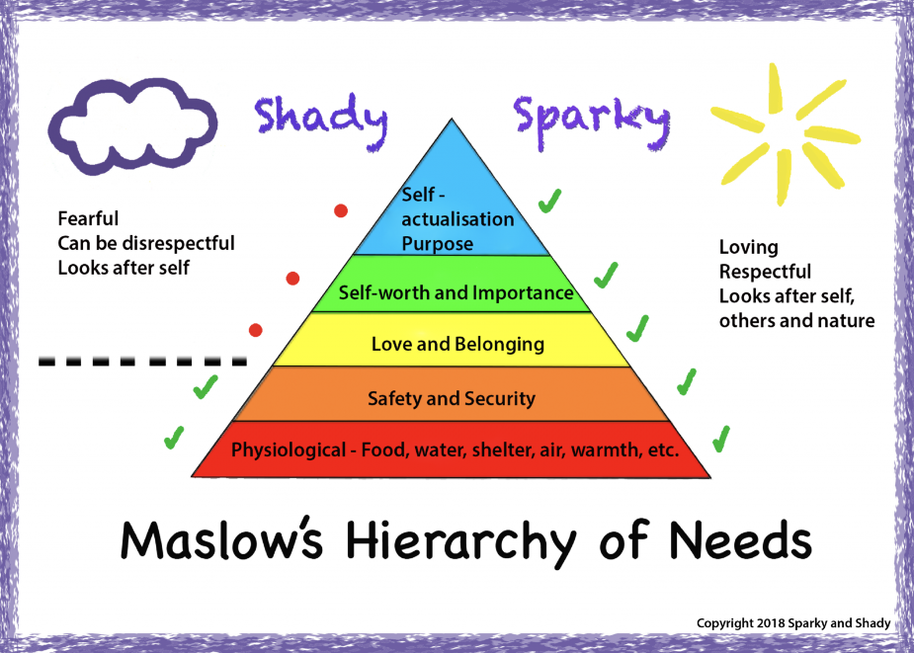
Linking Springside Primary & Early Years Vision, Values & Aims With UNCRC Rights Respecting Schools
At Springside Primary & Early Years we are working to embed children’s human rights into our school visions, values and aims and ensure each child’s physiological needs, safety needs, social needs and esteem needs and self-actualization needs are met.
Our children are developing in their understanding that their rights and the rights of others are inherent, inalienable, indivisible, universal and unconditional.
Children and adults collaborate to develop and maintain a rights respecting community based on equality, equity, dignity, respect, non-discrimination and participation.
Children are empowered to enjoy and exercise their rights and promote the rights of others both locally and globally.

Slide 4
Our children are growing in their understanding that UNCRC rights are…
Universal
Inherent
Inalienable
Indivisible
Unconditional
Indivisable

Slide 5
Working Towards Our Silver Award – Rights Aware
Children at Springside Primary & Early Years School engage with and enjoy their rights. •
Rights are embedded into the life of school.
Key ‘Rights Respecting Schools’ language is embedded. •
Children are learning to see themselves as global citizens. •
P4-7 children are confident in using their pupil voice & EY, P1-3 are learning that their voice is valued and are becoming more confident in sharing their thoughts and ideas . •
The whole school community shows respect towards others, irrespective of gender, ethnicity or
religion. •
Diversity is celebrated and valued. •
Visitors recognise the strength of relationships within school. •

Slide 6
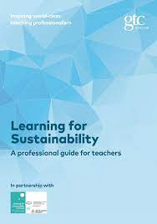
Linking UNCRC articles & SDG’s
Learning for Sustainability is an approach to life and learning - and an entitlement for learners in Scotland.
https://youtu.be/NfyPNHwOxvY
Notes:
https://www.unicef.org/media/60231/file

Slide 7
Joining Up All The Dots ….
https://youtu.be/gg_XZ-2Mx_8
Respect Earth and life in all its diversity.
Care for the community of life with understanding, compassion and love.
Build democratic societies that are just, participatory, sustainable and peaceful.
Secure Earth's bounty and beauty for present and future generations.
Notes:
https://www.unicef.org/media/60231/file

Slide 8
