Slide 1
Springside Primary

Slide 2
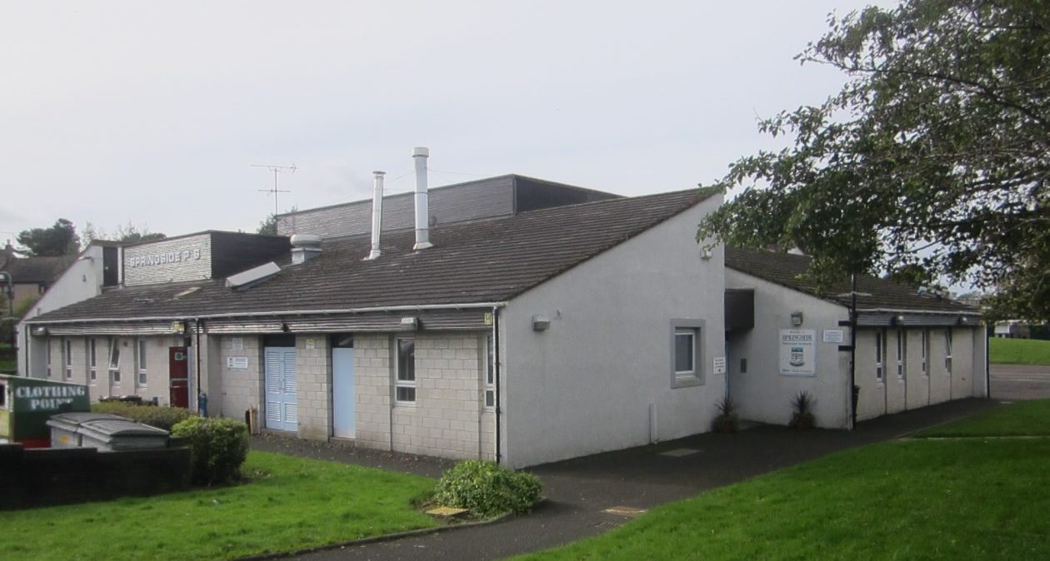
Opened December 3rd 1979

Slide 3
Best wee school in Ayrshire!

Slide 4
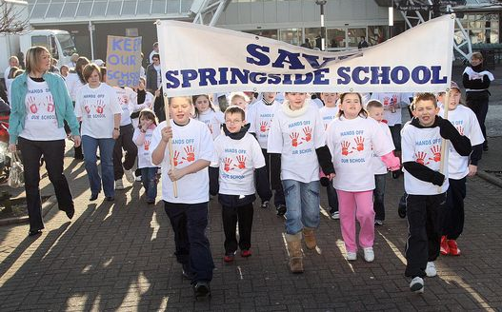
Springside Primary continues to be at the heart of the village community !

Slide 5
^{Our overall aim …}
to provide high quality experiences which motivate pupils, parents and staff to reach their full potential in the school and the wider community.
Respect
Inclusion
Citizenship
Equality
Ambition

Slide 6
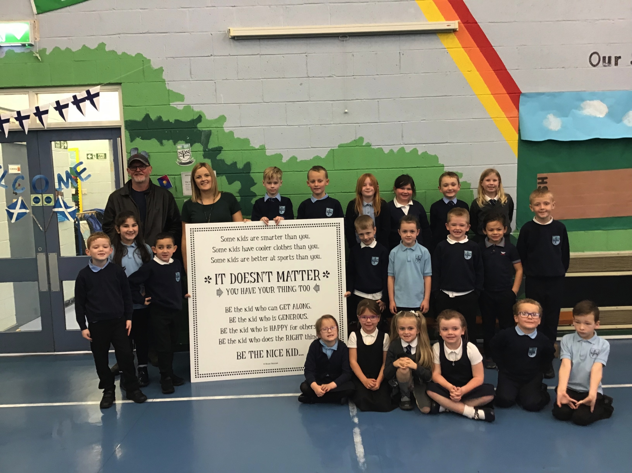
Citizenship
Inclusion
Equality
Respect

Slide 7
Coming Together To Learn Learning To Live Together
To set a high standard of achievement and attainment
To develop responsible citizens, confident individuals, successful learners and effective contributors
To promote parental engagement
To promote healthy lifestyles
To promote the professional development of staff
To promote sustainability
To develop sporting and cultural activities

Slide 8
Developing responsible citizens, confident individuals, successful learners and effective contributors.

Slide 9
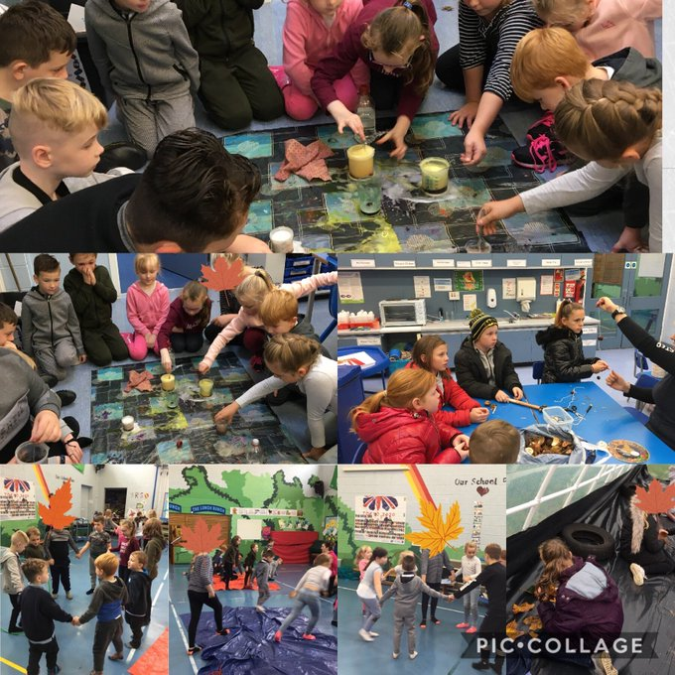
Developing responsible citizens, confident individuals, successful learners and effective contributors.

Slide 10
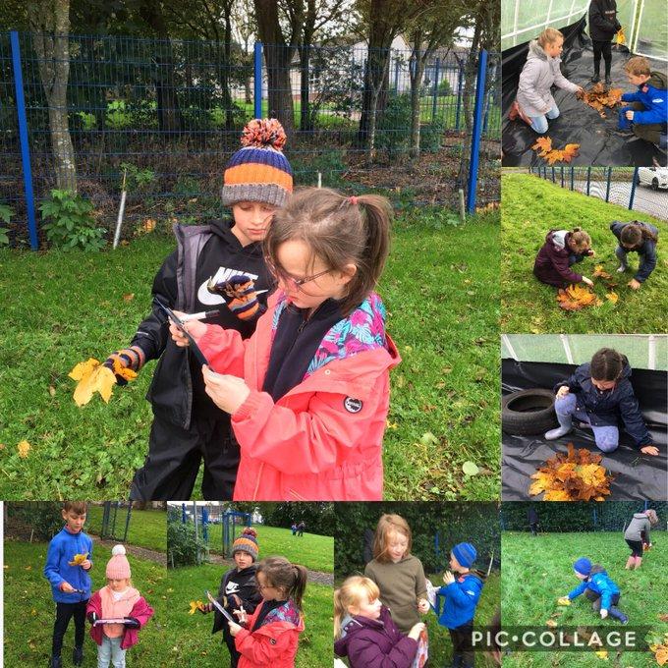
Developing responsible citizens, confident individuals, successful learners and effective contributors.

Slide 11
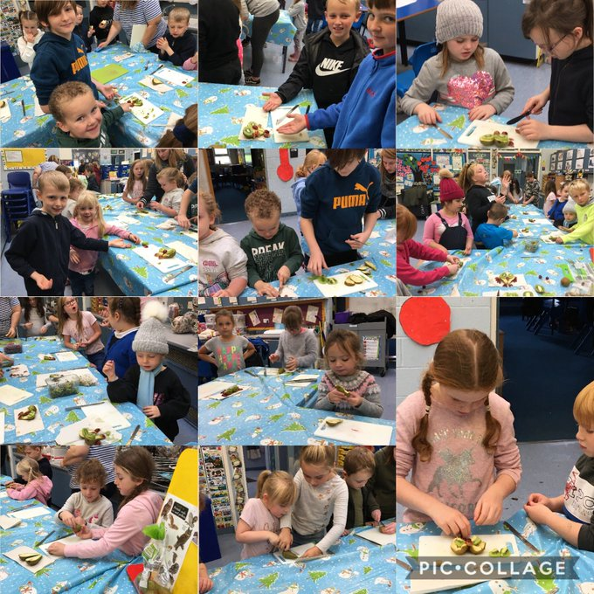
Developing responsible citizens, confident individuals, successful learners and effective contributors.

Slide 12
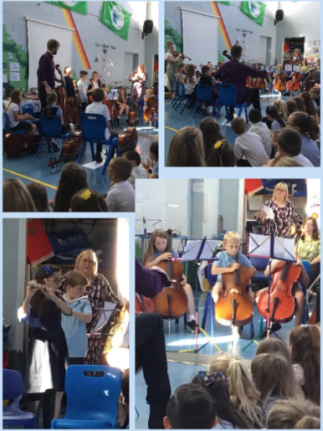
Developing responsible citizens, confident individuals, successful learners and effective contributors.

Slide 13
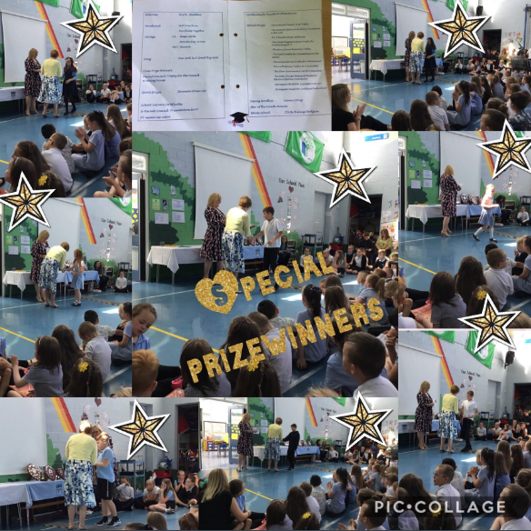
Developing responsible citizens, confident individuals, successful learners and effective contributors.
Setting high standards of achievement and attainment

Slide 14
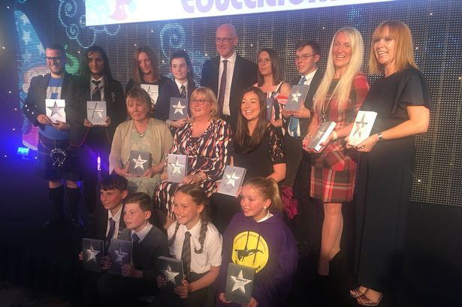
Celebrating Mrs Shedden as Scottish Headteacher of the Year!
Setting high standards of achievement and attainment

Slide 15
Developing responsible citizens, confident individuals, successful learners and effective contributors.

Slide 16
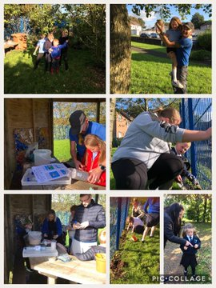
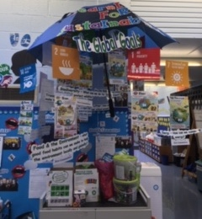
Developing responsible citizens, confident individuals, successful learners and effective contributors.

Slide 17
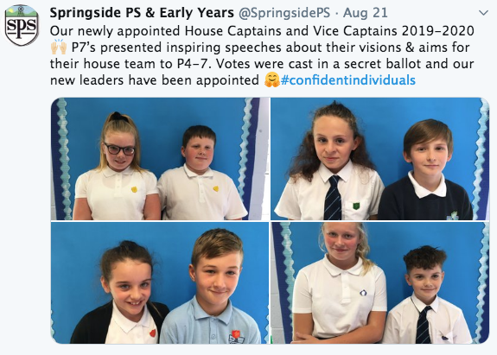
Developing responsible citizens, confident individuals, successful learners and effective contributors.

Slide 18
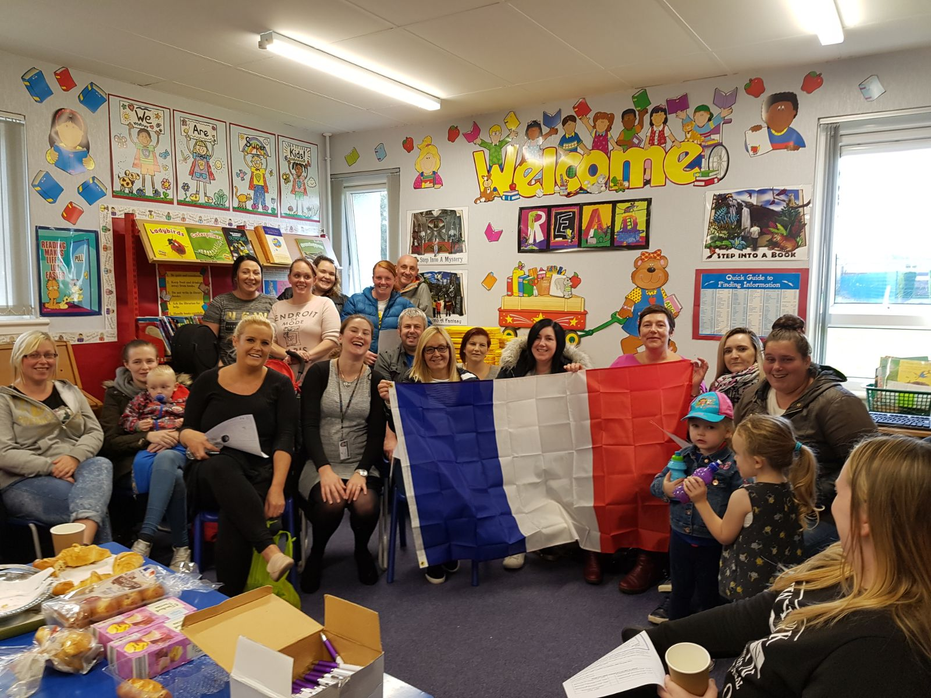
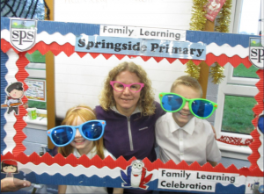
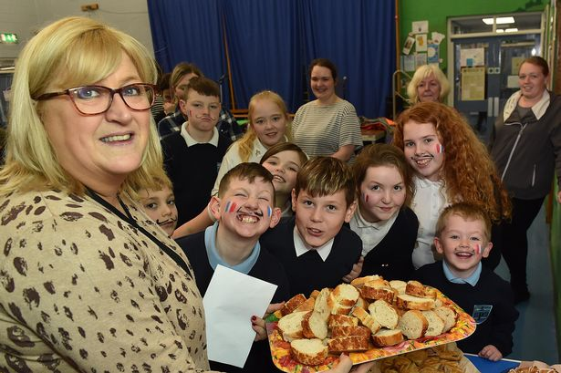
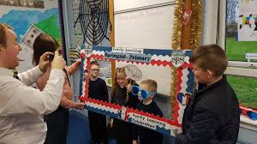
Wee Famille
#Family Learning
#Parental Engagement

Slide 19
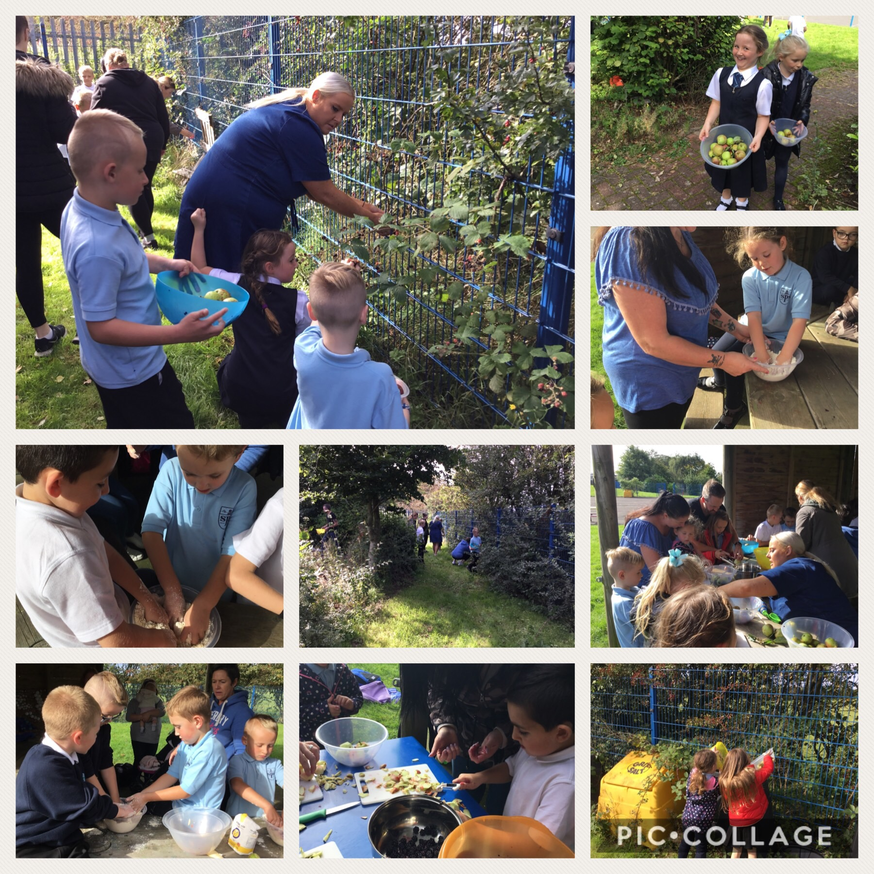
Promoting parental engagement.

Slide 20
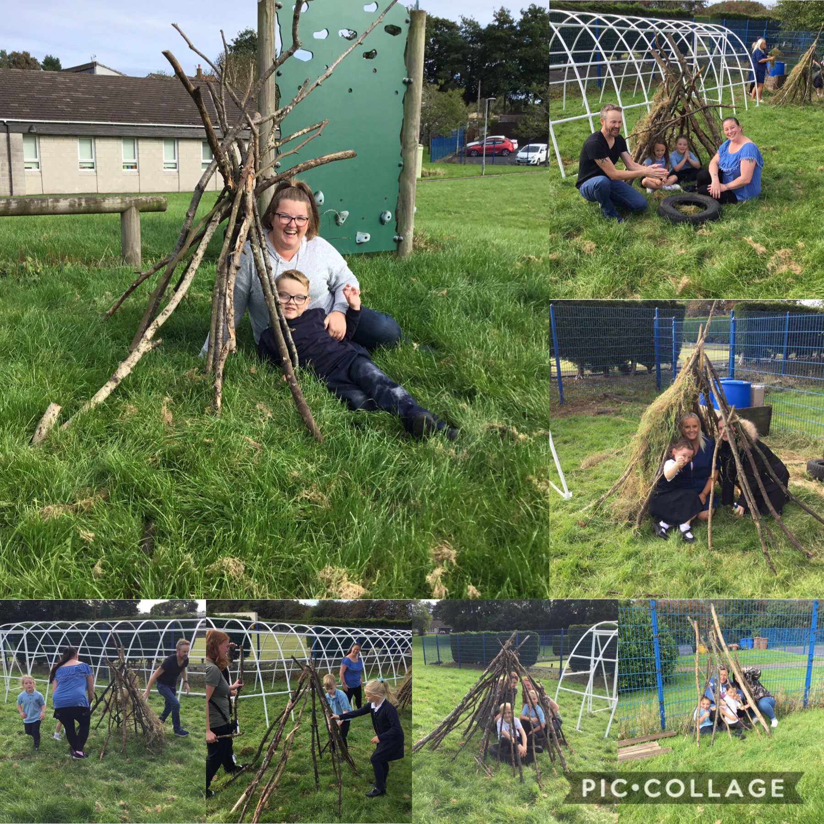
Promoting parental engagement.

Slide 21
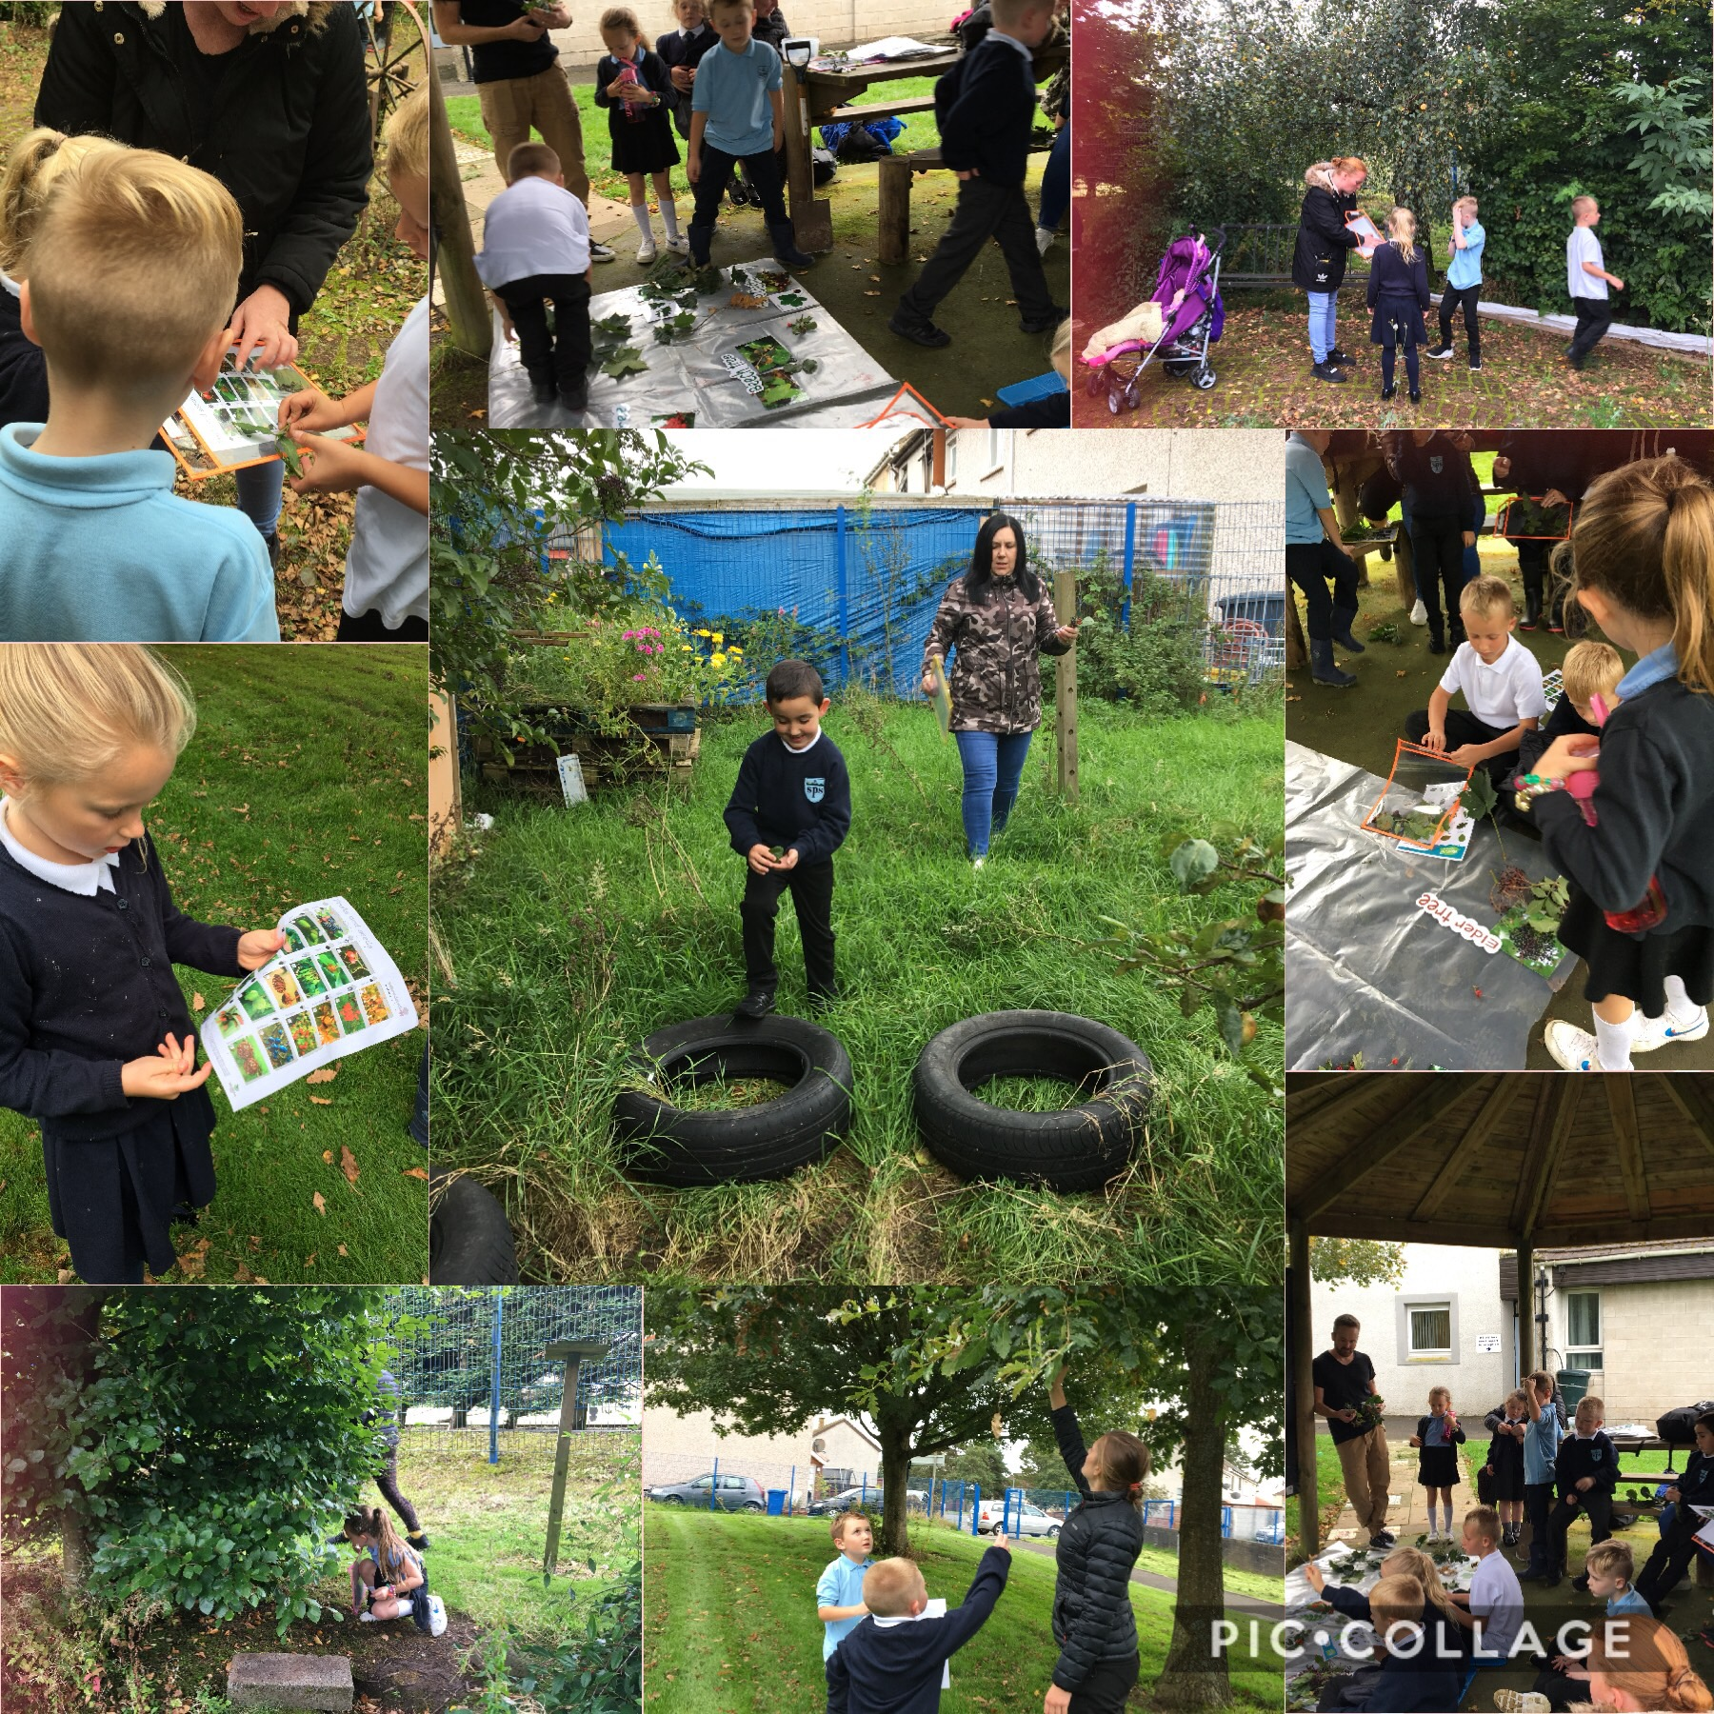
Promoting parental engagement

Slide 22
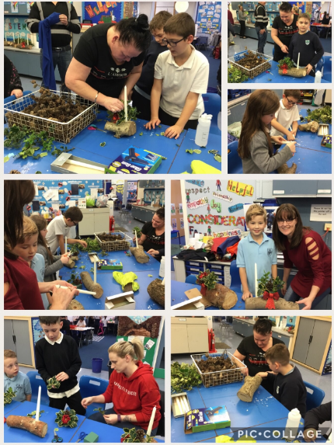
Promoting parental engagement

Slide 23
Promoting parental engagement

Slide 24
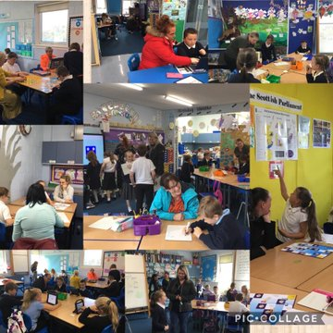
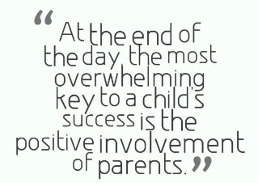
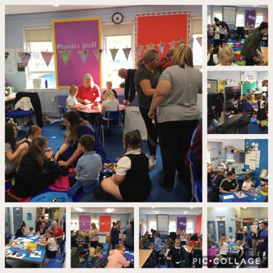
Promoting parental engagement

Slide 25
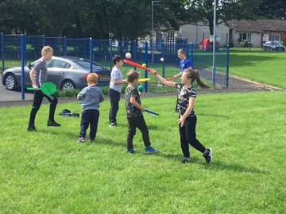
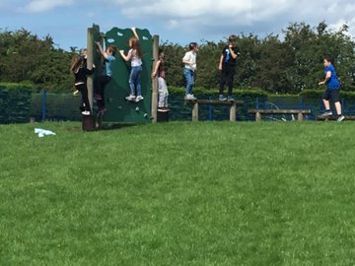
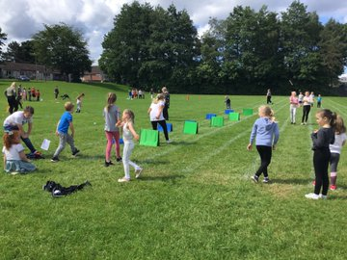
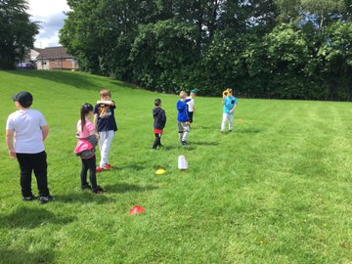
Promoting healthy lifestyles

Slide 26
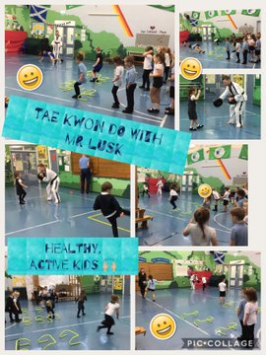
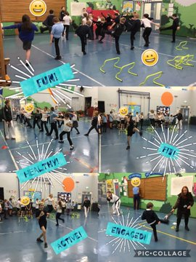
Promoting healthy lifestyles

Slide 27
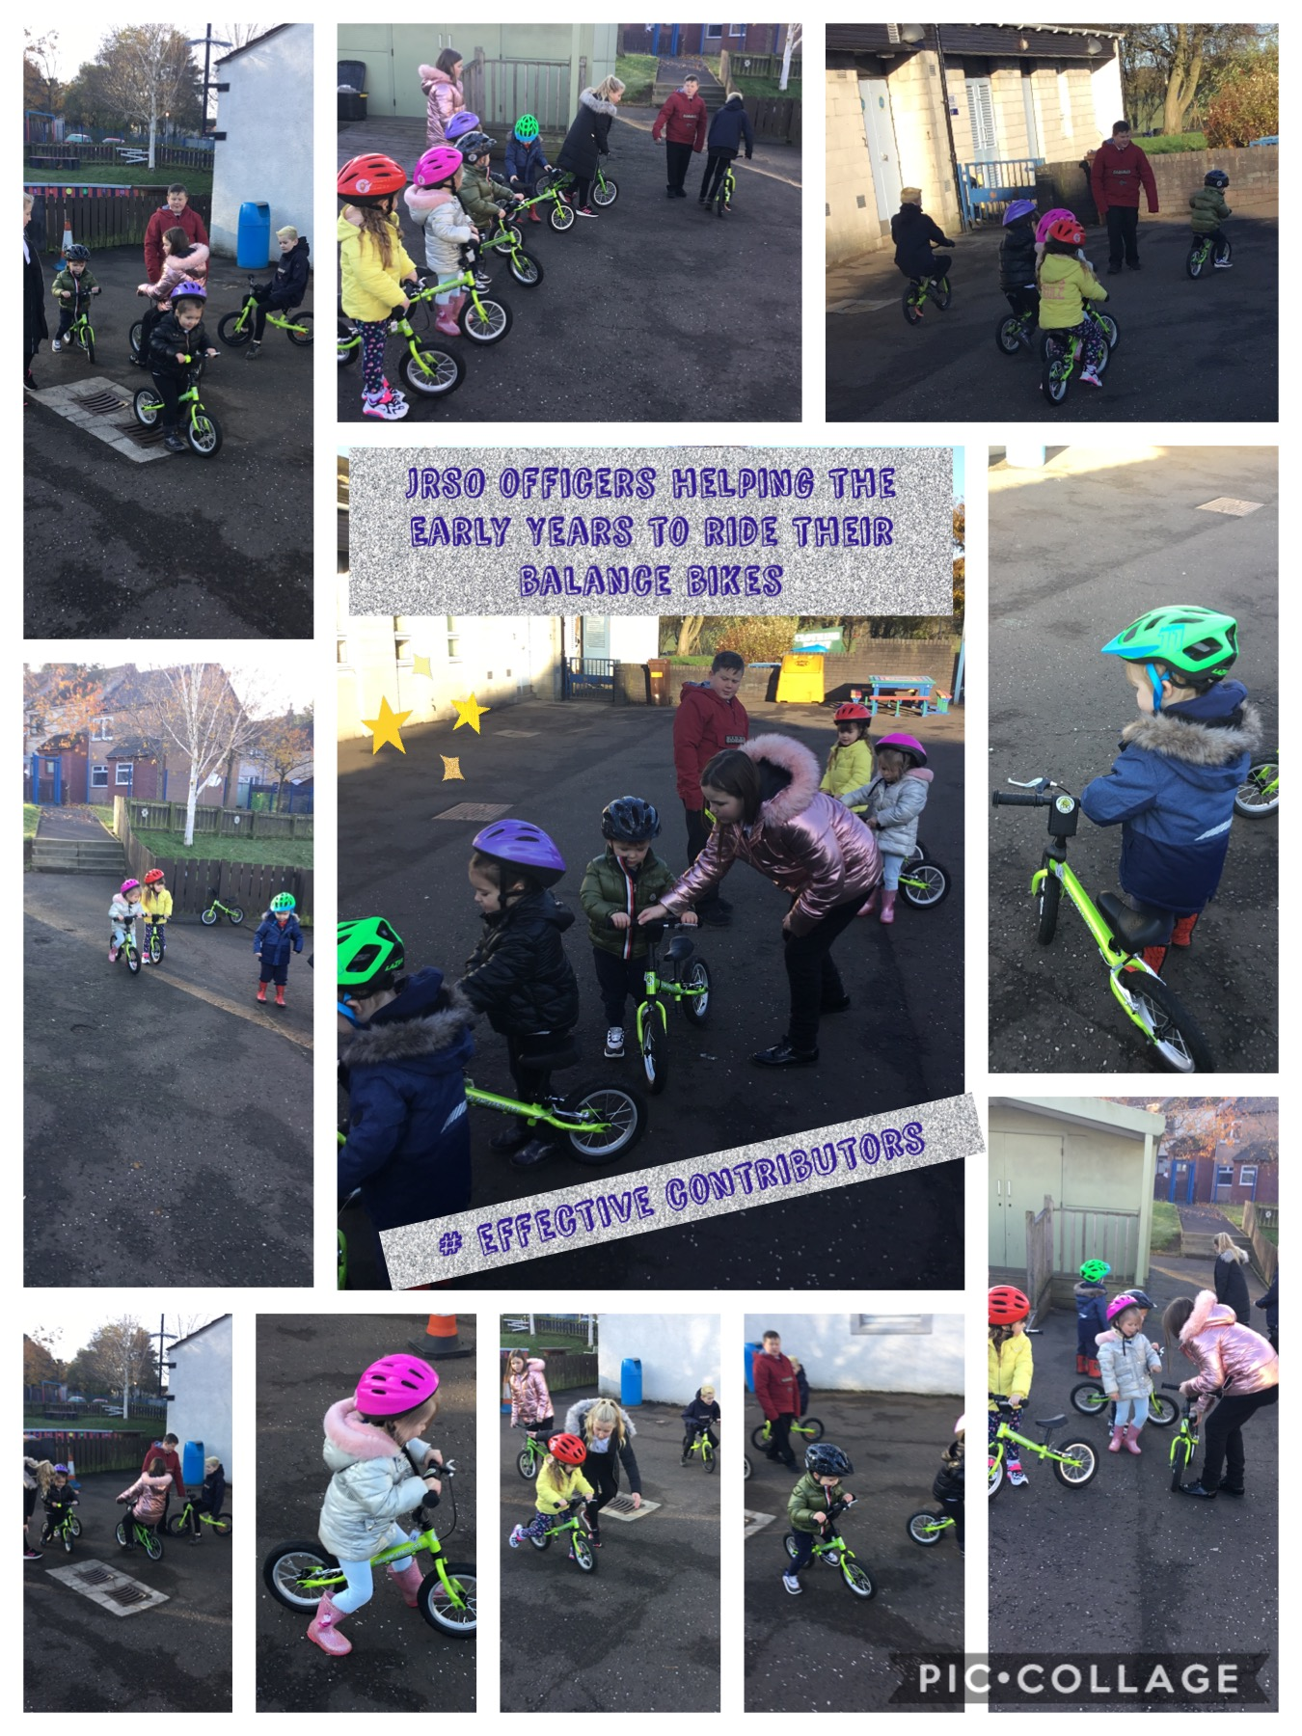
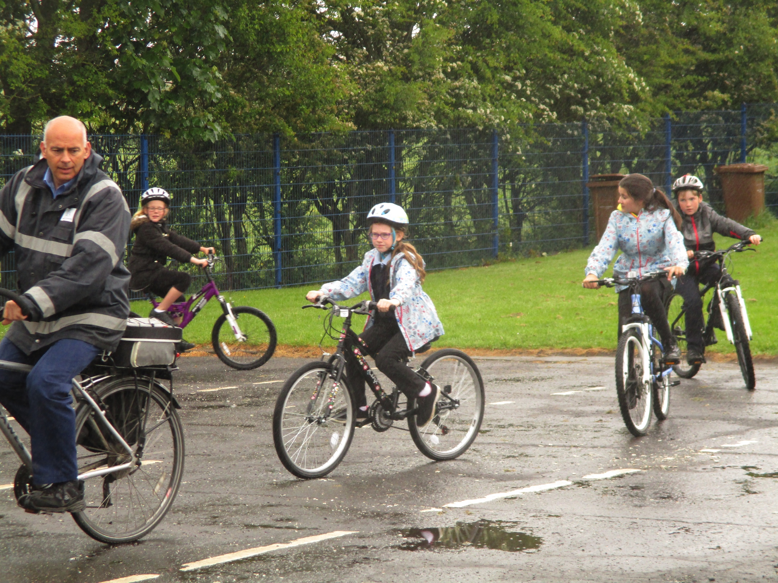
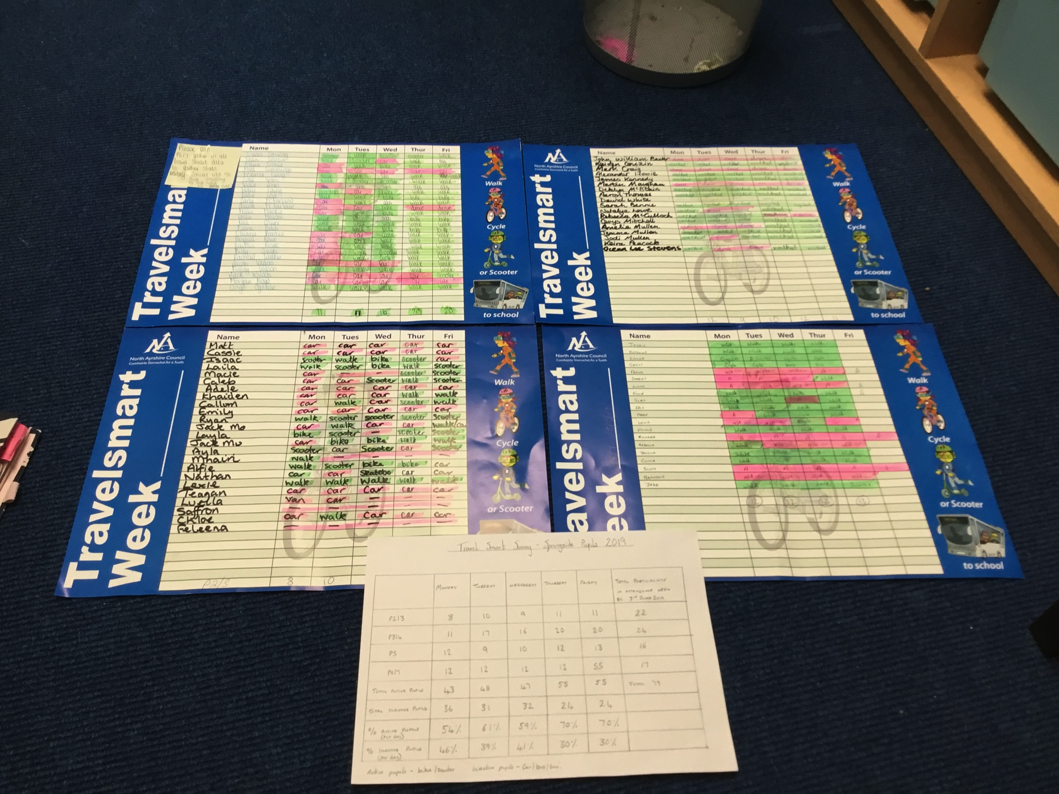
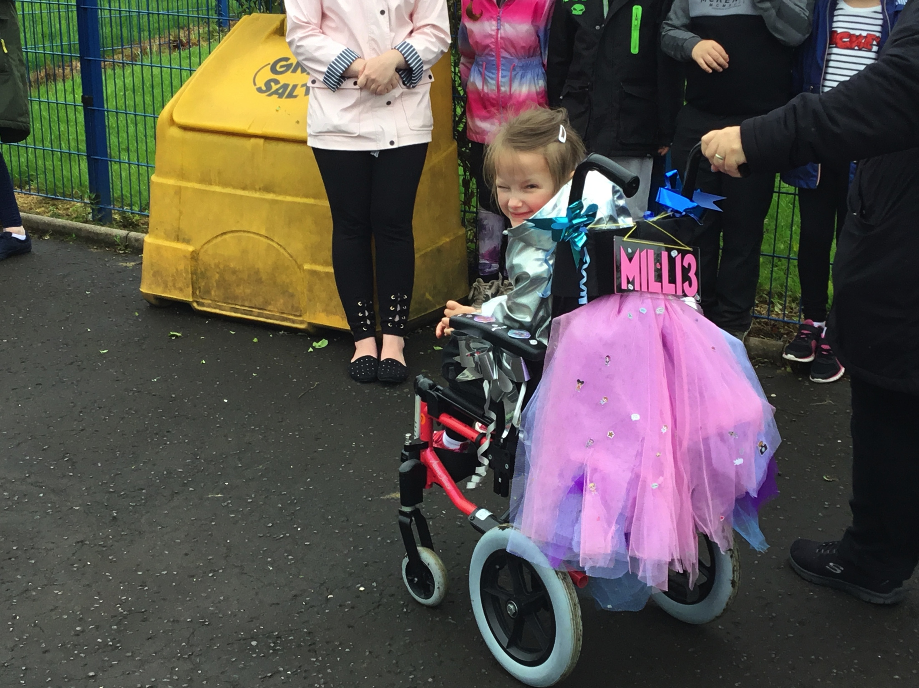
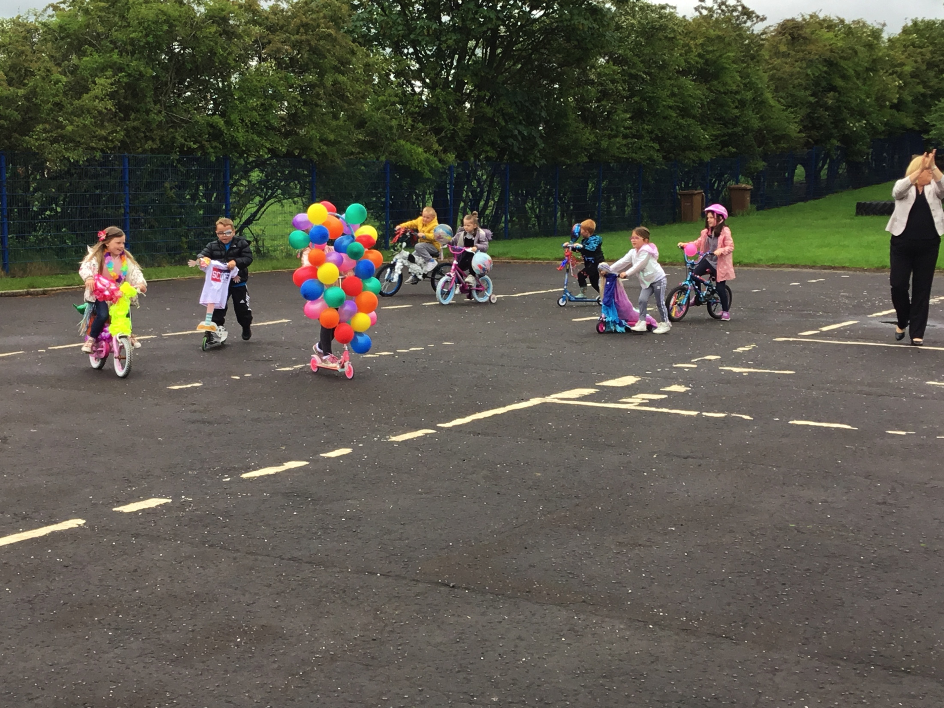
Promoting healthy lifestyles

Slide 28
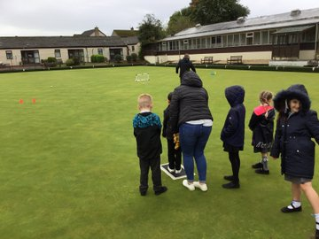
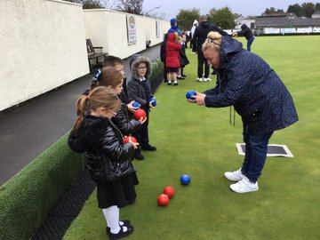
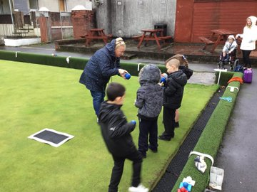
Promoting Healthy Lifestyles

Slide 29
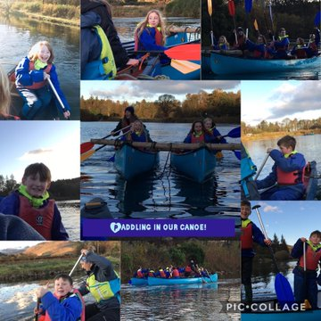
Promoting healthy lifestyles

Slide 30
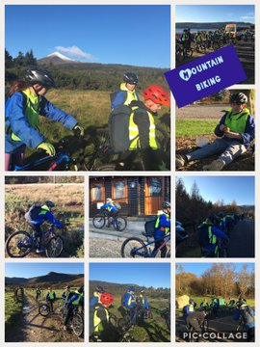
Promoting healthy lifestyles

Slide 31
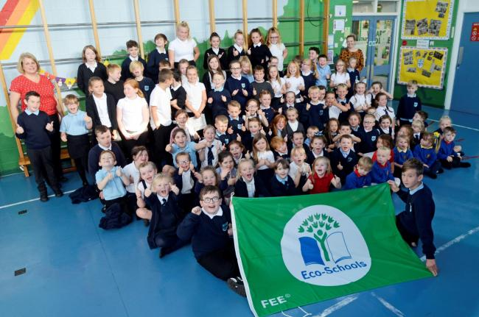
Promoting Sustainability

Slide 32
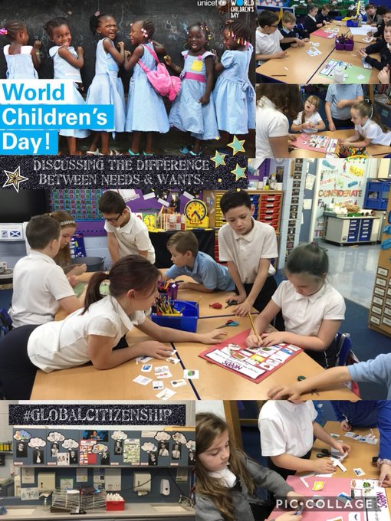
Promoting
Sustainability

Slide 33
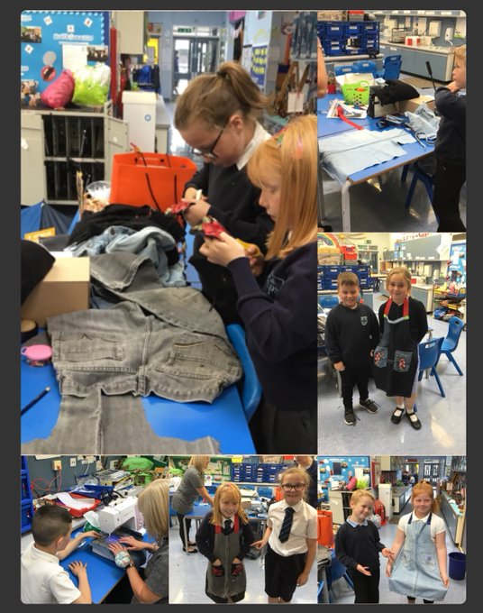
Promoting Sustainability

Slide 34
Connecting Classrooms
Promoting Sustainability

