Slide 1
Let’s go over the colors .

Slide 2
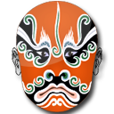
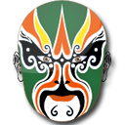
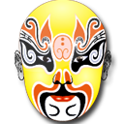
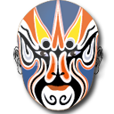
What colour is this?
zhè shì shí me yán sè？
这 是 什 么 颜色？ zhè shì + colour
这 是……
This is …

Slide 3
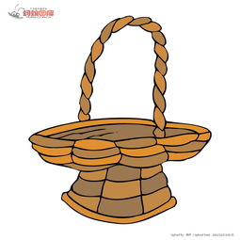
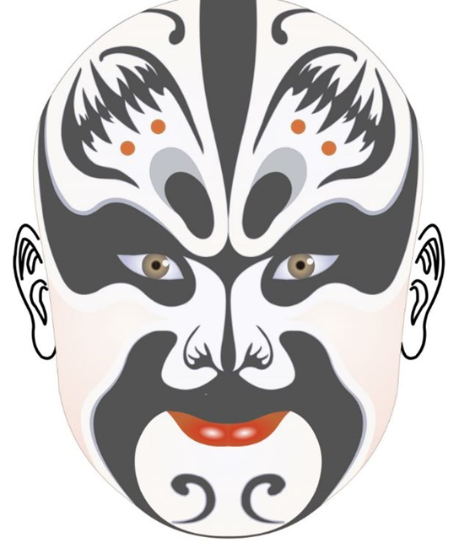
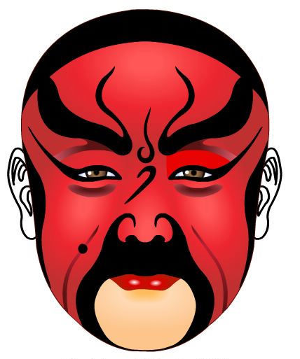
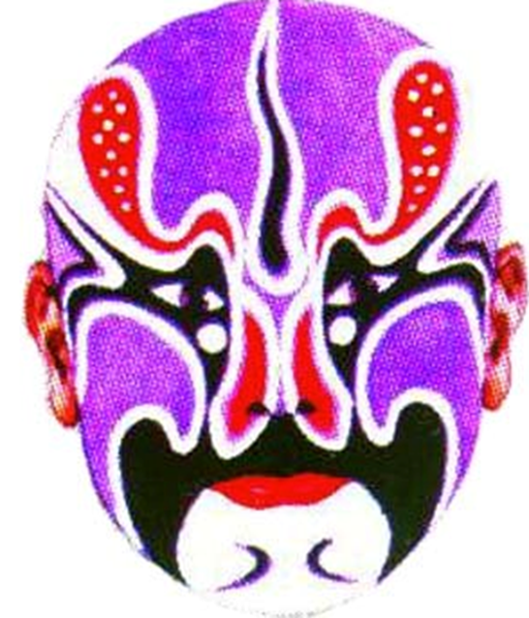
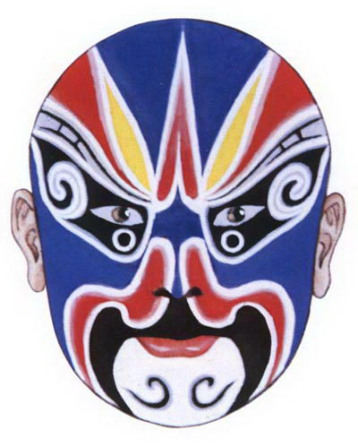
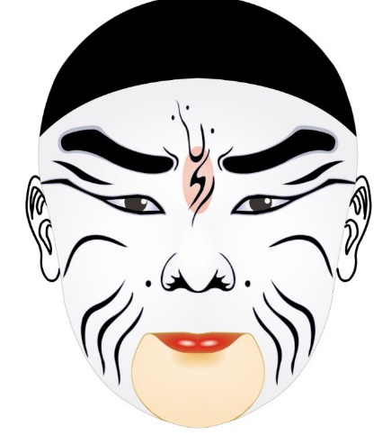
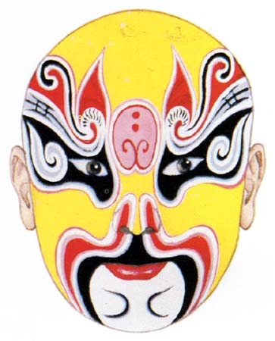
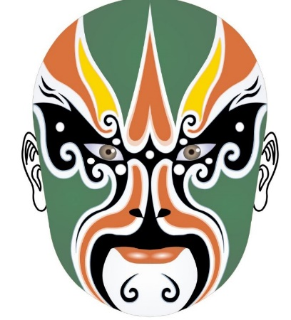
lánsè
蓝色
hēisè
黑色
hóngsè
红色
lǜsè
绿色
huángsè
黄色
báisè
白色
zǐsè
紫色

Slide 4
Chinese | Pinyin | English
黑 色 | hēi sè | black
白 色 | bái sè | white
红色 | hóng sè | red
蓝色 | lán sè | blue
黄 色 | huáng sè | yellow
绿 色 | lǜ sè | Green
紫 色 | zǐ sè | purple
这是什么颜色？ | zhè shì shí me yán sè？ | What colour is it?
这是+ colour 。 | zhè shì + colour。 | It is… .

Slide 5
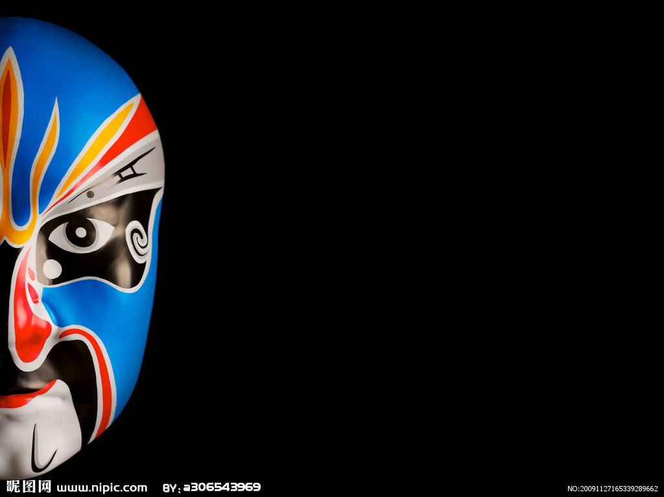
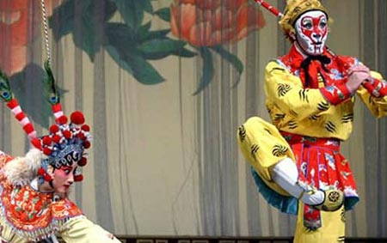
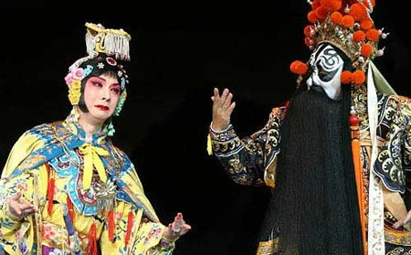
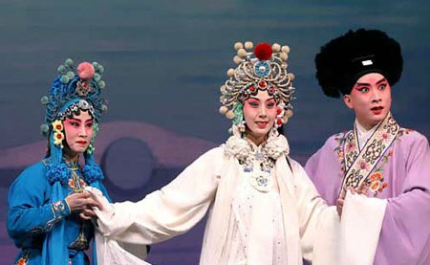
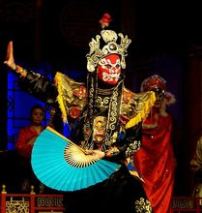
liǎn pǔ 脸 谱 Lianpu/Facial mask
https://www.youtube.com/watch?v=PnMRIzpO4nU

Slide 6
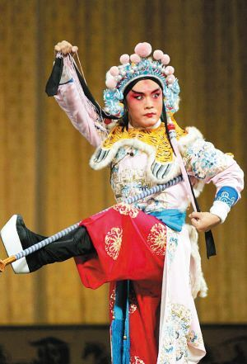
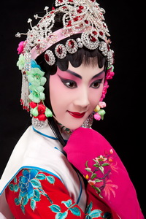
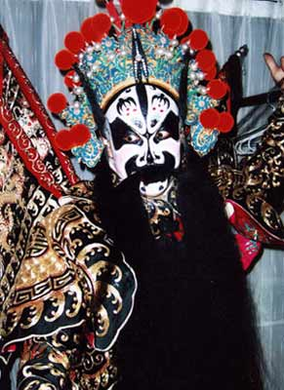
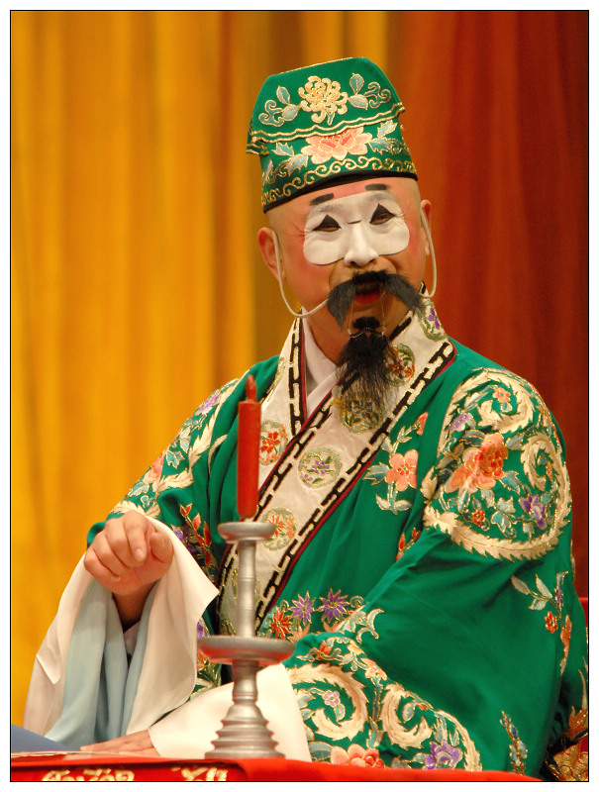
jīng jù de háng dāng 京 剧 的 行 当 The Roles of Peking Opera
dàn
旦
Jìng
净
Chǒu
丑
Shēng
生

Slide 7
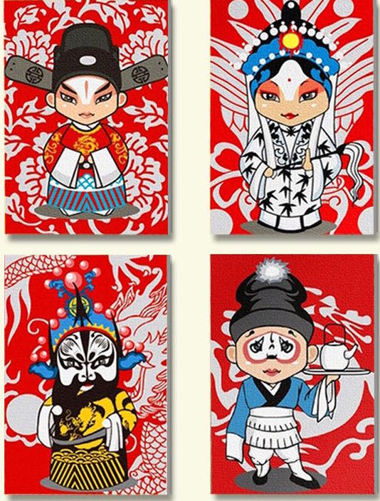
Four main roles in Beijing opera
旦
Female role
Dan is the positive,young and beautiful
female role
生
Male role
Sheng is the positive male role
净
Painted role
Jing is a supporting male role with a striking character
丑
Clown
Chou is the clown or a negative male or female
character.

Slide 8
京剧脸谱
Facial mask in Peking Opera
Facial mask is a type of stage makeup as well as an art of pattern for decorative use. It has a high value for appreciating, and is widely liked as a form of art.
1. Do you know how many colours are used in face masks?
2. What kind of character/personality does each colour indicate?

Slide 9
Learn about Lianpu
Colour is the language of Lianpu. Different colours represent the personalities of the different characters.

Slide 10
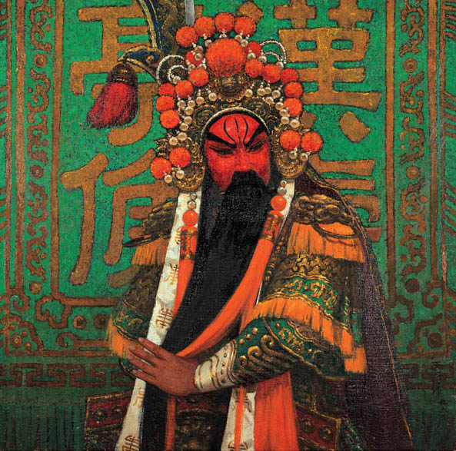
红色
Red
Red has expressed strong and loyal warrior types in operas such as Guan Yu.
hóng sè
红 色
RED
Brave, Loyal and Upright

Slide 11
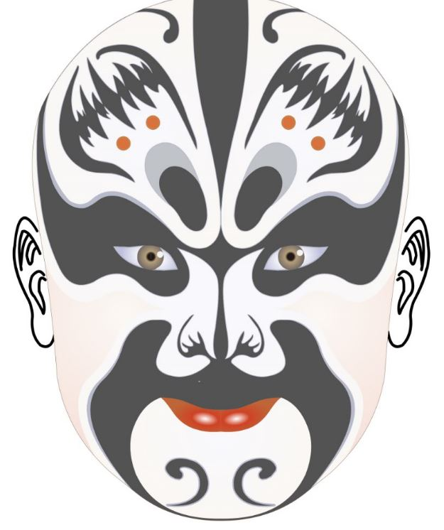
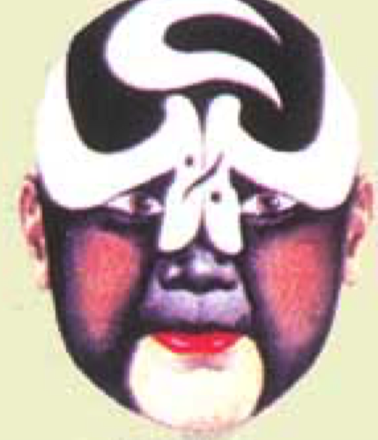
黑色
Black
Black refers to the righteous and reckless people, with integrity and bravery.
hēi sè
黑 色
Balck
Upright, bravery,firmness ,
honesty or temerity.
张飞
包拯

Slide 12
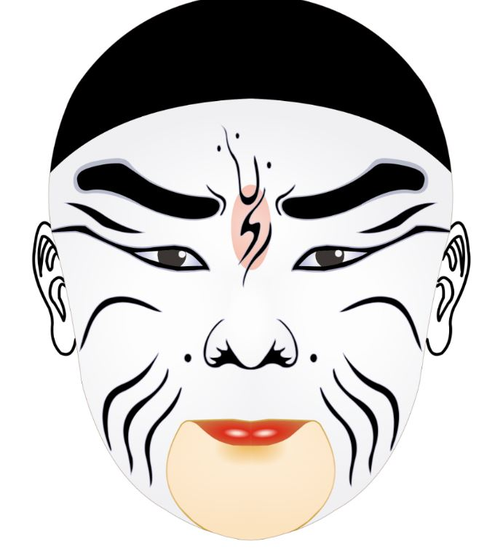
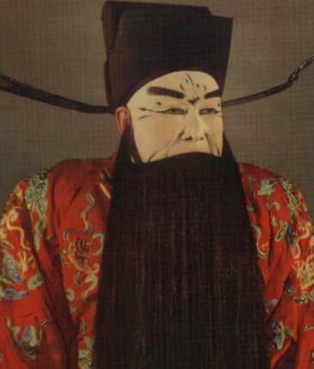
白色
White
Generally, the white face is relevant to the bad guys.
bái sè
白 色
White
Treacherous, crafty, self-willed.

Slide 13
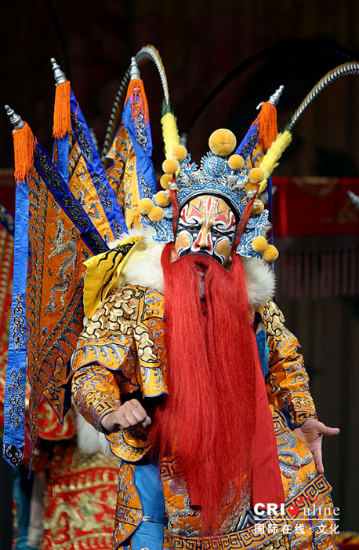
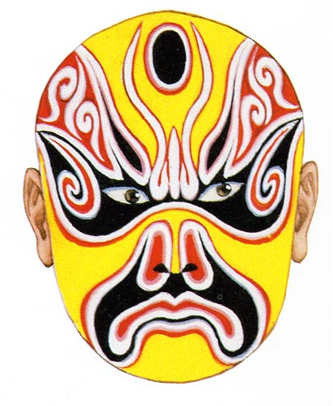
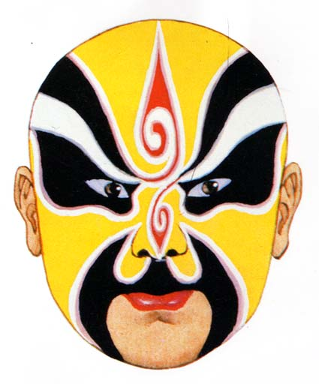
黄 色
Yellow
Yellow usually goes to those vicious brutal celebrities.
huáng sè
黄 色
Yellow
Bold/bad temper
Dangerous and cunning
典韦

Slide 14
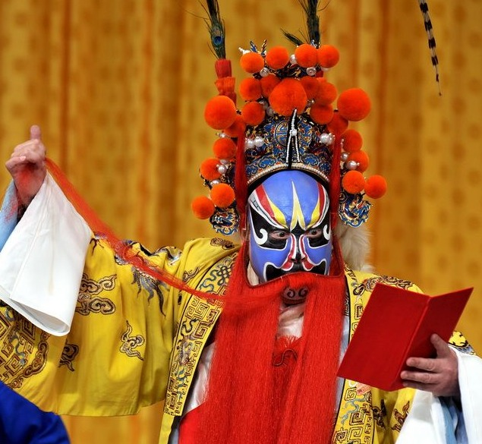
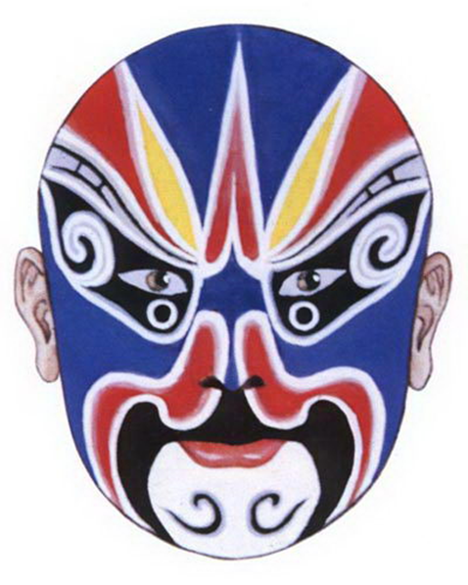
Blue or Green types of figures are usually irritable.
蓝 色
Blue
lán sè
蓝 色
blue
Unyeilding

Slide 15
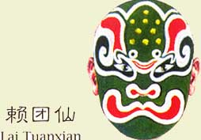
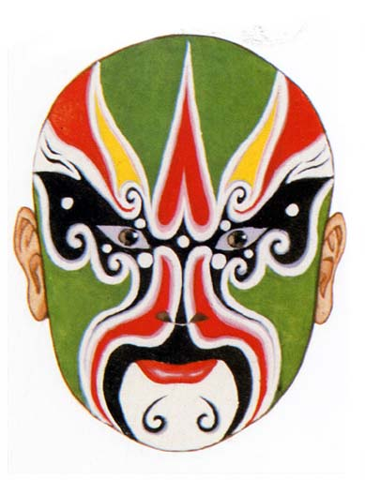
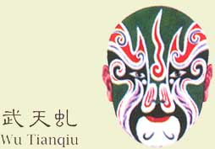
lǜ sè
绿色
绿色
Green
bold and powerful/rash

Slide 16
Upright / powerful
zǐ sè
紫色

Slide 17
lánsè
蓝色
hēisè
黑色
hóngsè
红色
lǜsè
绿色
huángsè
黄色
báisè
白色
zǐsè
紫色

