Slide 1
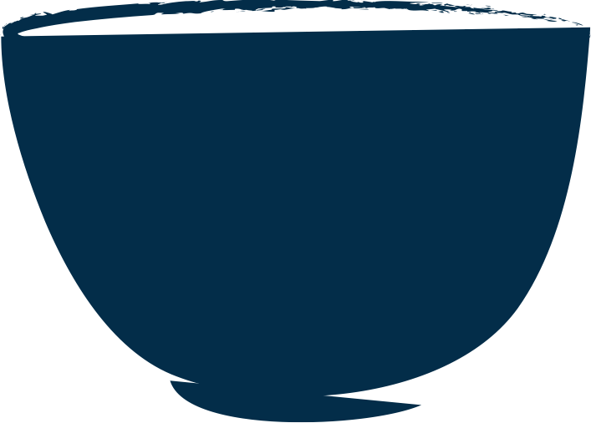
茶
禅 茶 一 味
Tea

Slide 2
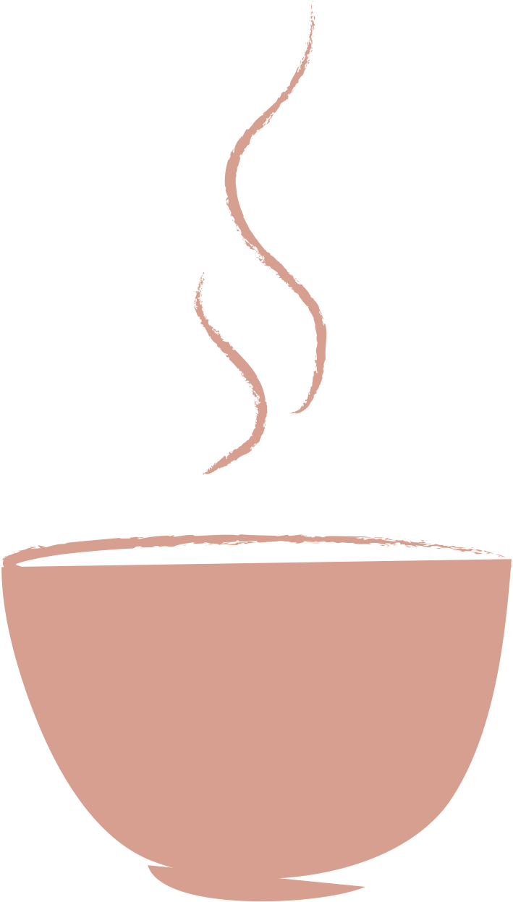
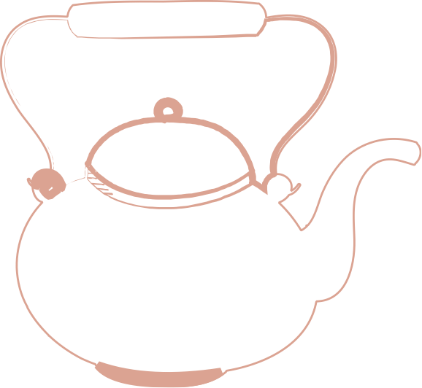
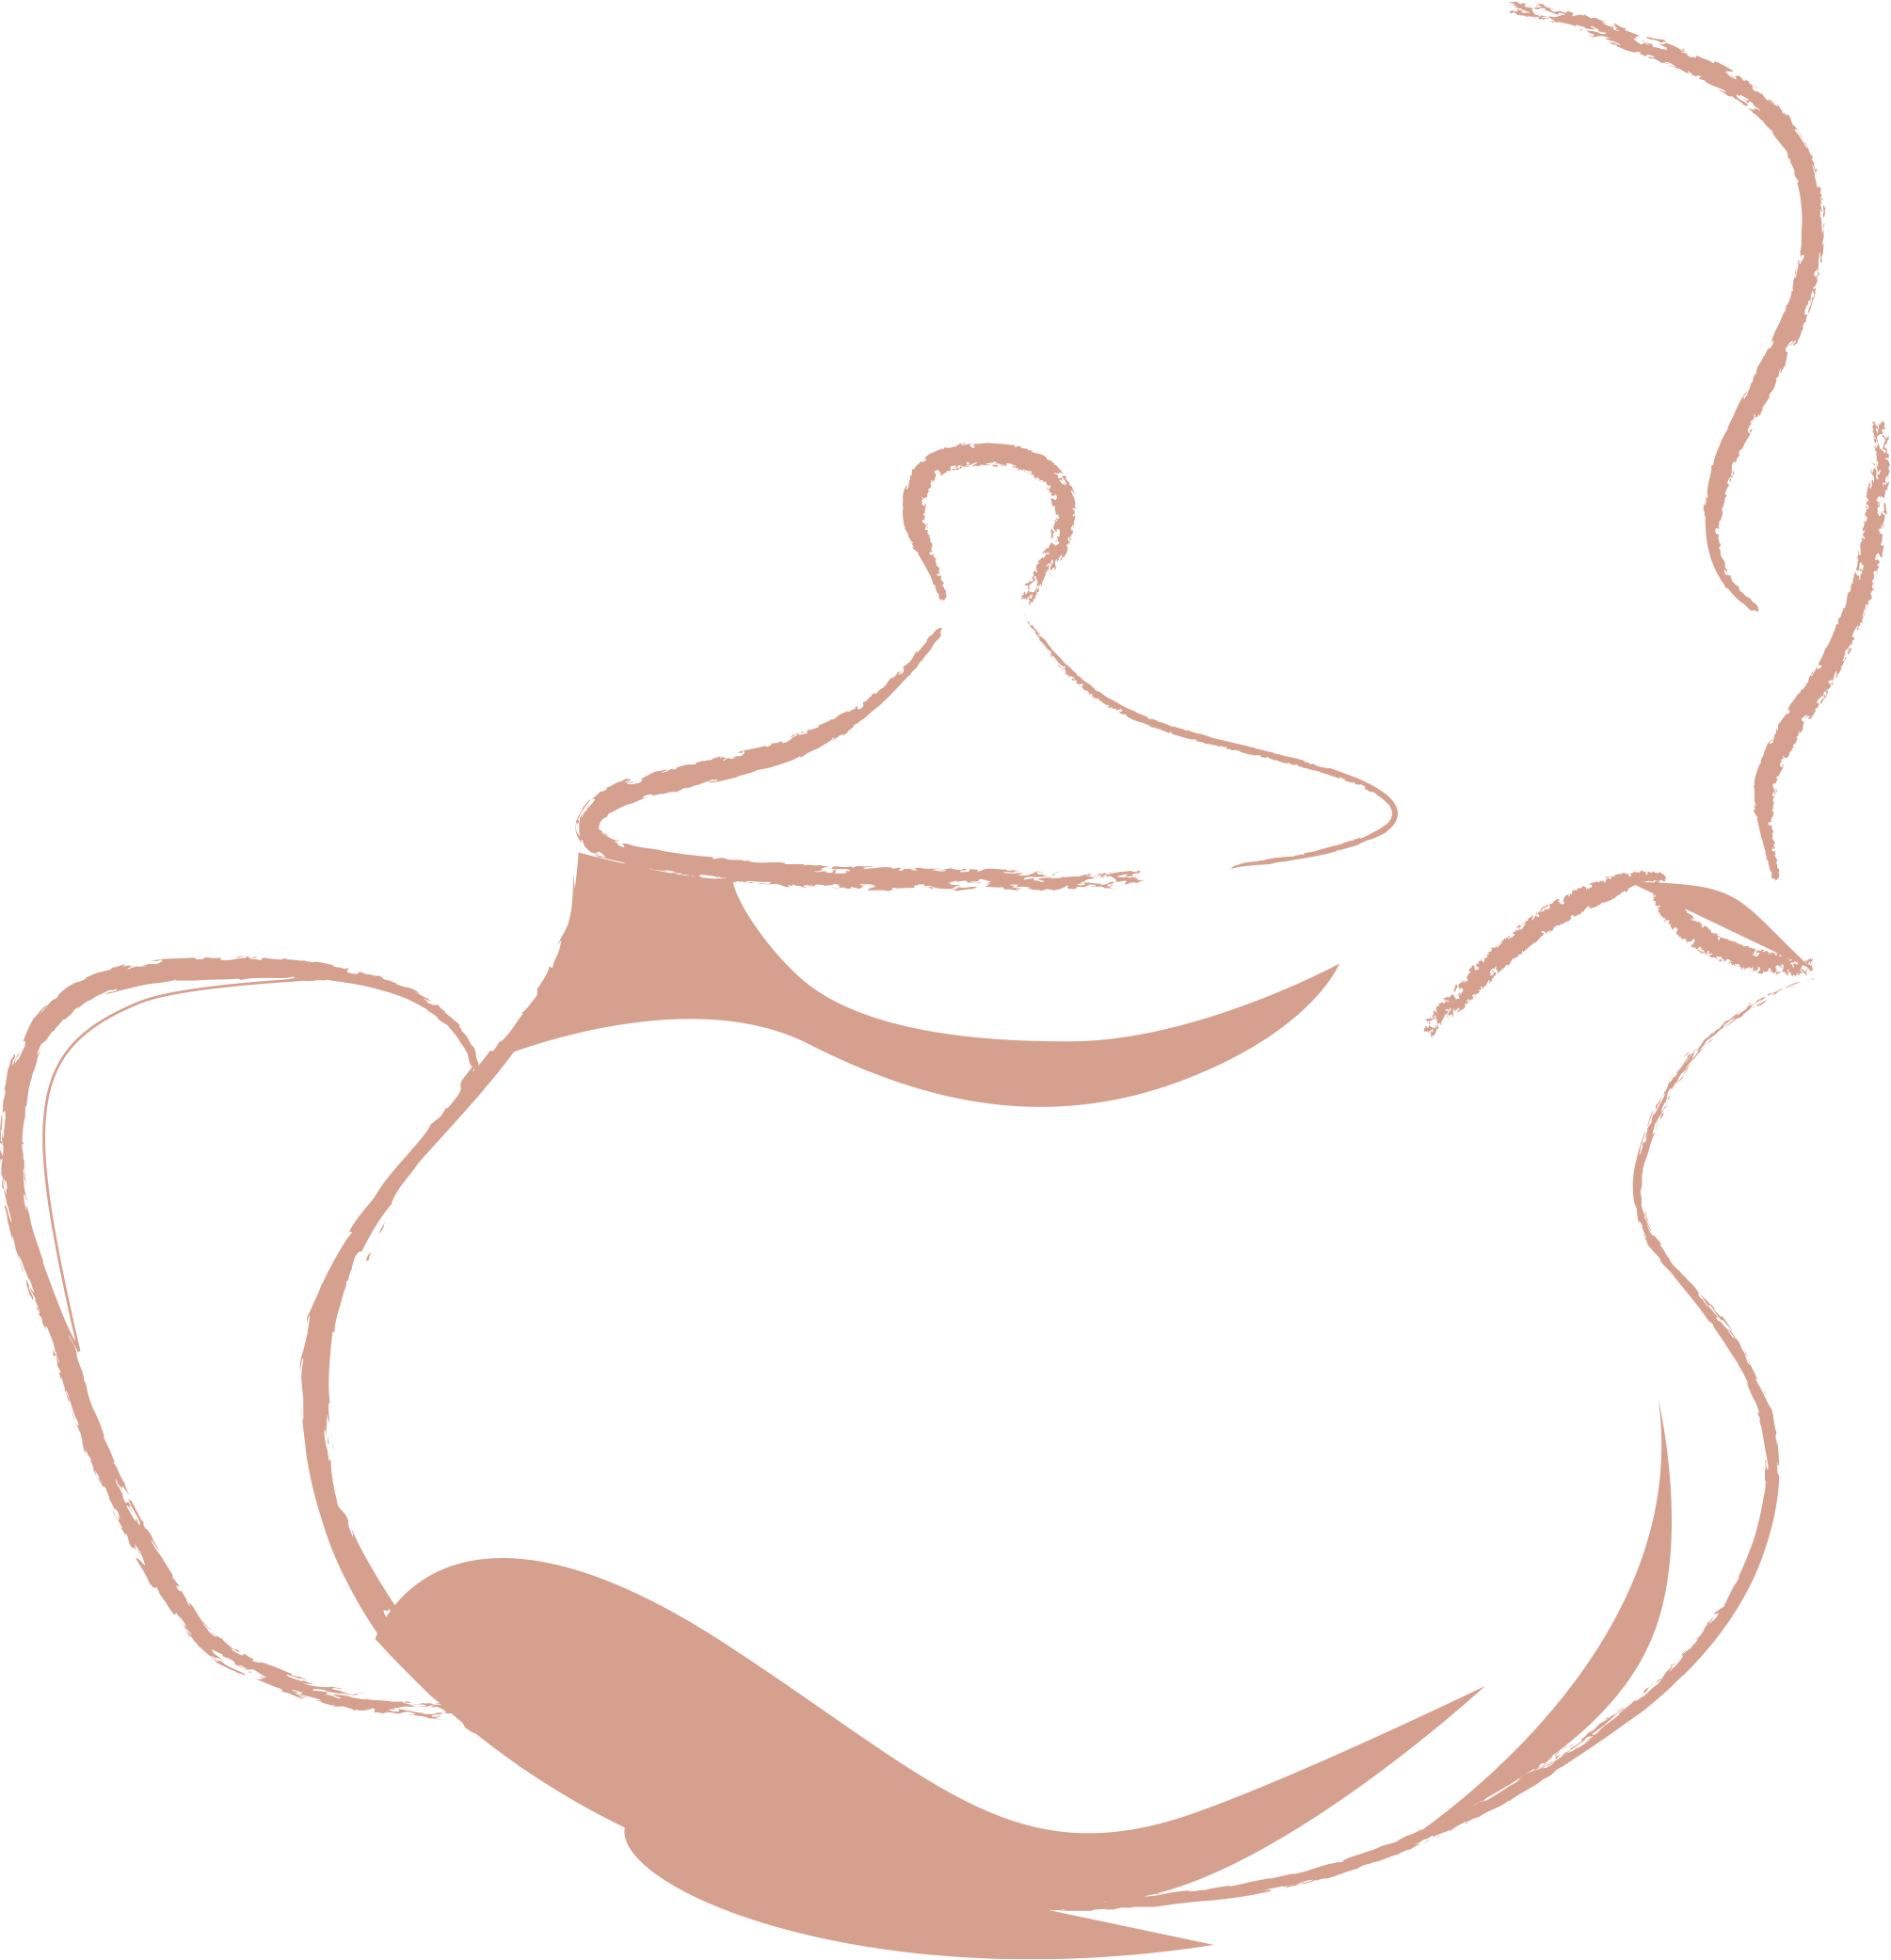
一 茶 一 世 界
Types
Tea Art
History
Area
一 茶 一 世 界
一 茶 一 世 界

Slide 3
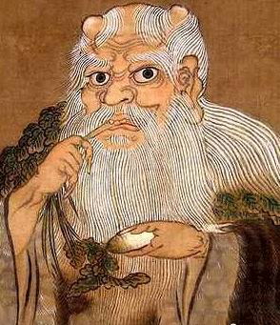
The History of Chinese Tea
5000 years ago
Shennong
Medicine
& Food
Han Dynasty: Tea as herbal medicine and drink
The Portrait of Shennong

Slide 4
茶 世
Story says original idea came from legendary emperor Shen Nong because he had all water boiled as hygienic precaution
When the emperor was travelling, he stopped to rest and servants began to boil water to drink. Dried leaves from a bush fell into boiling water, and the emperor decided to drink it and found he liked it.

Slide 5
Tea became into a beverage,
Tea culture , tea ceremony come into being
The discovery of tea;
Used as medicine and vegetable
Tea was introduced to UK
Spread to other Asian countries
Herb medicine and drink
Tea was introduced to Europe
5000 thousands years ago
Han Dynasty (206B.C.- A.D. 220)
11-12th century
16th century
17th century
Tang Dynasty (618-907)

Slide 6
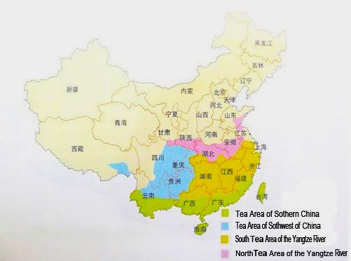
China’s Tea Producing Area
-Mainly divided into four parts

Slide 7
一 茶 一 世 界
types
Tea Art
History
Area
一 茶 一 世 界
一 茶 一 世 界

Slide 8
Varieties of Chinese Tea
How many kinds of Chinese tea do you know?
绿茶
Green tea
白茶
White tea
Red tea
红茶
乌龙茶
Yellow tea
Oolong tea
青茶
Dark tea
黑茶
花茶
Scented tea

Slide 9
Type of tea | Temperature
White tea | 80-85
Green tea | 80-85
Scented tea | 80-85
Red tea | 80-90
Oolong tea | 95-100
Pu’ er tea | 100

Slide 10
British and Chinese Tea Culture
 | Chinese tea | British tea
Drinking customs | Tea art Without milk or sugar | Tea break Afternoon tea High tea
Teasets | Tea leaves ; Small tea cups without handles ; No tea spoons; There are different 24 vessels were necessities for the ancients to perform and perfect the ritual of drinking tea. | Tea bags; Pottery and porcelain tea cups with handles ; Tea spoons
Britons are concerned more about the variety and taste of tea while Chinese pay more attention to the purity and quality. Instead of drinking pure tea, Britons have added milk, sugar, fruit, flowers and even spice to tea. In addition, sandwiches, scones, cookies and a special dessert such as a fruit tart or a rich cake are also served with tea. Moreover, Chinese associate tea with their traditional cultures, such as poetry, painting, calligraphy and even religions like Taoism, Confucianism and Buddhism.

Slide 11
Pu ‘er Tea
(普洱茶)
Black Tea （红茶）
Depends
70% -80%
Fermentation
<5%
15%-50%
Green Tea （绿茶）
Oolong Tea （乌龙茶）

Slide 12
Green Tea （绿茶）
茶
禅 茶 一 味
-Has The Biggest Number Of Types In China
一 茶 一 世 界
The national drink of China [国饮]
Main functions ：
Dispel the effects of alcohol
Clearing away summer-heat
Refresh oneself

Slide 13
Red Tea （红茶）
茶
-Originated In China And Spread And Known
Worldwide
禅 茶 一 味
一 茶 一 世 界
Main functions ：
Help manage - or even prevent - diabetes
Help protects your heart
A tremendous source of potent antioxidants
May help with weight loss

Slide 14
Oolong Tea （乌龙茶）
茶
禅 茶 一 味
-Of The Most Amazing Diverse Taste And Flavor
一 茶 一 世 界
Main functions ：
1. Stronger Immune System
2. Strengthens teeth
3.A tremendous source of potent antioxidants
4. Help with weight loss

Slide 15
Benefits of drinking tea
茶
1 Medical value
2 Eliminate grease
3 Lose weight
4 Refresh oneself
5 …

Slide 16
Medicinal value
Anti-cancer
2.Lower blood pressure
3.Improve eyesight

Slide 17
一 茶 一 世 界
types
Tea Art
History
Area
一 茶 一 世 界
一 茶 一 世 界

Slide 18
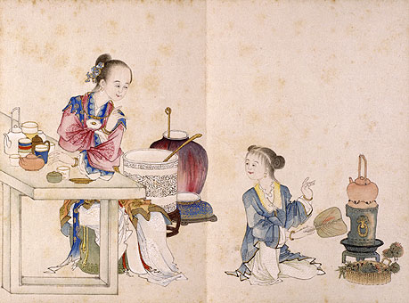
The Art of Tea 茶艺
茶 世
The art of tea including the tea ceremony, the technique of brewing tea, the process of tasting tea, tea set, tea paintings, etc.

Slide 19
Tea Tray
茶 世
Tea trays are usually very beautiful, showing off the beauty of the tea set and displaying all of your tools in a pleasing manner. Tea trays are shallow and can be of various sizes and shapes. The function of the tea tray is to hold your tea pots and cups and can be filled with any overflow of water or water discarded in the process of brewing. Some of the more common shapes of a tea tray are square, round and fan-shaped.

Slide 20
Tea Pot
茶 世
Tea pots are used to brew and pour tea, and you may use a tea pot or a traditional gaiwan to brew your tea. There are many different tea pots available, including porcelain pots, glass tea pots, and tea enthusiasts tend to enjoy the more traditional Yixing clay teapot or sand-fired tea pots.

Slide 21
Harmony
茶 世
Gaiwan
Gaiwan is used traditionally to brew your tea leaves in, and pour the brewed tea from when brewing tea Gongfu style. People use a gaiwan to gaze up the unfurling tea leaves and to smell the aroma of the brewing tea. Gaiwans can come in a variety of colors and styles. The gaiwan is also called the “sancai bowl”, which loosely translates into the synchronicity of man, earth and the sky as the cover of the gaiwan represents the sky, the bowl itself representing humankind, and the saucer below as earth.

Slide 22
The Filter and Filter Shelf
茶 世
The tea filter, is used to filter tea leaves after brewing so that you may pour the tea into the fair cup and Pinming cups without having tea leaves in them. The tea filter is traditionally stored on the filter shelf when it is not being utilized.

Slide 23
茶 世
The Tea Pitcher
Tea pitcher, which is also named fair cup and cha hai, is used to hold the brewed tea liquor. Once your tea leaves are brewed correctly, the tea is then poured into the fair cup, which is similar to a small pitcher. The fair cup is used to ensure the consistency of the flavor of the tea hence why it is called a “fair cup”.

Slide 24
Pinming Tea Cup
茶 世
Pinming tea cups are what you pour the brewed tea into from your fair cup to actually drink the brewed tea from, the western equivalent would be the teacup, although Pinming cups are much smaller, shallow and thin. Remember, brewing tea Gongfu style is about fully enjoying every aspect of the tea to the fullest.

Slide 25
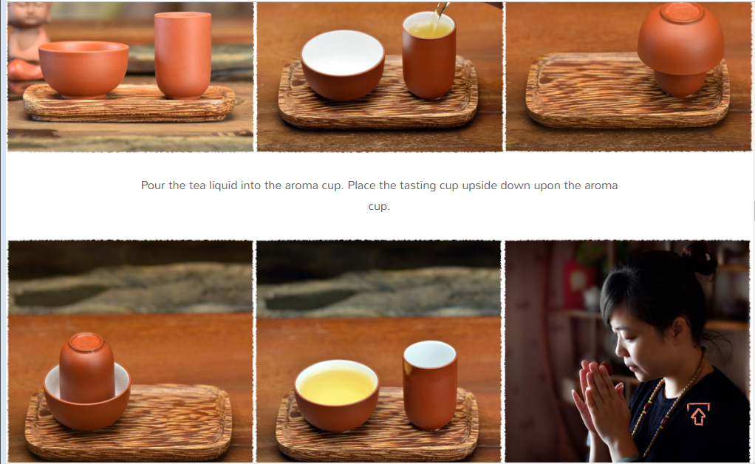
The Fragrance Smelling Cup （Aroma Cup）
Aroma tea cup is used for smelling the fragrance of tea, especially for oolong tea. The appearance of aroma cup is taller and more slender than tasting cup. Usually, one aroma cup should be matched with a tasting cup which of the same material and color. The fragrance smelling cup is intended to capture the aroma and essence of the brewed tea, and is matched with the Pinming cups.
茶 世

Slide 26
茶 世
Tea Holder (茶荷)
The tea holder is known also as the “enjoy tea holder.” The purpose of your tea holder is to hold the dried tea leaves which will be brewed, after removing them from the canister they have been stored in. Tea holders can be made from many materials including bamboo and wood, however the most common type of tea holder is made from a simple white porcelain.

Slide 27
茶 世
Tea Vase, 茶筒 (Cha Tong)
used to hold your utensils such as your tea tweezer, tea pin, tea funnel, tea spoon and tea scoop.

Slide 28
茶 世
Tea Scoop, 茶则 (Cha Ze)
used to take dry teas out from tea bag or tin into your gaiwan or teapot.

Slide 29
茶 世
Tea Funnel, 茶漏 (Cha Lou)
Tea Funnel is a cylindrical funnel used to direct the flow of tea into Yixing teapot, and also used to prevent the tea from overflowing.

Slide 30
Tea Tweezer, 茶夹 (Cha Jia)
a tool for picking the tea cup to protect your fingers from heat, or taking tea leaves out from Yixing teapot.
茶 世

Slide 31
茶 世
Tea Pin, 茶针 (Cha Zhen)
for clearing the small tea leaves which blocking the filter holes in Yixing teapots, so that the water can go to the spout smoothly.

Slide 32
茶
https://www.youtube.com/watch?v=HPkaWZ3IFoc&safe=active
https://www.youtube.com/watch?v=j3tA3fFCP34&safe=active

Slide 33
茶
禅 茶 一 味
一 茶 一 世 界
THANKS

