Slide 1
Animals

Slide 2
狗 gǒu
1
3
5
4
2
6

Slide 3
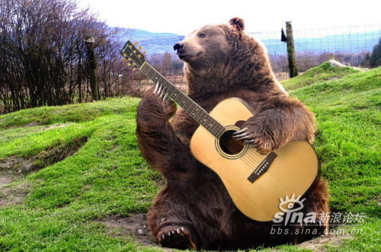
熊 xióng
1
3
5
4
2
6

Slide 4
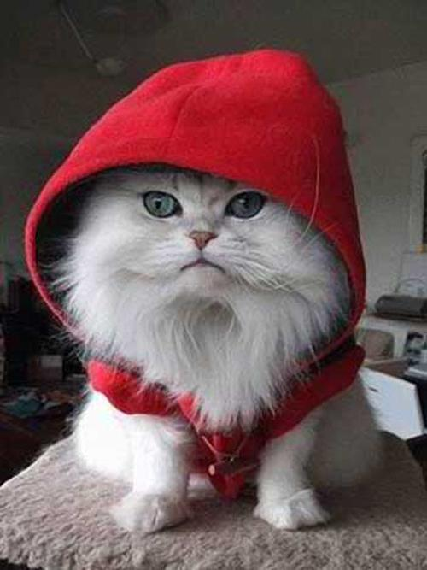
1
2
猫
māo
3
4

Slide 5
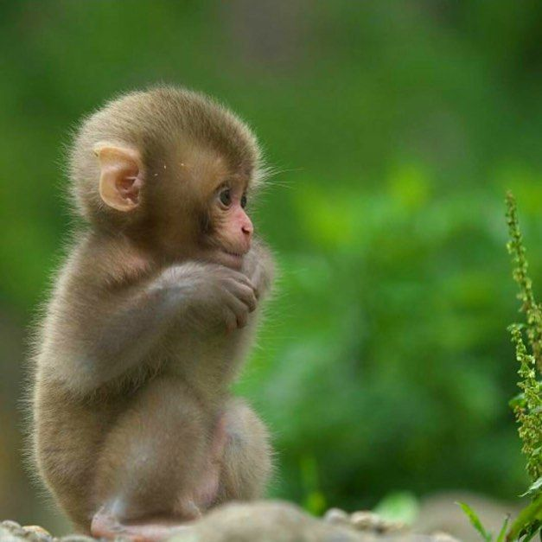
2
hóu
猴
1
3
4

Slide 6
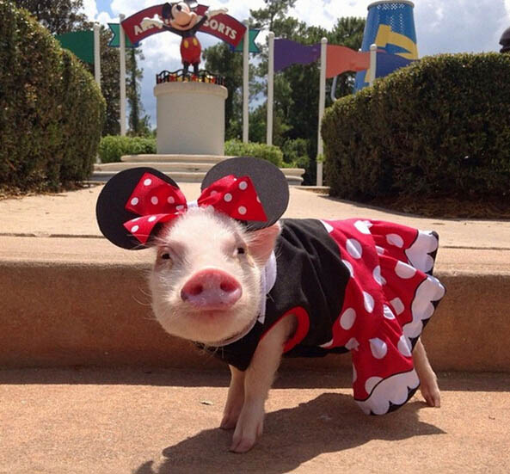
猪 zhū
1
3
5
4
2
6

Slide 7
兔 tù
1
3
5
4
2
6

Slide 8
鸭
yā
1
2
3
4

Slide 9
https://www.youtube.com/watch?v=GUFtwf1pZjY
Learn a song about animals!
yì zhī gǒu
yì zhī xióng
yì zhī hóu
It is an interesting song. If you like, you can listen to it and try to follow it !

Slide 10
https://www.youtube.com/watch?v=GUFtwf1pZjY
yì zhī zhū
yì zhī māo

Slide 11
lao shi you hen duo pengyou
yi ya yi ya yo
lao shi you hen duo pengyou
yi ya yi ya yo
yi zhi gou
woof woof
yi zhi gou
woof woof
yi zhi gou
woof woof
yi ya yi ya yo
lao shi you hen duo pengyou
yi ya yi ya yo
lao shi you hen duo pengyou
yi ya yi ya yo
yi zhi hóu
ooh ooh ooh
yi zhi hóu
ooh ooh ooh
yi zhi hóu
ooh ooh ooh
yi ya yi ya yo
lao shi you hen duo pengyou
yi ya yi ya yo
lao shi you hen duo pengyou
yi ya yi ya yo
yi zhi xiong
rawr
yi zhi xiong
rawr
yi zhi xiong
rawr
yi ya yi ya yo

