Slide 1
shí èr shēng xiào
十 二 生 肖
Chinese Zodiac Signs
Can you guess which animals belong to the Chinese Zodiac?
*
*
Notes:
*

Slide 2
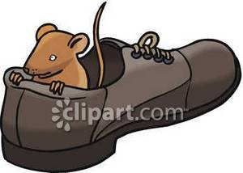
shǔ
鼠
Imagine rat in a shoe.
1936,1948,1960,1972,1984,1996, 2008，2020
Rat is clever, ambitious, and quick-witted.

Slide 3
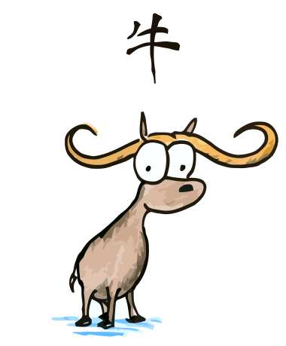
niú
牛
I’m NEW here!
Imagine an ox new to the farm.
1937,1949,1961,1973,1985,1997, 2009
Ox is honest, patient, and hard-working.
Notes:
*

Slide 4
hǔ虎
who is this in the tiger costume?
1938,1950,1962,1974,1986,1998, 2010
Tiger is brave, powerful and daring.

Slide 5
tù兔
How many bunny ears?
Answer: two
1939,1951,1963,1975,1987,1999, 2011
Rabbit is lucky, kind and peaceful.

Slide 6
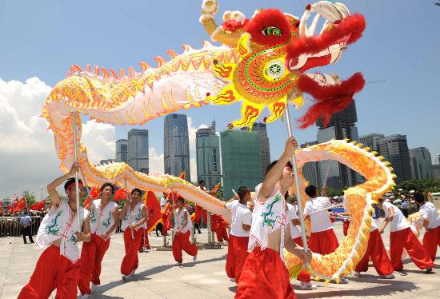
lóng
龙
The dragon’s body is very long.
1940,1952,1964,1976,1988,2000, 2012
Dagon is powerful, strong and energetic.

Slide 7
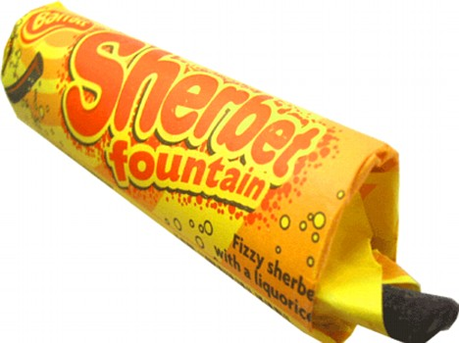
shé
蛇
A snake eating Sher-bet.
1941,1953,1965,1977,1989,2001, 2013
Snake is calm, wise and elegant.

Slide 8
mǎ
马
Mum rides a horse..
1942,1954,1966,1978,1990,2002, 2014
Horse is popular, independent and fun.

Slide 9
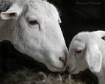
yáng
羊
A young sheep is lamb..
1943,1955,1967,1979,1991,2003, 2015
Sheep is artistic, loving and tender-hearted.

Slide 10
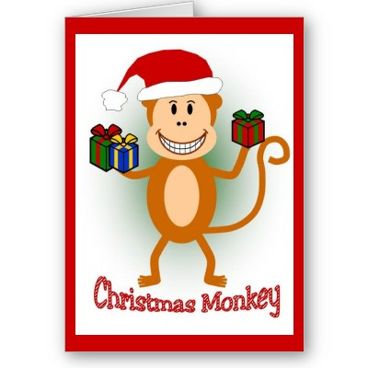
hóu
猴
Christmas monkey. HO! HO! HO!
1944,1956,1968,1980,1992,2004, 2016
Monkey is happy, confident, and enthusiastic.

Slide 11
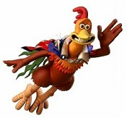
jī
鸡
Rooster in a jeep!
1945,1957,1969,1981,1993,2005, 2017
Rooster is adventurous, kind and hard-working.

Slide 12
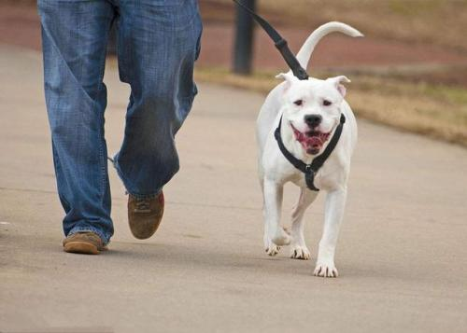
gǒu
狗
Let’s go walking. Go go go !
1946,1958,1970,1982,1994,2006, 2018
Dog is loyal, affectionate and generous.

Slide 13
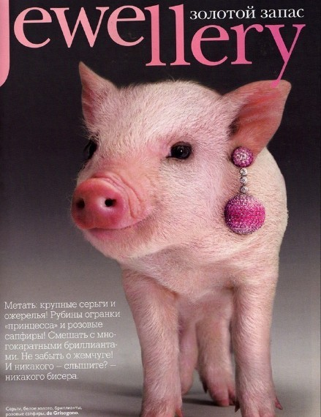
zhū
猪
A pig wearing jewels.
1947,1959,1971,1983,1995,2007, 2019
Pig is noble, helpful and forgiving.

Slide 14
鼠 Rat : 2008, 1996, 1984, 1972, 1960
牛 Ox : 2009, 1997, 1985, 1973, 1961
虎 Tiger : 2010, 1998, 1986, 1974, 1962
兔 Rabbit : 2011, 1999, 1987, 1975, 1963
龙 Dragon: 2012, 2000, 1988, 1976, 1964
蛇 Snake : 2013, 2001, 1989, 1977, 1965
马 Horse : 2014, 2002, 1990, 1978, 1966
羊 Sheep : 2015, 2003, 1991, 1979, 1967
猴Monkey: 2016, 2004, 1992, 1980, 1968
鸡Rooster : 2017, 2005, 1993, 1981, 1969
狗 Dog : 2018, 2006, 1994, 1982, 1970
猪 Pig : 2019, 2007, 1995, 1983, 1971
Do you know which Chinese Zodiac is your sign?
Wǒ shǔ
我 属
I was born in the year of …
*
Notes:
*

Slide 15
Wǒ shǔ
我 属 …
I was born in the year of …
shǔ 鼠 Rat
niú 牛 Ox
hǔ 虎 Tiger
tù 兔 Rabbit
lóng龙 Dragon
shé 蛇 Snake
mǎ 马 Horse
yáng羊 Sheep
hóu 猴 Monkey
jī 鸡 Rooster
gǒu 狗 Dog
zhū 猪 Pig

