Slide 1
By the end of this lesson you will:
Be able to ask where something/someone is.
Say where something/someone is.
Be able to give basic directions (turn, cross, go, left, right, straight).
Use some place vocabulary in context.

Slide 2
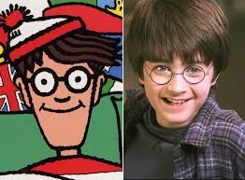
Où?
Notes:
Where?

Slide 3
ALLER = TO GO
1st | Je vais | I go
2nd | Tu vas | You go
3rd | Il va | He goes
3rd | Elle va | She goes

Slide 4
être = TO BE (singular)
1st | Je suis | I AM
2nd | Tu es | You ARE
3rd | Il est | He IS
3rd | Elle est | She IS
‘être’ Used to describe location, feelings and conditions

Slide 5
être = TO BE (plural)
1st | Nous sommes | We ARE
2nd | Vous êtes | You ARE
*3rd | Ils sont | They ARE
*3rd | Elles sont | They ARE
‘être’ Used to describe location, feelings and conditions

Slide 6
Can you think of times when you already use ‘je suis’ or ‘tu es’?
Ça va?
Non, je suis triste.
Notes:
How are you?
I am sad.

Slide 7
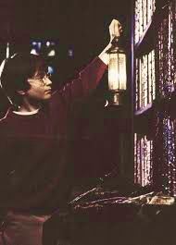
Où est Harry?
Notes:
Where is Harry?

Slide 8
Harry est dans la bibliothèque.
Harry is in the library.

Slide 9
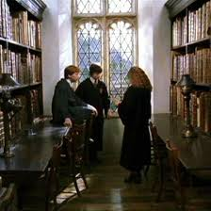
Où sont Harry, Ron et Hermione?
Notes:
Where ARE Harry, Ron and Hermione?

Slide 10
Harry, Ron y Hermione sont dans la bibliothèque.
Harry, Ron y Hermione are in the library.

Slide 11
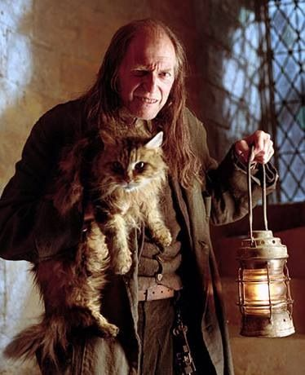
le concierge
Notes:
janitor

Slide 12
À l'école /à l'institut
In the school / In the high school

Slide 13
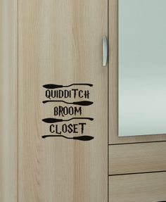
le placard
Notes:
the closet/store cupboard

Slide 14
la bibliothèque
Notes:
the library

Slide 15
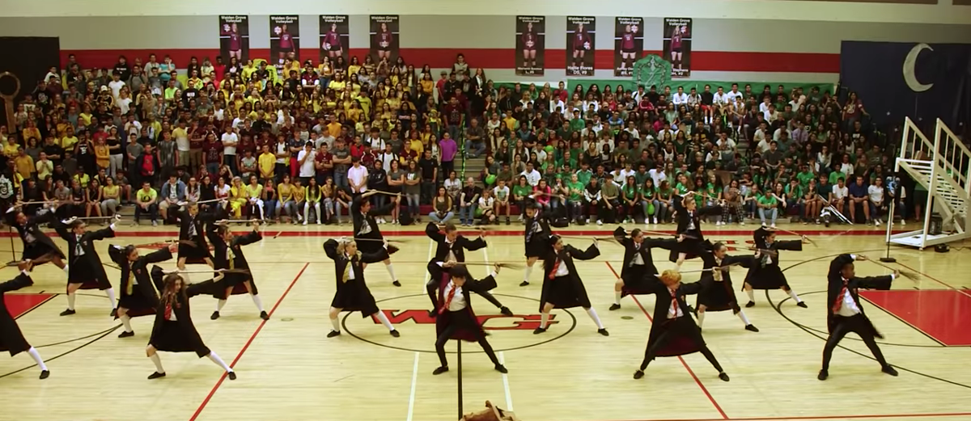
la salle de gym
Notes:
the gymnasium

Slide 16
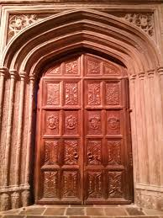
l'entrée (la porte d'entrée)
Notes:
the entrance

Slide 17
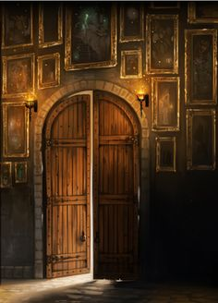
la sortie (la porte de sortie)
Notes:
the exit

Slide 18
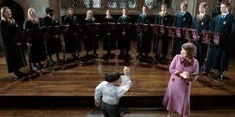
la salle de musique
Notes:
the music class

Slide 19
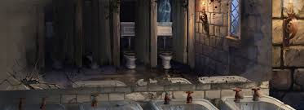
les toilettes
Notes:
the toilets

Slide 20
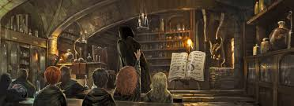
la salle
Notes:
the classroom

Slide 21
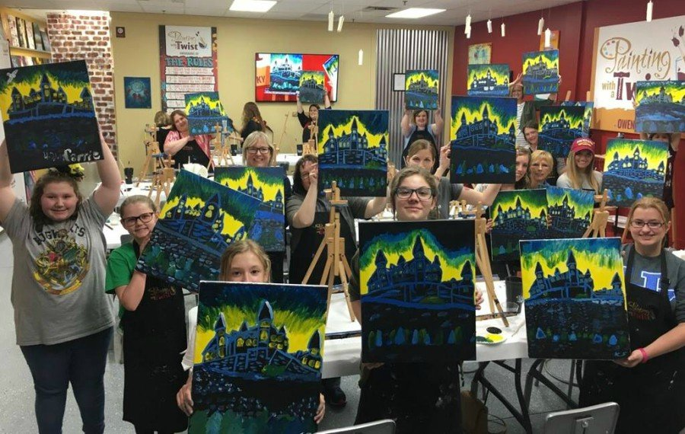
la salle d'art
Notes:
the art class

Slide 22
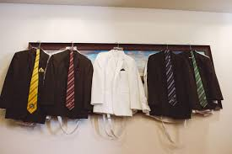
le vestiaire
Notes:
the cloakroom

Slide 23
l’école maternelle
Notes:
the Early Years

Slide 24
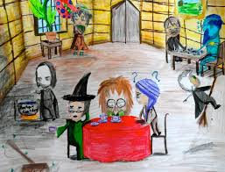
la salle des professeurs
Notes:
the Staff Room

Slide 25
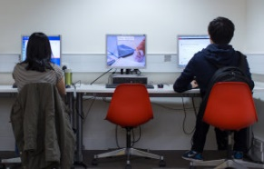
la salle d’informatique
Notes:
the IT classroom/suite

Slide 26
En ville/au village
In the city/In the town

Slide 27
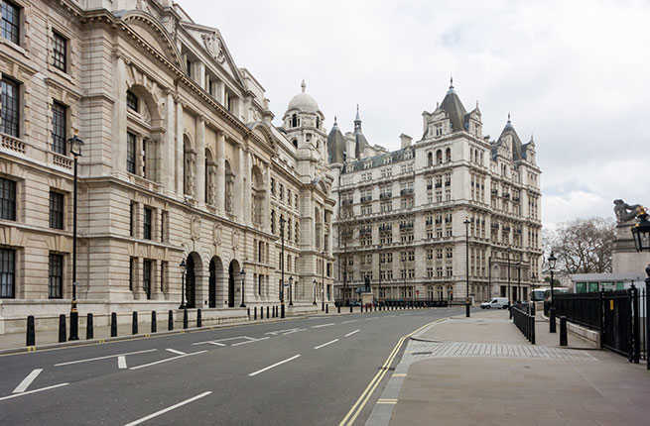
la route/la rue
Notes:
the road/the street

Slide 28
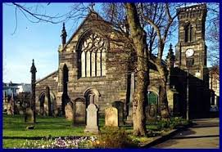
l’ église
Notes:
church

Slide 29
le musée
MUSEUM
Notes:
museum

Slide 30
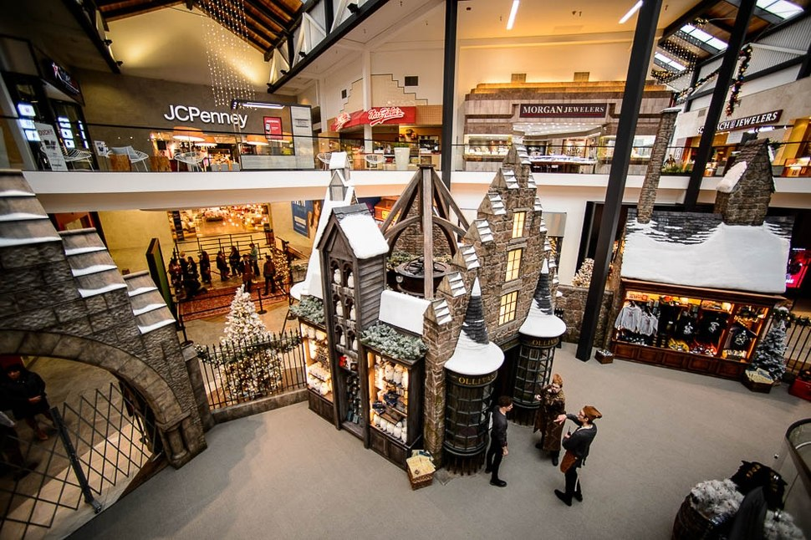
le centre commercial
Notes:
shopping mall/centre

Slide 31
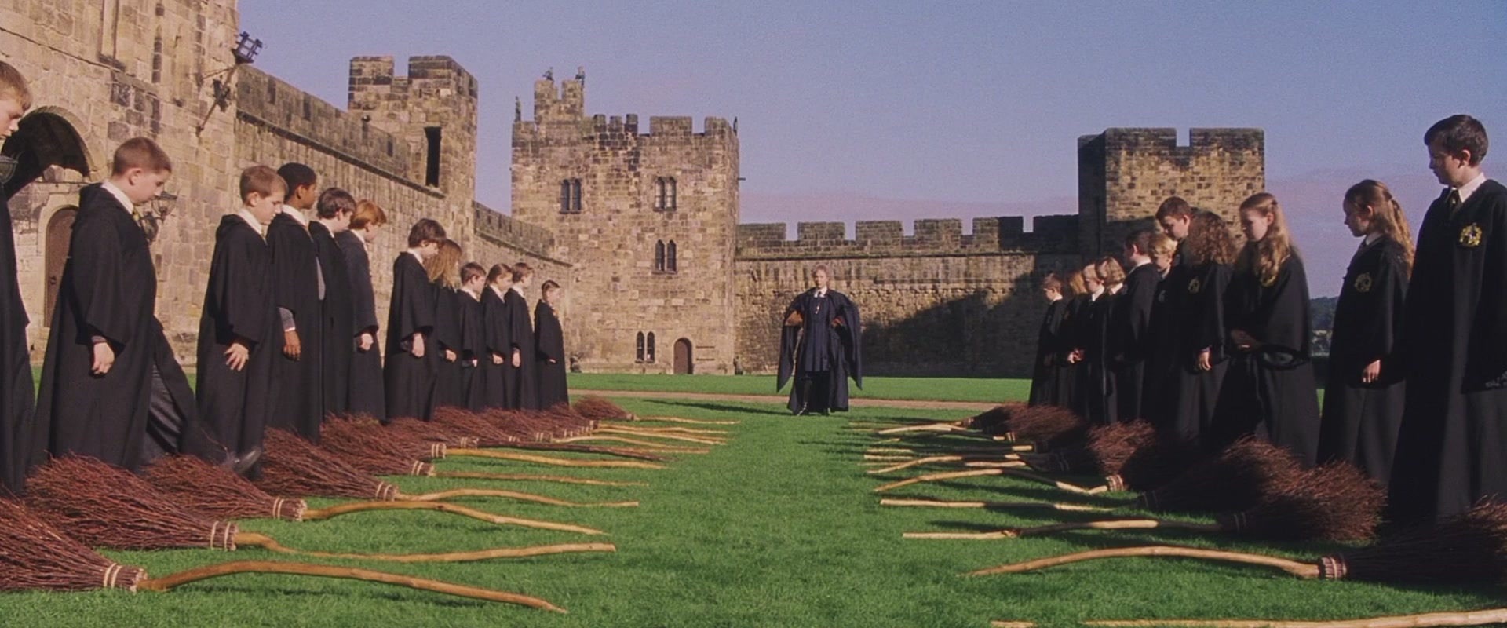
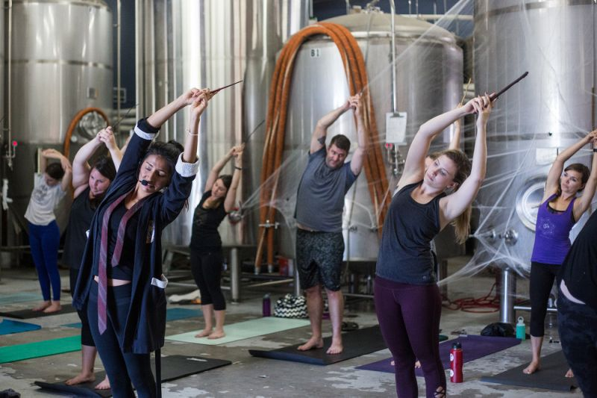
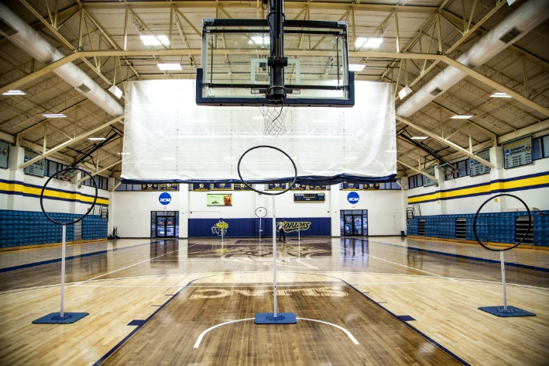
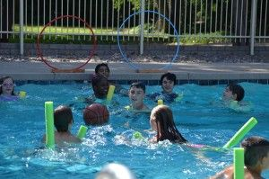
le centre sportif
clase de escoba
30ʛ /clase
jugar al quidditch en piscine o gimnasio
27ʛ /clase
clase de yoga con varitas
24ʛ /clase
Notes:
multisports centre
ʛ is the symbol for galleons (Wizard currency) – in Spanish they call 1 galleon, un galeón, and plural is unos galeones

Slide 32
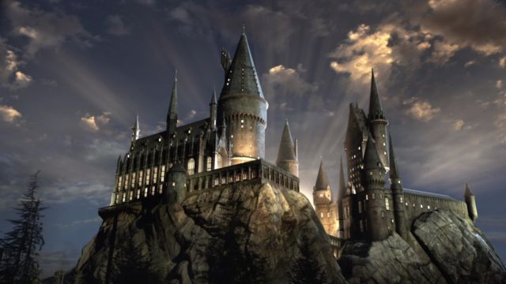
l'école
Notes:
school (not castle)

Slide 33
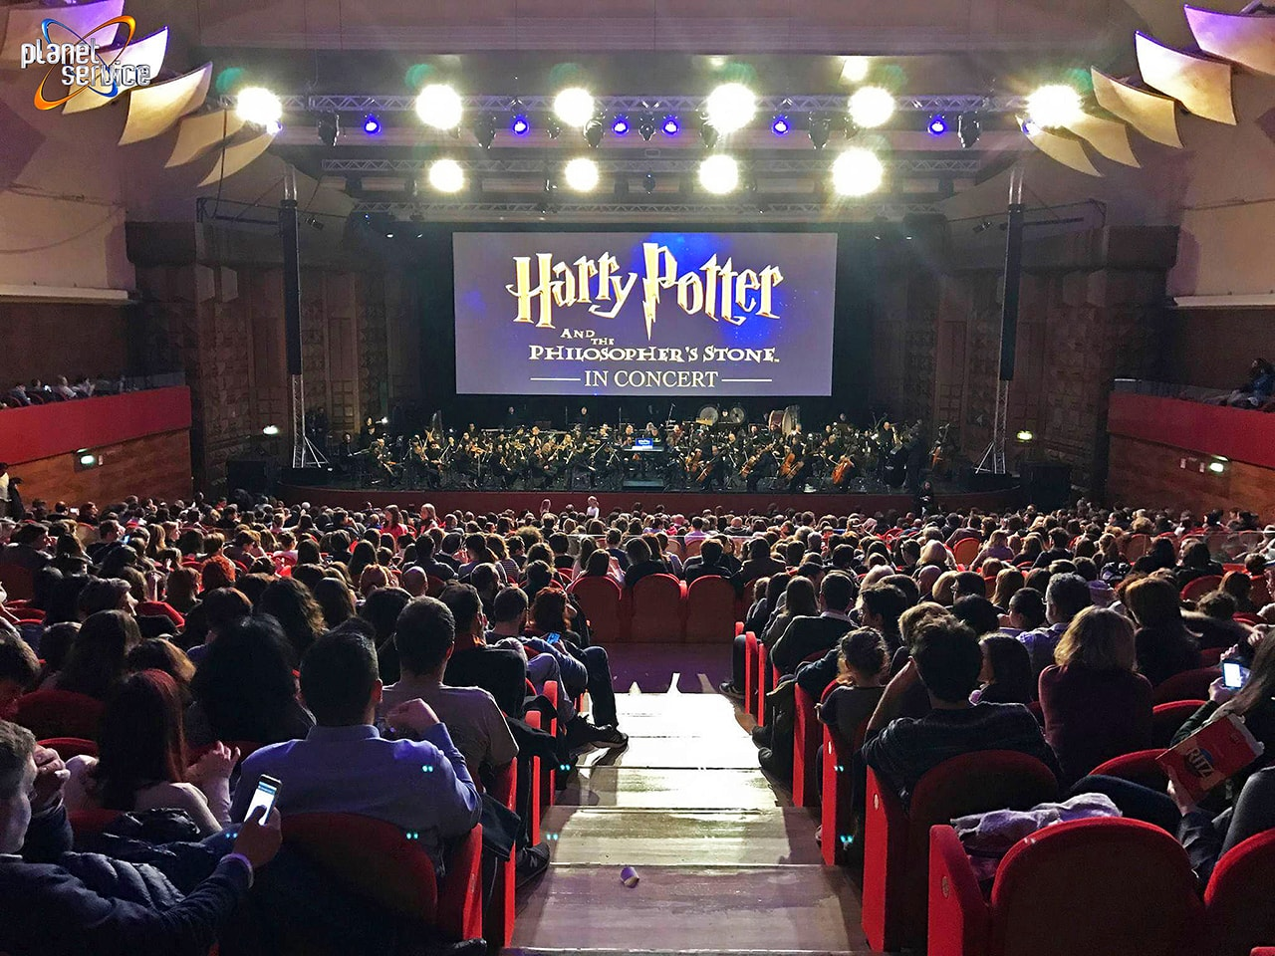
le cinéma/le ciné
Notes:
the cinema

Slide 34
Subject Pronouns
 | Singular |  | Plural
1st | Je | I | Nous | We
2nd | Tu | You | Vous | You (all)
3rd | Il | He | Ils | They
3rd | Elle | She | Elles | They
3rd | --- | It | --- | They
Notes:
Subject Pronouns are words that replace a noun acting as the subject of the sentence/clause.

Slide 35
Let’s review some bossy words from P6!

Slide 36
Entrer = to come in
 | SINGULAR | PLURAL
2nd | (Tu) Entre! (You) Come in! | (Vous) Entrez! (You all) Come in!

Slide 37
Sortir = To leave
 | SINGULAR | PLURAL
2nd | (Tu) Sors! (You) Leave from…! | (Vous) Sortez!(You all) Leave from…!

Slide 38
Aller à = To go to
 | SINGULAR | PLURAL
2nd | (Tu) Va à…! (You) Go to…! | (Vous) Allez à! (You all) Go to…!

Slide 39
And here’s a new ‘bossy word’…
Tourner = To turn
 | SINGULAR | PLURAL
2nd | (Tu) Tourne! (You) Turn! | (Vous) Tournez! (You all) Turn!

Slide 40
And one more ‘bossy word’…
Traverser = To cross
 | SINGULAR | PLURAL
2nd | (Tu) Traverse! (You) Cross! | (Vous) Traversez! (You all) Cross!

Slide 41
à gauche
à droite
tout droit
straight on
to the left
to the right

Slide 42
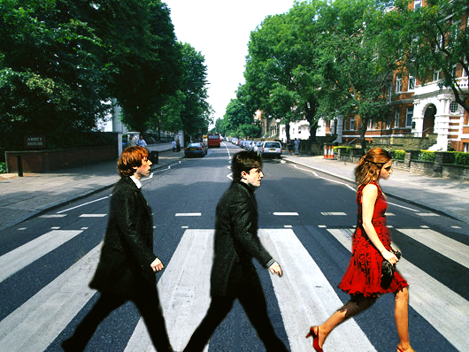
Traversez la route!
Notes:
Cross the road!

Slide 43
Traversez la rue!
Notes:
Cross the street!

Slide 44
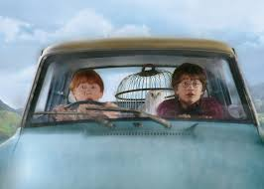
Allez tout droit!
Notes:
Go straight on!

Slide 45
Tournez à gauche!
Notes:
Turn to the left!

Slide 46
Tournez à droite!
Notes:
Turn to the right!

