Slide 1


P7 Hobbies
Harry Potter

Slide 2

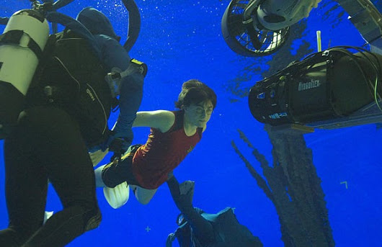
la natation

Slide 3
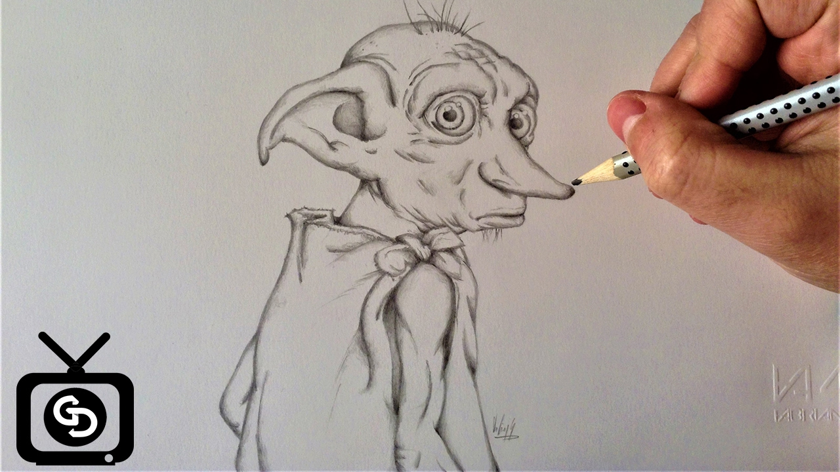
dessiner

Slide 4
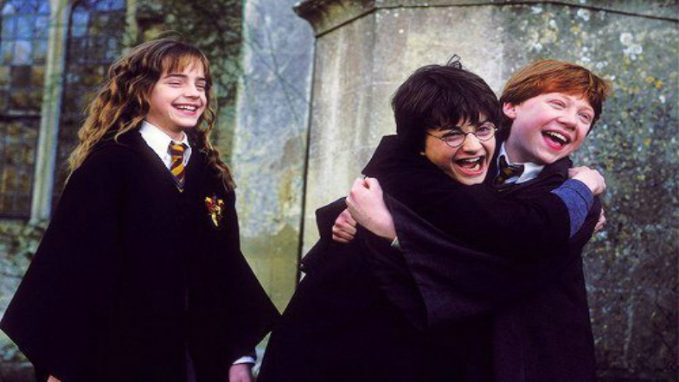
Jouer avec mes amis/amies

Slide 5
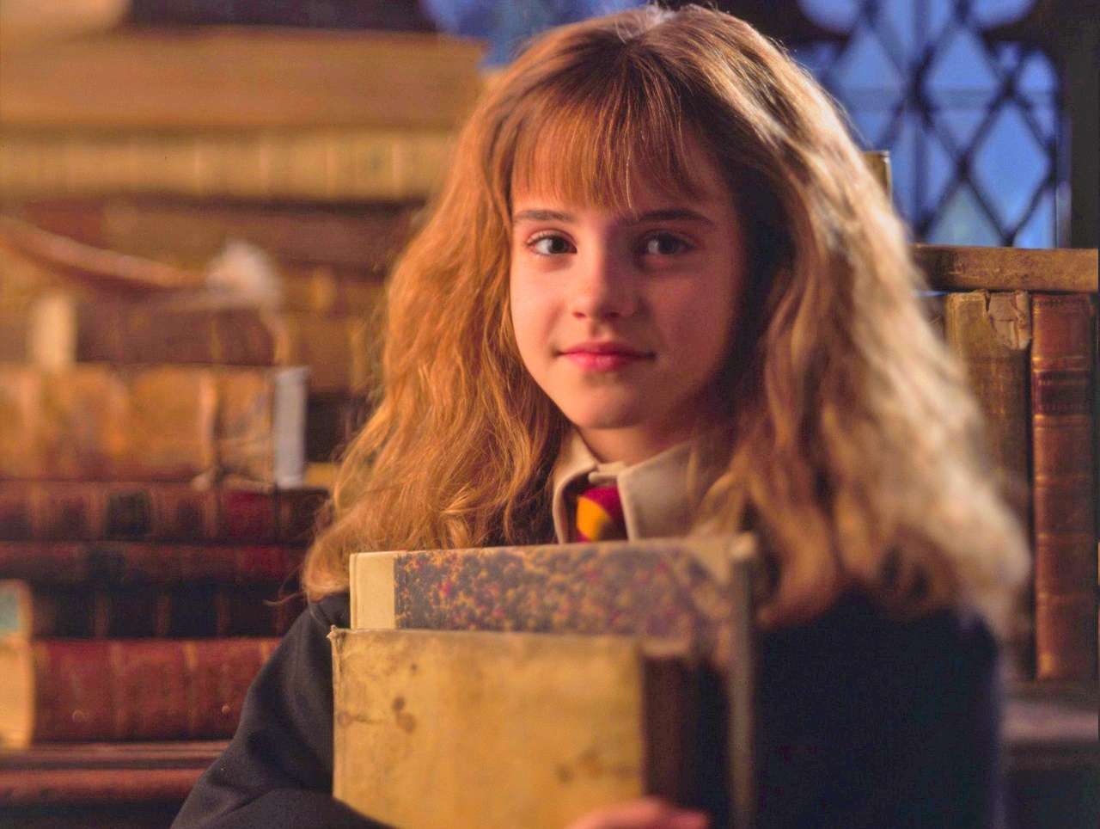
lire

Slide 6
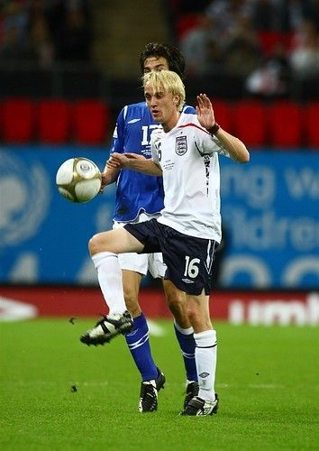
le football

Slide 7
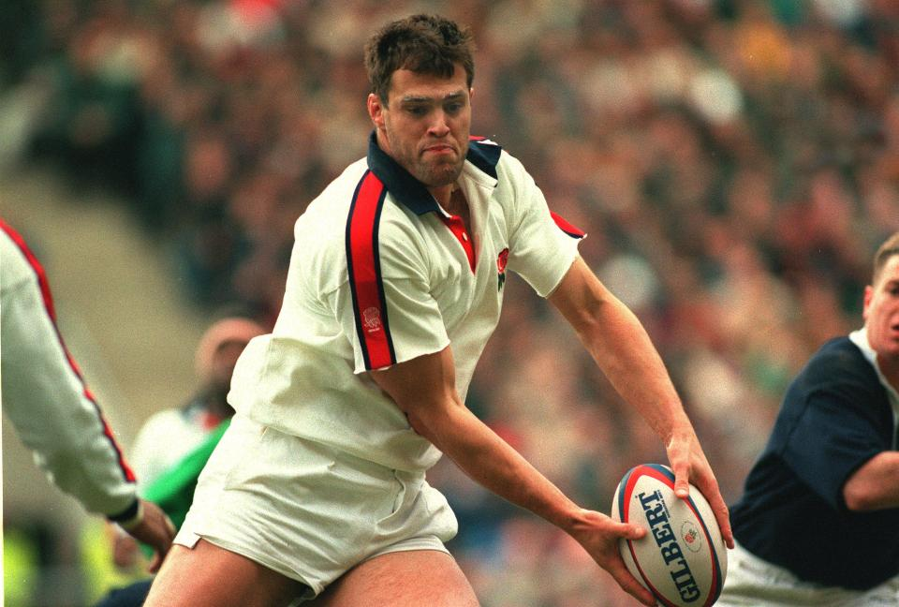
le rugby

Slide 8
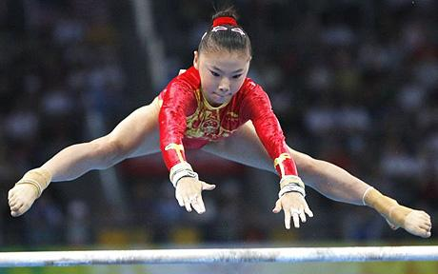
la gymnastique

Slide 9
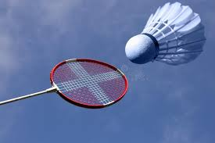
le badminton

Slide 10
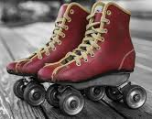
le patinage

Slide 11
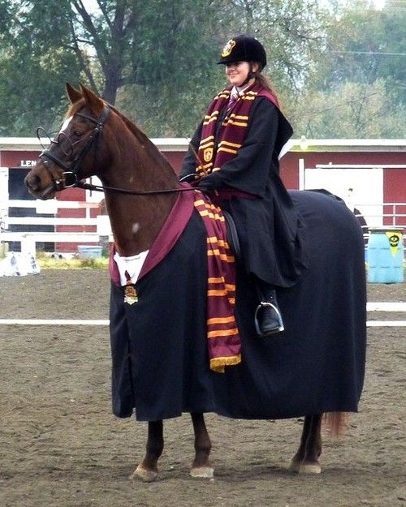
la équitation

Slide 12
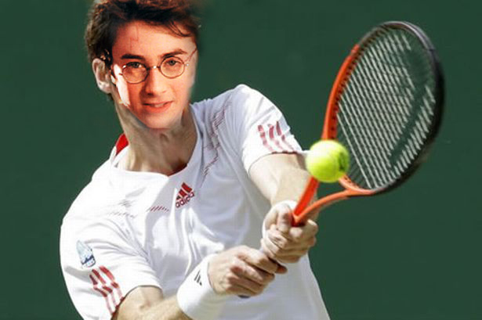
le tennis

Slide 13
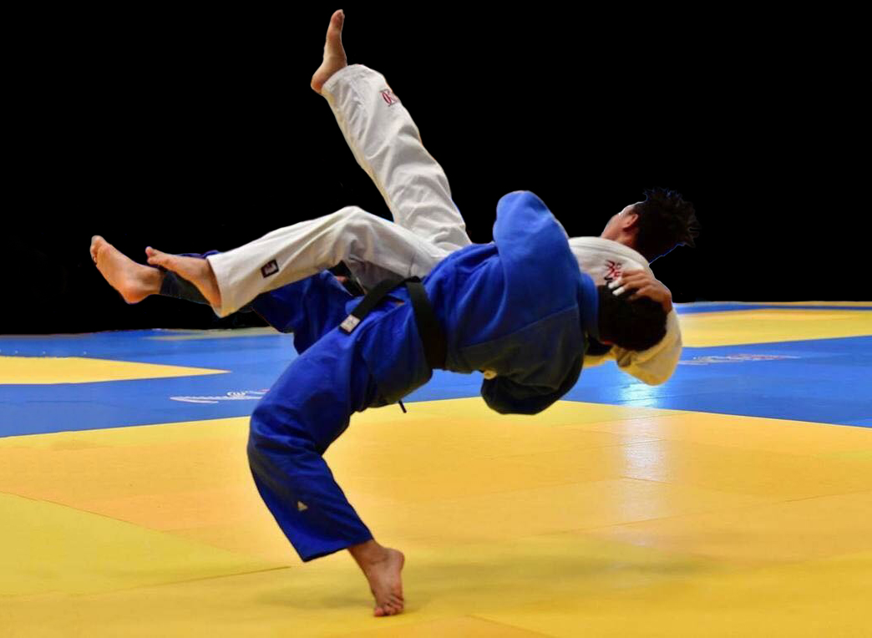
le judo

Slide 14

Regarder la télé

Slide 15
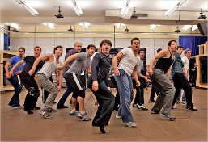
la danse

Slide 16
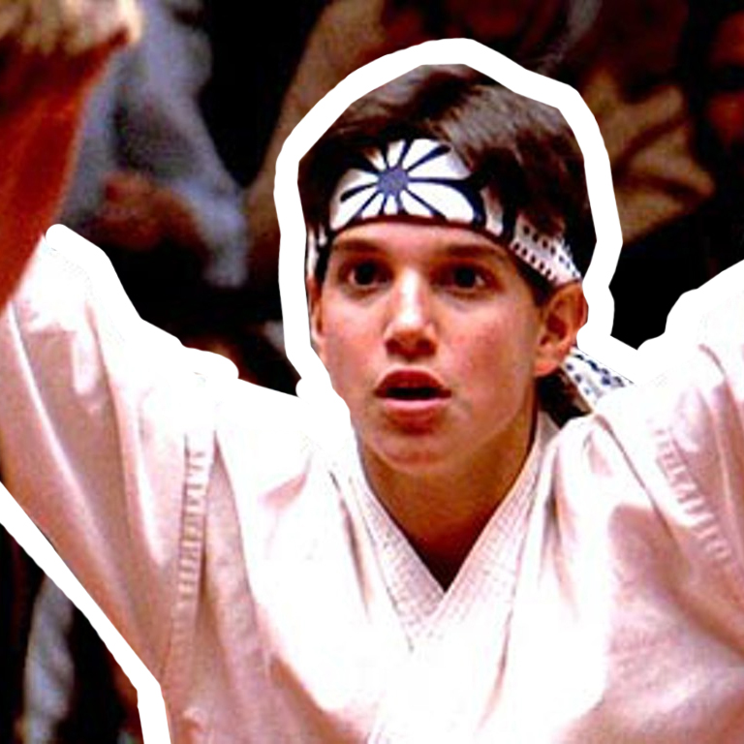
le karaté

Slide 17
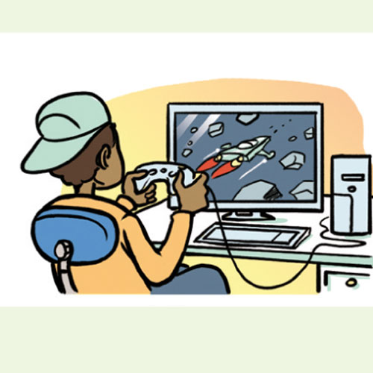
Jouer à l’ordinateur (les jeux vidéo).

Slide 18
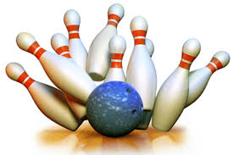
Jouer au bowling

Slide 19
Quidditch
L.I. To be able to read and write about things people like to do.

Slide 20
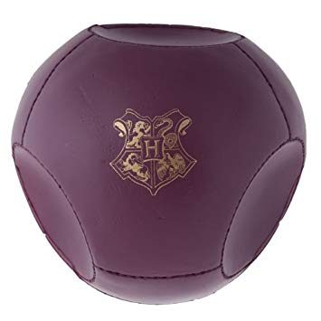
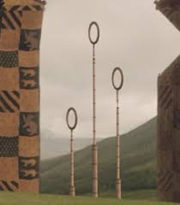
Find a pair to get the quaffle through the hoop!
The object is to find the corresponding French and English vocabulary word.
Take turns (in teams) to reveal two cards at a time.
Read each word for each card.
If you get a match, your team scores 10 points! If not, you have been knocked off your broomstick by a bludger!
If you find the snitch, your team gets 150 points and the game is over.
Add all points to see which team wins!

Slide 21
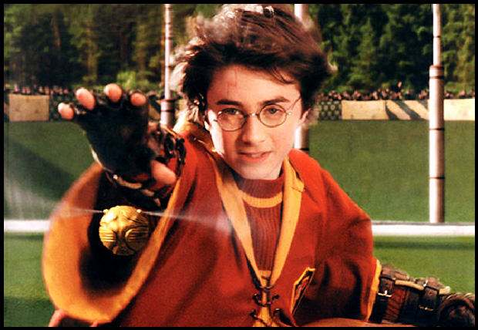



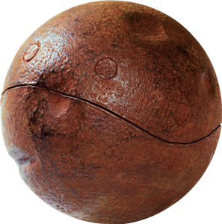
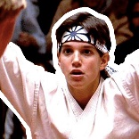
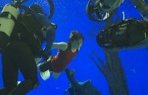


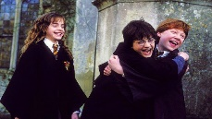
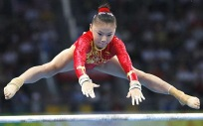
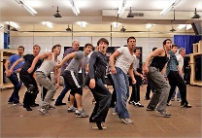



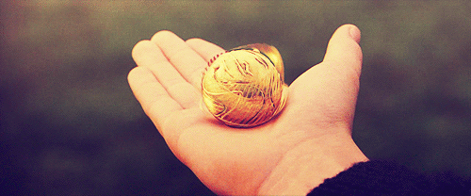

19
45
22
2
30
21
33
Let’s play Quidditch!
badminton
horse riding
lire
rugby
le tennis
to go bowling
dessiner
37
31
12
32
42
41
40
to draw
le karaté
la natation
des jeux vidéo
to play with friends
gymnastics
jouer au bowling
19
45
22
2
30
4
33
21
karate
jouer avec des amis/amies
la gymnastique
le badminton
le rugby
la danse
regarder la télé
37
31
12
32
42
41
40
to watch telly
le football
skating
tennis
le judo
swimming
to play the computer
19
45
22
2
30
21
33
le patinage
football
judo
to read
la equitation
37
31
12
32
42
41
40
44
11
29
38
Notes:
Front – do not edit.

Slide 22

Tu aimes...?

Slide 23
J’aime…

Slide 24
Je n’aime pas…

Slide 25
Primary 7 Hobbies
W.A.L.T.
Say, read and write about your own hobbies.
W.I.L.F.
Using the information in the text:
Fill in the table with the likes and dislikes
Following the model:
Write about your own likes and dislikes

Slide 26
Quick Quotes Quill with Rita Skeeter
L.I. To say, read and write about your own hobbies.
Rita Skeeter has been asked to conduct a survey about the most popular hobbies amongst Gryffindor pupils to help Professor McGonagall make a timetable for after school clubs.
Read the interview between Rita and the Gryffindor pupils and complete the table with the pupils’ likes and dislikes to help Professor McGonagall (see info. sheet).

Slide 27
Arrêtez
STOP
(Slides beyond this point are master slides for the matching game)

Slide 28
DO NOT EDIT
Notes:
Front – do not edit.

Slide 29
DO NOT EDIT
badminton
horse riding
lire
rugby
le tennis
to go bowling
dessiner
to draw
le karaté
la natation
des jeux vidéo
to play with friends
gymnastics
jouer au bowling
karate
jouer avec des amis/amies
la gymnastique
le badminton
le rugby
la danse
regarder la télé
to watch telly
le football
skating
tennis
le judo
swimming
to play the computer
le patinage
football
judo
to read
la equitation
Notes:
Background – do not edit

