Slide 1
Directions (Directions)
Ma ville
(The Town)

Slide 2
Oú est le/la………? Where is the….?
Notes:
Where is the…

Slide 3
Oú est …?
l’ église
le musée
le centre sportif
le centre commercial
l’ école
la bibliothèque
le cinéma
Notes:
Where is?
the church
the museum
the sports centre
the shopping mall/centre
the school
the library
the cinema

Slide 4
À l’église
At the church…
Notes:
At the church…

Slide 5
Au musée …
At the museum…
Notes:
At the museum…

Slide 6
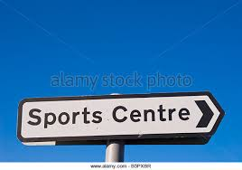
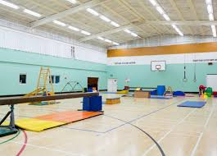
Au centre sportif
At the Sports Centre…
Notes:
At the Sports Centre…

Slide 7
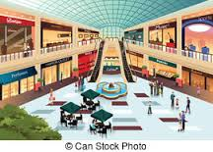
Au centre commercial …
At the shopping centre/mall…
Notes:
At the shopping centre/mall

Slide 8
À l’ école
At the school…
Notes:
At the school

Slide 9
À la bibliothèque
At the library…
Notes:
At the library

Slide 10
Au cinéma
…
At the cinema…
Notes:
At the cinema

Slide 11
Tournez à gauche!
Turn left!
Notes:
Turn left

Slide 12
Tournez à droite!
Turn right!
Notes:
Turn right

Slide 13
Allez tout droit!
Go straight on!
Notes:
Go straight on!

Slide 14
Traversez la rue!
Cross the street!
Notes:
Cross the street.

Slide 15
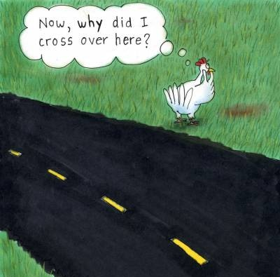
Traversez la route!
Cross the road!
Notes:
Cross the road!

Slide 16
Le/la voilà!
There you go/here it is!
Notes:
Turn

