Slide 1
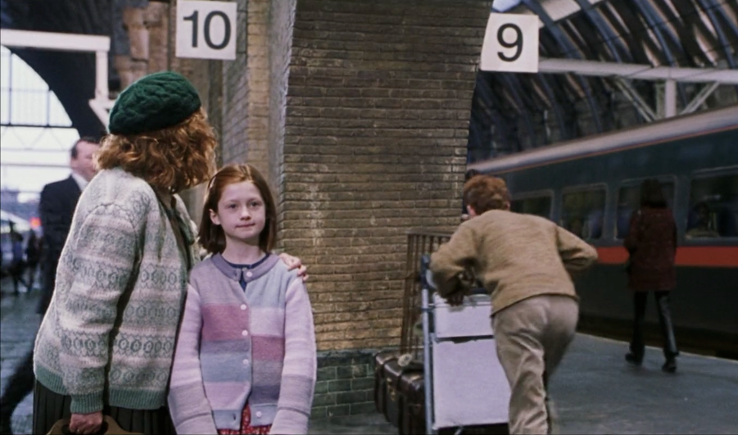

Slide 2
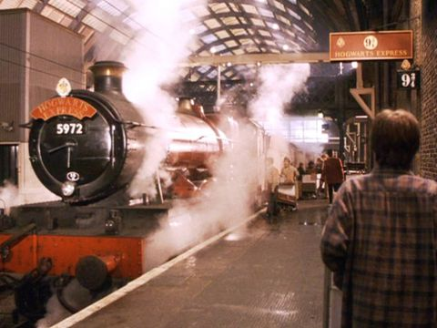

Slide 3
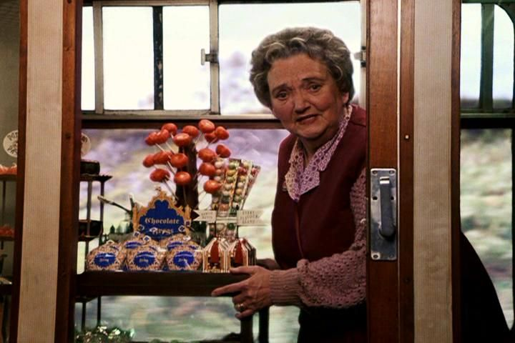
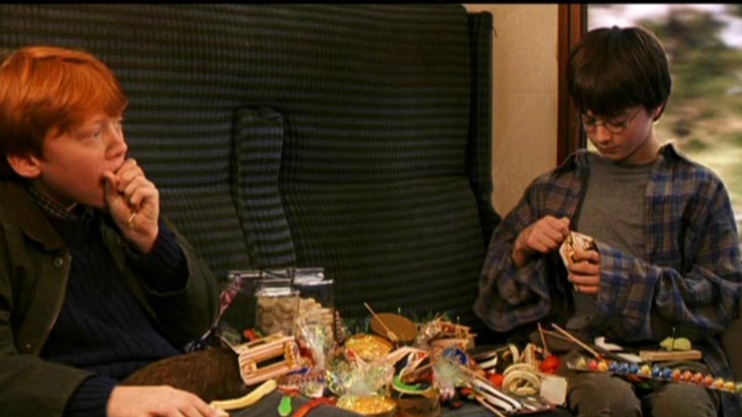
Harry Potter Food
Anything off the trolley dears?
We’ll take the lot!

Slide 4
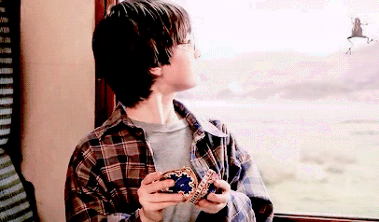
Today I am learning to read for information in French and write a list of what I would like in French, using vocabulary I have learned in class.
Je m’appelle Harry Potter.
Je voudrais une grenouille au chocolat.
Il y a du chocolat, des biscuits, des gâteau, des fruits et des bons bons.
Qu’est-ce que tu veux?
Je voudrais…………...

Slide 5
Qu’est-ce que tu veux?
First let’s learn some vocabulary!
Notes:
What is this?

Slide 6
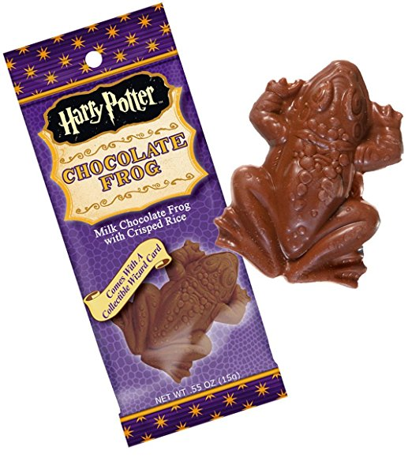
Je voudrais…..
du chocolat

Slide 7
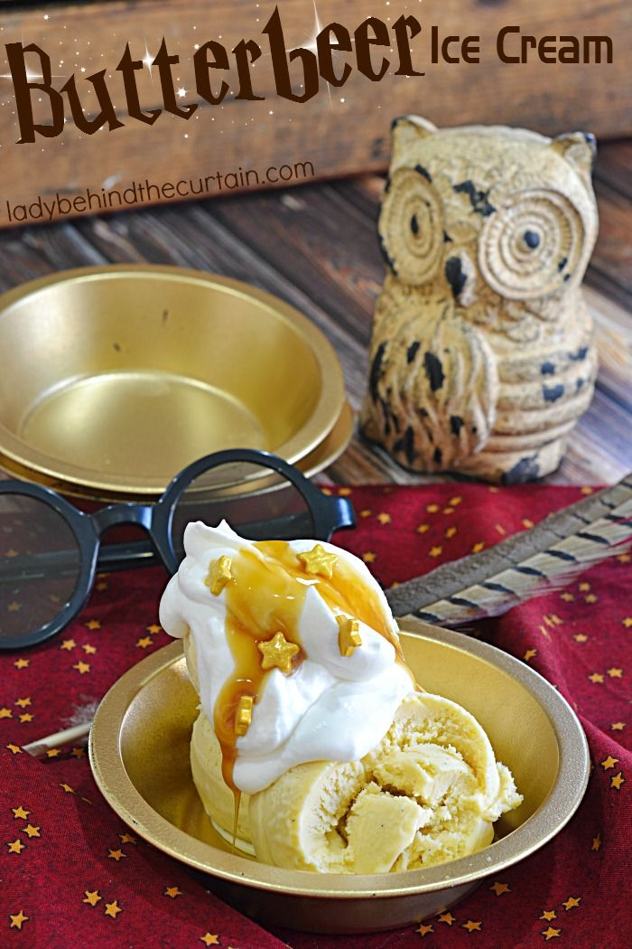
une glace

Slide 8
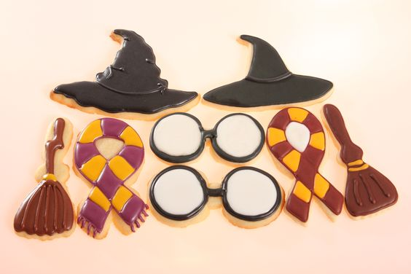
des biscuits

Slide 9
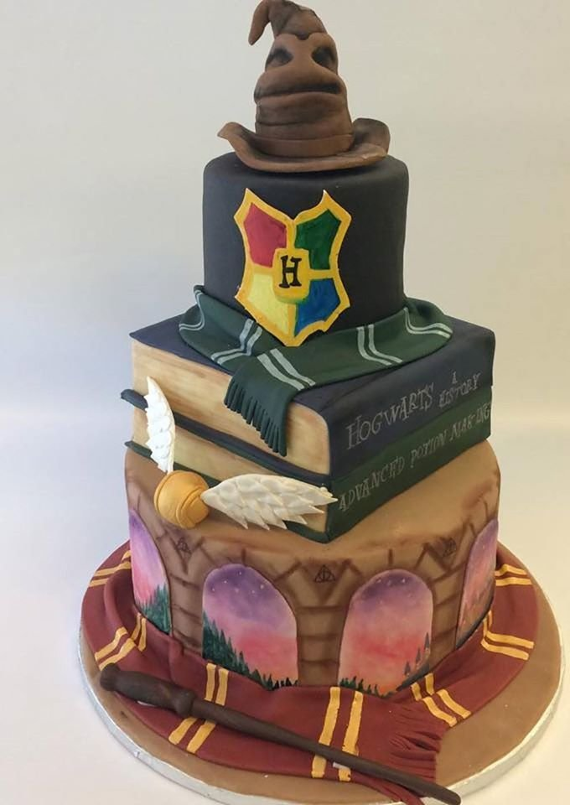
un gâteau

Slide 10
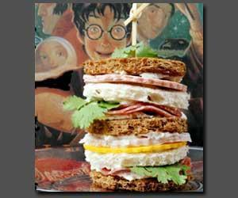
un sandwich

Slide 11
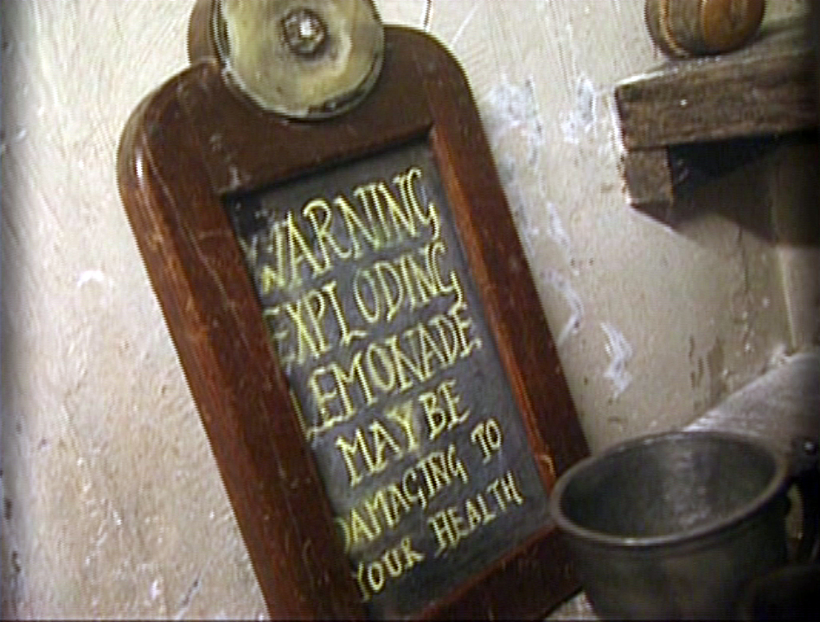
une limonade

Slide 12
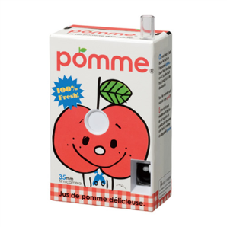
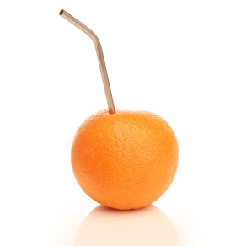
un jus de pomme
un jus d’orange

Slide 13
du lait

Slide 14
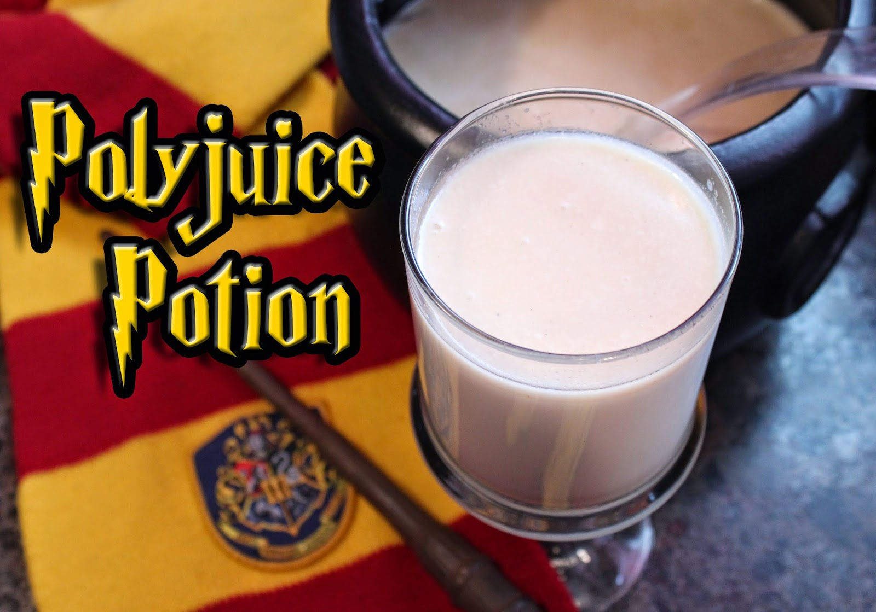
un milk-shake

Slide 15
des bonbons explosifs

Slide 16
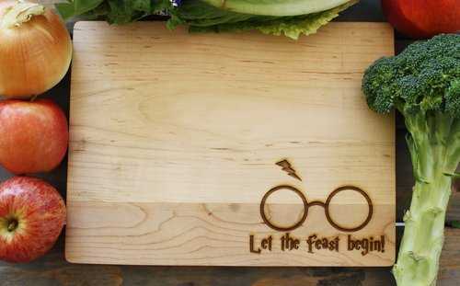
des légumes et des fruits

Slide 17
Don’t forget to say please!
S’il te plaît.
S’il vous plaît.

Slide 18
les élèves Beat the Teacher ! le Prof III IIII
On the next slide there are pictures with words.
Point at the word and say it in the target language.
Pupils should repeat it after you.
Now use the slide with pictures only (print off the one with words to use as a prompt). Point at the word and say it in the target language. Pupils repeat the word as before.
At some point you say the wrong word (on purpose, of course!). Pupils must remain quiet to win a point. If there is a peep, then the teacher gets the point. Play first to 5 wins!

Slide 19
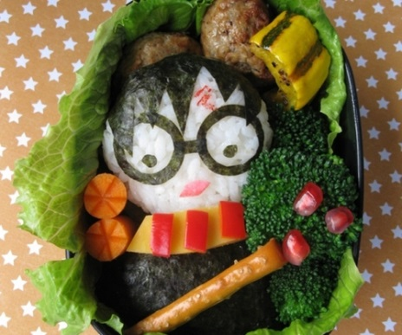
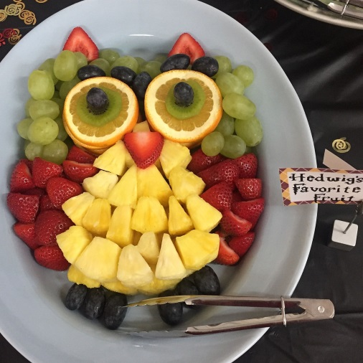
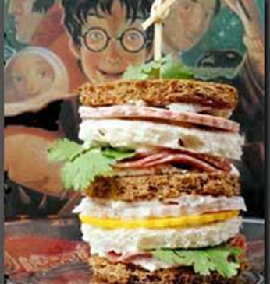
une glace
du lait
des biscuits
des bonbons
des légumes
du chocolat
des fruits
un sandwich
un gâteau

Slide 21
Reminder: Today I am learning to read for information in French and write a list of what I would like in French, using vocabulary I have learned in class.
Je m’appelle Harry Potter.
Je voudrais une grenouille au chocolat.
Il y a du chocolat, des biscuits, des gâteau, des fruits et des bons bons.
Qu’est-ce que tu veux?
Je voudrais…………...

Slide 22
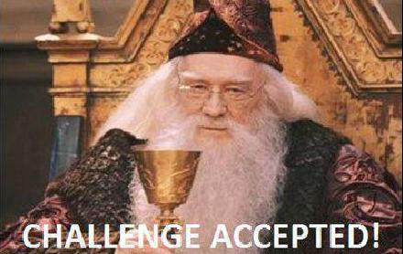
Write the date in French on your Worksheet.
Look at the side with ‘Anything off the trolley dears?’
Study the picture of the trolley on the Smartboard.
List what you would like from it in French.
Your sentence will begin with: Je voudrais ……
Now add in all of the things you have chosen. Remember when writing a list, you add a comma after each item except before the last item, where you put the word and (et) e.g. Je voudrais un limonade, des bonbons, des fruits et un sandwich s’il vous plaît.

Slide 23
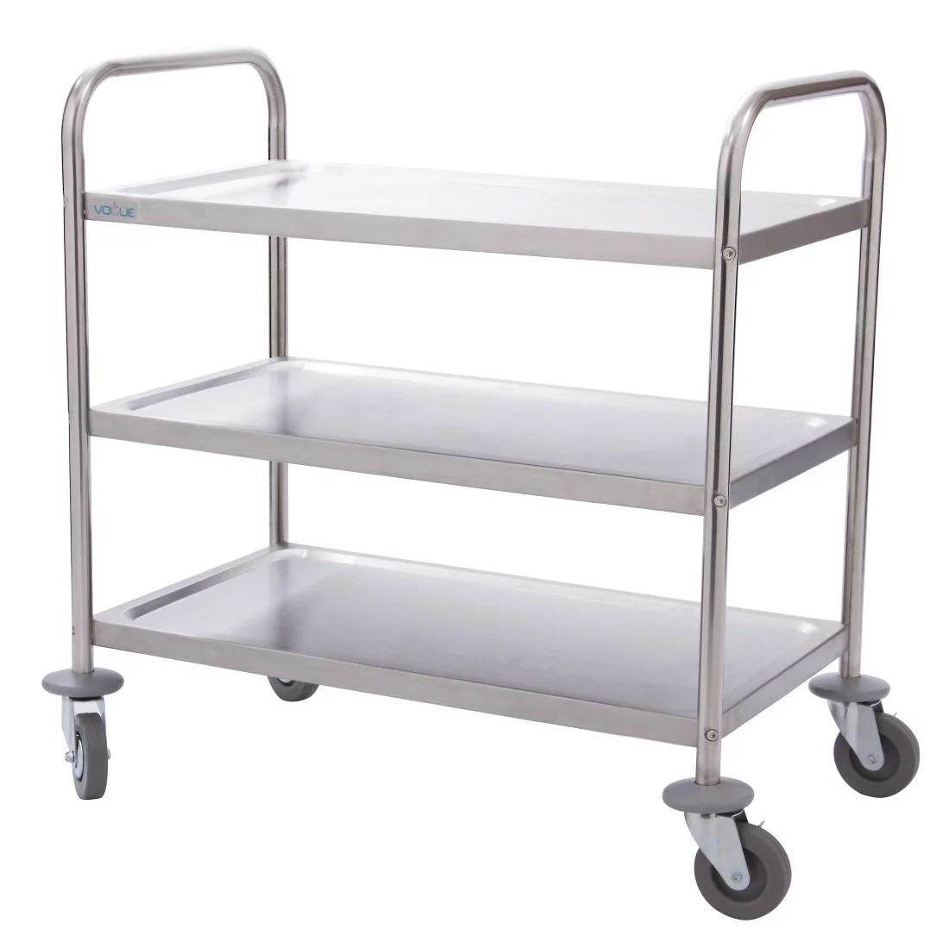
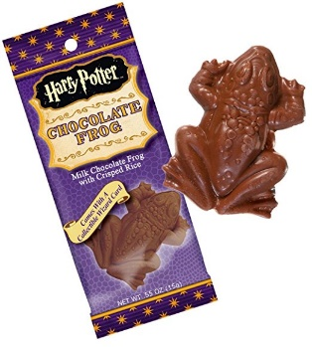
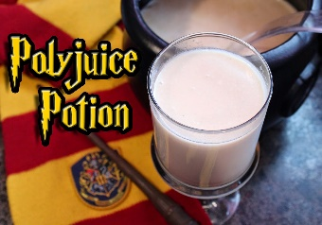
des légumes et des fruits
un gâteau
du chocolat
des bonbons explosifs
un milk-shake
une limonade
du lait
des biscuits
une glace
un sandwich
DU CHOCOLAT

Slide 24
Other useful questions and answers
Qu'est-ce que vous avez pour le goûter? J’ai….
(What do you have for snack? I have..)
Tu aimes...? (singular) Vous aimez...? (plural) (Do you like…?)
Tu n’aime pas...? Vous n’aimez pas…? (Don’t you like…?)
J’aime... (I like…)
Je n’aime pas..... (I don’t like…)
le goûter = snack
la récréation= playtime
le petit déjeuner= breakfast
le déjeuner = lunch
le dîner= dinner (eaten very late, as late as around 9/10 p.m.)

Slide 25
Trap-door!
To finish, lets play a game of ‘Trap-door’!
Teacher prints off a copy of the next slide and puts a dot beside one of the choices at each box (keep it top secret!).
Pull a lollipop stick or something with pupil’s name on. Ask that Pupil the question and they answer making a choice from the box.
If it matches the answer the teacher chose, they stay in the game and move onto the next question.
If the answer does not match the teacher’s, they fall down the ‘Trap-door’ and teacher says ‘Au revoir – la trappe’! Teacher then moves onto another pupil.
The winner is the person who gets to the end of the slide. Pupils must listen carefully, if they are to make the right choices!
Bonne chance!

Slide 26
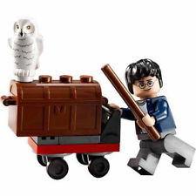
très bien merci.
bien.
Bonjour! Ça va?
Oui, ça va
Qu’est-ce que vous voulez?
du chocolat
des légumes
un sandwich
du lait
un jus d’orange
une limonade
Je voudrais
s’il vous plaît.
et
Est-ce que vous voulez autre chose?
du raisin.
une pomme.
du fromage.
Oui, je voudrais
Merci beaucoup.
Notes:
Trapdoor is brilliant for a) memory and b) speaking (repetition with a reason!) It’s a competitive game in pairs. Each chooses and option for each sentence in their head. One starts reading out loud, trying to anticipate the other’s choices. Each time they make a choice, the partner either nods or shakes his/her head. If the choice is wrong, play passes to the partner who starts the same process. If it is the right choice, the student gets to continue. The aim is to get to the end first. Answers don’t change, so this is also a great memory developer.

