Slide 1
Harry Potter
Primary 6: Lesson 6

Slide 2
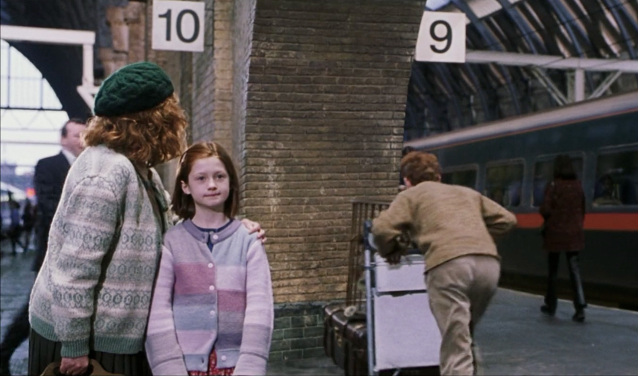

Slide 3
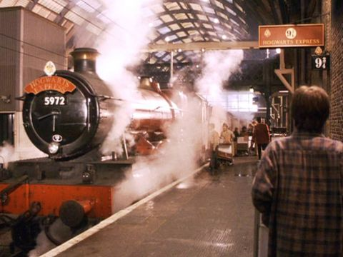

Slide 4
Primary 6 Lesson 6: Enrolling at Hogwarts
Today I am learning to:
Describe my hair and eye colour.

Slide 5
Enrolling at Hogwarts
When filling in an application form for Hogwarts, pupils are asked to give details of their physical traits.

Slide 6
Subject Pronouns
1st Person | Je | I
2nd Person | Tu | You
3rd Person | ll | He
 | Elle | She

Slide 7
LES YEUX
Notes:
The eyes

Slide 8
To describe someone’s eye colour in French:
We use the verb ‘AVOIR’ which means ‘TO HAVE’
They say: AVOIR + LES YEUX+ COLOUR (ADJECTIVE)
Let’s look at ‘AVOIR’ first.

Slide 9
Enrolling at Hogwarts
When filling in an application form for Hogwarts, pupils are asked what colour of eyes and hair they have.
J’ai | I have
Tu as | You have
Il a | He has
Elle a | She has

Slide 10
J’ai…(I have)…
les yeux bleus |  |  | les yeux verts
les yeux marron |  |  | les yeux gris
les yeux verts clairs |  |  | les yeux marron foncés
Notes:
I have:
Blue eyes, brown eyes, light green eyes, green eyes, grey eyes, dark brown eyes…

Slide 11
LES CHEVEUX
à

Slide 12
To describe someone’s hair colour in French:
We use the verb ‘AVOIR’ (‘TO HAVE’)
French people use:
AVOIR + LES CHEVEUX+ HAIR COLOUR (ADJECTIVE)

Slide 13
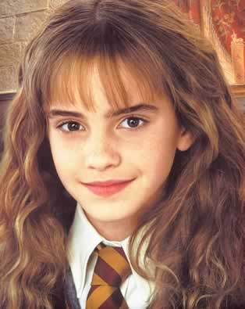
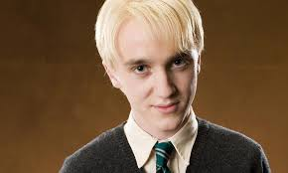
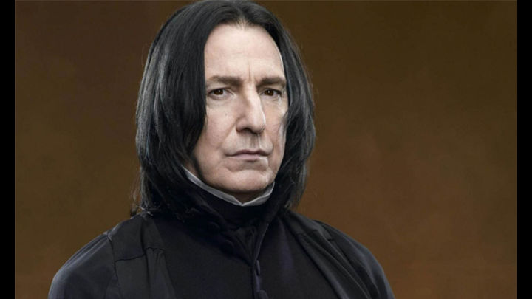
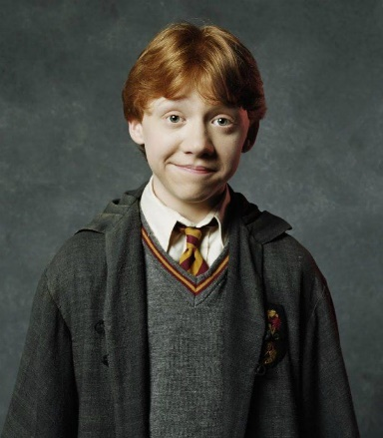
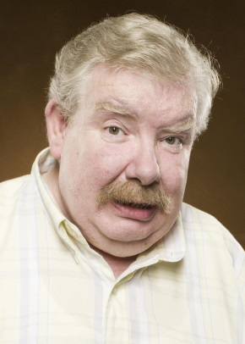
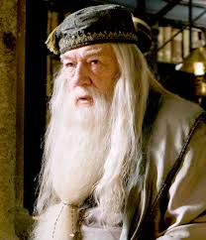
J’ai…(I have)…
les cheveux bruns |  |  | les cheveuxblonds
les cheveuxnoirs |  |  | les cheveuxroux
les cheveuxgris |  |  | les cheveuxblancs
Notes:
I have:
Brown hair, black hair, grey hair, blonde hair, red hair, white hair…

Slide 14
J’ai…(I have)…
les cheveux courts | les cheveux mi-long | les cheveux longs
short hair | medium hair | long hair

Slide 15
To describe someone’s hair type or length in Spanish:
We use the verb ‘AVOIR’ (‘TO HAVE’)
AVOIR + LES CHEVEUX + (LENGTH adjective)
AVOIR + LES CHEVEUX + (HAIR TYPE adjective)

Slide 16
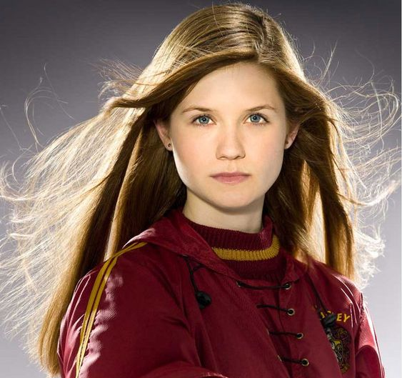
J’ai….
les cheveux raides | les cheveux bouclés | les cheveux frisés
straight hair | wavy/curly hair | curly hair (tight curls)

Slide 17
J’ai les cheveux bruns.
Je m’appelle Hermione.
Notes:
My name is…
I have BROWN hair.

Slide 18
Je m’appelle Ron Weasley.
J’ai les cheveux ROUX.
(Je suis ROUX.)
Notes:
My name is…
I have RED hair./
I am a REDHEAD.

Slide 19
J’ai les cheveux BLONDS.
Je m’appelle Draco Malfoy.
Notes:
My name is…
I have BLONDE hair.

Slide 20
J’ai les cheveux NOIRS.
Je m’appelle Professeur Snape.
Notes:
My name is…
I have BLACK hair.

Slide 21
J’ai les cheveux BLANCS.
Je m’appelle Professeur Dumbledore.
Notes:
My name is…
I have WHITE hair.

Slide 22
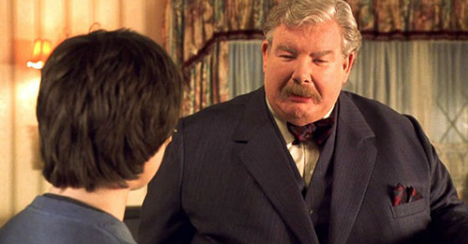
J’ai les cheveux GRIS.
Je m’appelle Oncle Vernon.
Notes:
My name is Uncle Vernon.
I have GREY hair.

Slide 23
LES YEUX
Notes:
The eyes

Slide 24
J’ai les yeux…bleus.
Notes:
I have BLUE eyes.

Slide 25
J’ai les yeux…….verts.
Notes:
I have GREEN eyes.

Slide 26
J’ai les yeux…gris.
Notes:
I have GREY eyes.

Slide 27
J’ai les yeux….marron.
Notes:
I have BROWN eyes.

Slide 28
J’ai les yeux…….verts CLAIRS
Notes:
I have light green eyes.

Slide 29
J’ai les yeux…….marron FONCÉS.
Notes:
I have dark brown eyes.

Slide 30
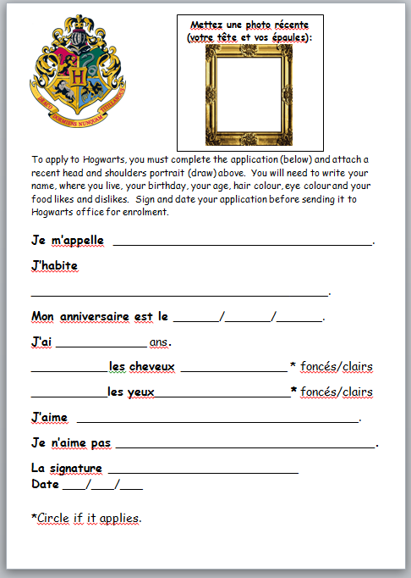
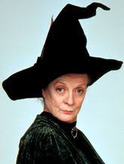
Writing Activity: Hogwarts Application Before you can be officially accepted to Hogwarts, Prof McGonagall would like you to complete the Enrollment Application with your Personal Details. Complete the application with the missing details in French.

