Slide 1

à la maison/chez toi
Notes:
Raise you hand for…
school lunch
packed lunch
home lunch

Slide 2
Food
la nourriture

Slide 3

Qu’est-ce que tu manges?
What are you eating?
Notes:
What are you eating?
What do you eat?

Slide 4
Je mange…
I’m eating…
Notes:
I’m eating
I eat
I do eat

Slide 5
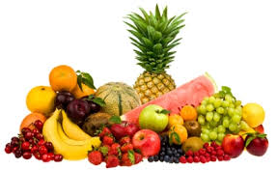
des fruits
Notes:
the fruit

Slide 6
une pomme
Notes:
an apple

Slide 7
une banane
Notes:
a banana

Slide 8
du raisin
Notes:
some grapes

Slide 9
une orange
Notes:
an orange

Slide 10
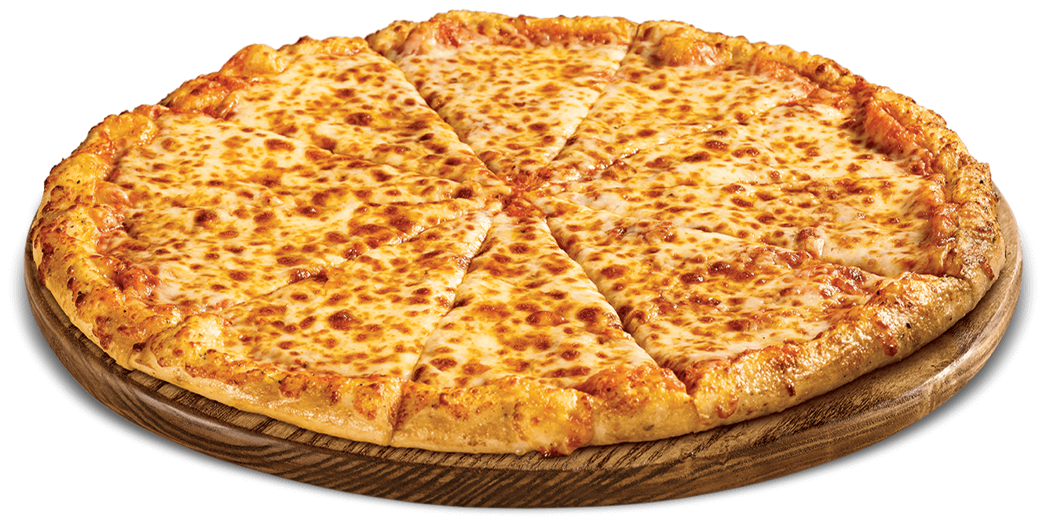
une pizza
Notes:
the pizza

Slide 11
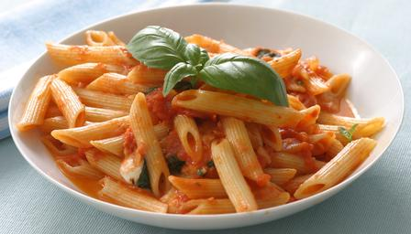
des pâtes
Notes:
the pasta

Slide 12
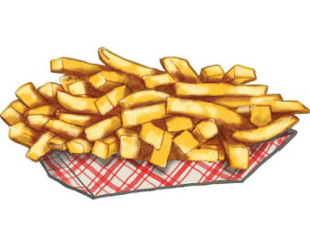
des frites
Notes:
the chips

Slide 13
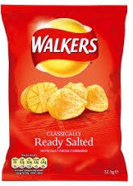
des chips
Notes:
the crisps

Slide 14
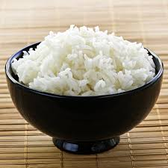
du riz
Notes:
the rice

Slide 15
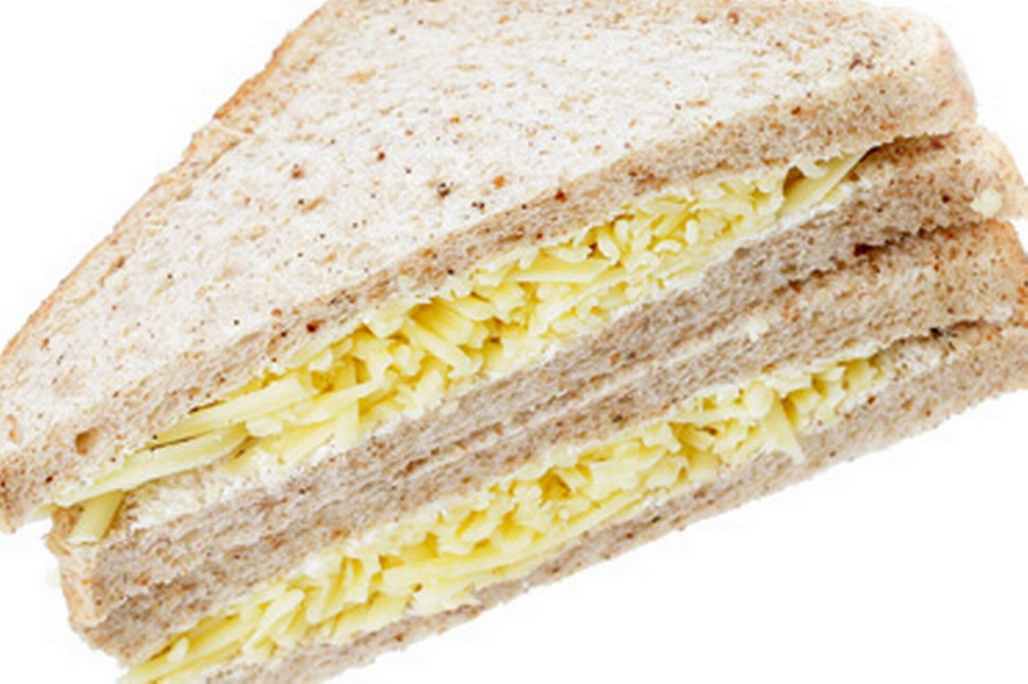
un sandwich
Notes:
the sandwich

Slide 16
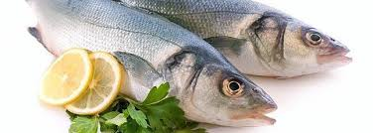
du poisson
Notes:
the fish

Slide 17
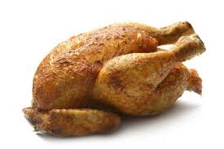
du poulet
Notes:
the chicken

Slide 18
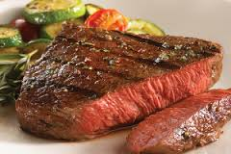
de la viande
Notes:
the meat

Slide 19
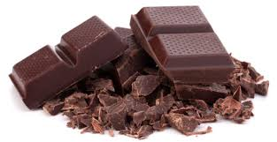
du chocolat
Notes:
the chocolate

Slide 20
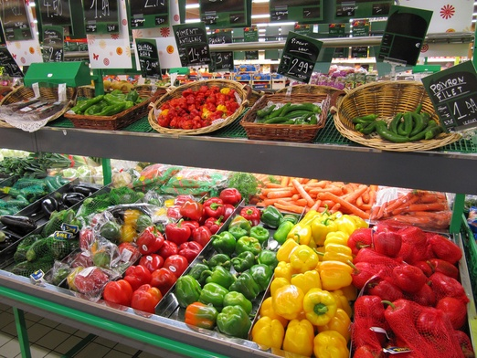
At a French market…
http://www.bbc.co.uk/education/clips/z6jygk7

Slide 21
Other useful questions and answers
Qu'est-ce que vous avez pour le goûter? Je….
(What do you have for snack? I have..)
Tu aimes...? (singular) Vous aimez...? (plural) (Do you like…?)
Tu n’aime pas...? Vous n’aimez pas……(Don’t you like…?)
J’aime... (I like…)
Je n’aime pas..... (I don’t like…)
le goûter = snack
la récréation= playtime
le petit déjeuner= breakfast
le déjeuner = lunch
le dîner= dinner (eaten very late, as late as around 9/10 p.m.)

Slide 22
Meal times etc. in France
https://www.bbcgoodfood.com/howto/guide/karen-le-billion-french-children-eat-anything
http://www.bbc.co.uk/education/guides/z2wk87h/revision
http://www.euroclubschools.net/Facts-About-French-Food(1889307).htm

Slide 23
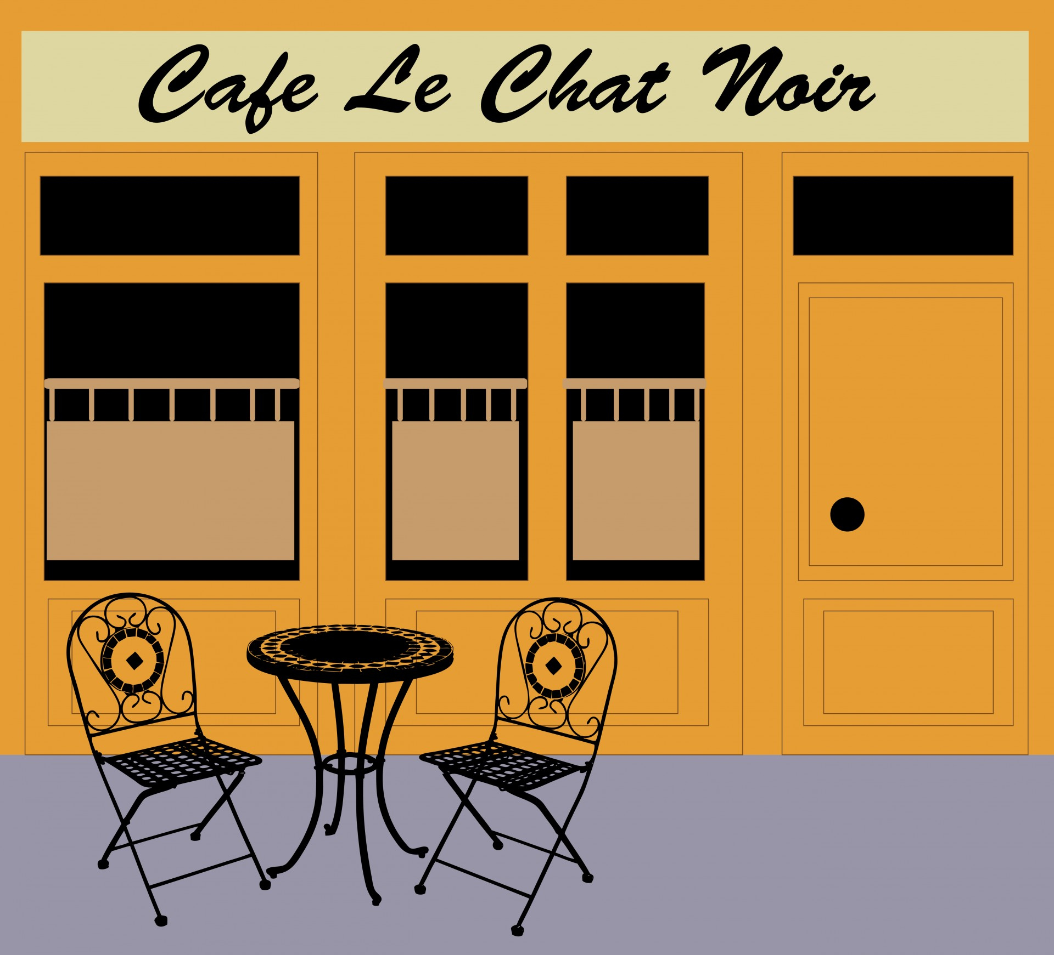
Café Game
Play “au Café” role play game , either using food in your kitchen or pictures you have drawn.
The waiter/waitress takes orders and has to serve the correct food to the customer.

Slide 24
Café Role Play Game
Have a table full of food. Call this table “léa Cuisine” – (the kitchen)
Customer(s)sit at table and someone folds tea-towel over their arm, as if pretending to be a waiter/waitress.
People in “le Café” begin by calling: “serveur/garçon” (male waiter) or “serveuse” (waitress).When the waiter/waitress arrives, they say “Oui, Monsieur/Madame/Mademoiselle?
The customer says the name of the object he or she would like + “s’il vous plaît

Slide 25
Café Role Play Game
Example: “Une pomme, s’il vous plaît.”
The waiter then says “un moment, merci” and goes away to fetch the item from the table to bring it to the customer.
If the waiter gets it correct. Then, the customer says “Merci!” The waiter takes the item back to the table and play begins again with the customer requesting a different item.
If the waiter gets it wrong, then the customer makes a fuss, saying “Non, non non! S’il vous plaît, une pomme” while waving the item away with hands. The waiter then takes back the item to the table and tries again until it is correct. Once it is correct, then item is returned to the “cuisine” and play starts again.

Slide 26

Poster Design
Make a poster about healthy/unhealthy snacks in French:
C’est bon/mauvais pour la santé (It’s good/bad for your health)!

