Slide 2
Words Are Disappearing!
The Anti-Word League is an evil and cunning group. Its mission is to stop people writing. The members of the Anti-Word League have been known to capture authors and they do not stop at that – they want to take every word from every single book. All over the world, reports of disappearing words are being made…
The Daily Word
On 1st March 2019, the Yorkshire-based bookshop owner, Mr Oliver Jolly, complained to the police that some words had gone missing from his books. Mr Jolly claimed that he had checked the book – The Wild Robot – before he sold it. Mr Jolly stated, “I always do it, I guess.” He later added, “I flick through all of the pages of books when a customer wants to buy one. I just would have spotted missing words when I sold it, but they were all there when the customer left the shop. When he brought the book back three days later, entire pages were blank – the words just weren’t there!” The police checked the copy of the book and confirmed that entire pages had several words, or in some cases all of their words missing. At the time, this was a treated as a one-off event. However, over the subsequent days, members of the public started to call the police complaining that words were disappearing from car manuals, menus and even school textbooks. Police are now very concerned that this may be an epidemic of word theft and are investigating the Anti-Word League.

Slide 3
The Anti-Word League
The Anti-Word League is a group of people. The members of the Anti-Word League are trying to take away all written words. Things we know about the members of the Anti-Word League:
They can find any book with their heightened sense of smell.
They can steal words from books.
They have been known to capture authors and illustrators to stop them working.
They can camouflage themselves well and pretend to be other people.

Slide 4
What Is Being Done to Prevent the Anti-Word League?
The police have launched a full investigation into the word thefts. Many famous authors and illustrators, including Cressida Cowell, Malorie Blackman and Rob Biddulph are reported to be assisting the police with the investigation. A spokesperson for the group of authors and illustrators stated, “We are very anxious.” One author went on to explain, “Our lives and our thoughts are being taken from us, as well as the magical worlds we create. Without words, there will be no magical lands in books, no medical reports to help people and no song lyrics for people to dance to. Life simply won’t be as it is today.”

Slide 5
Can You Become a Detective?
We need your help for the Anti-Word League investigation. You are going to take on the role of a detective, working to stop the Anti-Word League.
You will need to write a report for the police about the Anti-Word League and include the following:
Explain who the Anti-Word League is.
Say why the Anti-Word League may be stealing words.
Tell the public why the Anti-Word League is a danger.
State what the Anti-Word League could do if it is not stopped.
Describe the appearance of the Anti-Word League.
State what the reward is for finding the Anti-Word League.

Slide 6
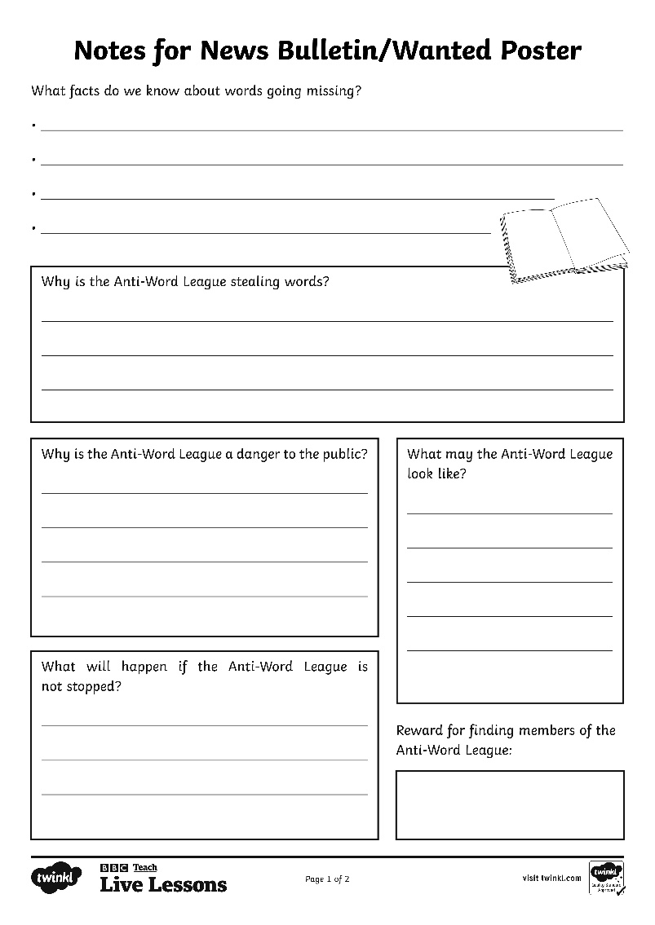
Write Your Interview Notes
Facts
Description of what they look like
Main Information
Reward information

