Slide 1
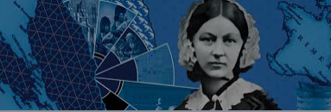
Florence Nightingale Maths Project
Casey Moore

Slide 2
Facts
Born – 12 May 1820
Died – Age 90 – 13 August 1910
Parents – William Nightingale , Frances Smith
Nationality – British
Known For – Pioneering Modern Nursing
Awards – Royal Red Cross (1883)
Lady of Grace of the Order of St John
(LGSt) (1907)

Slide 3
Childhood Facts
She grew up in a wealthy and well - connected British family at the villa Colombaia in Florence, Tuscany, Italy and was named after the city of her birth.
Florance's older sister Frances Parthenope had similarly been named after her place of birth , Parthenope , a Greek settlement now part of the city of England in 1821.
With Nightingale being brought up in the family's homes at Embley, Hampshire, Lea Hurts and Derbyshire.

Slide 4
How Nightingale's math's affected the world
Whilst in Turkey Nightingale collected data and organised a record keeping system.
This information was then used as a tool to improve city and military hospitals.
Nightingale's knowledge of mathematics and statistics became evident when she used her collected data to calculate the mortality rate in the hospital.

Slide 5
Relationships
Nightingale had several male admirers and during her life she received at least two proposals of marriage.
However she believed that God had chosen her for her work and she never married or had children.

Slide 6
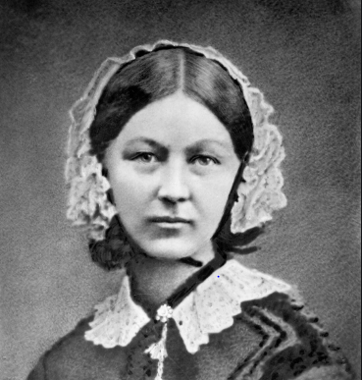
Interesting Fact
Due to the Corona Virus pandemic, there has been an emergency hospital opened up in London, and is named after Florence Nightingale.

