Slide 1
Describing a setting.
Slow writing.

Slide 2
Why is describing a setting important?
What should you include when describing a setting?

Slide 3
L.I We are learning to use a slow writing structure to describe a setting.
Create a title for your setting.
Sentence one must used at least 3 adjectives to describe what you can see.
Sentence two must include how the setting makes you feel.
Sentence three must describe the weather using at least one adjective.
Sentence four must describe your setting using your senses (what can you hear, smell, touch)
Sentence five must contain an example of alliteration.
Sentence six must contain a simile.
Sentence seven must start with a pronoun.

Slide 4
Can you think of a title for this setting?

Slide 5
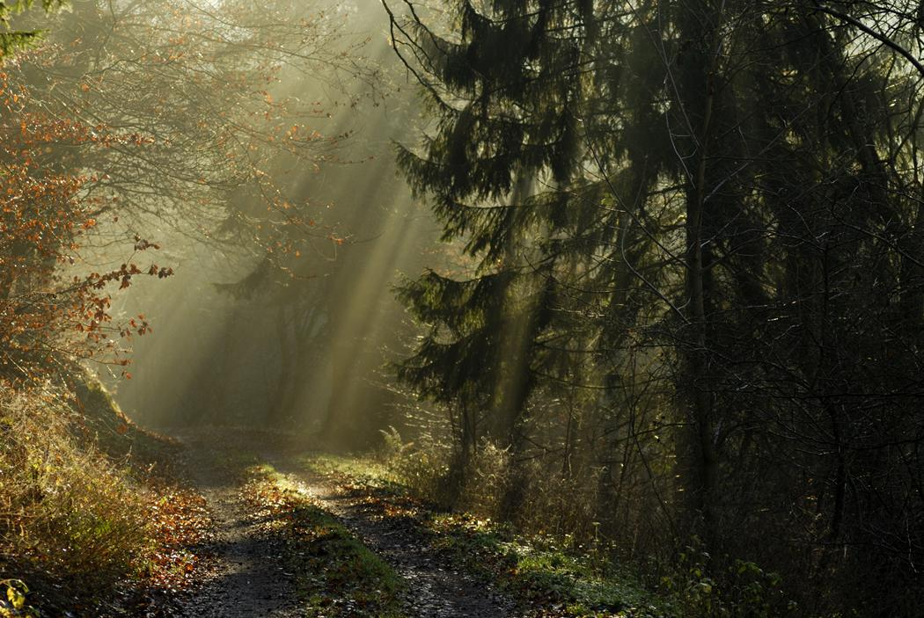
Can you think of three adjectives to describe what you see?

Slide 6
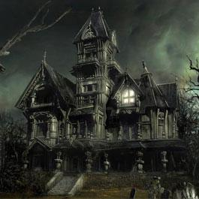
Describe how this setting makes you feel.

Slide 7
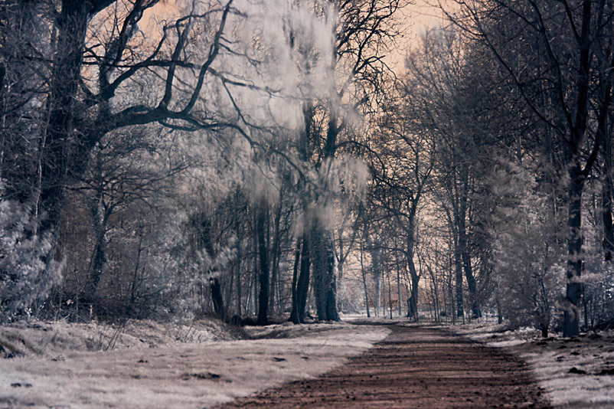
Describe the weather using at least one adjective.

Slide 8
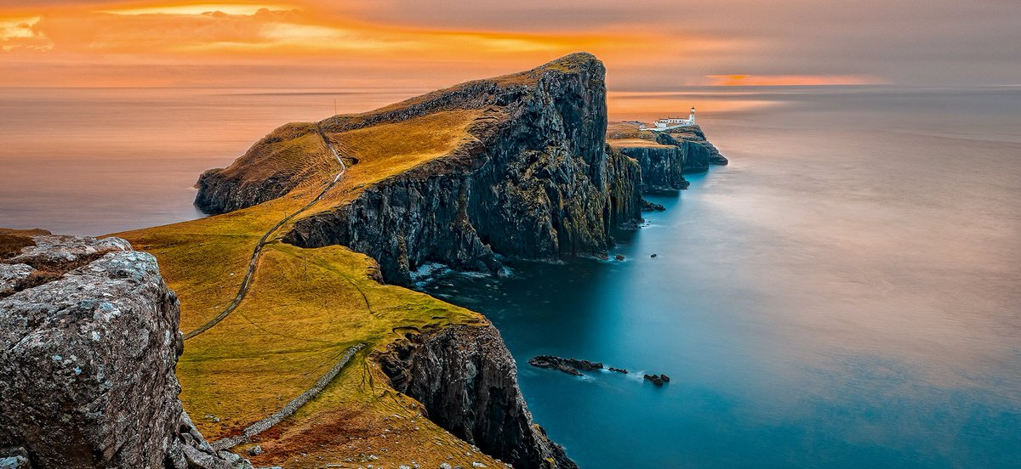
Describe this setting using your senses. What can you hear, smell and touch?

Slide 9
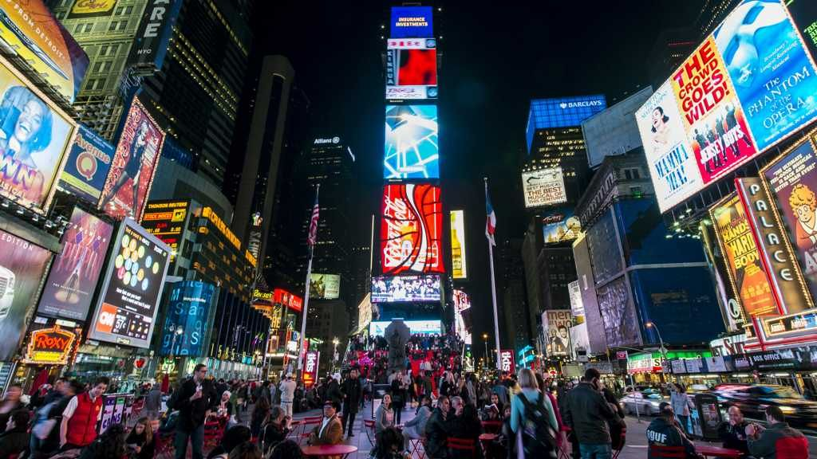
Use an example of alliteration to help describe this setting.

Slide 10
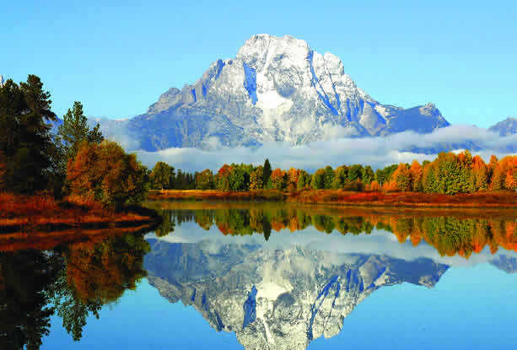
Use a simile to help describe this setting.

Slide 11
Give me an example of a sentence starting with a pronoun.
“I walked towards the haunted house…”
“My hairs were standing on end…”
“They swam in the beautiful lake…”

Slide 12
Blether station activity.
Brainstorm examples of adjectives, similes and alliteration that you may use in your final piece of writing in your groups.
Write your ideas on your blether station record by matching number on the picture to the number on your blether station record sheet.
Use these ideas, along with the slow writing structure to form a quality paragraph describing your setting.

Slide 13
Plenary.
What was our learning intention today?
What is important to include when describing a setting?
Why is it important to give a detailed description of you setting?

