Slide 1
We hope you find the information on our website and resources useful. This resource contains links to external websites. Please be aware that the inclusion of any link in this resource should not be taken as an endorsement of any kind by Twinkl of the linked website or any association with its operators. You should also be aware that we have no control over the availability of the linked pages. If the link is not working, please let us know by contacting TwinklCares and we will try to fix it although we can assume no responsibility if this is the case. We are not responsible for the content of external sites.

Slide 3
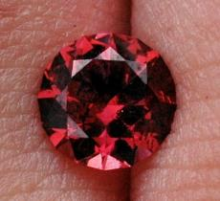
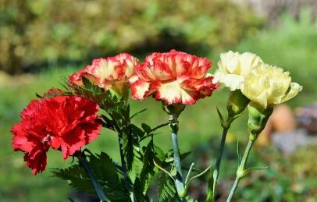
January’s Pinboard
January is the first month of the year and has 31 days.
Each month has a special flower and birthstone. January is carnations and garnet.
Our calendar was created by the Romans and it is thought they named the first month of the year after their god Janus, god of beginnings.
Things to do:
walk by the river
make a mini booklet to carry in your pocket
grow potatoes
plant a tree
make popcorn chains for the birds
have a walk round an estuary as the flowing water doesn’t freeze
take part in a garden bird survey
It once had 29 days but after the Roman Emperor Julius Caesar named July after himself, the number of days assigned to January was increased.
The zodiac signs are Capricorn and Aquarius.

Slide 4
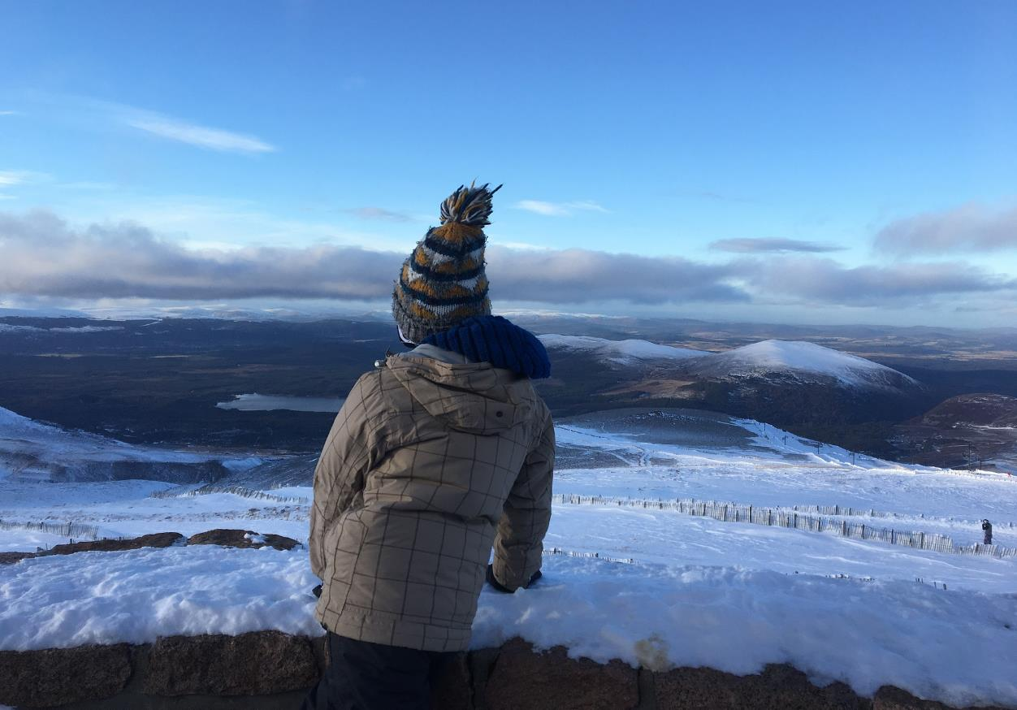
Although the number of daylight hours is extending, January can still feel like a rather dark and grey month. Don’t let that put you off, wrap up warm and see what you can discover.

Slide 5
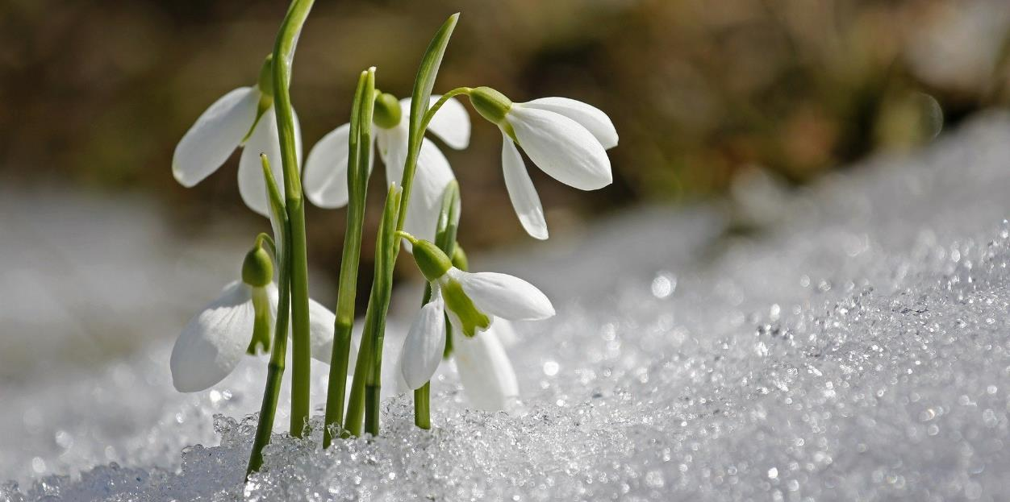
Awakenings from Underground
Lying dormant for months underground, snowdrops are now ready to bloom. Emerging from frozen soil and thriving in Scottish winter weather, these dainty flowers are actually pretty tough.
How much do you know about this winter warrior?
Try this true or false quiz and click on the snowdrops to reveal the answers.

Slide 6
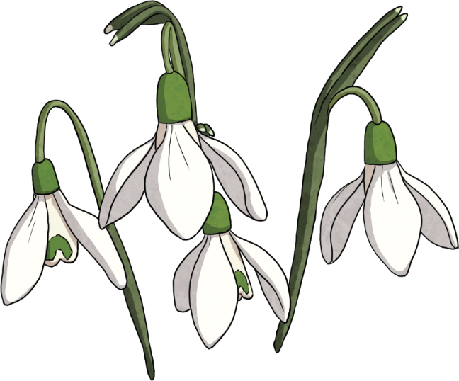
Quiz
Galanthus nivalis, the snowdrop’s scientific name, means ‘milk flower of the snow’.
Snowdrops freeze in icy weather but recover quickly.
Doctors use snowdrops to help with memory loss.
Mutant snowdrop bulbs are worth hundreds of pounds.
Snowdrops and their bulbs are poisonous.
Snowdrops are native to Scotland.
Snowdrops have three petals.
False They don’t have any! They do have six tepals, three outer and three inner, that look very much like petals. Petals are used by flowers that need to attract insects for pollination but snowdrops don’t need to attract insects since they reproduce by growing more bulbs.
True Snowdrops that look different from the normal varieties are sometimes referred to as mutants and one bulb can sell to snowdrop collectors for hundreds of pounds.
True One of the medicines used to treat dementia uses galantamine, which is found within snowdrop bulbs.
True They are toxic to humans.
False They were introduced from mainland Europe. No one knows exactly when but it thought to be around 500 years ago.
False They contain a natural form of antifreeze.
True
Click the snowdrop to reveal the answers.

Slide 7
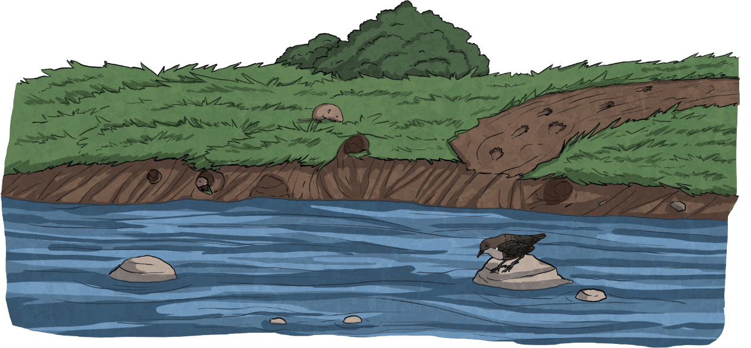
Along the Riverbank
Taking a quiet stroll along some of the 125,000 km of running freshwater in Scotland will give you an opportunity to spot signs of nature above the water.
Otter tracks can be seen in the mud. The pawprints are about the size of a medium dog but otters have five claws instead of four.
The water vole’s burrow can seen as a series of holes along the steep bank.
The dipper can be spotted, bobbing about on rocks, hunting for insects and fish in the water.
Click the dots to find out more and again to hide.

Slide 8
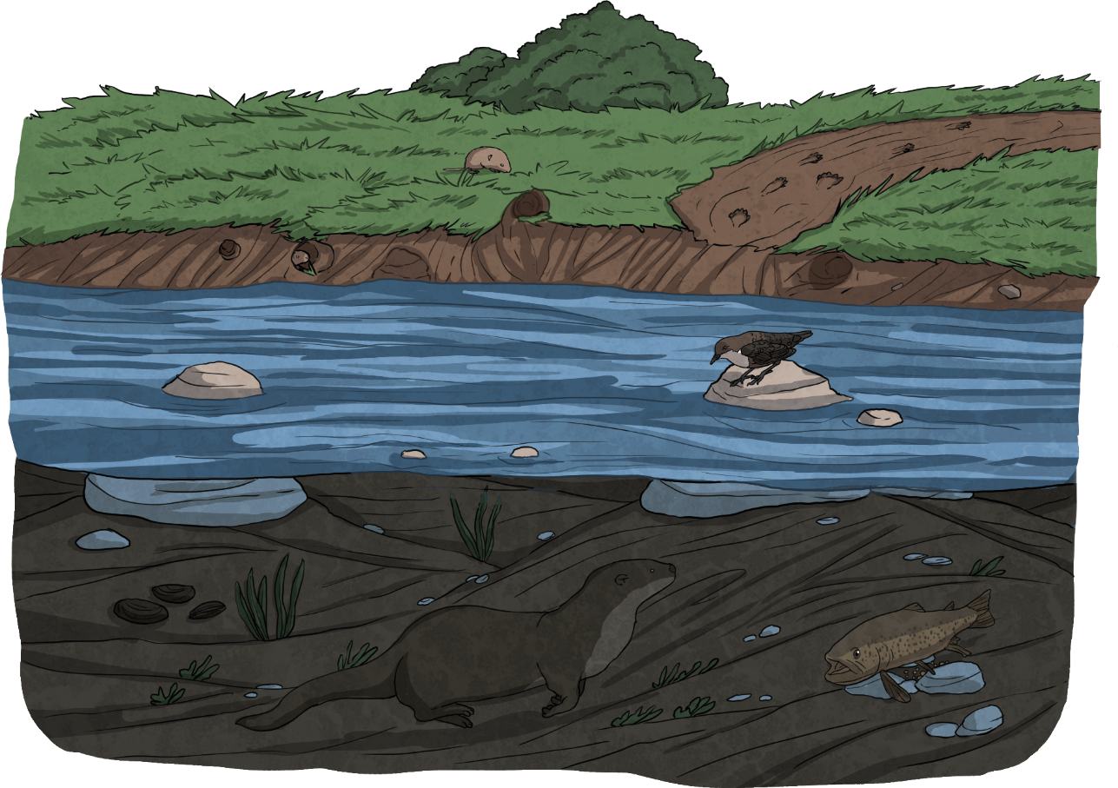
Now let’s dive underneath to see what is going on under the surface.
Click the dots to find out more and again to hide.
The dipper’s clear eyelids act like goggles and they can search for food for up to 30 seconds.
Freshwater pearl mussels are critically endangered. The oldest individuals are over 100 years old, bigger than both your hands put together and can have a pearl inside.
The brown trout is spawning, laying eggs on the riverbed. They have the ability to see all around them as one eye can look back while the other looks forwards.
The Eurasian otter dives, using its long whiskers in search of food and leaving a trail of bubbles behind.

Slide 9
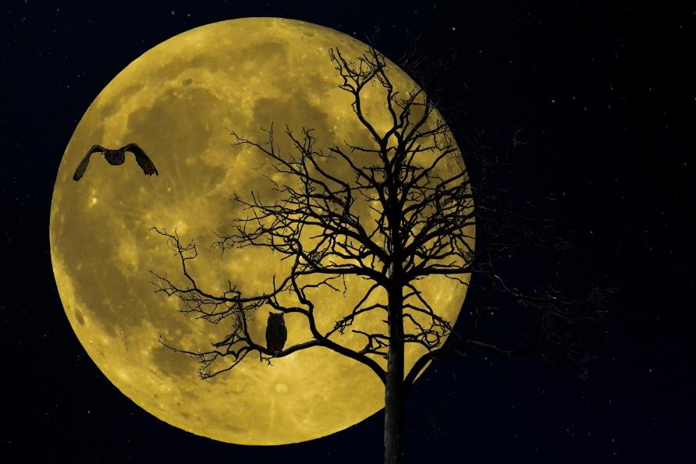
Nocturnal Nature
As the sun sets and we get ready for bed, there are a some creatures who are just waking up. While you are on your way to school in the dark the following morning, you might see catch a glimpse of one of these nocturnal animals.
What does ‘nocturnal’ mean?
active at night

Slide 10
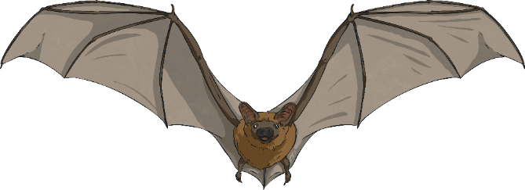
diurnal means to be active during the day like us!
crepuscular
What do you call an animal that is mainly active at dawn and dusk?
Do you know the opposite of nocturnal?
Nocturnal animals often have excellent hearing, smell and modified eyesight to give them an advantage during the hours of darkness.

Slide 11
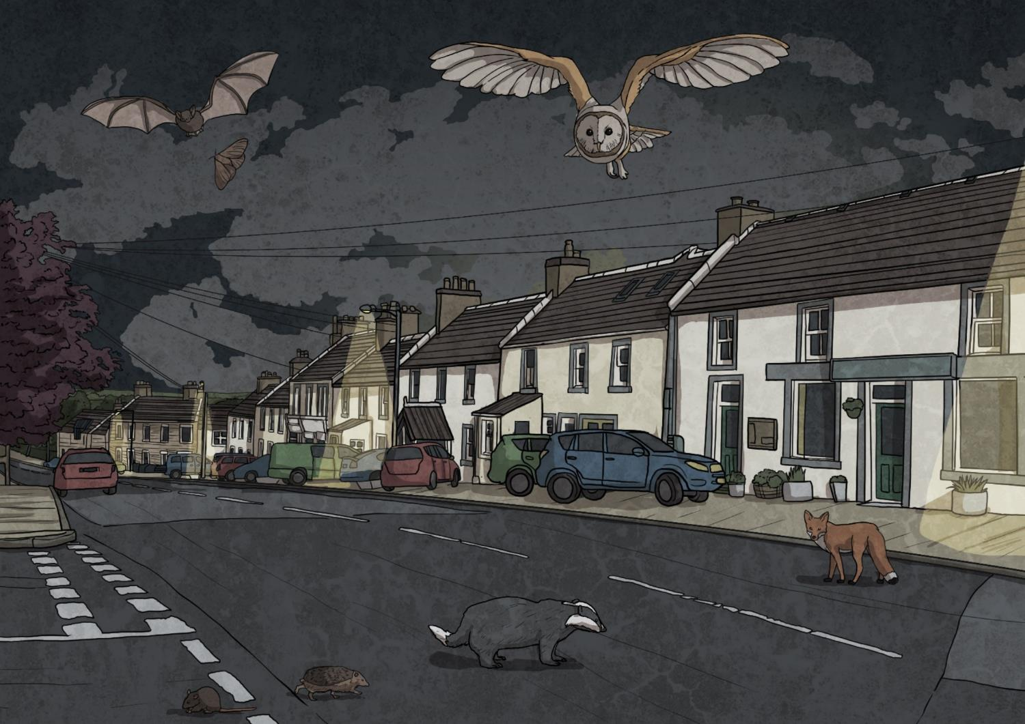
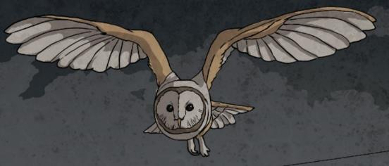
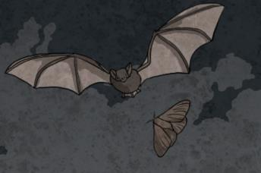
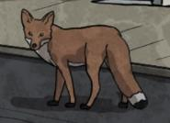
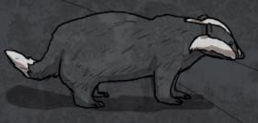
Can you spot the seven nocturnal creatures?
Click on them to shine the torch.

Slide 12
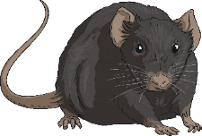
What are the Advantages to Being Nocturnal?
Competition
Hunt prey
Looking for food at night allows nocturnal wildlife to reduce the level of competition with species that look for the same food source but are active during the day.
Having enhanced night vision or special adaptations like echolocation, gives some predators a greater advantage over their prey with poor night vision.
Avoid predators
Avoid losing water
Under the cover of darkness, some creatures take the opportunity to gather together or search for food.
Not something that applies to wildlife in Scotland! In hot climates, nocturnal creatures lose less water from their bodies by avoiding the worst of the heat during the day.

Slide 13
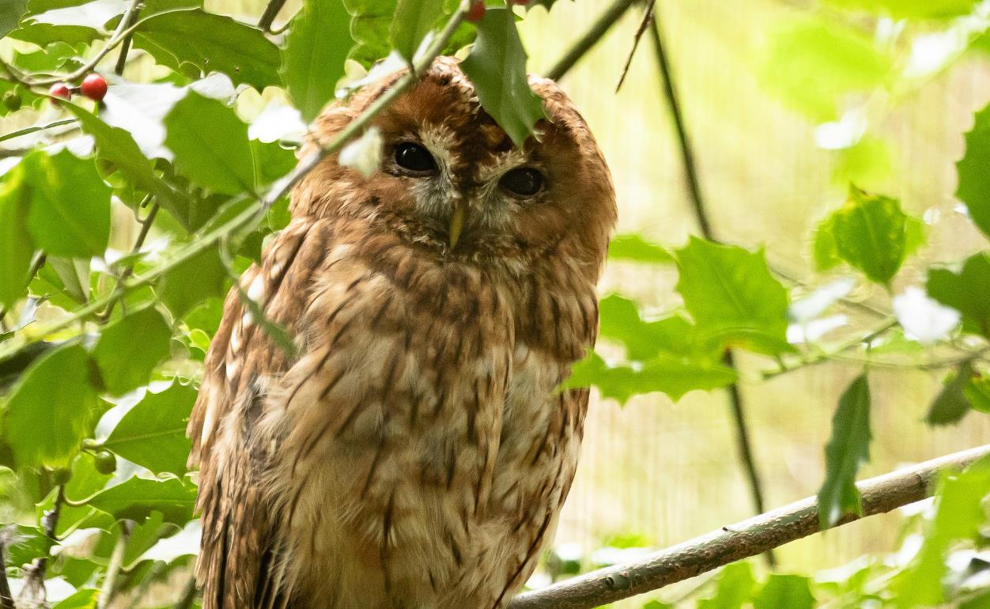
Twit-Twooo or Twit and Twooo?
The call of the tawny owl is heard far more often than the bird itself is seen.
It can be found in woodlands and in city parks. However, it is not just one owl that makes the ‘twit-twooo’ call, it is infact a conversation between a female that calls the ‘twit’ and the male with the ‘twoo’.
Click here to go to the RSPB’s page and hear a recording.

Slide 14
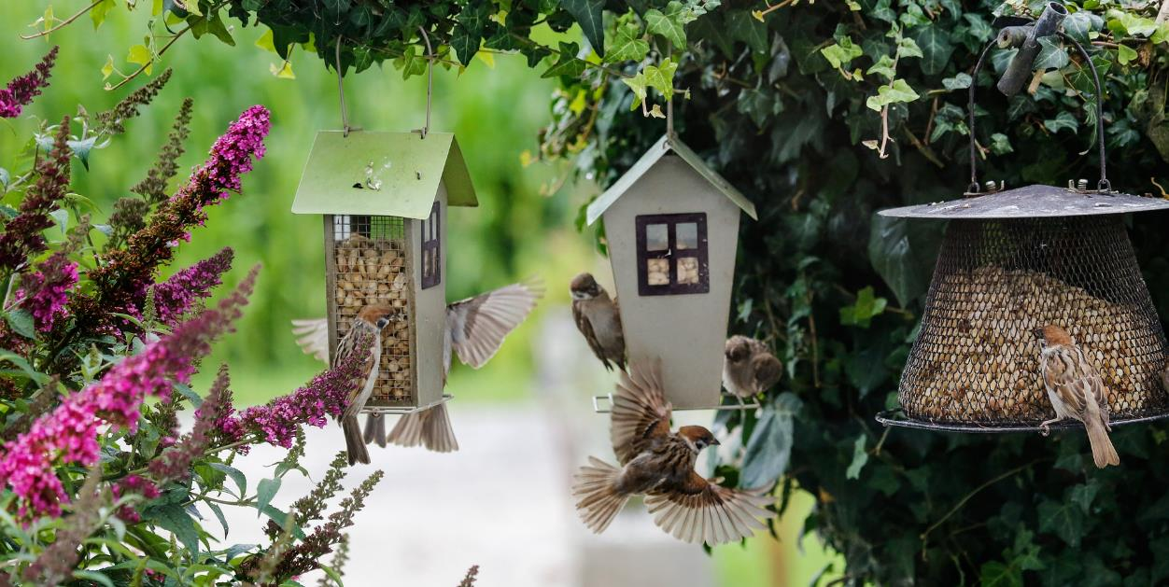
At the Bird Feeder
Taking one hour to record the birds that come into your garden or school grounds and contributing to the RSPB’s Big Garden Birdwatch will create data that scientists can use to find trends in bird populations across the UK.
Find out more from the RSPB website here.

Slide 15
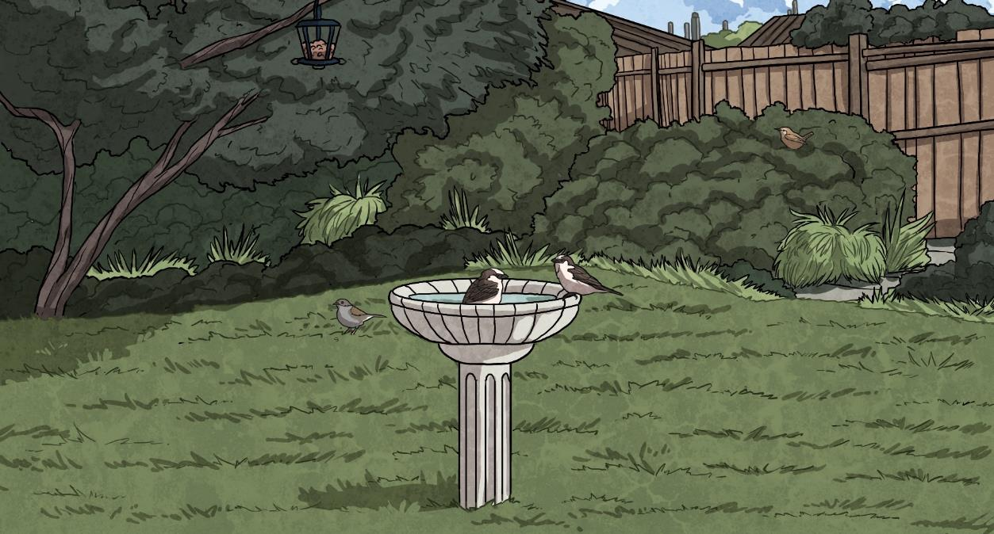
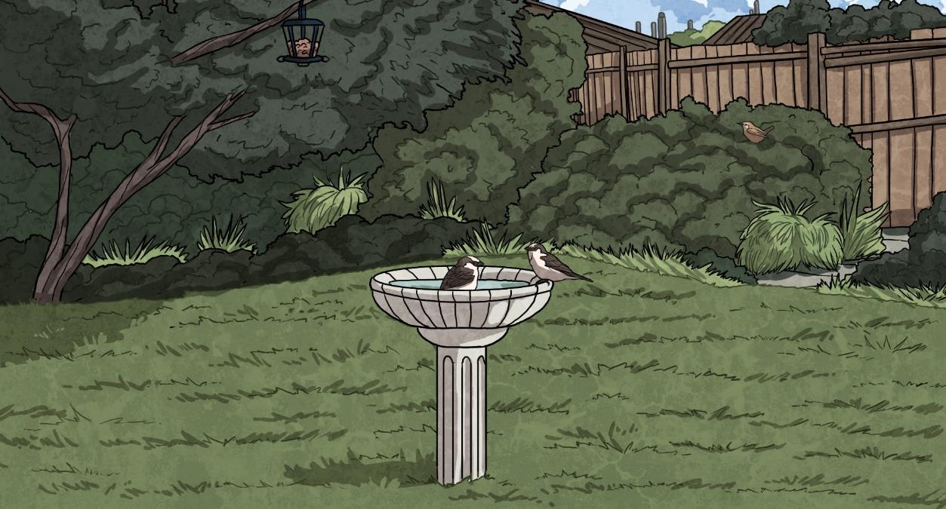
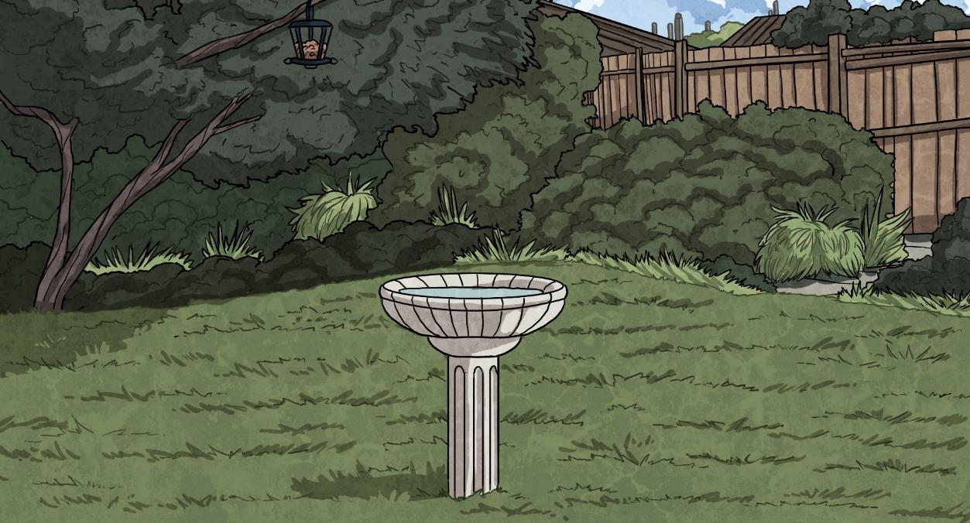
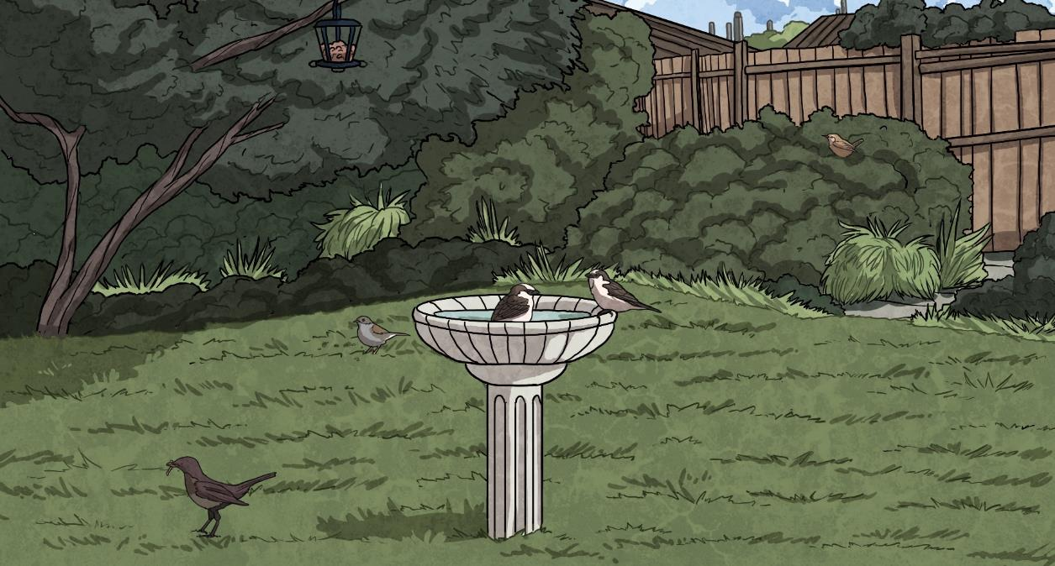
Those Little Brown Birds
Some of the brightly coloured birds are easier to identify but with those little brown birds, looking at behaviour rather than colour can give clues.
The house sparrow is very sociable and will usually visit gardens and take dust or water baths as part of a small flock.
The dunnock can be found bobbing about under the feeder and has a grey chest.
A female blackbird isn’t black at all! The brown female is likely to be on her own or with her male partner sporting his bright orange eye ring and beak.
The wren is often spotted darting in and around hedges and its small tail is upright.

Slide 16
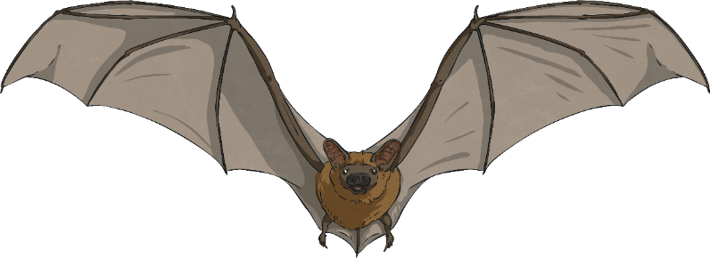
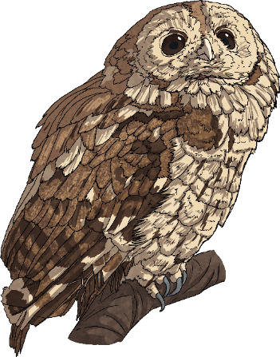
Now get out and about and see what’s WILD about January where you are!

