Slide 2
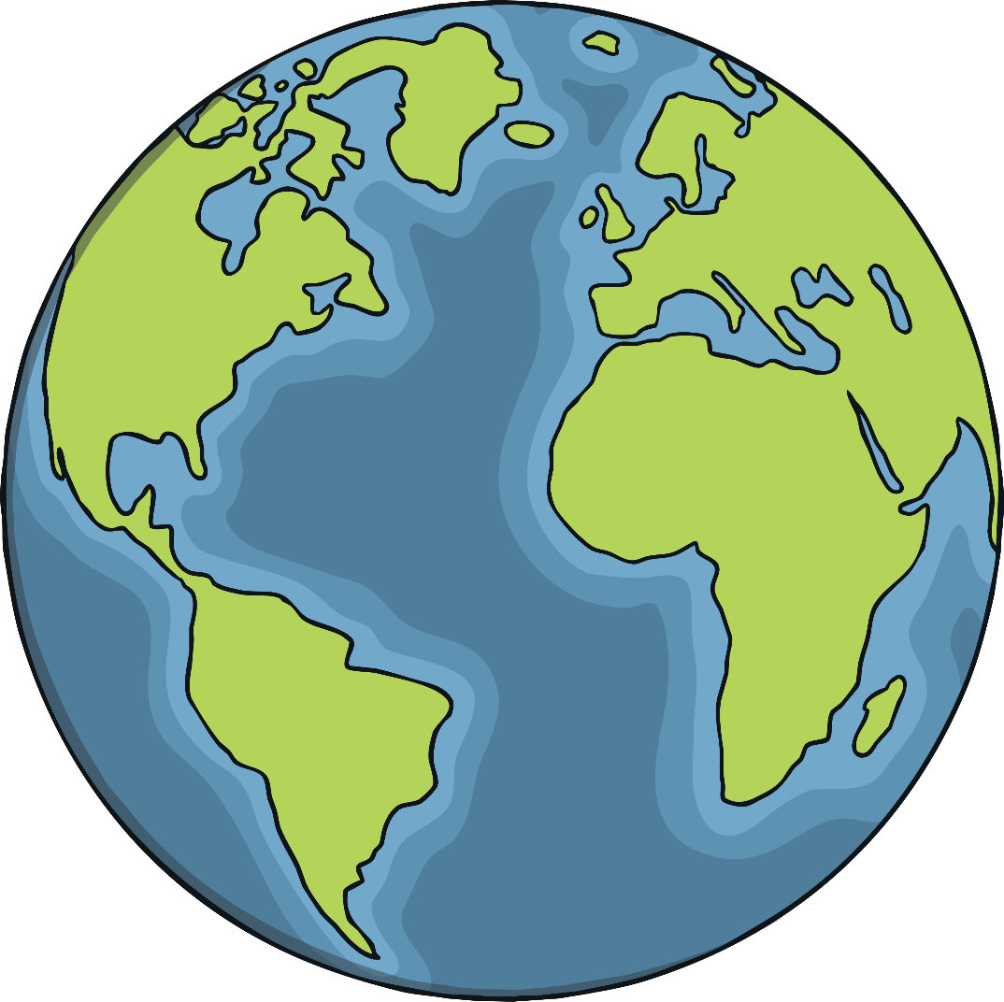
Where Do We Live?
We all live on the planet earth.

Slide 3
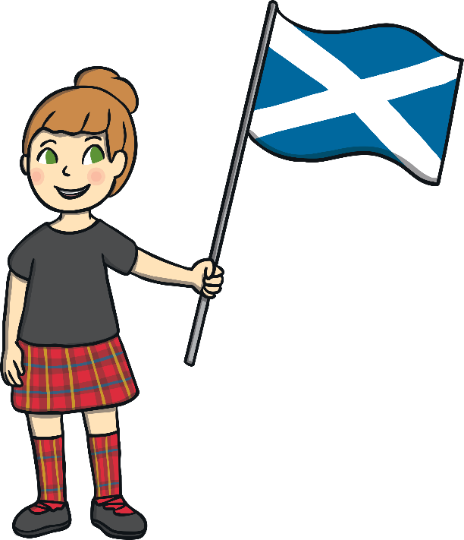
Which Country Do We Live In?
The Earth has lots of countries. We are born and live in a certain country.
Can you point to the country that you live in?

Slide 4
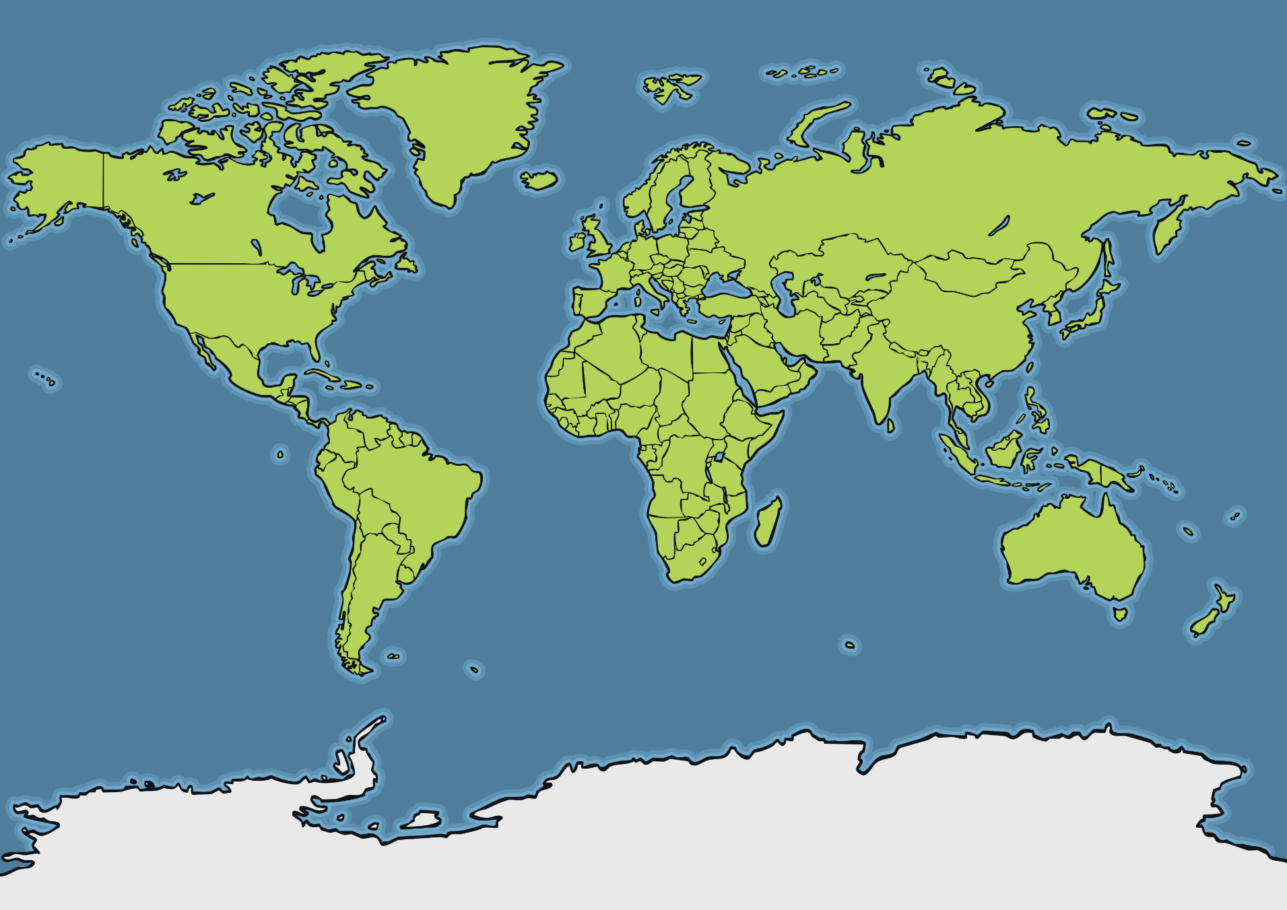
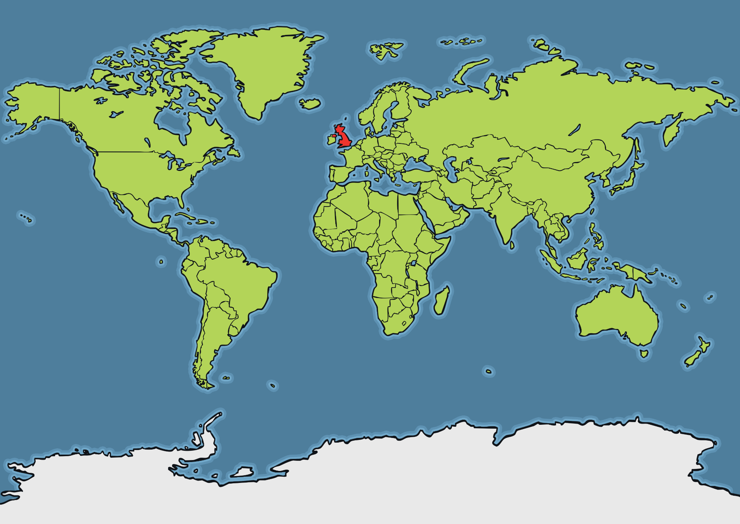

Slide 5
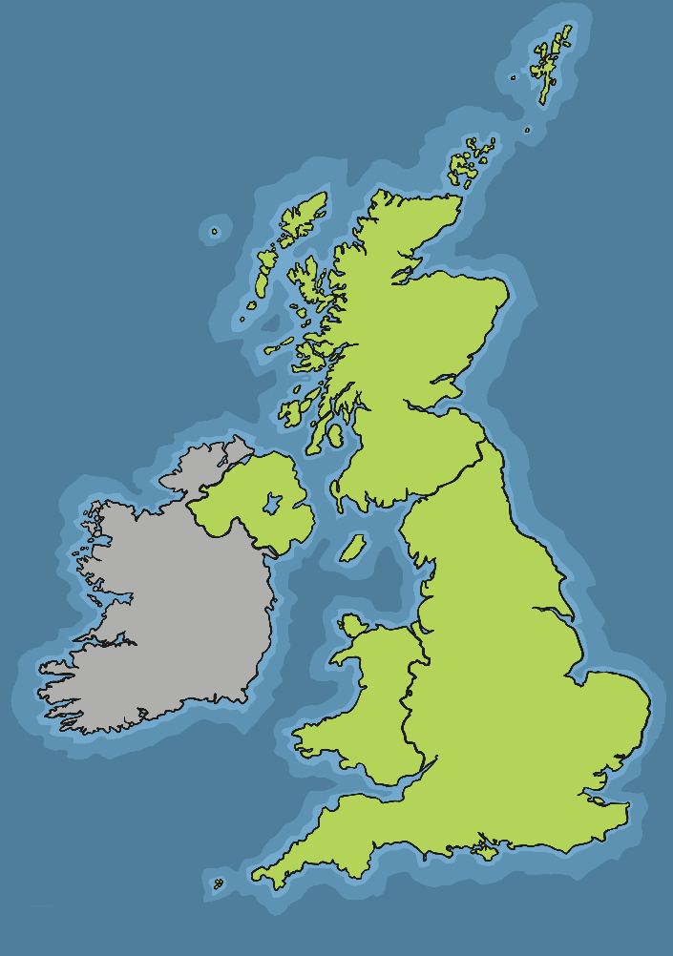
The United Kingdom
A country is a very big place. The United Kingdom is a country of four nations.

Slide 6
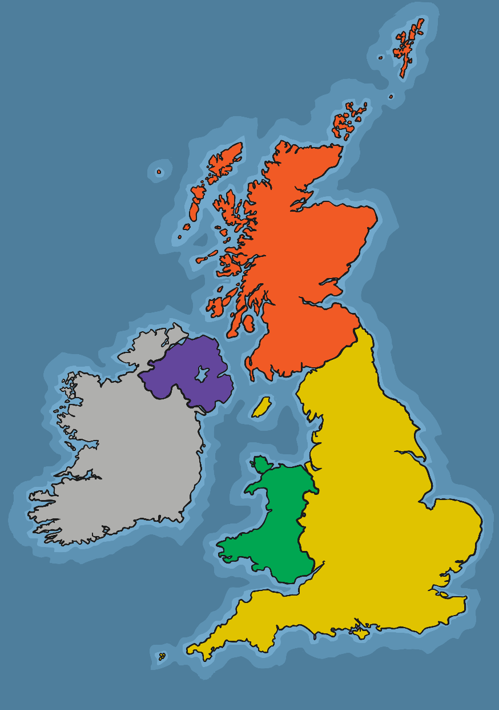
Where Do We Live?
Northern Ireland
Scotland
Wales
England

Slide 7
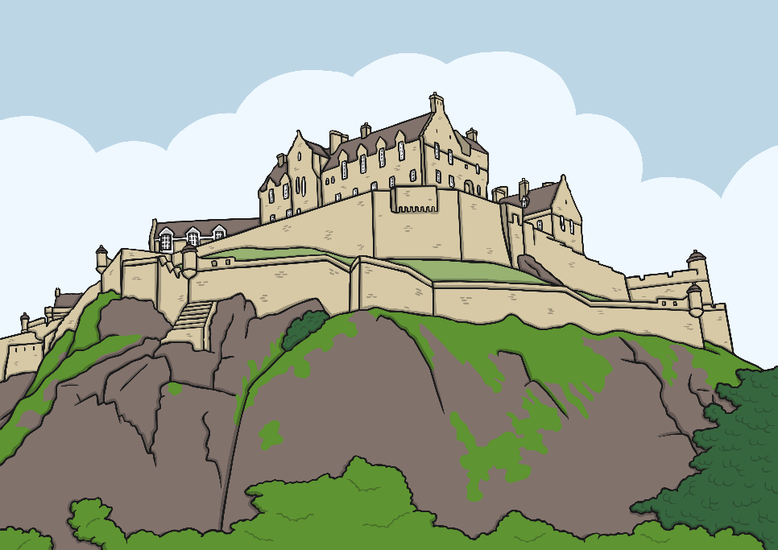
Cities and Towns
Scotland has large cities and small towns and villages. Cities and towns have shops, libraries, hospitals and many other things. They also have houses and flats for people to live. Edinburgh is the capital city of Scotland.
Do you know the name of your village, town or city?

Slide 8
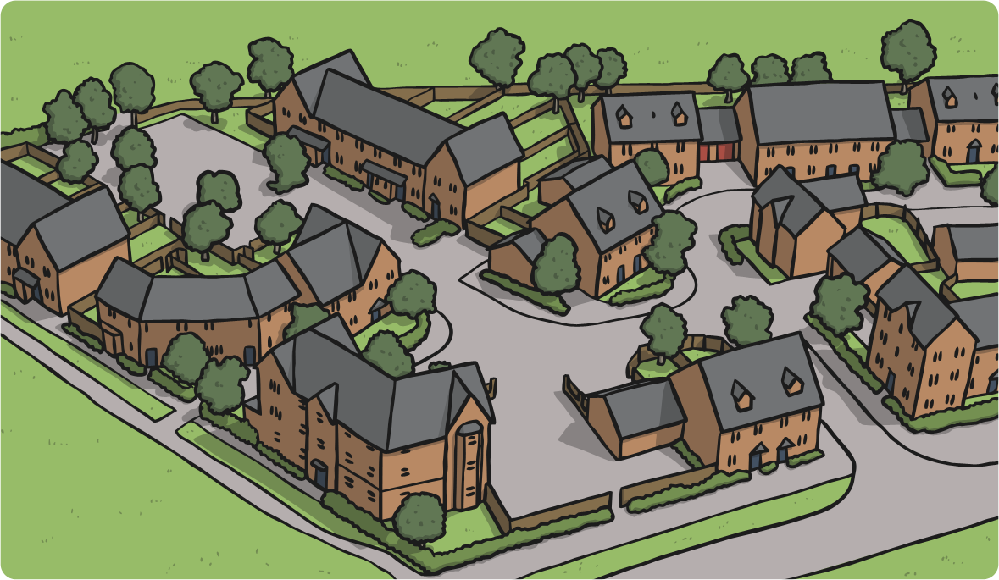
How Do You Feel Like You Belong?
There are many different ways in which we feel connected to the place we live. This helps us to feel like we belong.
In our neighbourhoods, we do lots of things to feel like we are part of the local community.

Slide 9
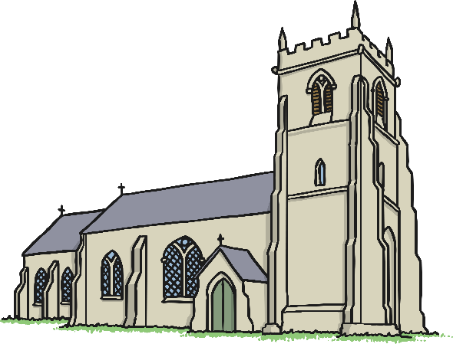
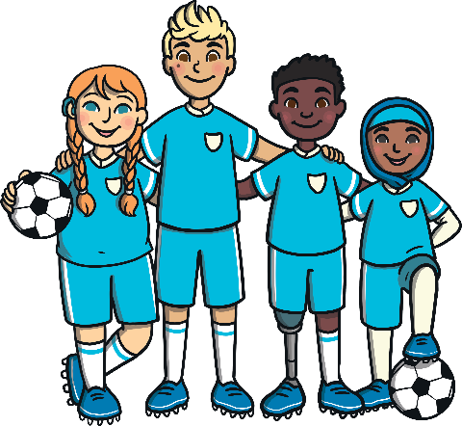
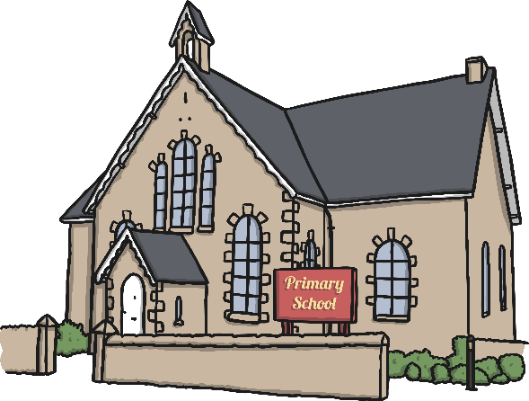
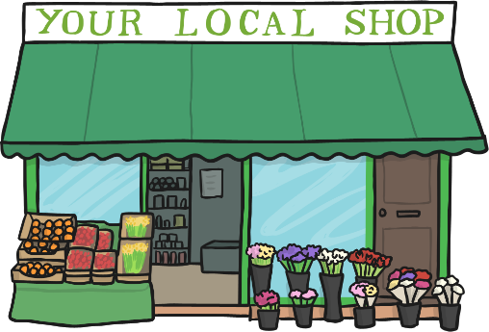
Belonging to the Community
We might be a part of our local community in many ways:
church
sporting team
school
visiting local attractions like parks, museums or the zoo
visiting local shops

Slide 10
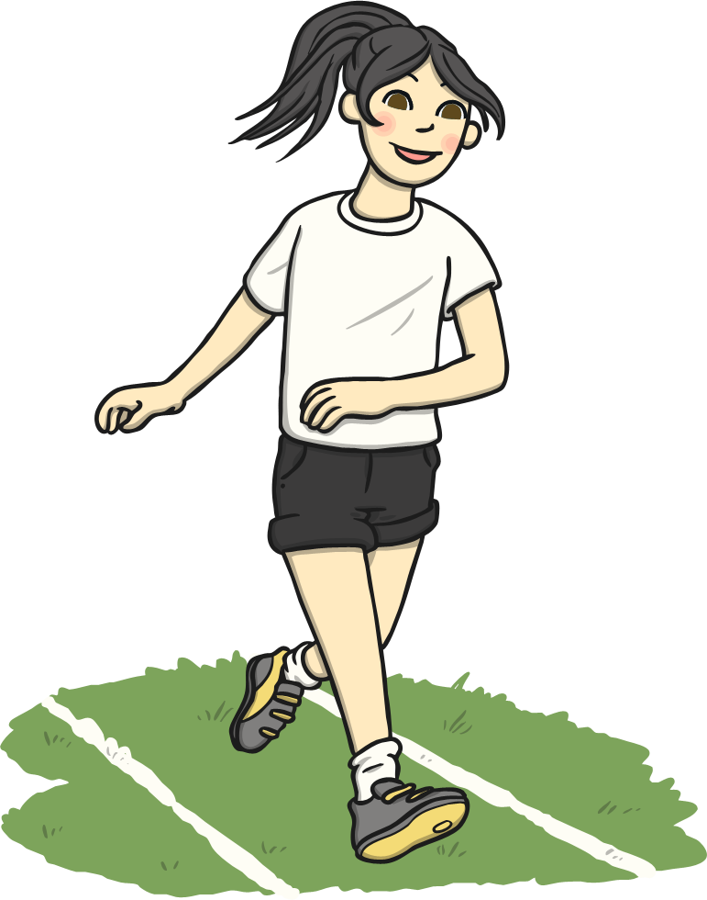
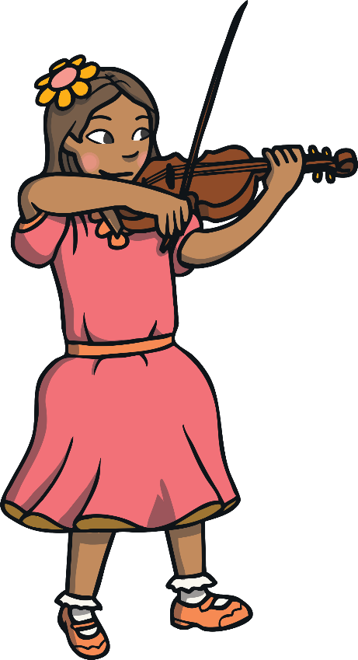
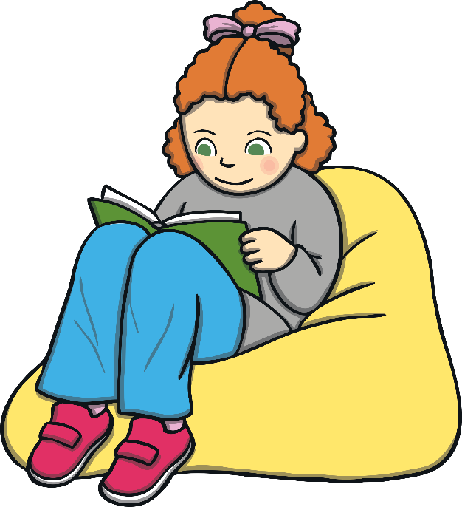
How Do You Belong to the Place Where You Live?
What activities do you do that connect you to your local community?

Slide 11
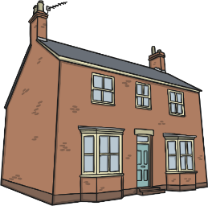
Plenary
village or town

