Slide 1
Scottish poems

Slide 2
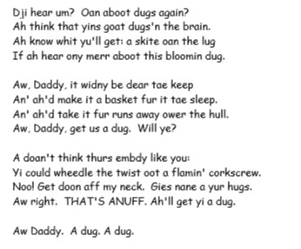
A Dug, A Dug by Bill Keys

Slide 3
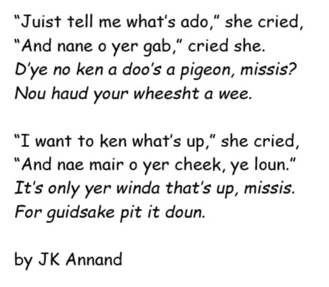
Street Talk by JK Annand

Slide 4
Twa-Leggit Mice by JK Annand

