Slide 2
Diving into Mastery Guidance for Educators
Each activity sheet is split into three sections, diving, deeper and deepest, which are represented by the following icons:
These carefully designed activities take your children through a learning journey, initially ensuring they are fluent with the key concept being taught; then applying this to a range of reasoning and problem-solving activities.
These sheets might not necessarily be used in a linear way. Some children might begin at the ‘Deeper’ section and in fact, others may ‘dive straight in’ to the ‘Deepest’ section if they have already mastered the skill and are applying this to show their depth of understanding.
Diving
Deeper
Deepest

Slide 3
Aim
Measure, compare, add and subtract mass (kg/g).

Slide 4
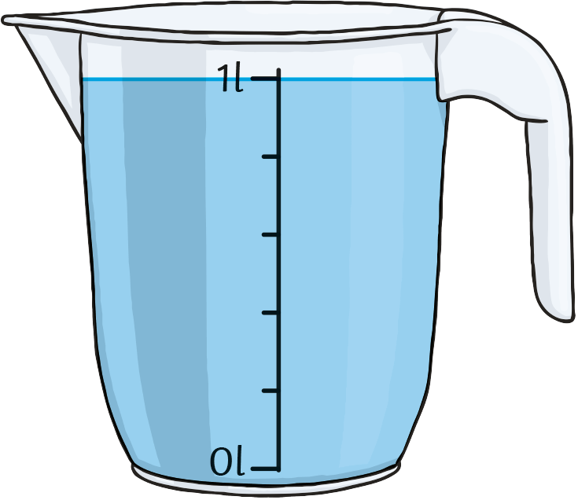
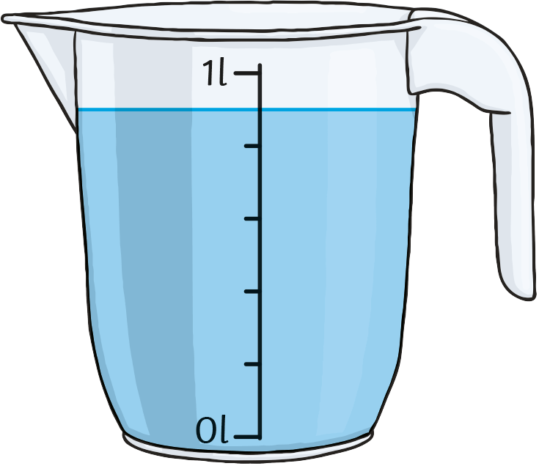
Measure Capacity in Millilitres and Litres
Diving
Intervals on Scales
What is each interval worth?
What is the capacity of one of the containers?
What volume of liquid is in the part-filled container?
What is the total volume of liquid?

Slide 5
Measure Capacity in Millilitres and Litres
Diving
Intervals on Scales
What is each interval worth?
There are 5 intervals between 0 and 1l.
1000 ÷ 5 = 200
Each interval is worth 200ml.
What is the capacity of one of the containers?
The capacity of the container is the maximum amount of liquid it could hold.
The capacity of this container is 1l.
What volume of liquid is in the part-filled container?
The liquid covers four full intervals and half of the fifth interval.
4 × 200 = 800
½ of 200 = 100
800 + 100 = 900.
The volume of liquid is 900ml.
What is the total volume of liquid?
There are two full jugs and one jug with 900ml.
The total volume of liquid is 2l 900ml.

Slide 6
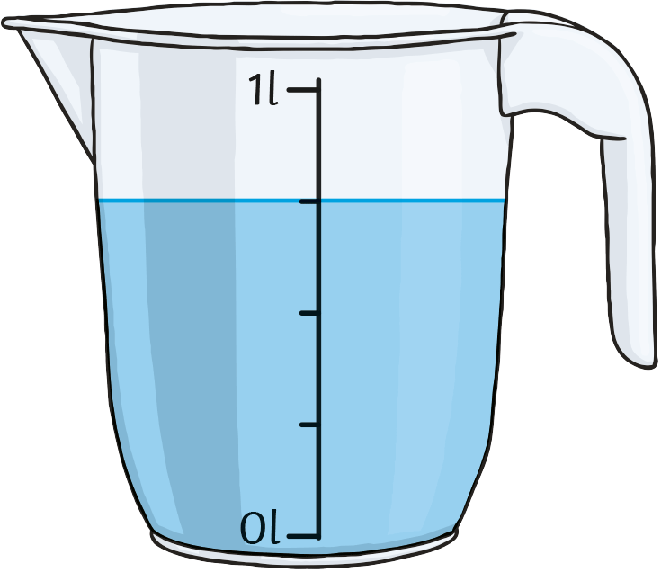
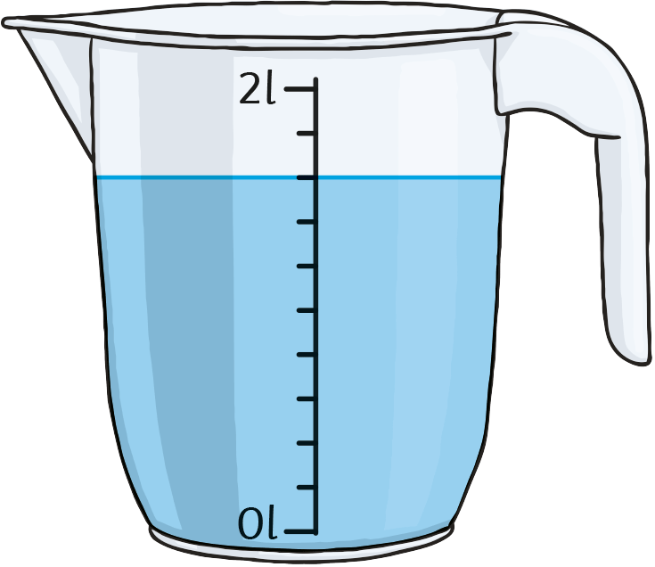
Measure Capacity in Millilitres and Litres
Deeper
Who Used More?
Verity and Joseph have been using jugs of water to fill a bowl. They kept a tally chart of full jugs that they used.
Joseph says, “I put this part-filled jug into the bowl.”
Verity says, “I also put this part-filled jug into the bowl.”
Verity
Joseph
Who put the least amount of water into the bowl?

Slide 7
Measure Capacity in Millilitres and Litres
Deeper
Who Used More?
Verity and Joseph have been using jugs of water to fill a bowl. They kept a tally chart of full jugs that they used.
Verity
Joseph
Verity put in seven full jugs of 1l. That’s 7l.
Joseph put in three full jugs of 2l. That’s 6l.
Verity says, “I put this part-filled jug into the bowl.”
Joseph says, “I also put this part-filled jug into the bowl.”
Each interval is 250ml. (1000 ÷ 4 = 250)
The liquid covers three intervals.
3 × 250 = 750
In total, Verity put in 7l 750ml.
Each interval is 200ml. (2000 ÷ 10 = 200)
The liquid covers 8 intervals.
8 × 200 = 1600 or 1l 600ml
In total, Joseph put in 7l 600ml.
Who put the least amount of water into the bowl?
Joseph put in less water than Verity.

Slide 8
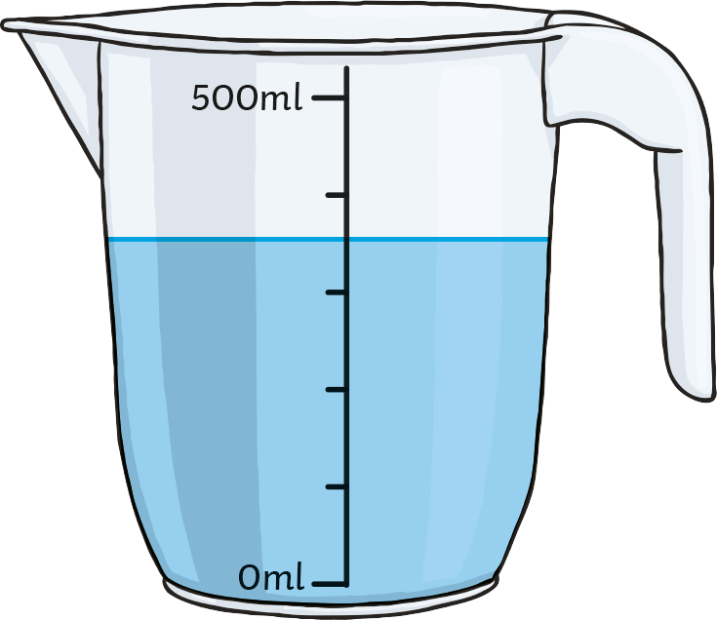
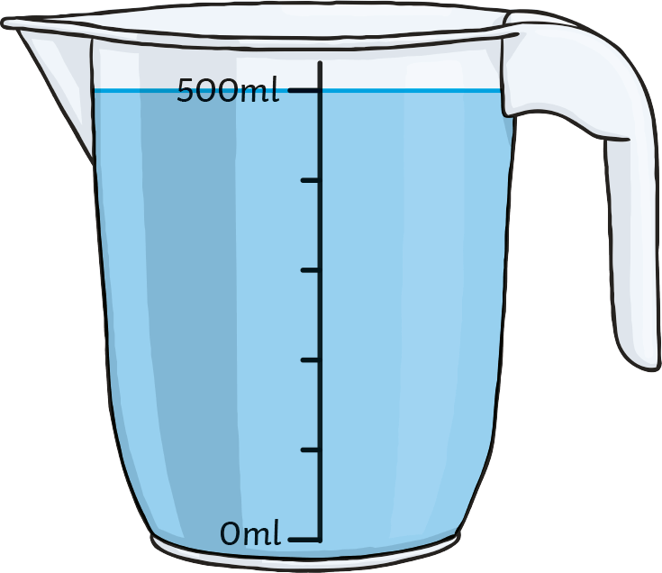
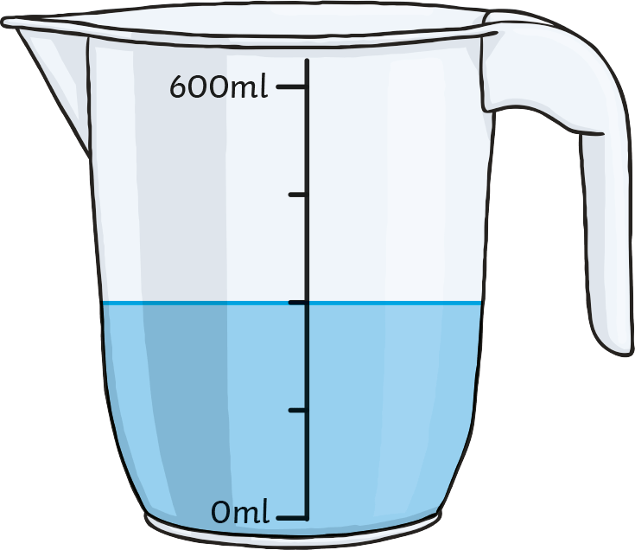
Measure Capacity in Millilitres and Litres
Deepest
Work It Out!
Which set of containers is each child describing?
Set A
Set B
Set C
Julie says, “Combined, the containers have a total capacity of less than 2l.”
Andrew says, “The volume of my containers is greater than Julie’s but less than 2l.”
How could you describe the remaining set?

Slide 9
Measure Capacity in Millilitres and Litres
Deepest
Work It Out!
Which set of containers is each child describing?
Set A
Set B
Set C
Julie says, “Combined, the containers have a total capacity of less than 2l.”
Andrew says, “The volume of my containers is greater than Julie’s but less than 2l.”
Set A has a total capacity of 2l. (1l + 1l)
Set B has a total capacity of 1l 500ml. (500ml + 500ml + 500ml)
Set C has a total capacity of 2l 400ml. (600ml + 600ml + 600ml + 600ml)
Set B has a total capacity less than 2l.
Julie is describing Set B.
Set A has a volume of 1l 750ml. (1l + 750ml)
Set B has a volume of 1l 350ml. (500ml + 500ml + 350ml)
Set C has a volume of 2l 100ml. (600ml + 600ml + 600ml + 300ml)
Andrew is describing Set A.

Slide 10
Measure Capacity in Millilitres and Litres
Deepest
Work It Out!
How could you describe the remaining set?
Set A
Set B
Set C
There are lots of ways to describe Set C:
Set C has a total volume of more than 2 litres.
The total capacity of Set C is 2l 400ml.

Slide 11
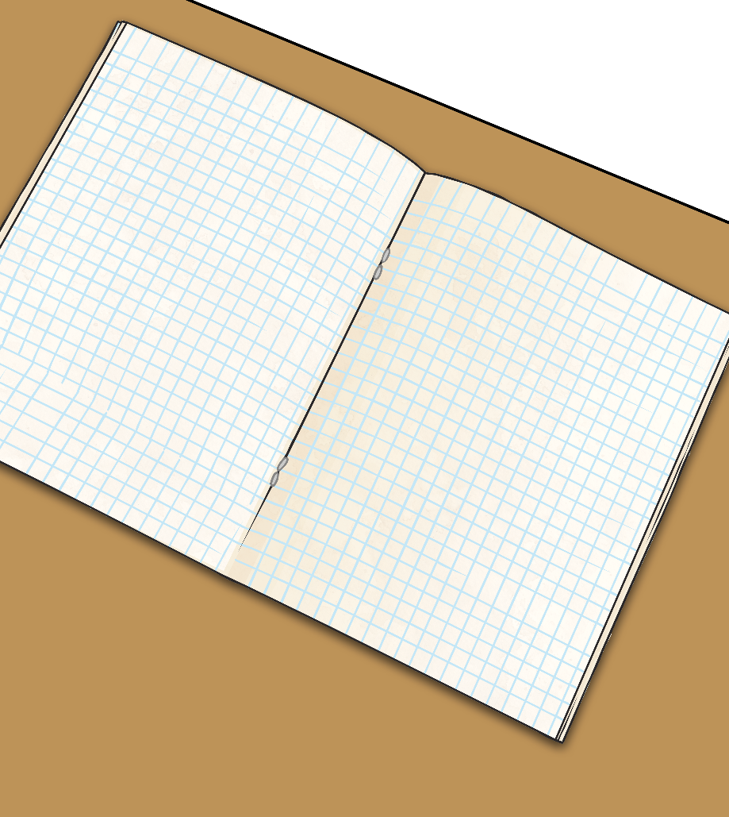
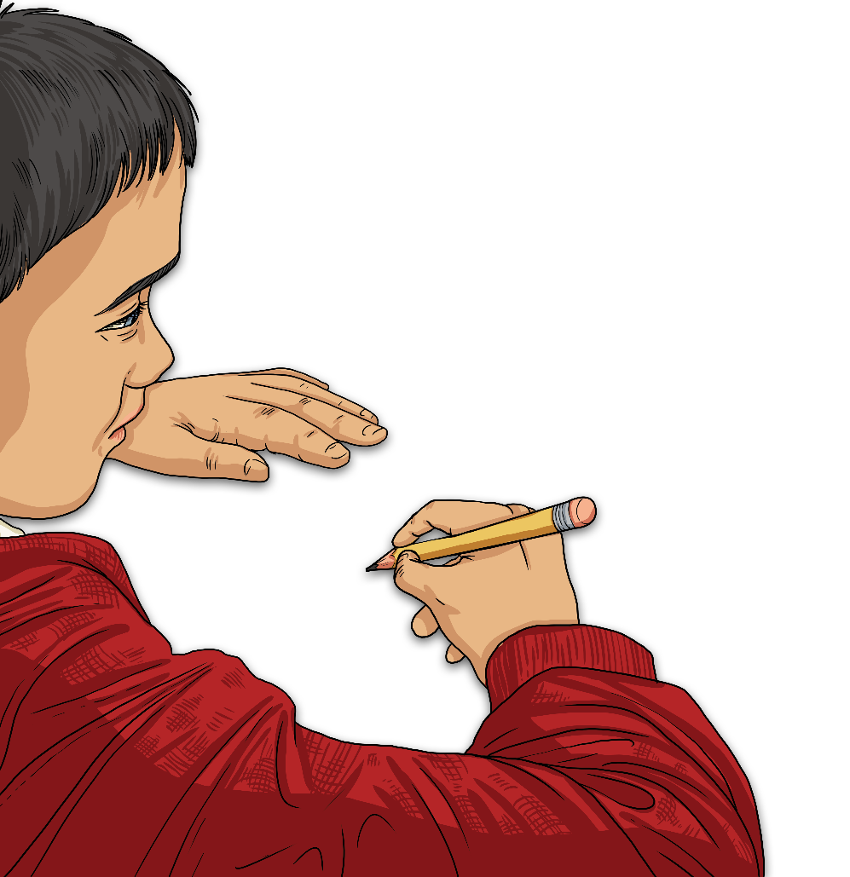
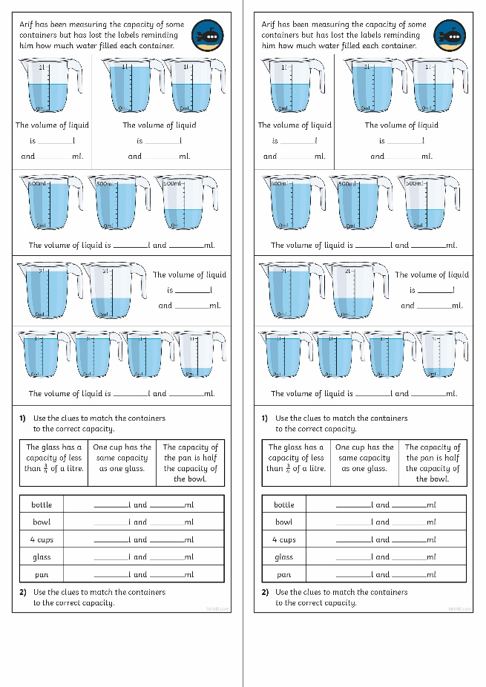
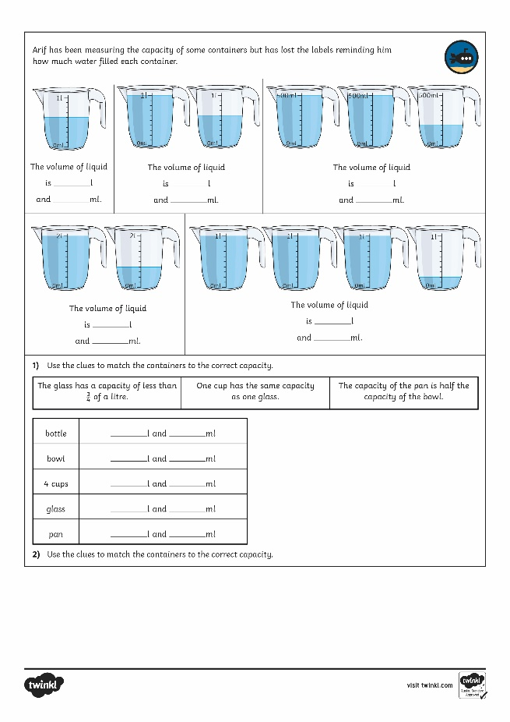
Measure Capacity in Millilitres and Litres
Dive in by completing your own activity!

Slide 12
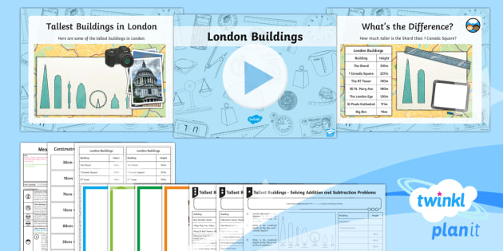
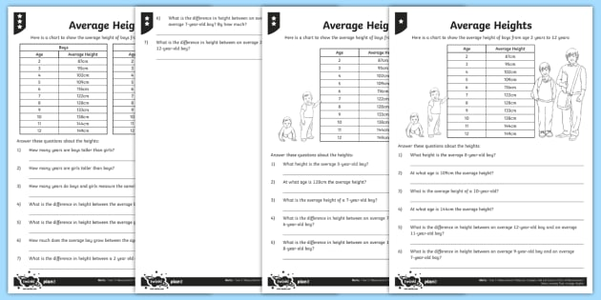
Need Planning to Complement this Resource?
National Curriculum Aim
Insert National Curriculum Aim here.
For more planning resources to support this aim, click here.
Twinkl PlanIt is our award-winning scheme of work with over 4000 resources.

