Slide 1
P2 Numeracy Jobs
08.02.21

Slide 2
Monday 08.02.21
There are 3 jobs today.
X Complete the sums for the Triangles, Circles or Squares
X Complete the time worksheet for O’clock/Half past/Quarter to and past times
X Log into Sumdog and earn some coins

Slide 3
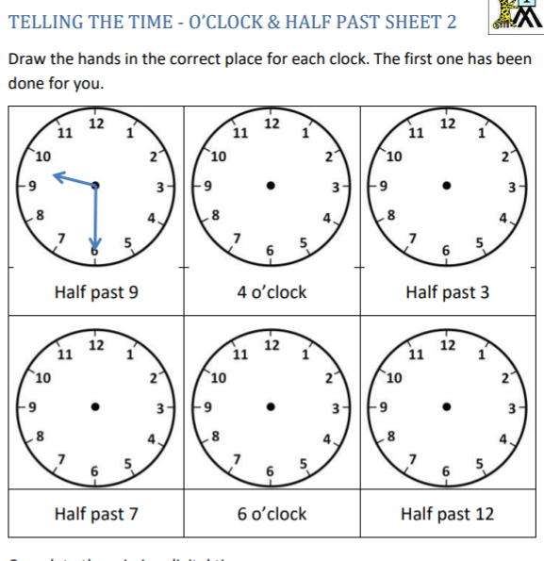

Slide 4
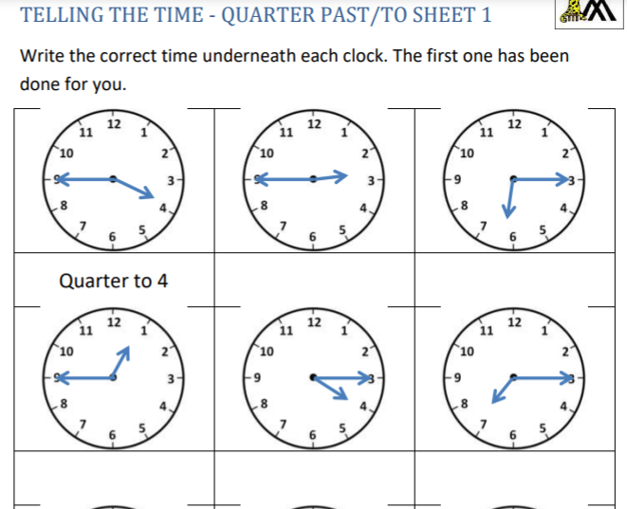

Slide 5
Triangles 1. 63 + 4 = 2. 52 – 3 = 3. Is 59 an odd or even number? 4. What comes next: 55, 50, 45, 40, ____, ____, ____. 5. How many minutes in an hour? 6. What day was it yesterday? 7. 25 + 20 = 8. How many 10s in 60? 9. Round 57 to the nearest 10. 10. 45- 5 =

Slide 6
Circles 1. 33 + 4 = 2. 32 – 3 = 3. Is 19 an odd or even number? 4. What comes next: 55, 50, 45, 40, ____, ____, ____. 5. How many minutes in an hour? 6. What day was it yesterday? 7. 25 + 10 = 8. How many 10s in 60? 9. Round 57 to the nearest 10 (is it nearer 50 or 60?). 10. 25- 5 =

Slide 7
Squares 1. 13 + 4 = 2. 12 – 3 = 3. Is 9 an odd or even number? 4. What comes next: 5, 10, 15, 20, ____, ____, ____. 5. How many minutes in an hour? 6. What day was it yesterday? 7. 25 + 4 = 8. How many 10s in 60? 9. 14 + 2 = 10. 12- 12 =

Slide 8
Tuesday 09.02.21
Today is a live lesson.
Today we will be learning about digital time.
You need your analogue clock and something to write on.
Times will be posted on Teams as usual.

Slide 9
Wednesday 10.2.21
There are 3 jobs today.
X Complete the number ordering job on the next slide.
X Complete the odd or even number activity on the following slides.
X Complete the digital time worksheet.

Slide 10
Smallest to Biggest: 34 38 14 81 12 110 109 45 18 121 Biggest to Smallest: 23 36 12 49 81 108 101 15 18 100

Slide 11
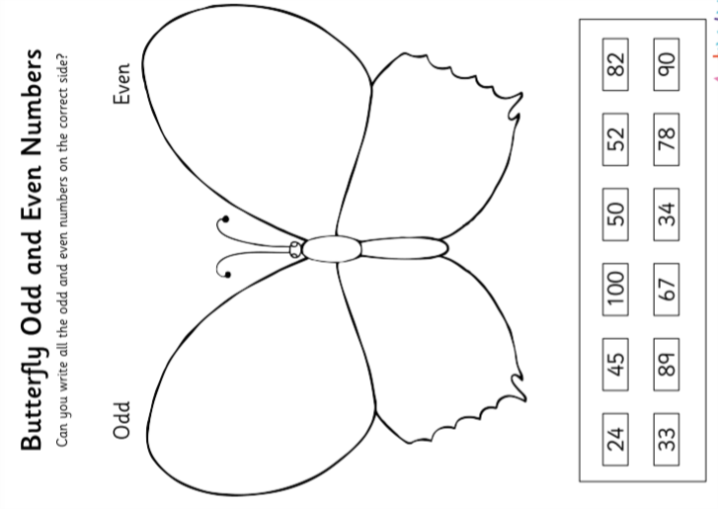
Recommended for Triangles

Slide 12
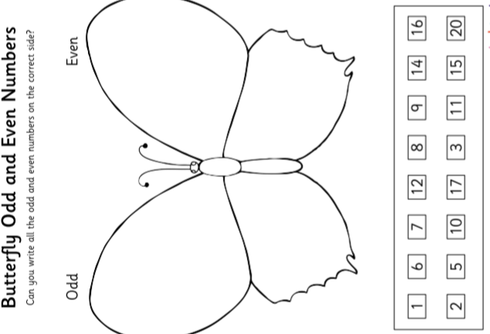
Recommended for Circles and Squares

Slide 13
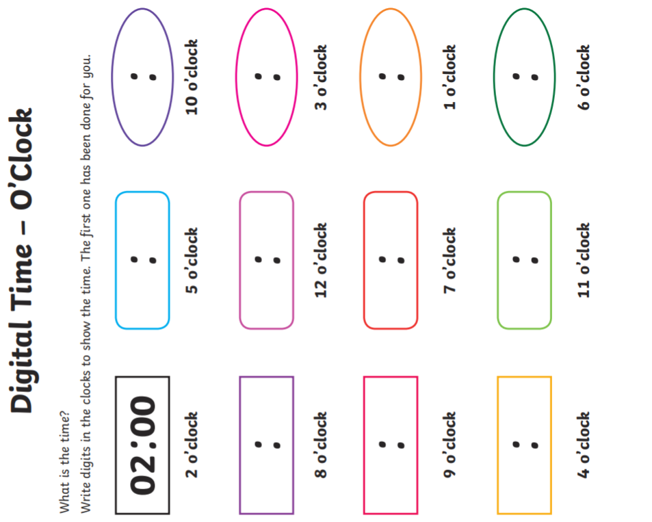

Slide 14
Thursday 11.02.21
Today is a live lesson.
Please bring your clocks and something to write on.
While you are waiting on your lesson, visit https://www.topmarks.co.uk/ordering-and-sequencing/chinese-dragon-ordering to practise sequencing numbers in 5s.

Slide 15
Friday 12.02.21
H O L I D A Y !!

