Slide 1
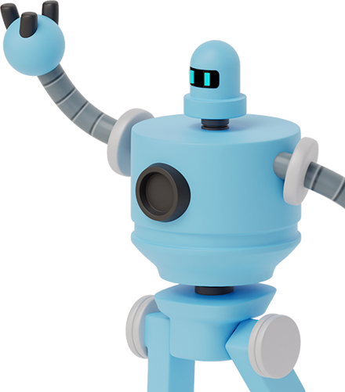
P2 Literacy Jobs
Week Beginning 08.2.21

Slide 2
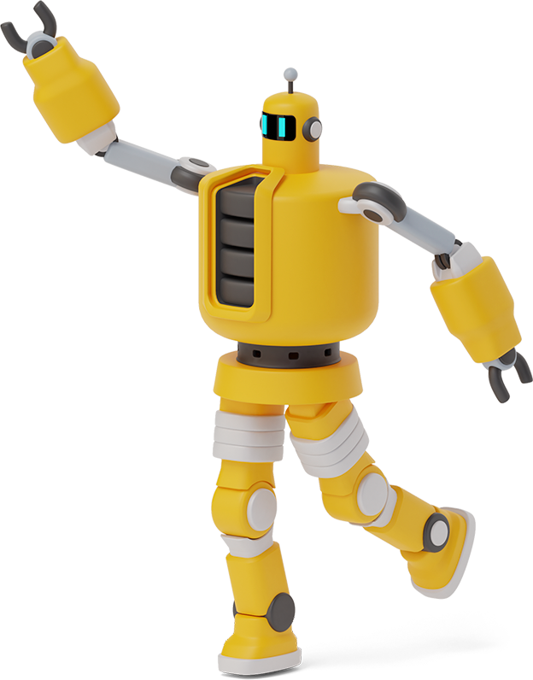
MONDAY 08.2.21
There are two jobs today.
Use the Story Setting Sheet in the writing workbook to write a description about the picture. There are lots of adjectives in the box next to the picture but you can use your own ones too.
Log into Education City and play the grammar games about nouns, verbs and adjectives.

Slide 3
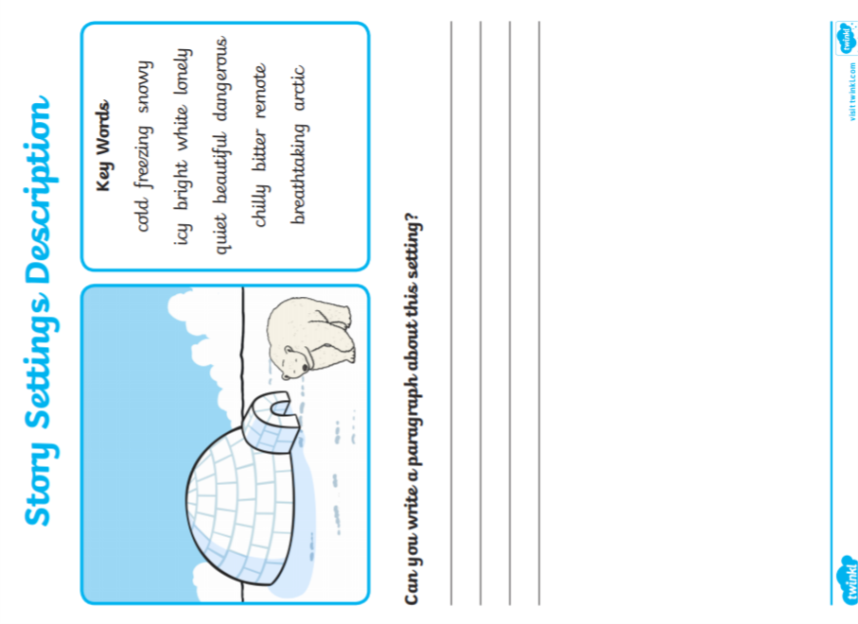
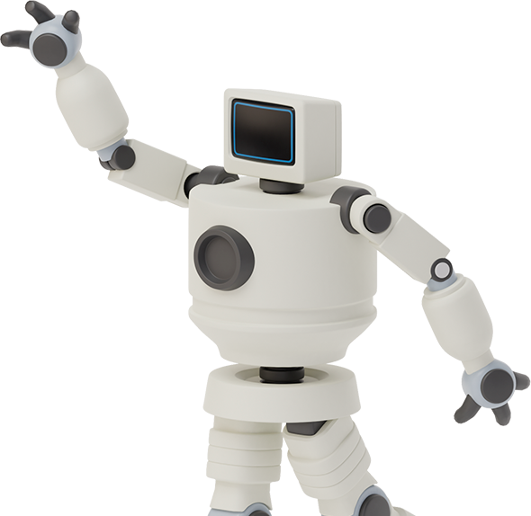

Slide 4
TUESDAY 09.2.21
There are three jobs today.
Phonics
Please login to www.phonicsplay.co.uk and practise Tricky Word Trucks for Phase 3 and 4.
Complete the next page in your Phonics workbook. You will find a photograph on the next slide (although as it is not a digital copy, it is not very clear).
Punctuation and Grammar
Click on the link to watch the video on adjectives and complete the worksheet on the following slide.
https://www.youtube.com/watch?v=IT-G4c2-CHU&feature=emb_logo&safe=active

Slide 5
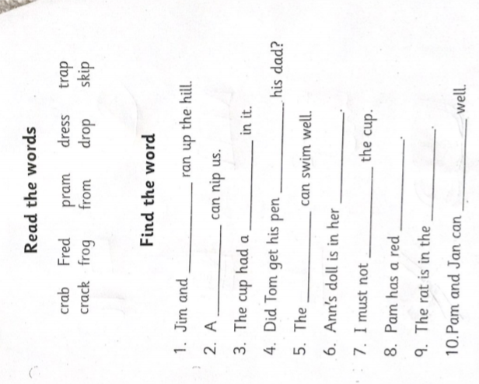
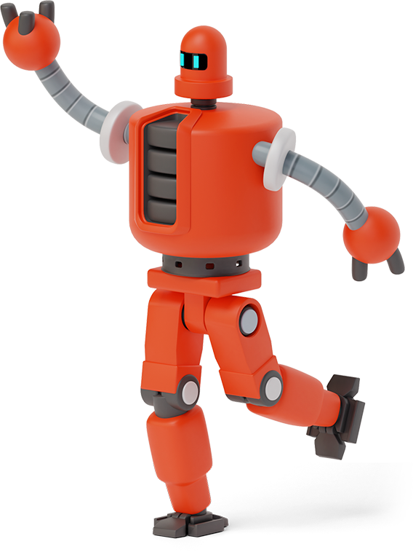
Phonics worksheet (in workbook)

Slide 6
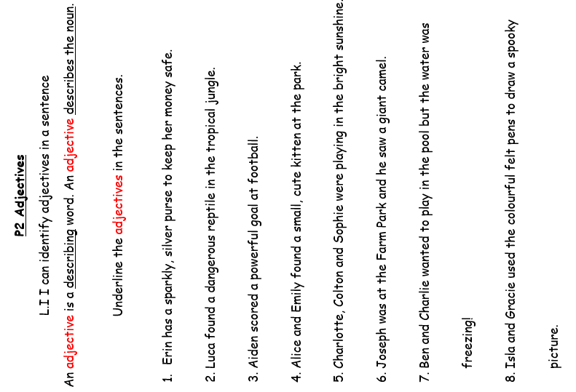

Slide 7
Wednesday 10.2.21
Today is writing day!
Times will be posted on Teams. There will be two groups today.
We are going to be up-levelling our sentences.
While you are waiting on your lesson, or once you have finished, please log in to Bug Club and read a book. Remember to answer the ‘bugs’ to earn coins.

Slide 8
Thursday 11.2.21
There are two jobs today.
Reading Comprehension
Choose one of the passages to complete. You can choose ‘Zoom to the Moon’ or ‘The Missing Sock’.
Punctuation and Grammar
Sort the words into nouns, verbs and adjectives. You’ll find the worksheet on the following slides.

Slide 12
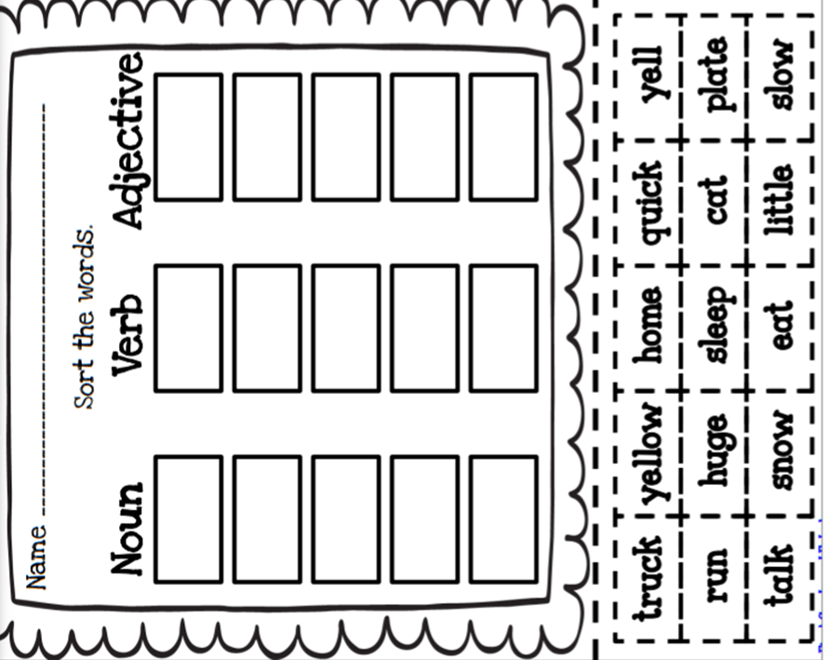

Slide 13
friday 12.2.21
H O L I D A Y
(See you all on Tuesday)

