Slide 1
Primary 2 Science Jobs

Slide 2
How to use …
The jobs this week are in a slightly different format. This week we are having a Science focus and it is easier to display the different experiments using a PowerPoint.
Please choose which experiments you would like to try. You do not have to do all of them!
Check the weekly timetable to see which days are Science days. Having fun is the main objective so please don’t put yourself under any pressure!

Slide 3
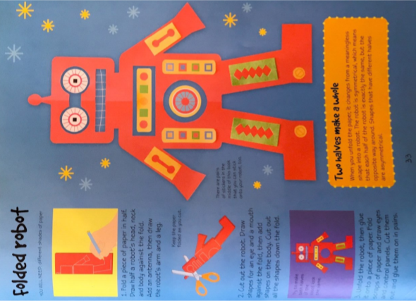

Slide 4
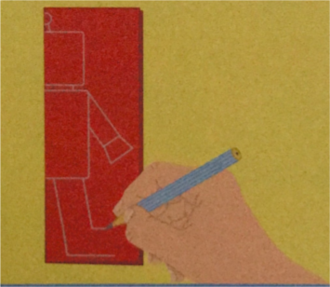
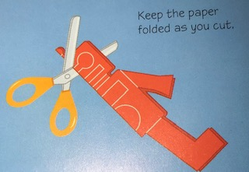
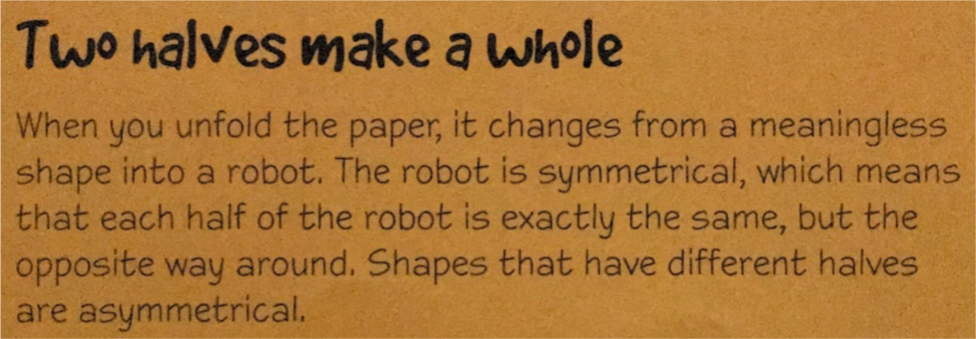
Folded Robot Instructions
Fold a piece of paper in half. Draw half a robot’s head, neck and body against the fold. Add an antenna, then draw the robot’s arm and a leg.
Cut out the robot. Draw shapes for an eye and a mouth against the fold and draw shapes for the body. Cut out all the shapes down the fold.
Unfold the robot. Decorate it and post a picture on Teams.

Slide 5
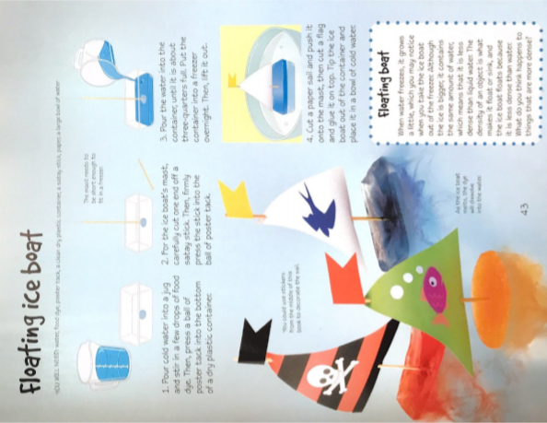

Slide 6
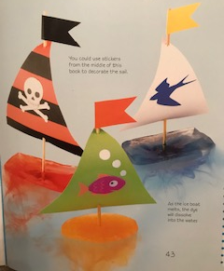
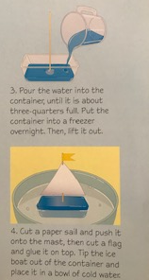
Floating Ice Boats
Press a blob of bluetac or plasticine into the bottom of a plastic container.
Use a straw for the mast and press it firmly in to the bluetac.
Pour water into the container until it is about three quarters full. Add a few drops of food colouring if you wish. Put in the freezer and leave overnight.
Once frozen, cut out a sail and a flag and stick these to the mast. Tip the boat out of the container into a bowl of cold water.

Slide 7
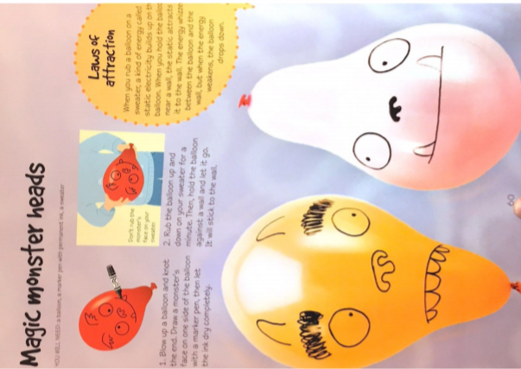

Slide 8
Magic Monster Heads
Blow up a balloon and tie a knot in the end. Draw a monster face on one side of the balloon. Let the ink dry completely.
Use the blank side of the balloon, rub it up and down your jumper for a minute or two.
Hold the balloon against at wall and watch it stick!

Slide 9
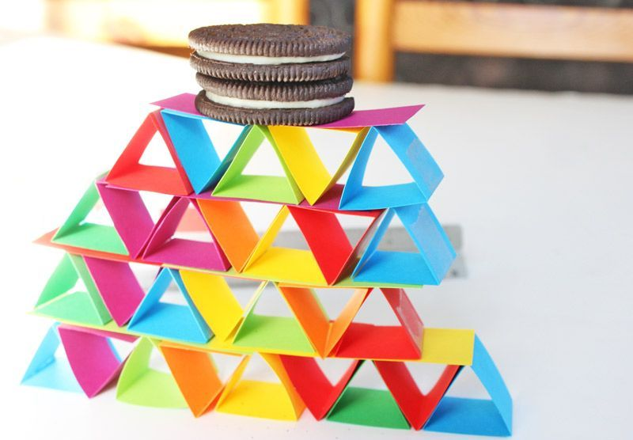
Triangle Tower

Slide 10
Triangle Tower
Cut 5 cardboard strips that are 12cm long. Make marks 4cm and 8cm along each strip, then fold along the marks.
Tape the strips into triangles. Put 3 triangles in a line next to each other. Then cut a strip of cardboard and lay it on top.
Then stand 2 triangles on top and cut a shorter strip to place on top. Try putting different objects on your tower.

