Slide 1
Numeracy Jobs 01.2.21

Slide 2
Monday 01.2.21 There are 3 jobs today
Complete the sums for the Triangles, Circles or Squares
Complete the Time Worksheet for half past the hour
Log into Sumdog. There are 200 coins waiting on you!
Click to start

Slide 3
Triangles
32 + 7 =
36 – 4 =
How many days are in February?
18 + ? = 21
How many 10s in 70?
Complete: 14, 16, 18, 20, 22, ____, ____, _____.
What’s missing: 500, 600, 700, 900?
Round 87 to the nearest 10
10p + 2p + 5p =
Name a 2D shape with 4 vertices

Slide 4
Circles
22 + 5 =
36 – 1 =
How many days are in February?
18 + ? = 19
How many 10s in 70?
Complete: 14, 16, 18, 20, 22, ____, ____, _____.
What’s missing: 500, 600, 700, 900?
Round 87 to the nearest 10 (is it nearer to 80 or 90?)
5p + 2p + 5p =
Name a 2D shape with 4 vertices

Slide 5
Squares
12 + 5 =
16 – 1 =
How many days are in February?
18 + ? = 19
How many 10s in 70?
Complete: 14, 16, 18, 20, 22, ____, ____, _____.
20 + 2 =
18 – 2 =
5p + 1p + 1p =
Name a 2D shape with 4 vertices (corners)

Slide 6
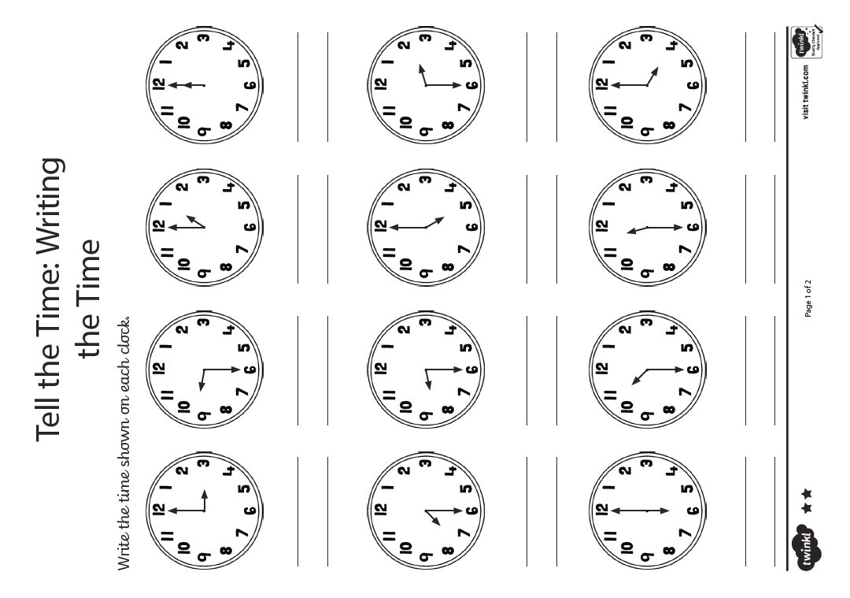

Slide 7
Tuesday 02.2.21 Today is a live lesson. Remember your clock!
Click to start

Slide 8
Wednesday 03.2.21 There are 3 jobs today
Complete the number ordering job on the next two slides
Draw the hands on the clock for half past times (worksheet)
Look for analogue clocks in your house. How many can you find? Take some pictures if you feel like sharing them.
Click to start

Slide 9
Put these numbers in the correct order from smallest to biggest.
54 98 30 115 16
14 85 23 109 96
46 32 14 105 28

Slide 10
Put these numbers in the correct order from biggest to smallest.
64 108 55 105 26
54 25 2 95 101
51 26 104 121 8

Slide 11
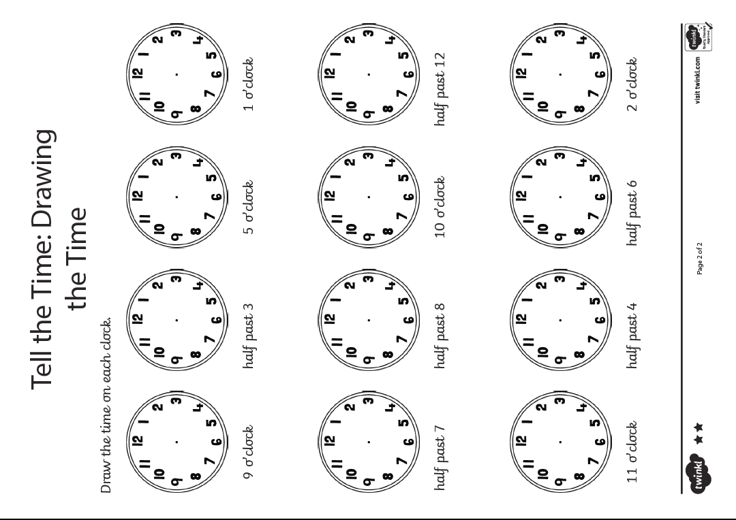

Slide 12
Thursday 02.2.21 Today is a live lesson. Remember your clock!
Click to start

Slide 13
Friday 05.2.21 There are 3 jobs today
Complete the sums for the Triangles, Circles or Squares
Complete the Time worksheet for quarter past
Visit https://www.topmarks.co.uk/maths-games/5-7-years/measures and choose any of the Time Games to play
Click to start

Slide 14
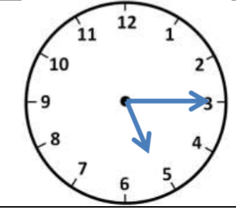
Triangles
54 + 5 =
51 – 2 =
What is the name of the ‘round’ clock?
28 + ? = 31
50 + 40 =
Write the number ‘one hundred and fifteen’ in numerals
90 – 20 =
What time is it on this clock?
Is 43 an odd or even number?
29 + 10 =

Slide 15
Circles
24 + 4 =
31 – 2 =
What is the name of the ‘round’ clock?
18 + ? = 20
50 + 40 =
Write the number ‘twenty two’ in numerals
90 – 10 =
What time is it on this clock?
Is 13 an odd or even number?
9 + 10 =

Slide 16
Squares
14 + 4 =
11 – 2 =
What is the name of the ‘round’ clock?
8 + ? = 10
10 + 10 =
Write the number ‘twenty two’ in numerals
14 – 2 =
What time is it on this clock?
Is 7 an odd or even number?
6 + 8 =

Slide 17
