Slide 1
Health and wellbeing grid
Choose one job on tue, wed and thur

Slide 3
Things I am good at

Slide 4
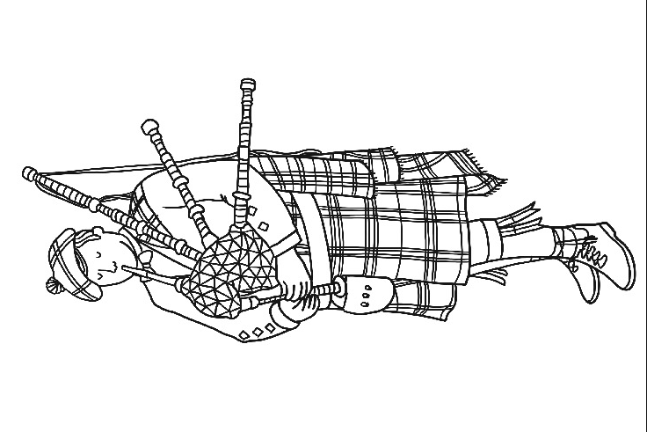
MINDFULNESS

Slide 5
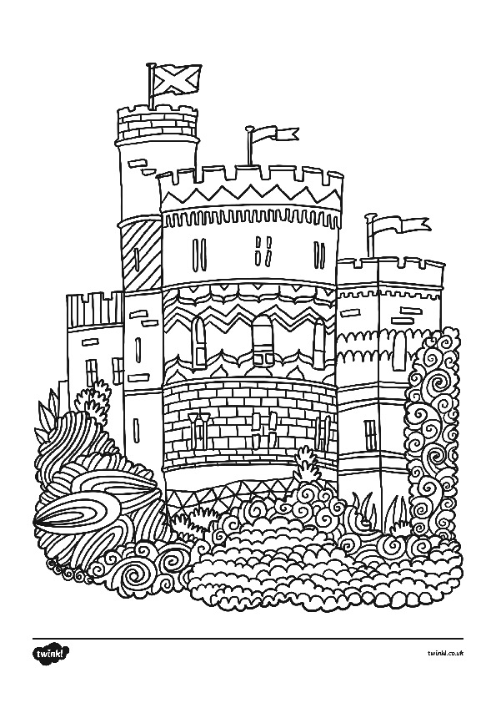

Slide 6
MINDFULNESS

Slide 7

mindfulness

Slide 8
Things I am good at (wksht)

