Slide 1

Numeracy
Week beginning 18.1.21

Slide 2
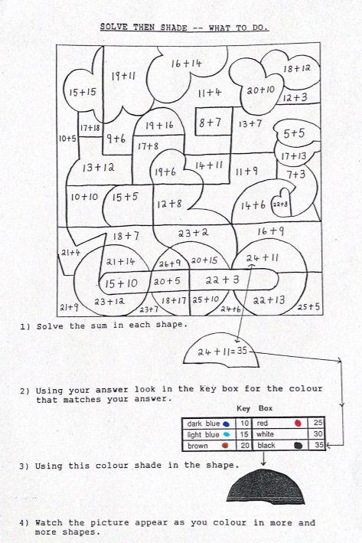
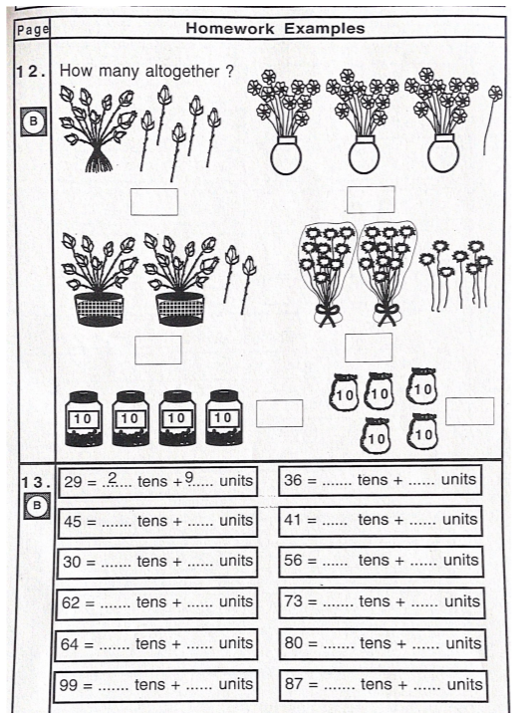
Monday 18.1.21
There are two jobs today.
Please do the sums for your group. You will find these on the next slides.
Complete these pages in your number workbook that is in your pack. They should look like this.
Squares Triangles and Circles

Slide 3
Triangles
42 + 3 =
75 – 2 =
30 + ? = 40
60 – ? = 40
What’s missing: 111, 112, 113, ____, ____, ____.
Find half of 14.
Add on 2 each time , 0, 2, 4, 6, ___, ___, ___, ____
Name a shape with 4 sides and 4 vertices.
Round 45 to the nearest 10.
Double 7 = _____

Slide 4
Circles
42 + 3 =
35 – 2 =
30 + ? = 40
60 – ? = 40
What’s missing: 111, 112, 113, ____, ____, ____.
Find half of 14.
Add on 2 each time , 0, 2, 4, 6, ___, ___, ___, ____
Name a shape with 4 sides and 4 vertices.
Round 34 to the nearest 10 (is it nearer 30 or 40?).
Double 7 = _____

Slide 5
Squares
22 + 3 =
25 – 2 =
30 + ? = 32
16 – ? = 15
What’s missing: 111, 112, 113, ____, ____, ____.
Which number is bigger: 54 or 24?
Add on 2 each time , 0, 2, 4, 6, ___, ___, ___, ____
Name a shape with 4 sides and 4 vertices (corners).
Which number is smaller: 98 or 112?
Double 5 = _____

Slide 6
Tuesday 19.1.21
There will be a live lesson today.
Please look out for the information on Teams.
Please log in to Sumdog today. There are coins waiting!

Slide 7
Wednesday 20.1.21
There are 3 jobs today.
Complete the sums for your group which you will find on the next slides.
Complete a counting in 5s worksheet. There are two to choose from.
Log into Education City and play the 3D shape games.

Slide 8
Triangles
26 + 10 =
45 – 5 =
54 + ? = 58
32 – ? = 30
What’s missing: 120, 119, 118, ____, ____, ____.
Name a 3 sided shape.
Add on 5 each time 0, 5, 10, 15, ___, ___, ___, ____
20p + 5p =
Round 89 to the nearest 10.
Share 16 equally between 2

Slide 9
Circles
26 + 5 =
25 – 4 =
24 + ? = 28
32 – ? = 30
What’s missing: 120, 119, 118, ____, ____, ____.
Name a 3 sided shape.
Add on 5 each time 0, 5, 10, 15, ___, ___, ___, ____
20p + 5p =
Round 32 to the nearest 10 (is it nearer to 30 or 40?).
Share 8 equally between 2 people

Slide 10
Squares
20 + 4 =
22 – 2 =
10 + ? = 20
19 – ? = 17
What’s missing: 100, 90, 80, ____, ____, ____.
Which number is bigger: 66 or 113?
Add on 10 each time 0, 10, 20, 30, ___, ___, ___, ____
Name a 3 sided shape
Which number is smaller: 110 or 115?
Double 3 = _____

Slide 13
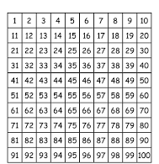
Thursday 21.1.21
There is a live lesson today.
Please check Teams for the information.

Slide 14
Friday 22.1.21
There are 3 jobs today.
Complete the estimation activity on the next slide (no cheating P2!!)
3D Shape worksheet
Counting in 5s dot to dot

Slide 15
Estimate and then check!

Slide 16
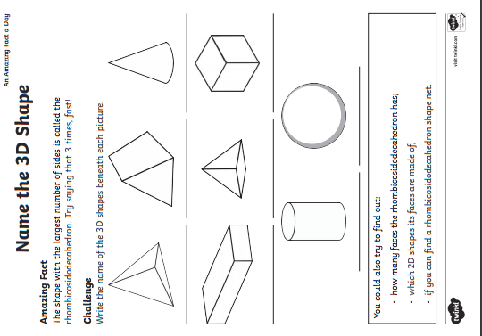

Slide 17
