Slide 1
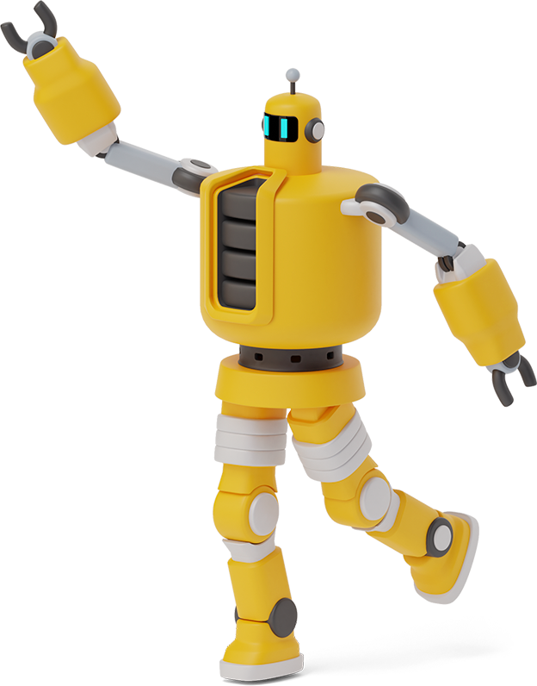
LITERACY JOBS FOR WEEK BEGINNING 11.1.21

Slide 2
MONDAY 11.1.21
There are two jobs today.
The first job is the Syllable Challenge which is on the next slide.
The next job is News Jotter.
Write an account of your Christmas holidays. Although you wouldn’t have been able to get out and about, you can talk about what you got from Santa and how your family celebrated Christmas Day.

Slide 3
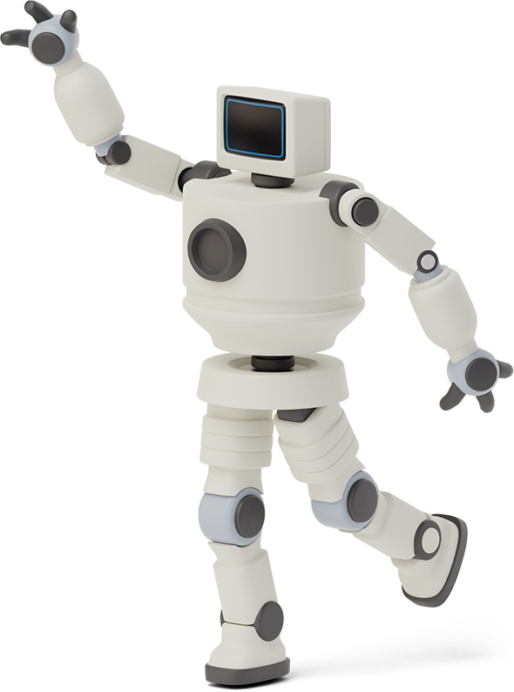

Slide 4
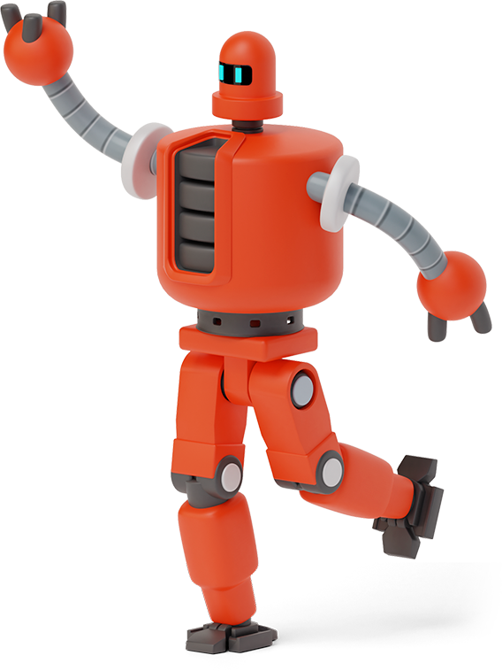
Remember to write your news jotter!
Think about the different openers you are encouraged to use in class:
At the weekend …
During the holidays …
On Christmas Day …
At New Year …

Slide 5
TUESDAY 12.1.21
There are two jobs today.
Tricky Words
The first job is a quick practise of your tricky words. Log on to www.phonicsplay.co.uk and select “Tricky Word Trucks” for Phase 3 and Phase 4.
The next job is Reading Comprehension.
There are two passages to choose from. Please choose the one you are most comfortable with. You will find these on the next slides.

Slide 6
In twoo three columns

Slide 8
wednesday 13.1.21
Today is writing day!
We are going to attempt a live lesson.
You will be sent an email with a link to attend a Vscene meeting. You should access this link at the set time.
This is the first time I’ve ever taught a writing lesson online so fingers crossed it goes smoothly.
You will need a pencil, rubber and paper.

Slide 9
THURSDAY 14.1.21
There are two jobs for today.
Phonics
You will need your phonics booklet for this. It looks like this.
More information is on the next slide.
Scots’ Poem
On the following two slides you will find your Scottish poem.

Slide 10
Phonics 14.1.21
4 words.

Slide 11
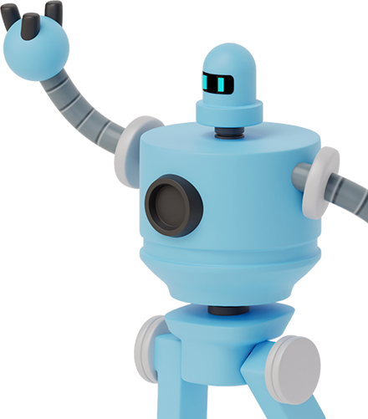
P2 Scots’ Poem
The Polis

Slide 12
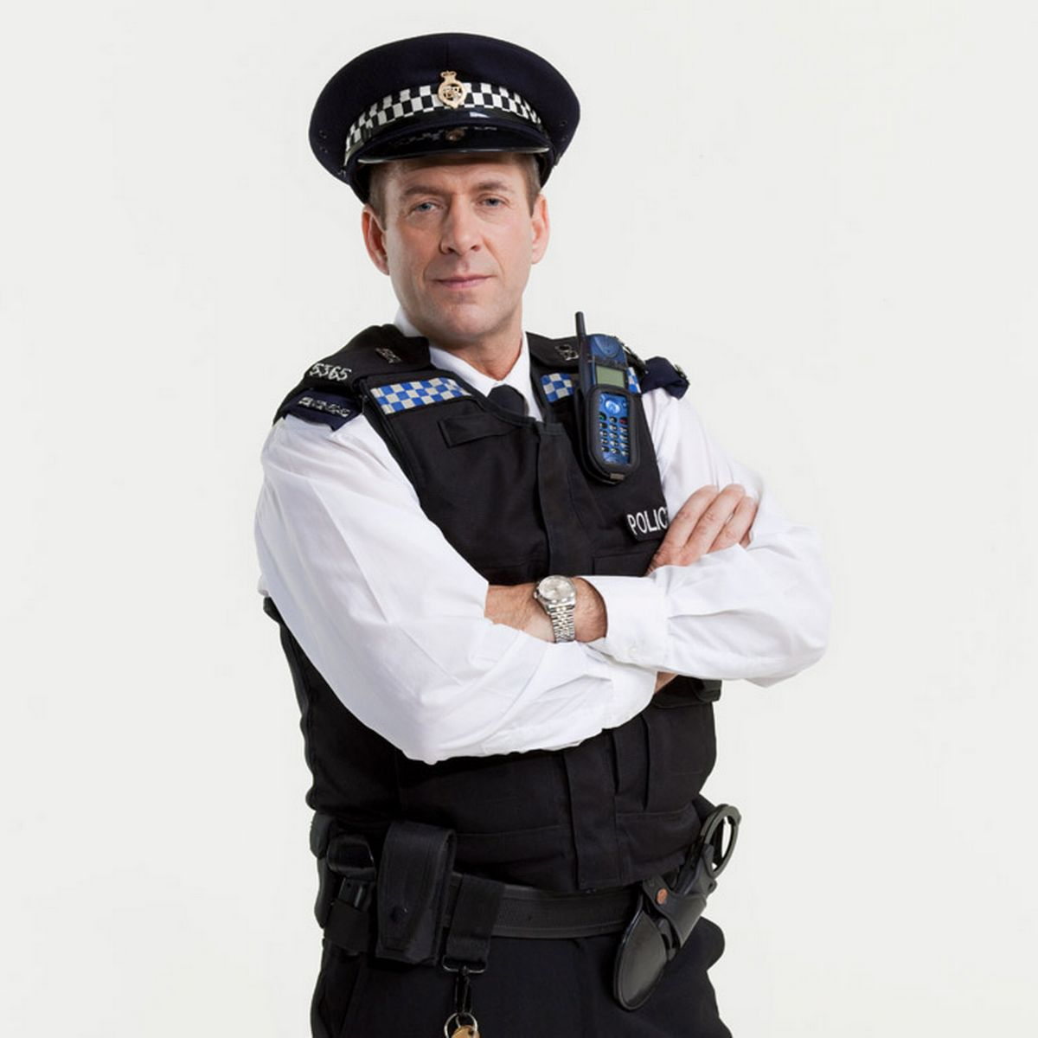
It's great to be a polis.
A muckle strappin polis.
And stride upon my beat.
The Shoat cries, "The Polis"
To gamblers and to goalies
When I come up the street.
When we're the traffic polis.
Motorists hae to thole us
And draw up unco quick.
And gif the motor stole is.
We lift them holus bolus
And pit them in the nick

Slide 13
friday 15.1.21
There are three jobs for today.
Reading
Bugclub – please login to your account and read your book.
Scots’ Poem
Have a go at saying your Scottish poem.
Phonics
Enjoy Miss McCabe’s Phonics video a https://vimeo.com/498907133
The password is class12

