Slide 1
Primary 1
Numeracy Tasks
Week 15.02.21

Slide 2
Tuesday 16.02.21Count to 100 videohttps://youtu.be/IXP47uZJ8qc

Slide 3
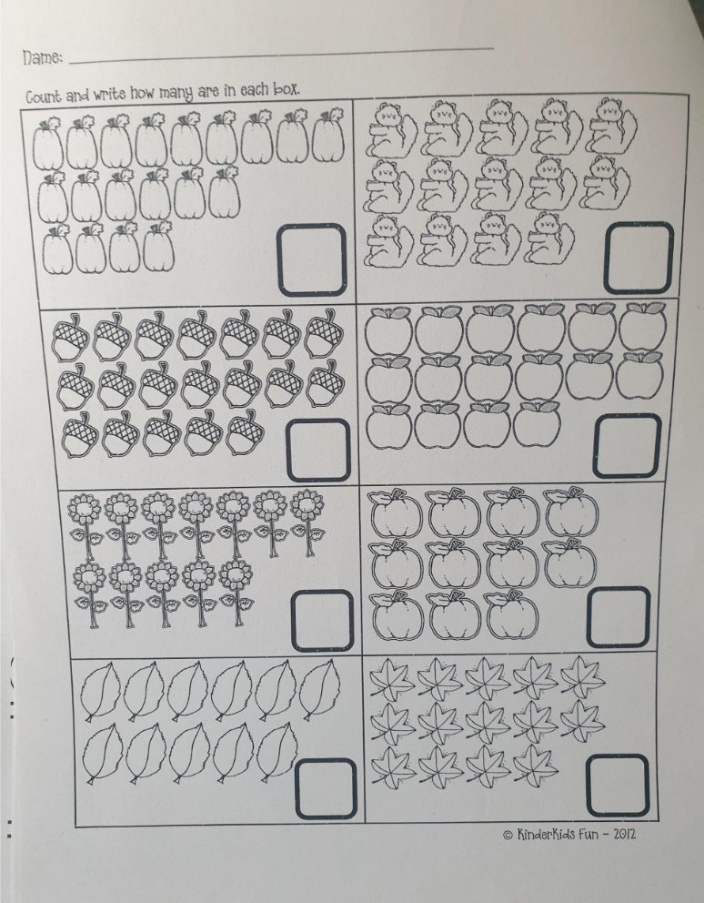
Tuesday 16.02.21
LI: To count an amount of items in rows Task 1 : Counting collections to 20. count items in rows and write down how many there are altogether. Complete page 7 in your ‘counting to 20’ workbook.

Slide 4
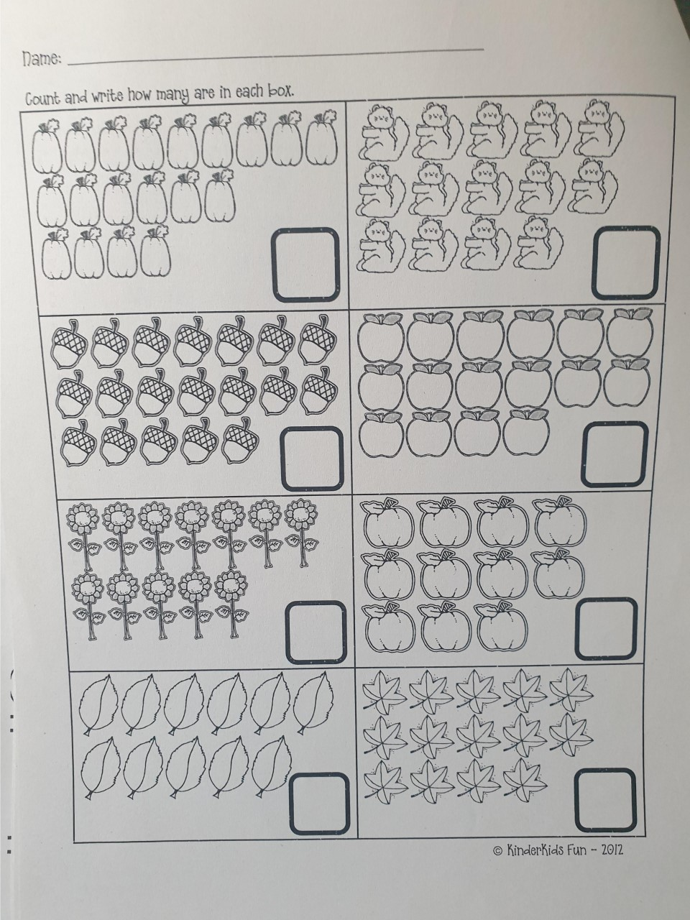

Slide 5
That’s all for today folks!
Good work everyone

Slide 6
Wednesday 17.02.21Count to 100 video https://youtu.be/IXP47uZJ8qc

Slide 7
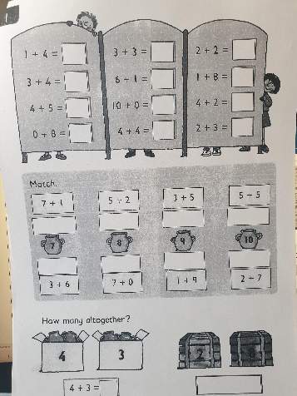
Wednesday 17.02.21
Task : Addition to find the total
Snake booklet – page 5 You can colour them in or mark or circle them.
Counting Pennies PPT count out the right amount of pennies

Slide 9
Wednesday 17.02.21
Maths Games – Topmarks Addition
https://www.topmarks.co.uk/addition/robot-addition

Slide 10
great work again everyone!

Slide 11
Thursday 18.02.21Count to 100 video https://youtu.be/IXP47uZJ8qc

Slide 12
Thursday 18.02.21
L.I. To make an amount of money using the smallest amount of coins.
Task: For each value can you use the smallest amount of coins to show the value.

Slide 14
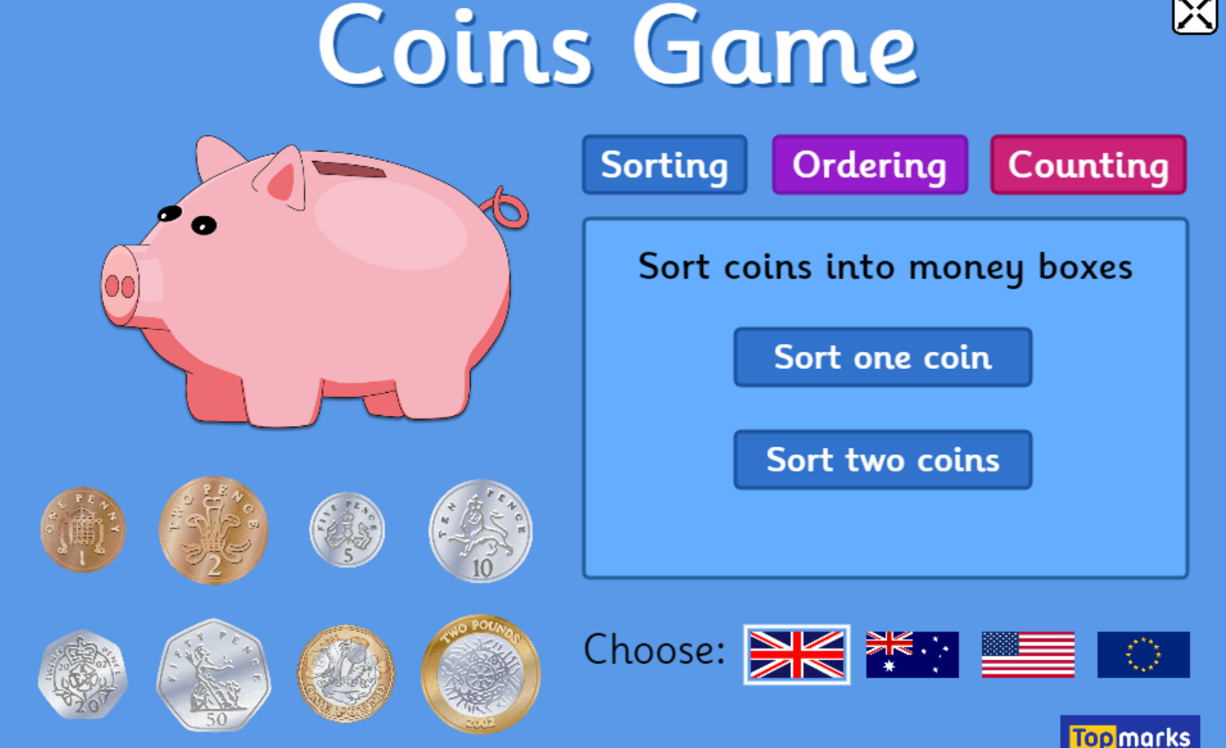
Thursday 18.02.21
https://www.topmarks.co.uk/money/coins-game

Slide 15
Super Effort! YOU ROCK!

Slide 16
Friday 19.02.21Count to 100 video https://youtu.be/IXP47uZJ8qc

Slide 17
Friday 19.02.21
Task : How Much Money!
Count and add together the coins to find the total amount.

Slide 19
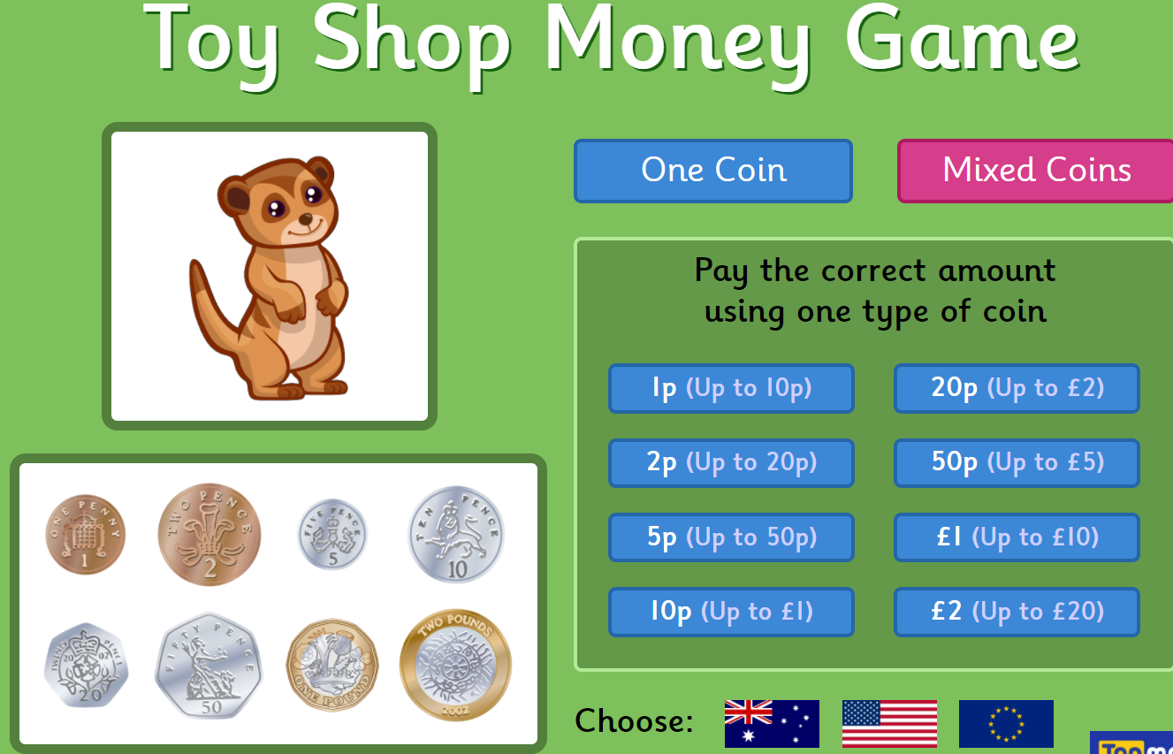
Friday 19.02.21
Topmarks – Toy shop game
https://www.topmarks.co.uk/money/toy-shop-money

Slide 20
WoooHooo! You did it!

