Slide 2
Primary 1 Chinese New Year Activities
In this PowerPoint there are 3 different activities.
1. Read the story about Chinese New Year and then find out what animal you are! The story is uploaded to the blog, an adult will have to help you read this story.
2. Make a lantern. Look at all the pictures that show how Chinese new year is celebrated and watch the video. After this, there is a template of a lantern for you to make.
3. Design a Dragon Mask. Watch the video of the dragon dances and cut out and design your own dragon mask.

Slide 3
Chinese New Year Story
I have uploaded a story on to the blog all about the animals in the Chinese calendar. Ask an adult to read the story to you and then look at the calendar and find out what animal it was when you were born.

Slide 4
What Animal Are You ?
Find out what year you were born. Look for that year on that poster and find out what animal it was when you were born. Draw a picture of that animal. You could also do the same for any adults in the house or brothers or sisters.

Slide 5
Chinese New Year Celebrations
Over the next few slides you will see pictures that show us how people celebrate Chinese New Year. One of the things people are , is decorate their houses with lanterns. Lanterns are believed to be symbols of good luck and to frighten off the Nian monster.
Story of Nian: https://www.youtube.com/watch?v=EZM5I-g4Kng&safe=active
You will find a template for you to create your own lantern.

Slide 6
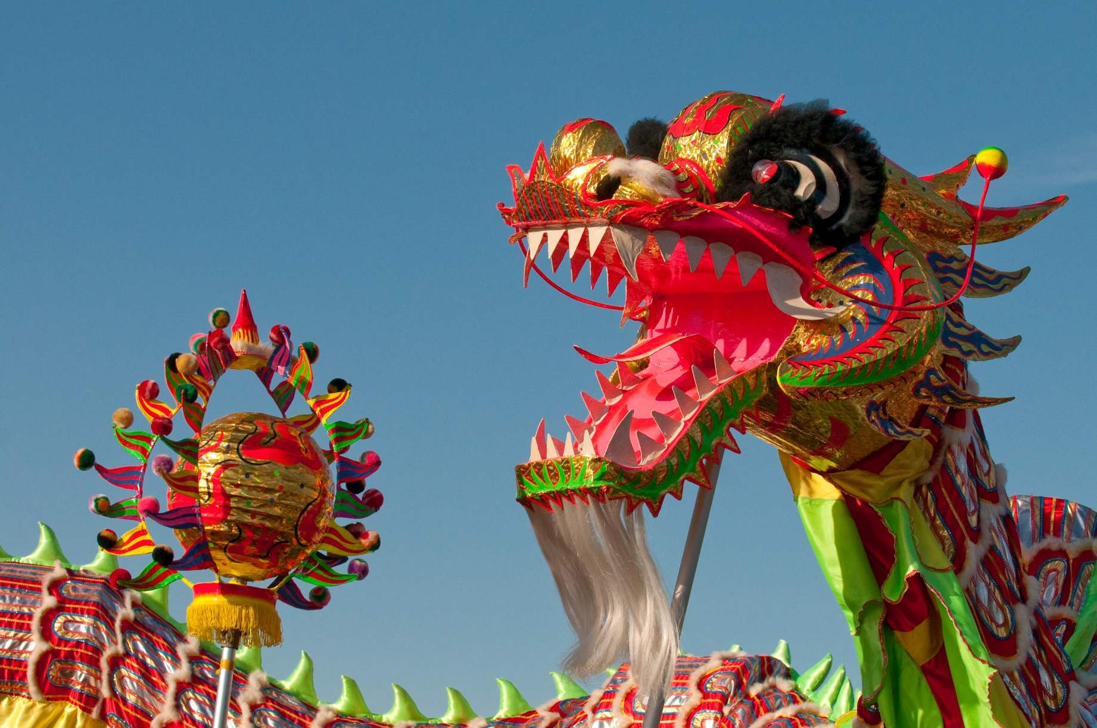
Dragon Dances
Photo courtesy of kennymatic (@flickr.com) - granted under creative commons licence – attribution

Slide 7
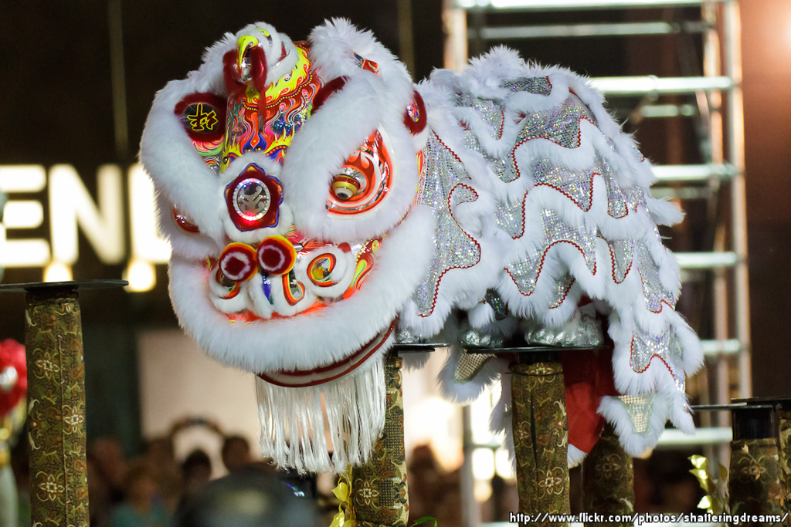
Lion Dances
Photo courtesy of KWSW (@flickr.com) - granted under creative commons licence – attribution

Slide 8
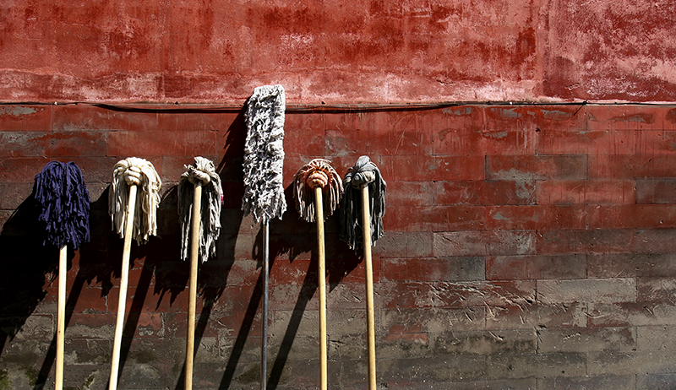
House Cleaning to Sweep Away Bad Fortune
Photo courtesy of Frederuc Poirot (@flickr.com) - granted under creative commons licence – attribution

Slide 9
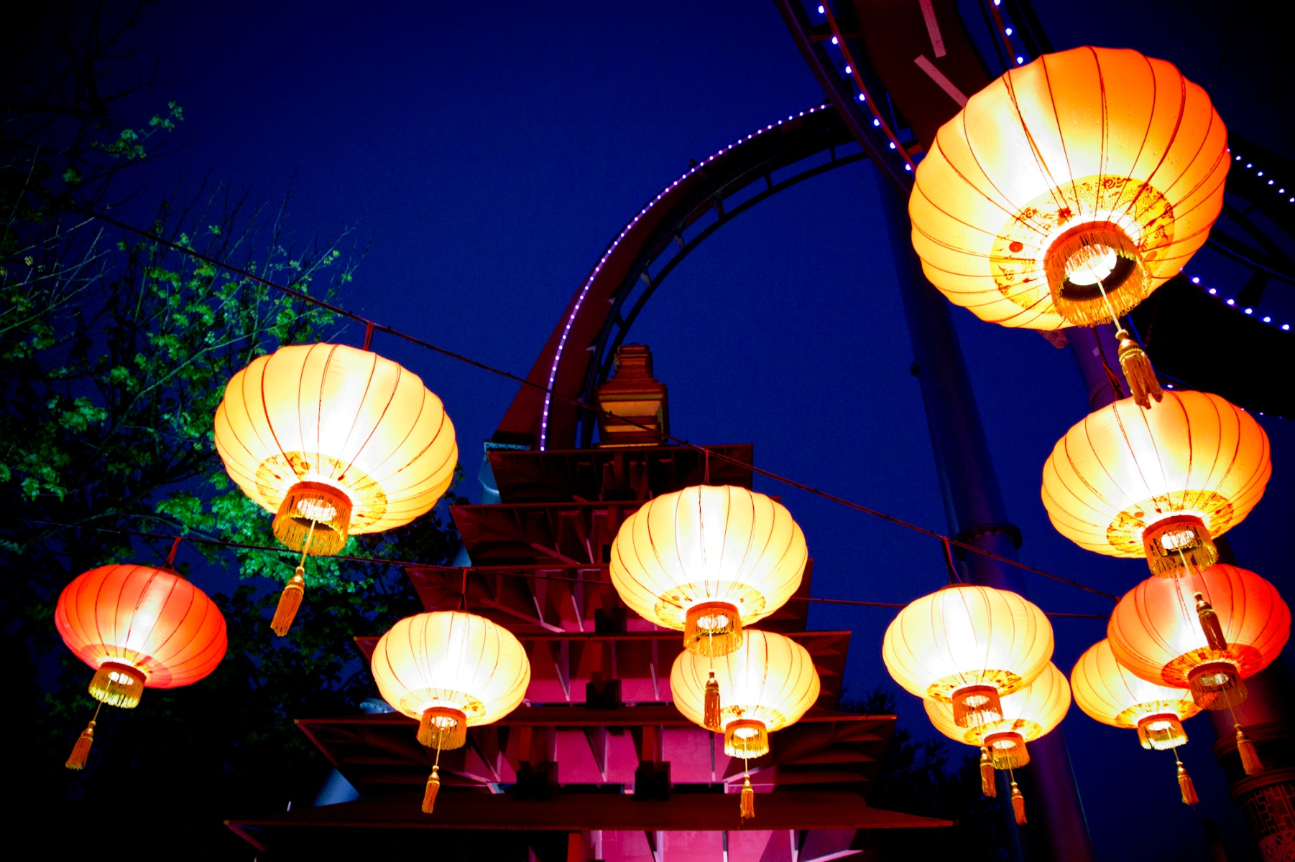
Lanterns Are Lit
Photo courtesy of pellesten (@flickr.com) - granted under creative commons licence – attribution

Slide 10
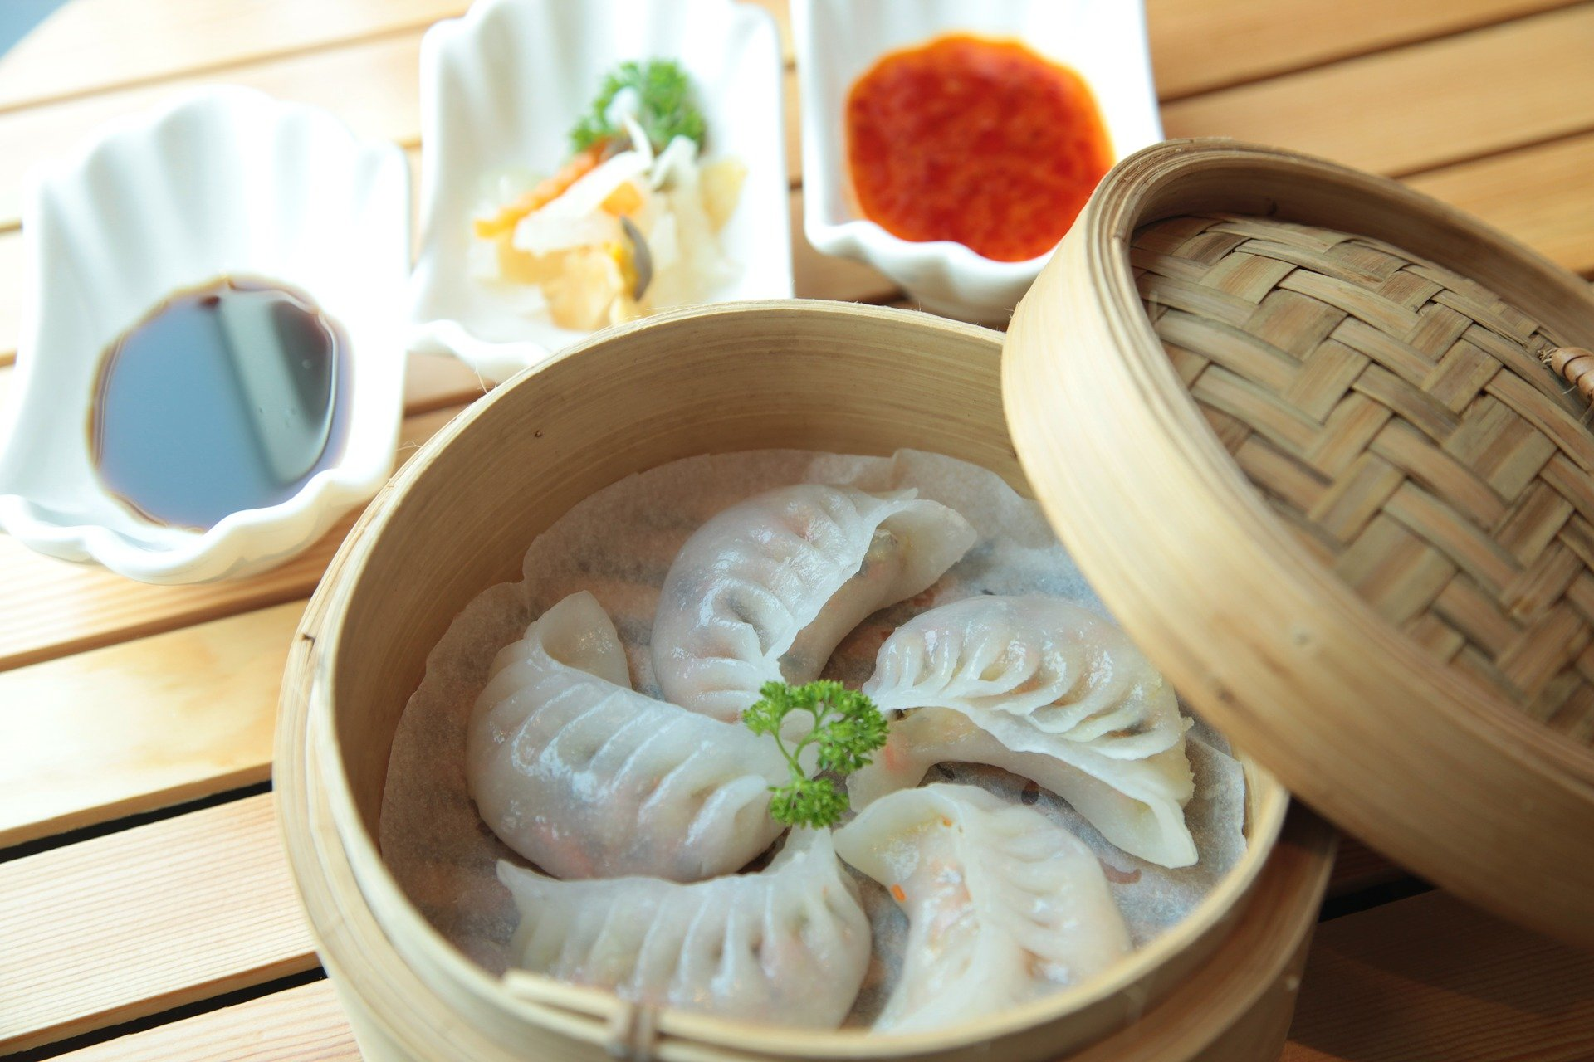
Dumplings Are Eaten

Slide 11
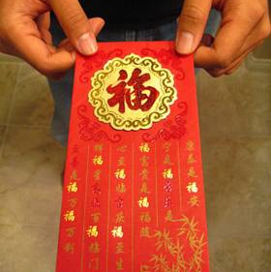
Red Envelopes
Photo courtesy of imtfi (@flickr.com) - granted under creative commons licence – attribution

Slide 12
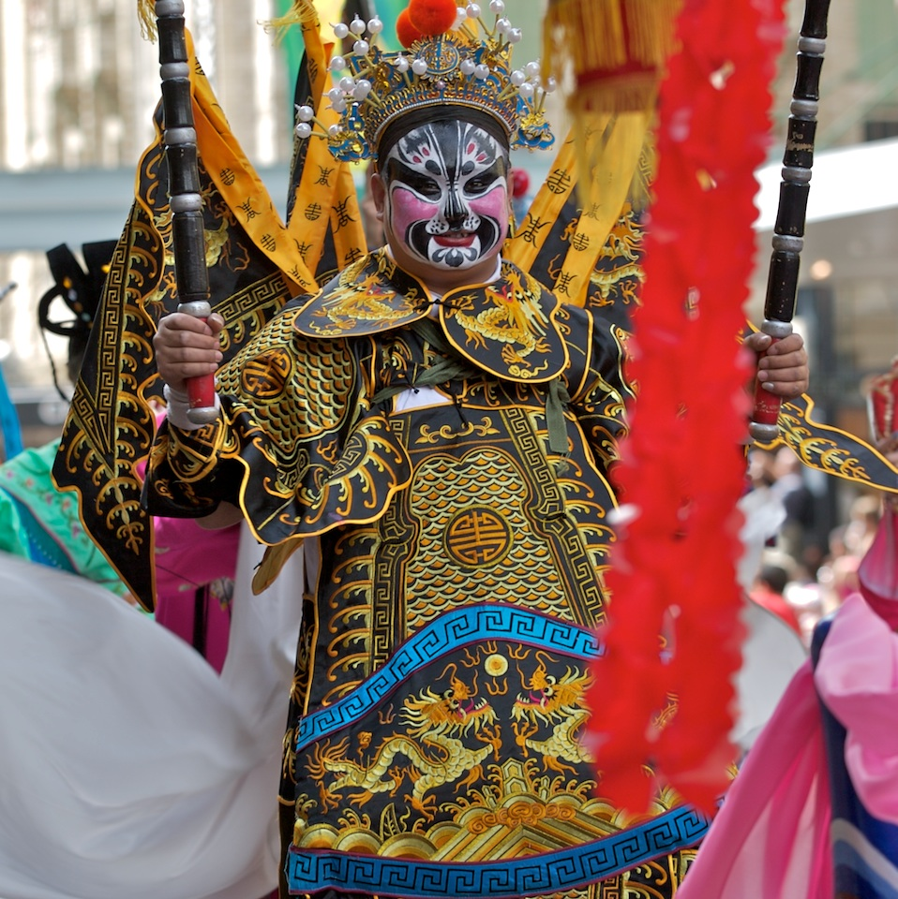
Traditional Dancing
Photo courtesy of yewenyi (@flickr.com) - granted under creative commons licence – attribution

Slide 13
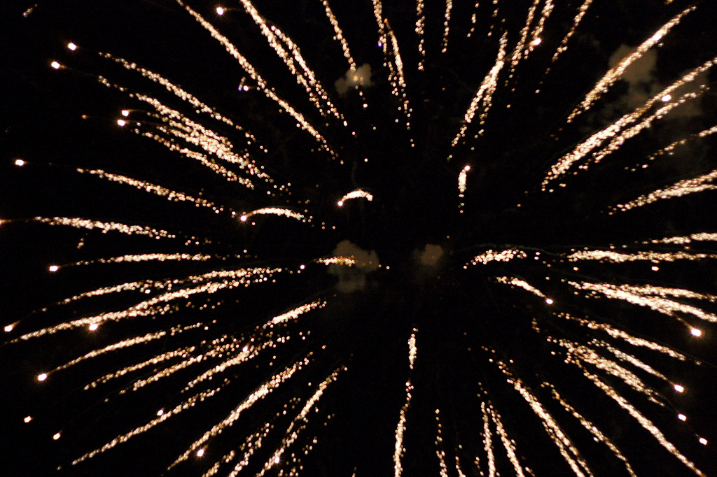
Fireworks
Photo courtesy of stoneflower (@flickr.com) - granted under creative commons licence – attribution

Slide 16
Street Celebrations
https://www.youtube.com/watch?v=1cRMRp9-Z08&safe=active
This video shows you lots of ways that Chinese New Year is celebrated and lots of traditions that people follow. Watch carefully as the family attends a street celebration to watch the dragon dance. Now you can create your own dragon mask.

Slide 17
Print out and colour in you own dragon mask then cut out whole for your eyes!

